Slide 1
Changes to the Shoreline of Mud Bay, Bellingham, Washington
Ruby Leotta
UW Dept. of Earth and Space Sciences

Slide 2
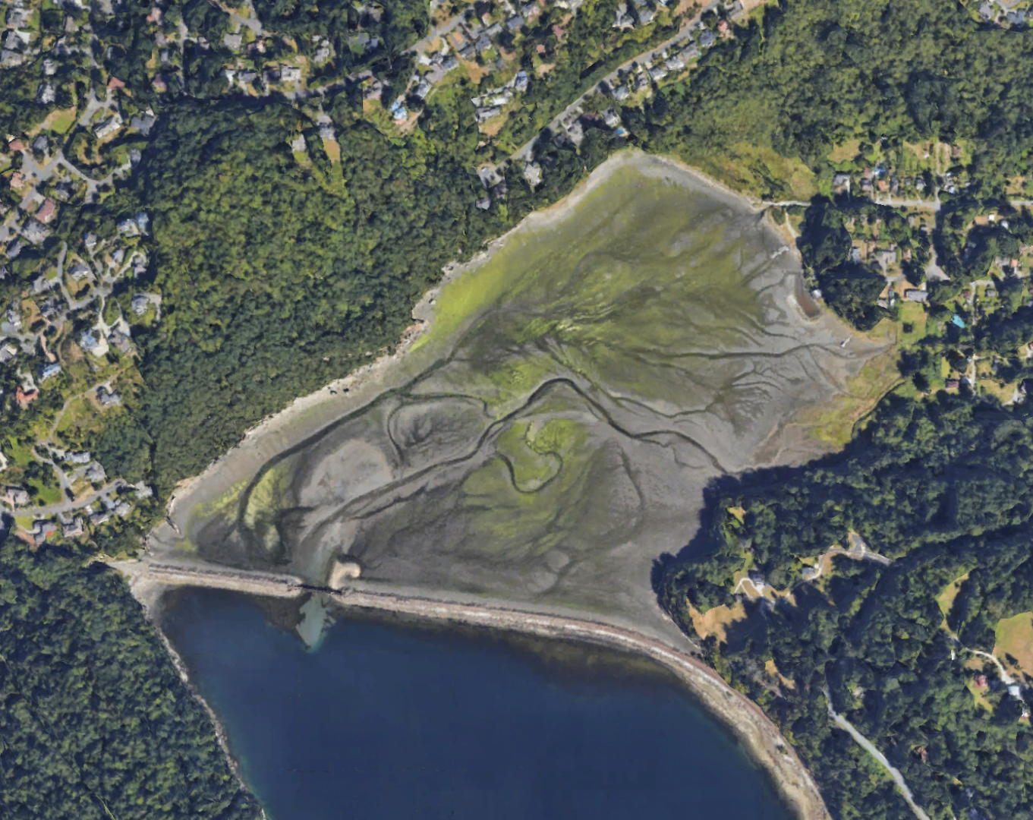
Notes:
This is what Mud Bay looks like

Slide 3
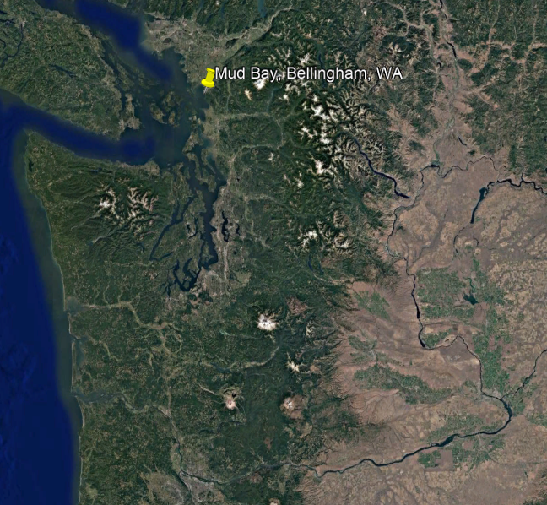
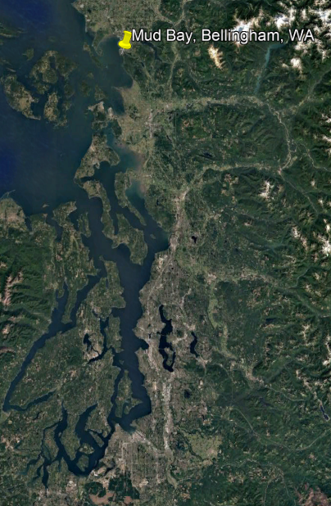
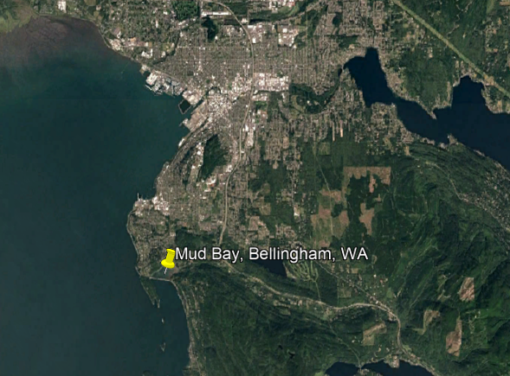
Notes:
This is the location of Mud Bay in reference to Washington state, the Puget Sound, and the city of Bellingham

Slide 4
Background
Land use in and around area has changed over time
  May have caused increased sediment accumulation
Bay is filling will sediment faster than projected sea level rise
Notes:
The land use in and around Mud Bay has changed over time, including logging, mining and quarrying in the late 1800s to early 1900s, as well as railroad and interstate construction in the 1920s and 1960s.
The railroad that was constructed across the mouth of the bay in the 1920s limited tidal and storm wave energy. The construction of Interstate 5 in the 1960s may have caused additional sediment to be transported into the bay. The logging, mining and quarrying that occurred in the area also may have increased sediment accumulation.
Prior work has shown that the bay is filling with sediment at a rate greater than the projected sea level rise
In this project, I document the timing of major land-use change and determine whether the shoreline of the enclosed bay has changed over time
I also compare the shoreline and land-use changes with each other.

Slide 5
Why is this important?
To learn how sea level rise and land-use change affects position of shoreline and sedimentation
Homes near the bay– at risk of flooding?
Notes:
With this research, I aim to learn about the competing influences of sea level rise and land-use change on the position of the shoreline and sedimentation in Mud Bay.
Conducting this research on Mud Bay will also provide information on how to apply these methods and information to other similar landforms around the world.
This research is also important because we can use it to predict whether homes near the bay are at risk of flooding or not.

Slide 6
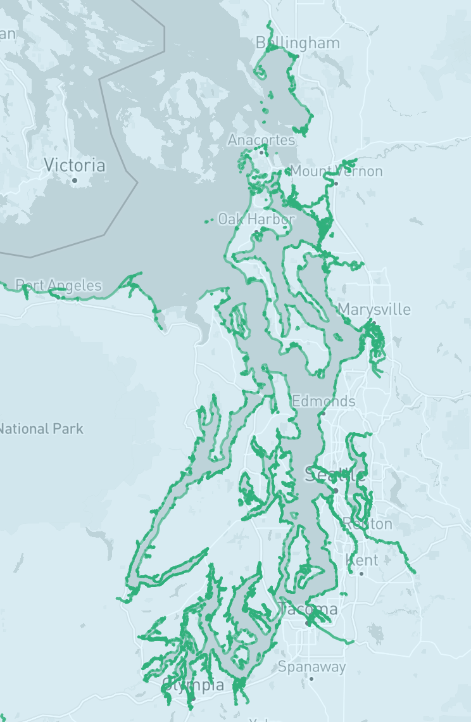
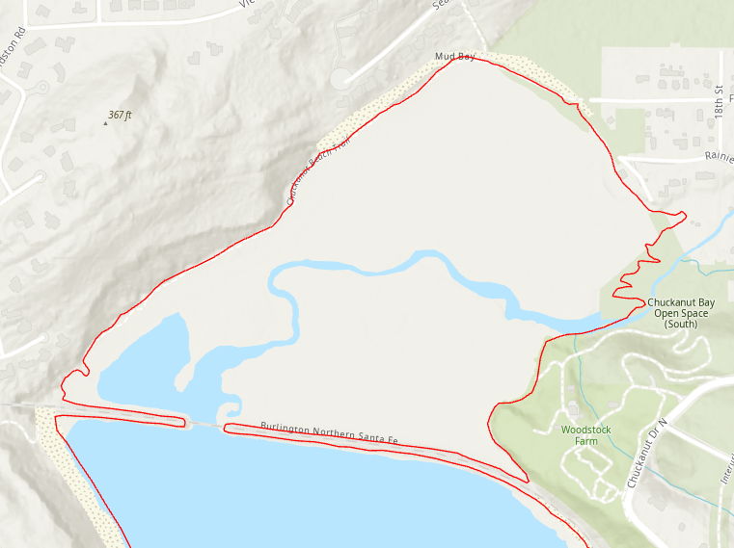
Methods
Notes:
I was able to find an outline of the Mud Bay shoreline from the NOAA Shoreline Data Explorer.
I downloaded the CUSP data, which stands for continually updated shoreline project.
Although it is unclear exactly which year this data is from, CUSP is defined as the most up to date shoreline data for the region.
It was already georeferenced so I was able to directly add it to the ArcGIS project

Slide 7
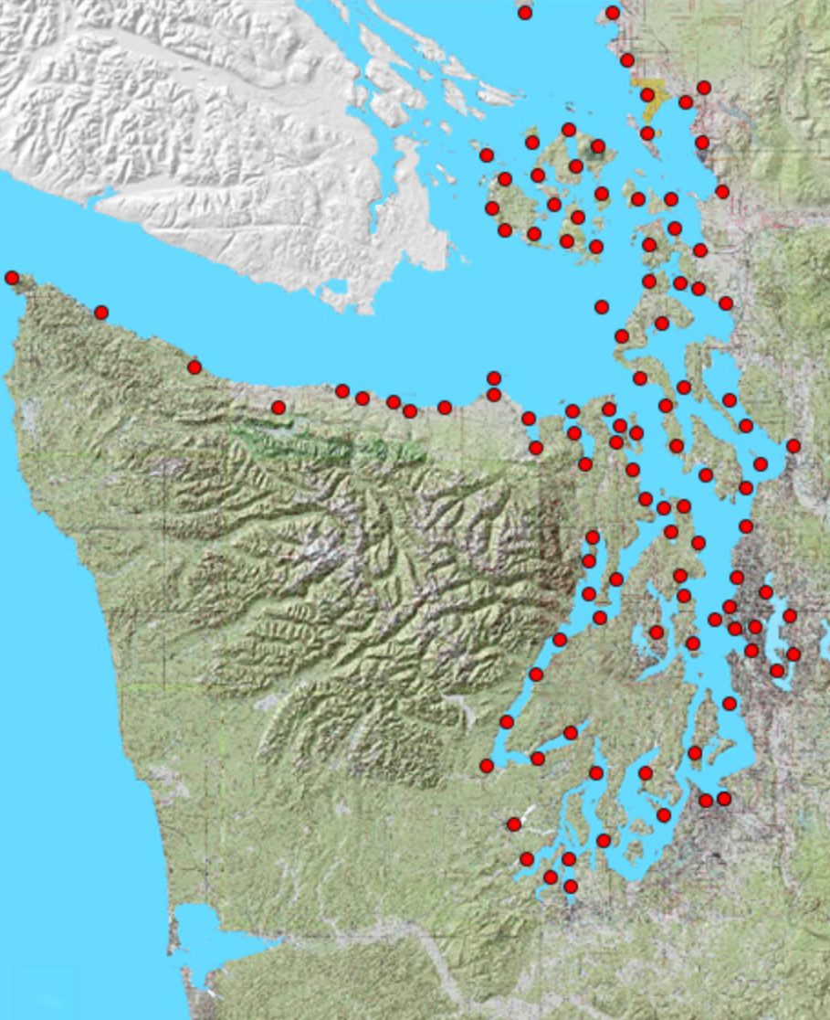
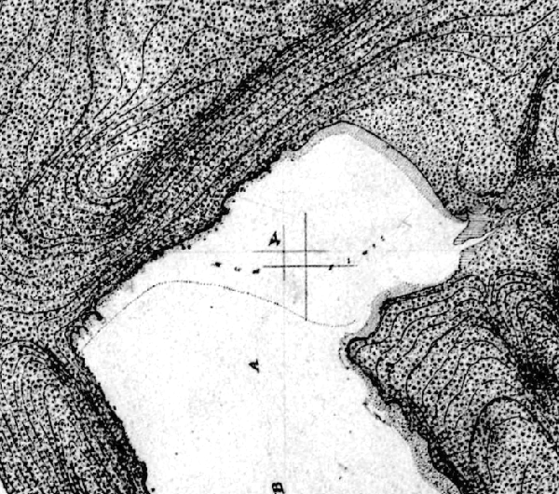
Methods
1887
Notes:
I used the Puget Sound T-sheets (topographic sheets) website to find and download a historic map from 1887 that includes Mud Bay, which shows the area before the railroad was built.
It was already georeferenced so I was able to add it directly to the ArcGIS project.

Slide 8
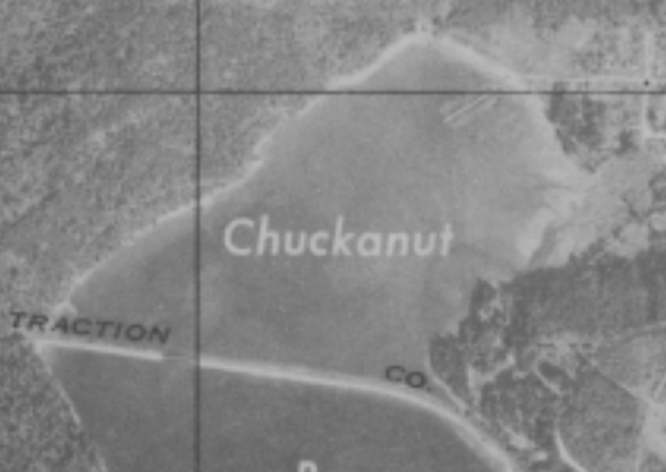
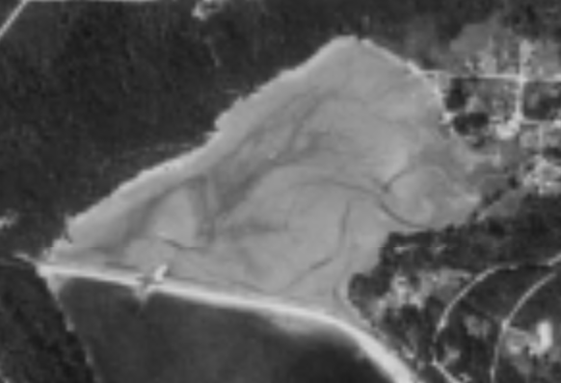
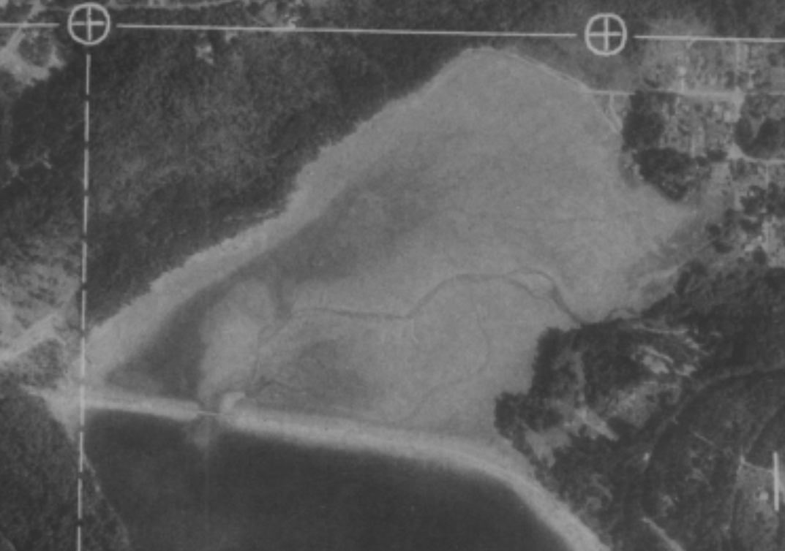
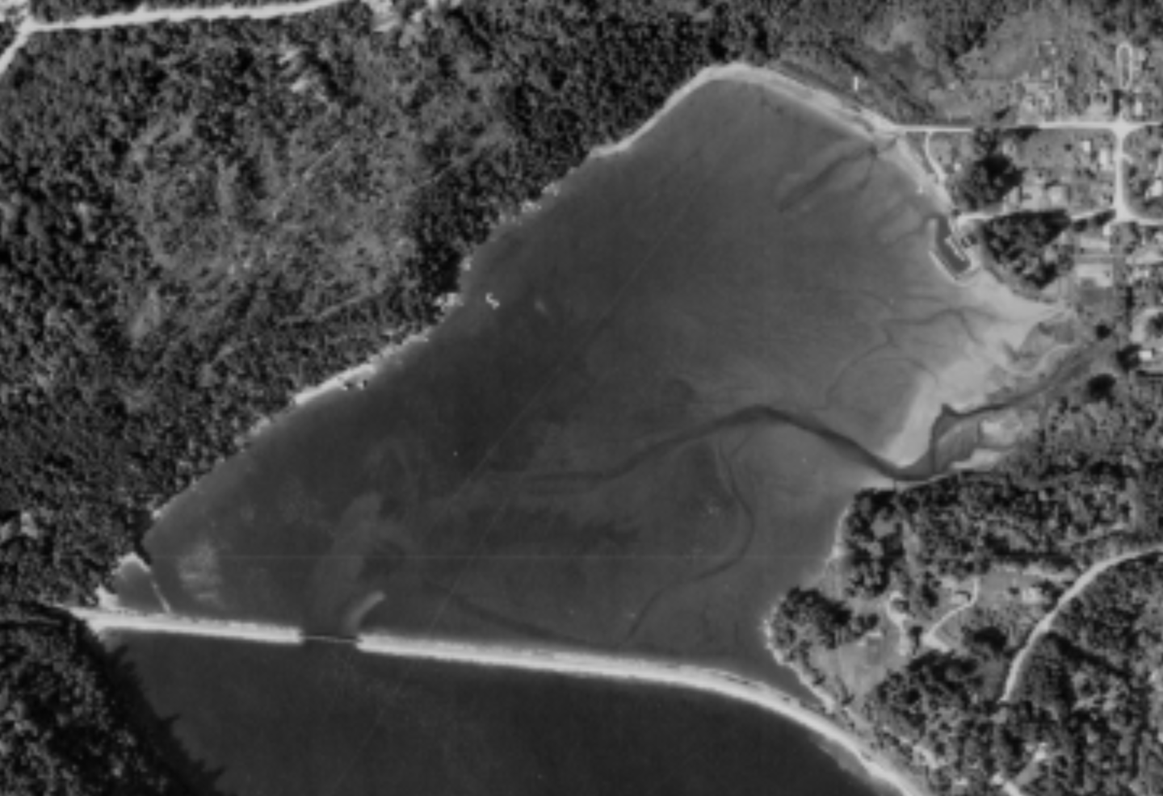
Methods
1944
1965
1971
1978
Notes:
I also obtained aerial photographs of the area from the Suzzallo library at UW, and scanned these maps and uploaded them to Google Drive. I was able to find aerial photographs from 1944, 1965, 1971 and 1978.

Slide 9
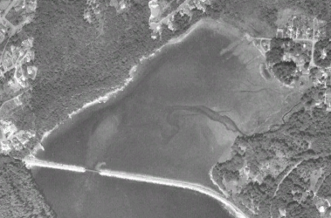
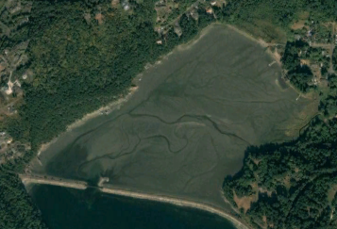
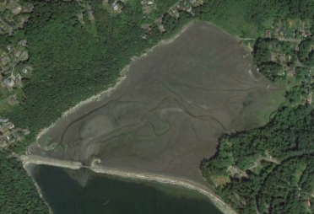
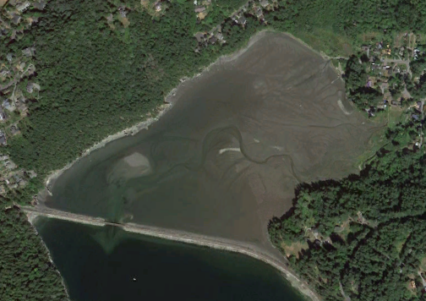
Methods
1998
2006
2014
2022
Notes:
For more recent data, I found images from Google Earth Pro spanning from 1998 to 2022.
I added the photographs to the map and georeferenced them.

Slide 10
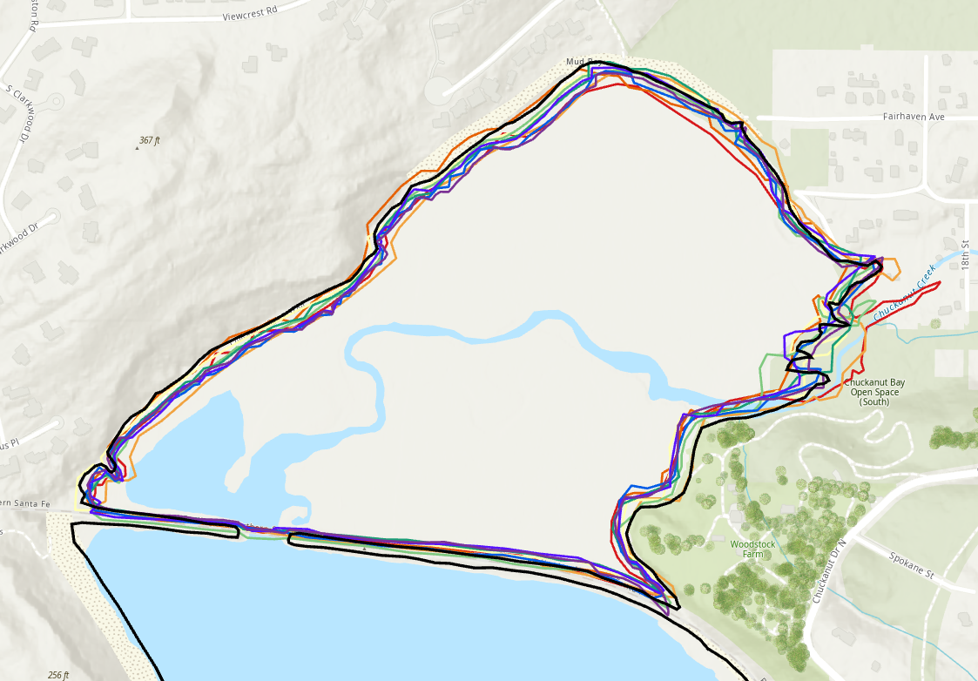
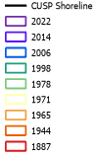
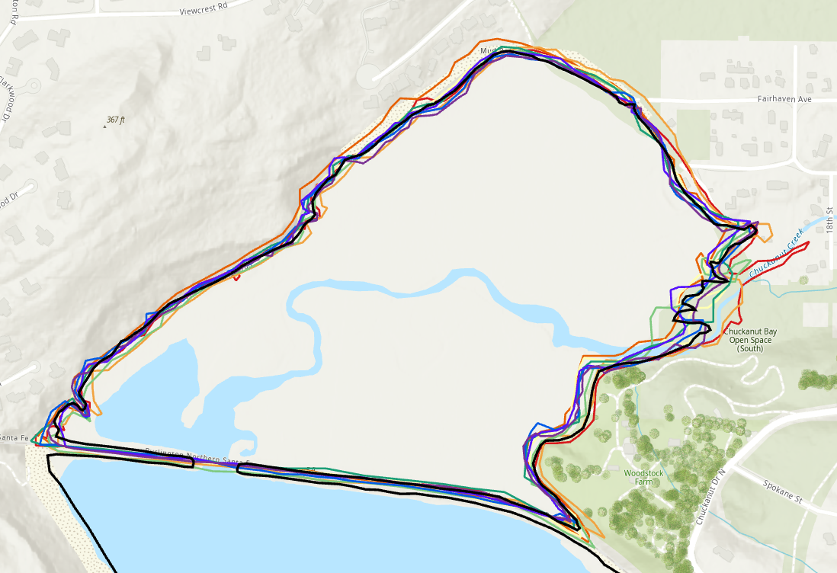
Methods
Vegetation Line
Water Line
Digitized shorelines compared to CUSP
Notes:
Once all my data was georeferenced as accurately as possible, I digitized Mud Bay and turned it into polygons, so I could easily see the shoreline for each year and observe the changes.
To compare among images, it is important to identify a feature that consistently represents the shoreline and is visible in all images. Two different methods were used to digitize the shoreline
2 different methods were used to digitize the shoreline: the line between vegetation and sand, and the line between wet and dry sand (how far the water reaches).

Slide 11
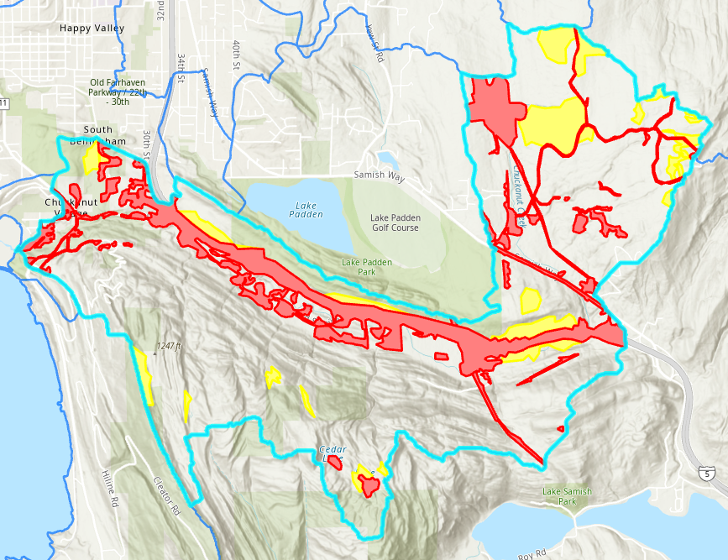
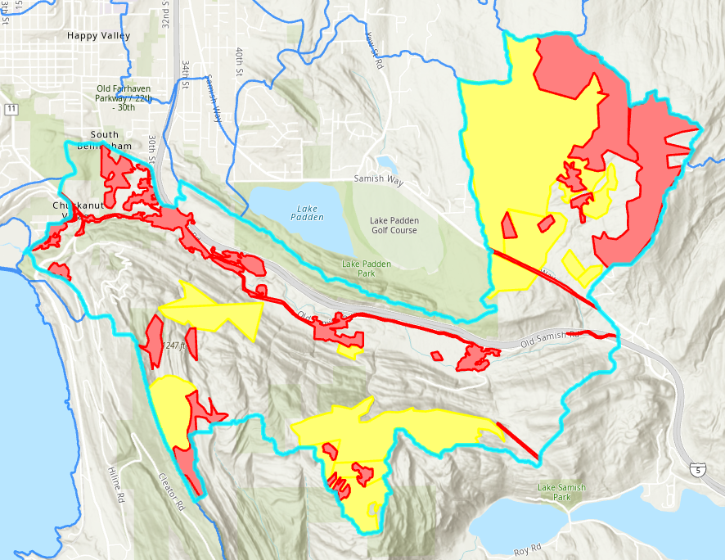
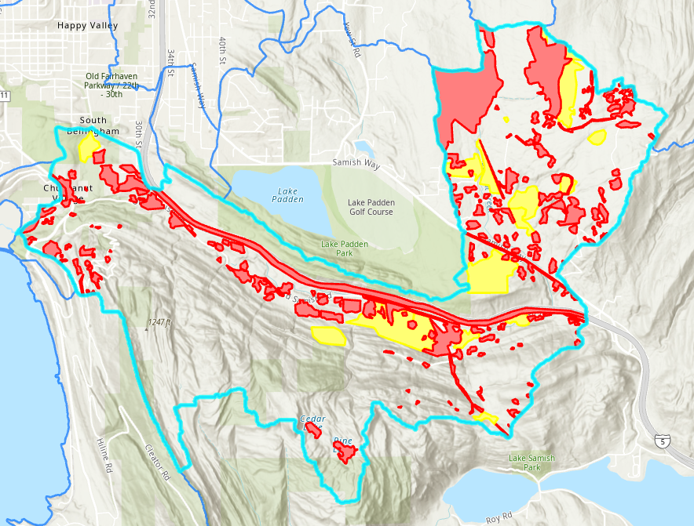
Methods
1965
1944
2022
Notes:
The Chuckanut Creek Watershed (highlighted in light blue) feeds into Mud Bay.
These land cover maps represent areas within the Chuckanut Creek Watershed where the land is deforested (red) or indeterminate (yellow).
The indeterminate areas may represent deforested areas that have since partially grown back, or other types of land cover that is somewhere in between forested and deforested. The areas within the watershed that are not filled in are forested.
An 1887 map, from before the railroad was built, is not included because the entire area was forested.
The 1944 map shows the land cover before Interstate-5 was built, the 1965 map shows the area just after Interstate-5 was built, and the 2022 map shows the land cover of the area in the present day.

Slide 12
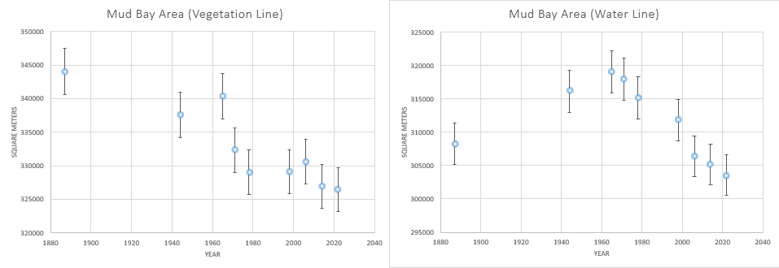
Results and Discussion
Notes:
I found the area in sq meters of the bay for each year, then plotted the area on a graph
The Mud Bay area graphs both show that the area of Mud Bay has slightly decreased over time, since there is an overall downward trend in both graphs since 1965 and in the vegetation-line graph since 1887
The 1887 maps are difficult to directly compare with the photos, but the vegetation line may be more reliable since it was drawn more clearly than the line where wet sand stops
Most of the data points are close to the average of 332,955 sq. m (vegetation line) and 311,505 sq. m (water line)
Overall downward trend could suggest that the shoreline is slightly advancing over time
in both graphs, the area of the bay is slightly smaller in 1944, then it becomes larger in 1965
The main difference in the land use within the watershed from 1944 to 1965 was that Interstate-5 was constructed in Bellingham over this time period (completed in 1964)
Did the construction of Interstate-5 add sediment to the bay and cause the shoreline to change?
The retreat may be related to the construction, but since I am missing over 20 years of data, it is likely that another event caused this change.
The downward trend in area points after 1965 would suggest that that Mud Bay has infilled with sediment after the Bellingham segment of Interstate-5 was completed.

Slide 13
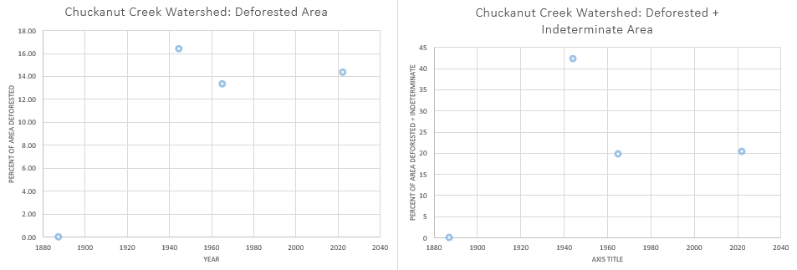
Results and Discussion
Notes:
The entire Chuckanut Creek Watershed was forested in 1887, and the amount of deforested area in the watershed did not change drastically between 1944, 1965 and 2022.
However, there was significantly more deforested + indeterminate area in 1944 than in the later years.
This suggests that these areas had been deforested between 1887 and 1944, but grew back.
The amount of deforested + indeterminate area stayed consistent from 1965 to 2022.
Since I don’t have data from 1887 to 1944, I don’t know if the shoreline was advancing or retreating during this period, but it is possible that deforestation from this time period caused the shoreline to change as well.
Based on the vegetation-line data from 1887, it appears as if the shoreline has overall advanced between 1887 and 1944, which would make sense because deforestation during this time period may have been a source of sediment infilling the bay.

Slide 14
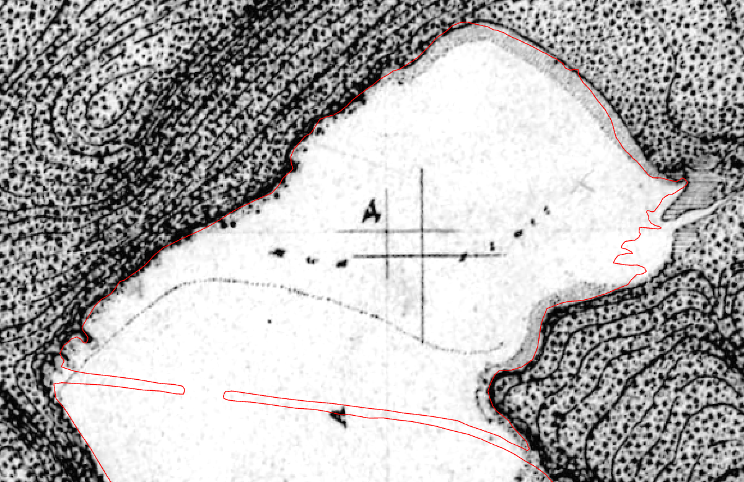
Results and Discussion
Earliest recorded shoreline (1887) compared to CUSP
Notes:
The shoreline of Mud Bay does not appear to have changed significantly from 1887 to 2022.
When I compare the earliest shoreline data from 1887 to the modern CUSP data, I can see that the differences in the shoreline are minor, which suggests that any changes in the shoreline of Mud Bay have been fairly insignificant
The most variation occurs at and near the marsh area, at the mouth of Chuckanut Creek
Deforestation and Interstate-5 construction may be a source of sediment that contributed to minor changes of the shoreline of Mud Bay.

Slide 15
What’s Next?
Notes:
The next steps for this project would be to compile data relating to the shoreline and land use changes of Mud Bay from the time periods that I currently do not have data for.
Since the land in this area was used for many different purposes, it is possible that other land uses changes contributed to the changes in the shoreline of Mud Bay.

Slide 16
Thank you!

