Slide 1
UnlockedMaps: A Web-Based Map for Visualizing the Real-Time Accessibility of Urban Rail Transit Stations
Ather Sharif

Slide 2

Hi, I’m Ather (he/him)
Ph.D. Candidate at the University of Washington (CSE) (Committee: Jacob Wobbrock [Chair], Jeffrey Heer, Richard Ladner, Joanne Woaik)
Research focus: Accessibility, Visualization, Personalization (Broadly Human-Computer Interaction)

Slide 3

Notes:
This is Liz. She lives in Philadelphia, has a mobility disability and uses a wheelchair.
She uses urban rail transit for her daily commute and takes the train from the 15th Street station to West Philadelphia for work everyday.

Slide 4
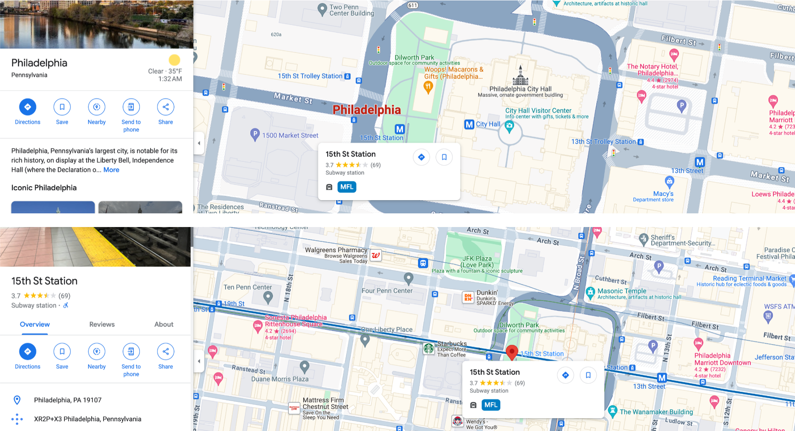
Notes:
Much like most people, she uses Google Maps to plan her commute. When she views the station on Google Maps, it shows that the station is accessible. She feels reassured, plans her day, and heads to the station for her commute.

Slide 5
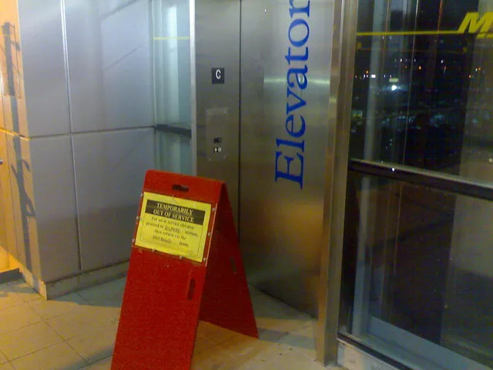
Notes:
But. She arrives at the station and finds the station elevator out of order. What does she do then? Uber and Lyft don’t offer wheelchair accessible vehicles, wheelchair cabs are sparse and can take hours, and these options are expensive. She could take a bus but that adds an hour and a half to her commute. Only if she knew ahead of time that there would be disruptions in her commute.

Slide 6

Notes:
This is where UnlockedMaps comes in. UnlockedMaps is an open-data map that visualizes the real-time accessibility of urban rail transit stations. This project assists people with mobility disabilities, pregnant people, people who carry bikes or heavy equipment, civic hackers, and disability advocates. As you can imagine, this project is very personal for me.

Slide 7
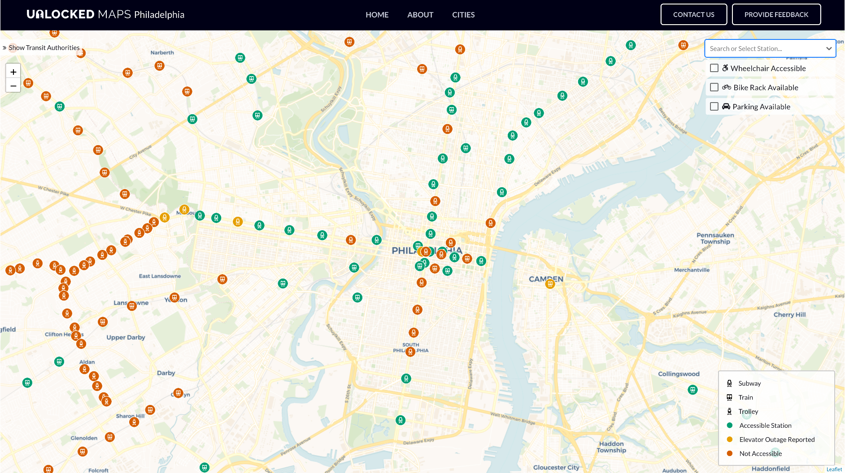
Notes:
It enables users, like Liz, to quickly and easily see which stations are accessible, which stations are not, and which are experiencing an elevator outage at any given point in time.

Slide 8
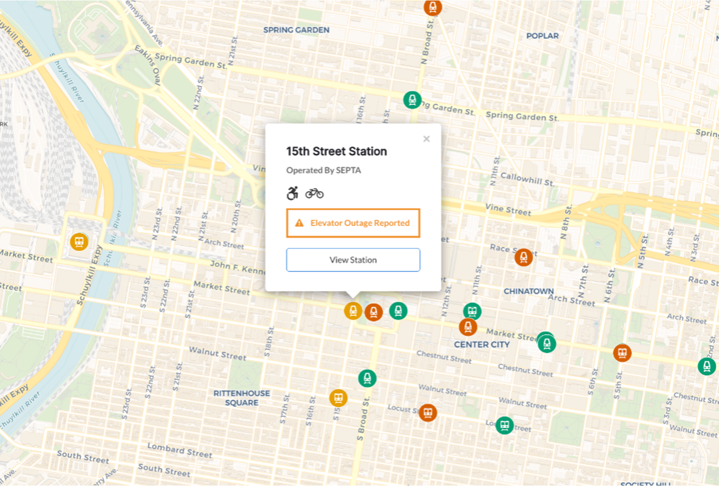
Notes:
Users can filter the map using transit authorities and lines, search for their desired station, or filter by wheelchair accessibility. People who use bikes or need parking can also use this tool to filter stations to those where these features are available.

Slide 9
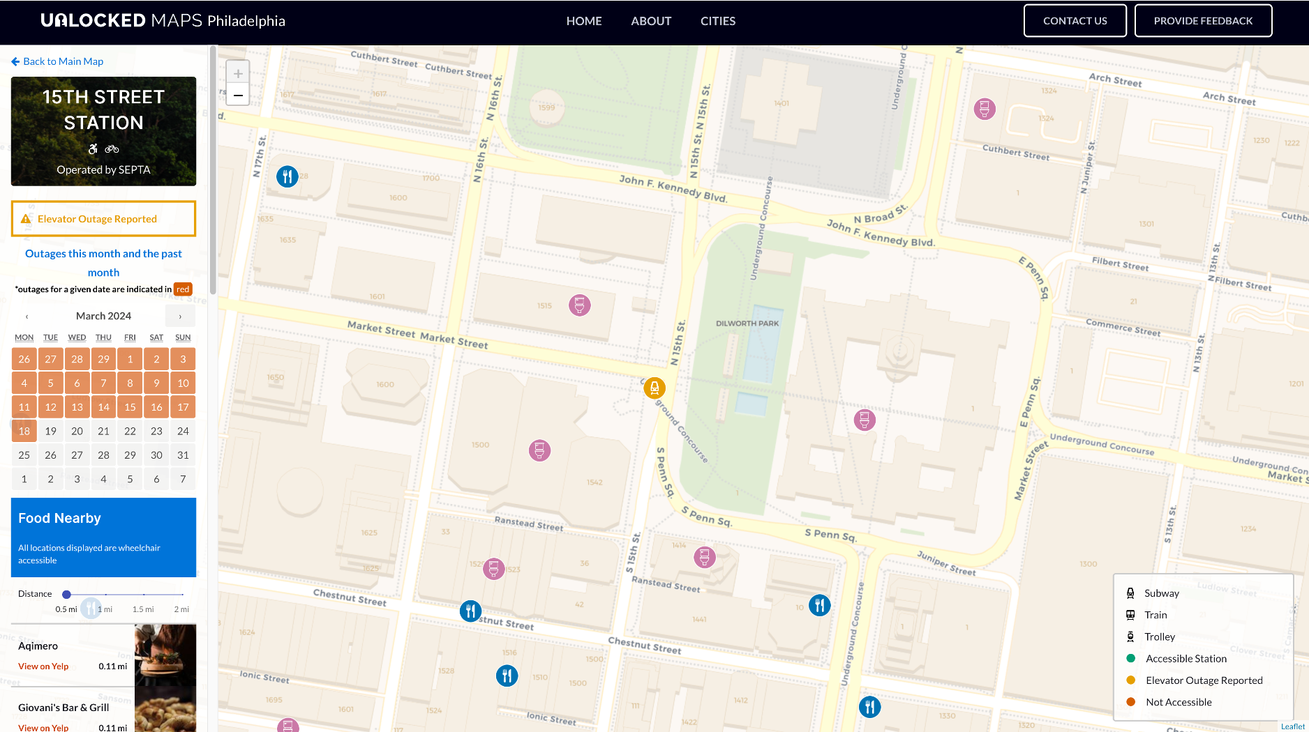
Notes:
Additionally, users can view the elevator outage history to assess the reliability of any given station.

Slide 10
Notes:
Not just that, users can view the nearby accessible restaurants without going through reviews and photos for each restaurant.

Slide 11
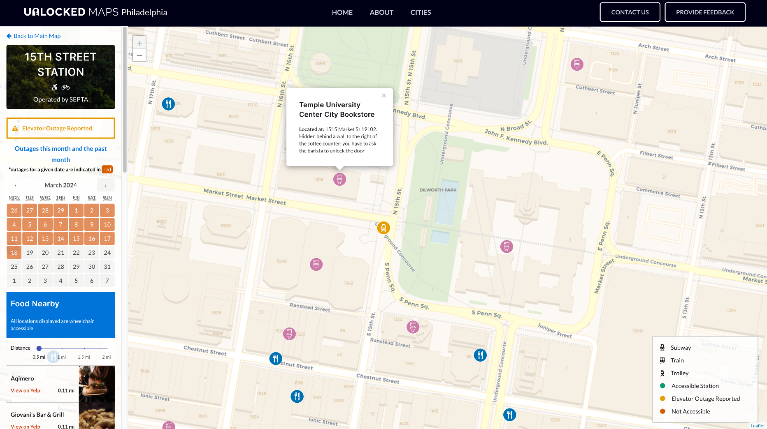
Notes:
Users can also find accessible restrooms around the station as well, along with crowdsourced instructions on accessing the restrooms.

Slide 12
UnlockedMaps is designed with a central focus on accessibility and is deployed in six North American cities:
Bay Area, Chicago, New York,
Philadelphia, Seattle, and Toronto.
Notes:
UnlockedMaps is designed with a central focus on accessibility in mind and is currently deployed in six different North American cities, including the Bay Area, Chicago, New York, Philadelphia, Seattle, and Toronto.

Slide 13
We collected elevator outages data from 2,336 transit stations over 23 months and released it for public consumption via our API
Notes:
So far, we’ve recorded millions of elevator outages from 2,336 transit stations in these cities directly from the transit authorities every hour since the past 4 years. More data is being collected and made available to the public as we speak.

Slide 14
UnlockedMaps provides utility outside of accessibility as well!
Notes:
This data has benefits outside of accessibility as well. For example, researchers and advocates can use this data to answer questions such as: can we know which neighborhoods experience the most elevator outages? And which neighborhoods take the longest to repair those elevators? The answers to these questions can help us understand our cities better and drive policy changes.

Slide 15
Spoiler Alert! New cities, including Tokyo, Seoul, Washington D.C., and Singapore, are coming to UnlockedMaps soon!
Notes:
At present, we’re working on onboarding new cities to the UnlockedMaps platform, including Tokyo, Seoul, Washington D.C. and Singapore. Through UnlockedMaps, we hope to make commute planning more equitable for people who rely on functioning elevators, especially those with mobility disabilities, such as Liz, such as myself.
It was a pleasure presenting UnlockedMaps to you all, today.

Slide 16


Thanks!
Do you have any questions?
ather@cs.washington.edu | athersharif.me

