Slide 1
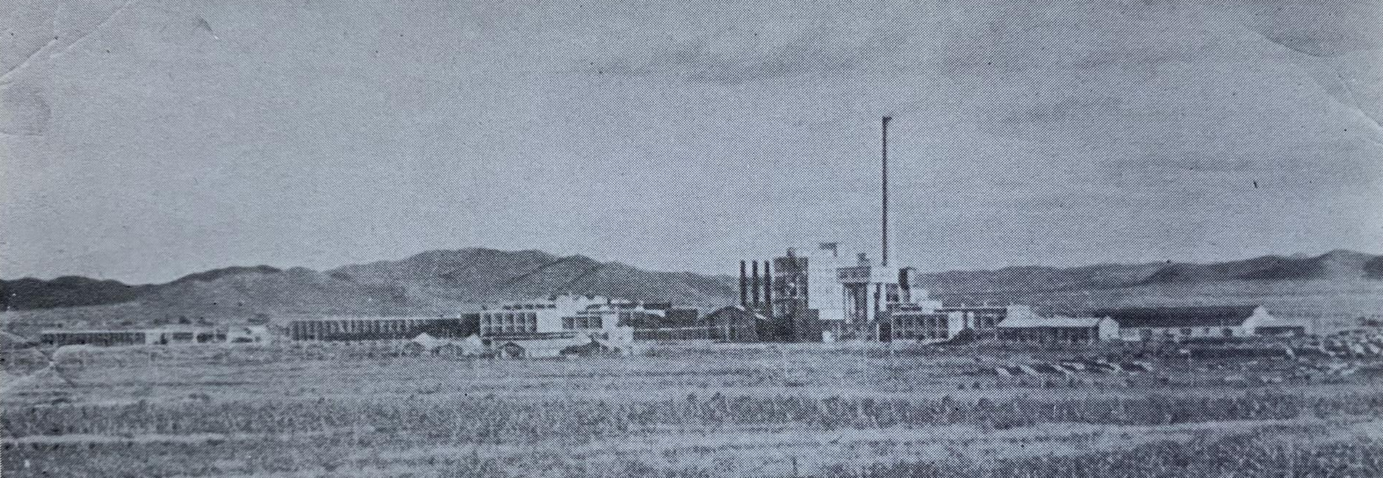
Japan’s Paper Empire:
Mapping the Environmental Effects of Manchurian Paper Industrialization
Chad Westra | University of Washington | 5/20/2025

Slide 2
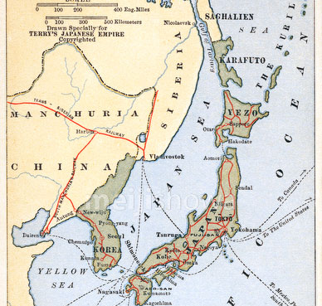
Japanese pulp frontiers
1926: 97% of pulp supply from Sakhalin and Hokkaido
Notes:
Condense! Take out a bunch of information: I’m happy to talk more about the historical context of Japanese colonization, its economic model of self sufficiency, and other factors.
The remarkable success of Japan’s modernization in the late 19th century transformed it into a society that produced and consumed large amounts of paper, which was mostly machine made by the early 20th century, and produced from fibrous wood pulp.
By the 1920s, Japanese paper companies drew 97% of its pulpwood supply from the northern, timber rich islands of Hokkaido and Sakhalin. But demand for pulp and paper had significant room to grow—per capita consumption of paper in Japan at this time was 25 lbs, compared to over 200 lbs in the US.
. At this time, per capita annual paper consumption in Japan was 2x lbs, compared to 2xx lbs. in the US. Supplying a growing modern society, and competing on the global market, required new sources of timber.

Slide 3
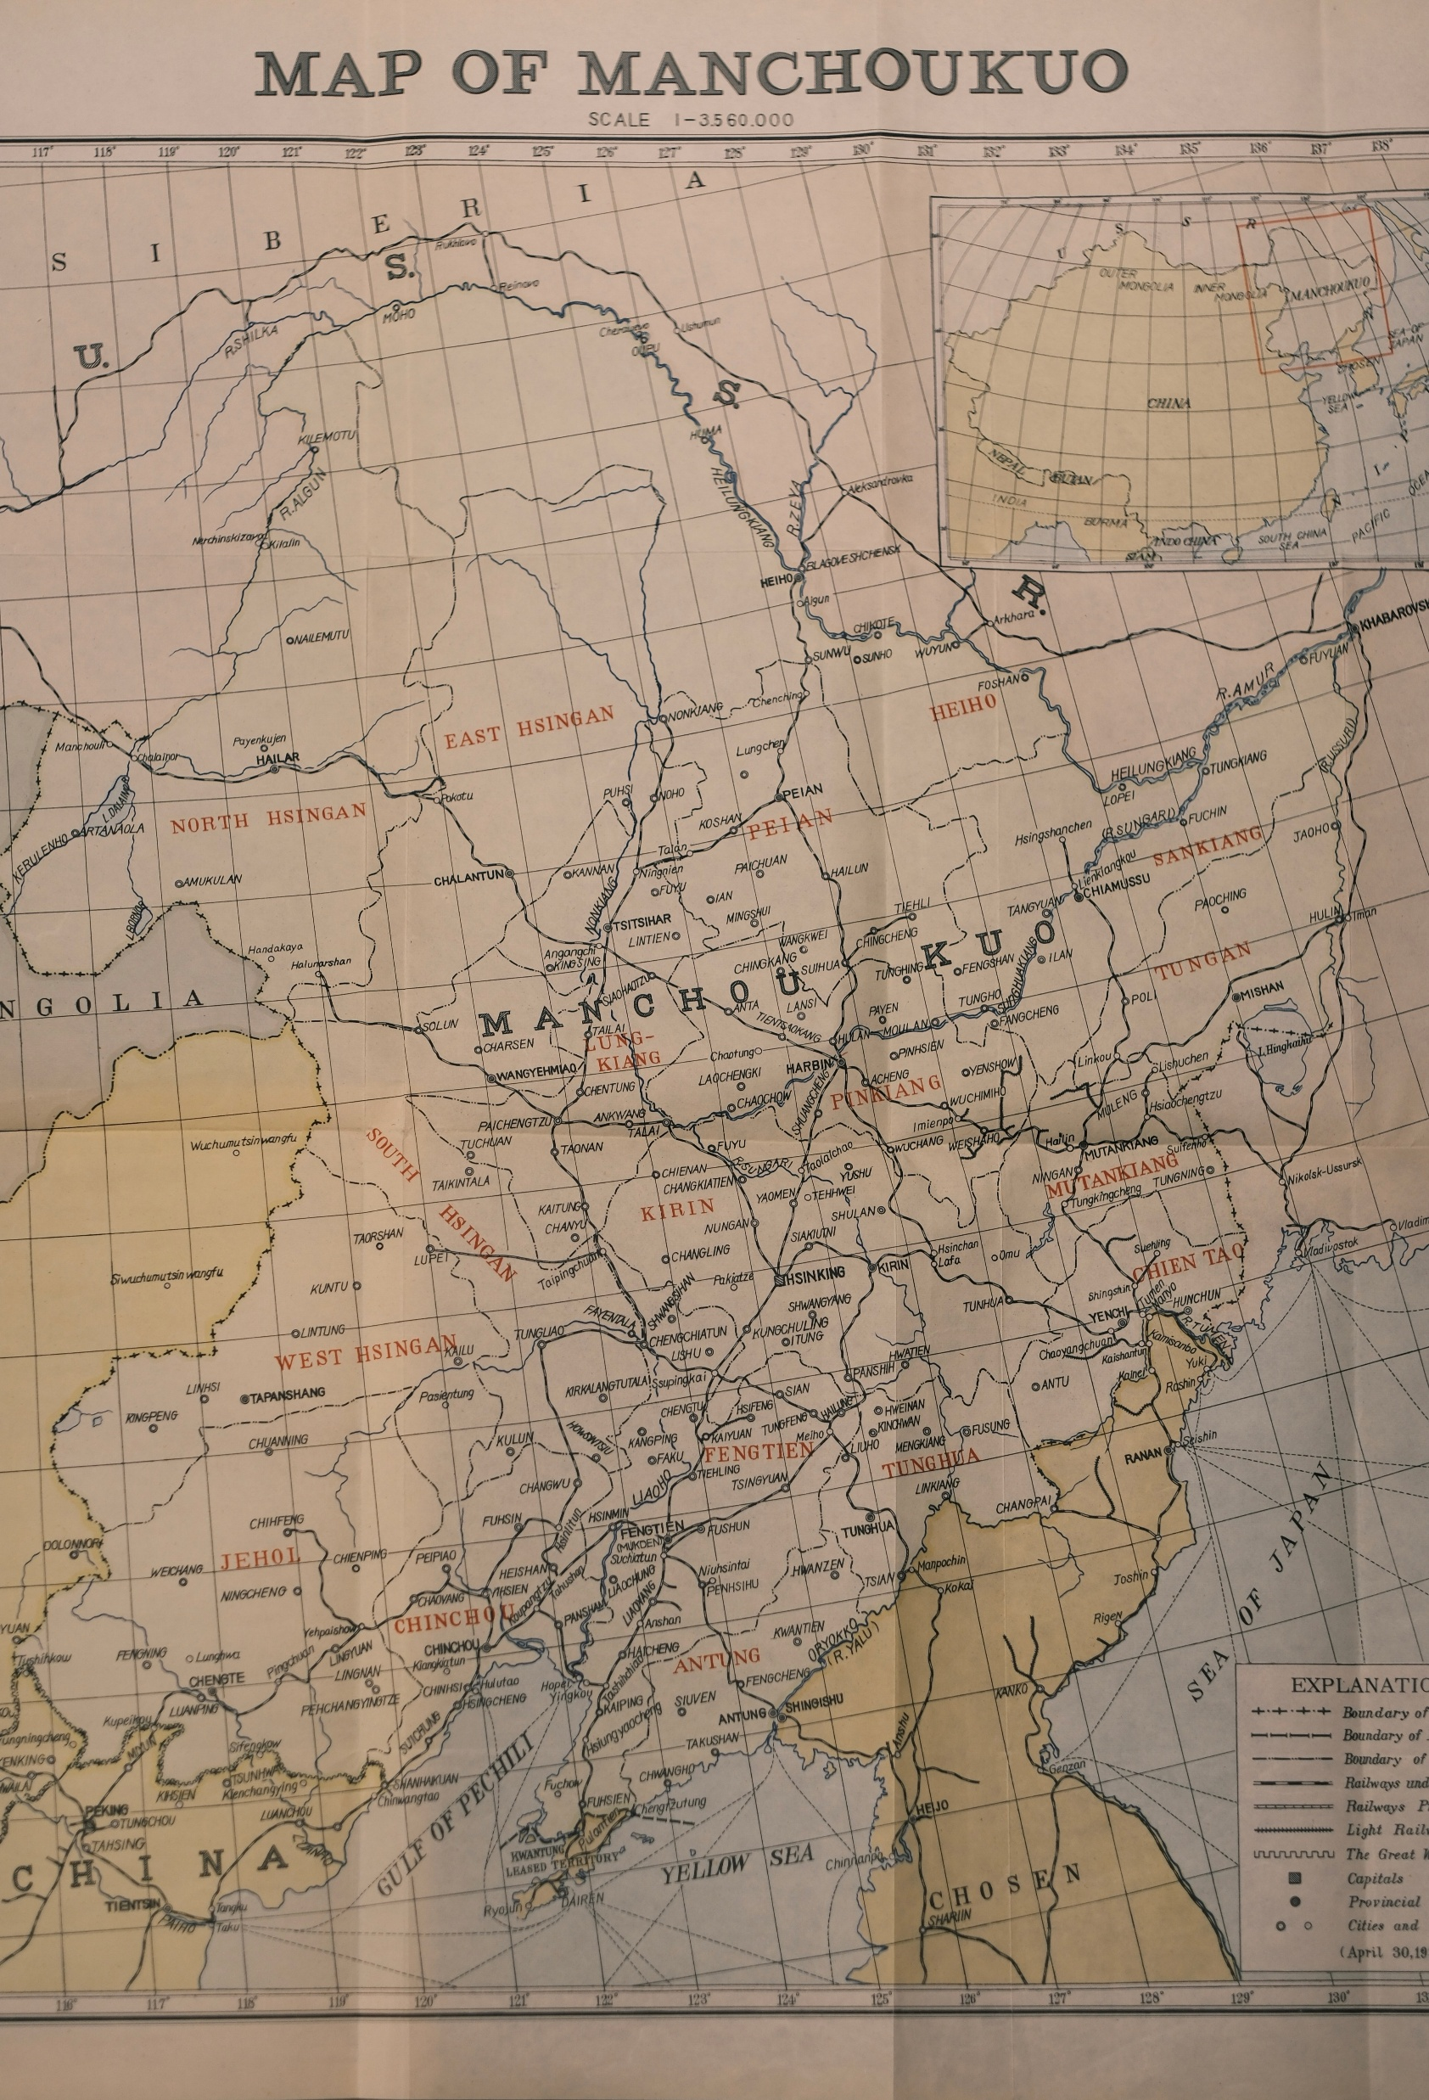
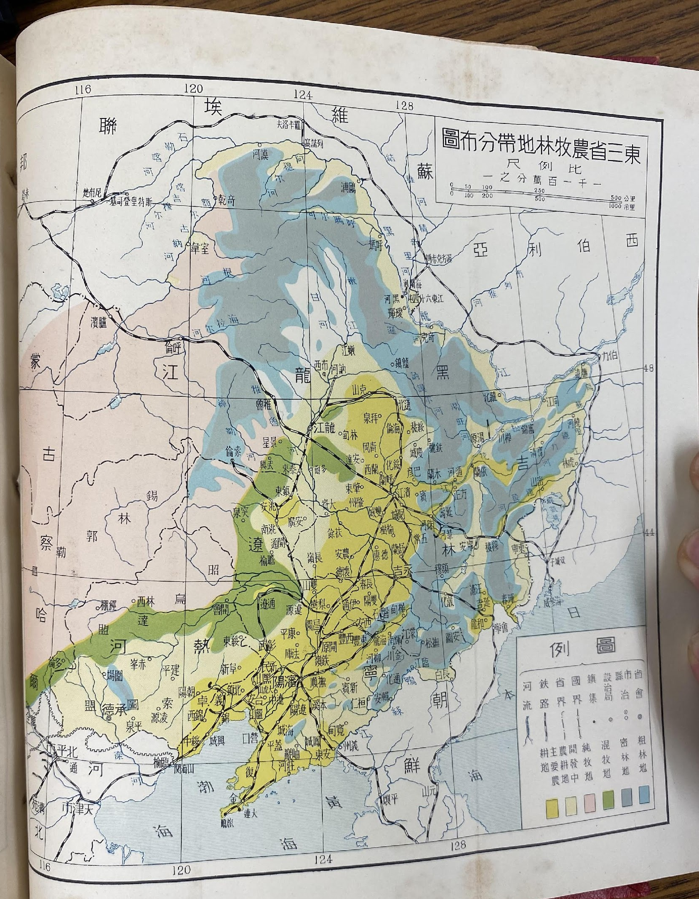
Notes:
My first step was to georeferenced historical maps from the 1930s, such as a railway map shown on the left, and a map on the right which includes layers of dense and sparse forest coverage, to create a baseline map in Arc GIS of the status of Manchuria in 1932
I created a Show you the historical soures I used to create this map.
-detailed railway map
-1933 report that shows forest coverage: grey blue color shows dense forests, while the light blue shows sparse forests. In total estimated amount of X hectares of forest coverage, or the size of state of X.

Slide 4
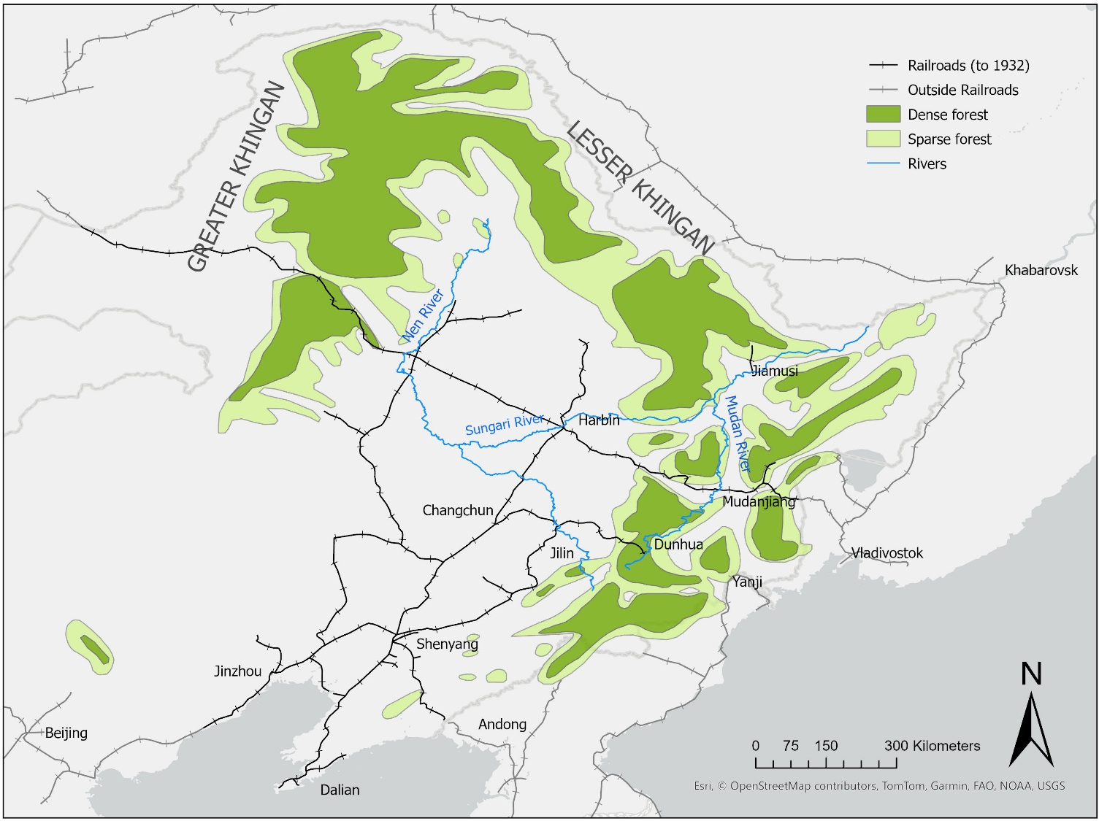
Manchuria, 1932
Notes:
Here is a map I created using GIS, which shows why Manchuria was so attractive.

Slide 5
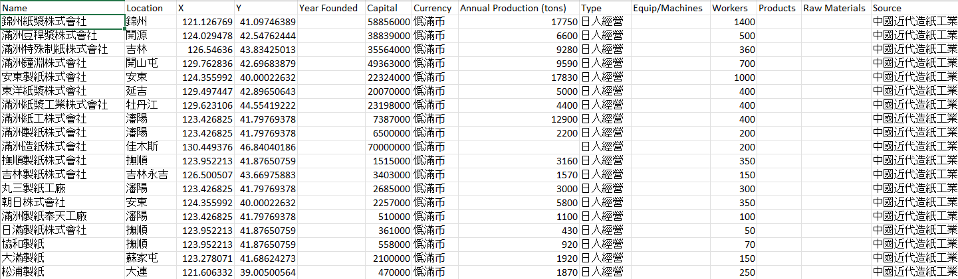
Coordinate approximations
Notes:
After importing the paper factory sites from my database, we can see the layers together…

Slide 6
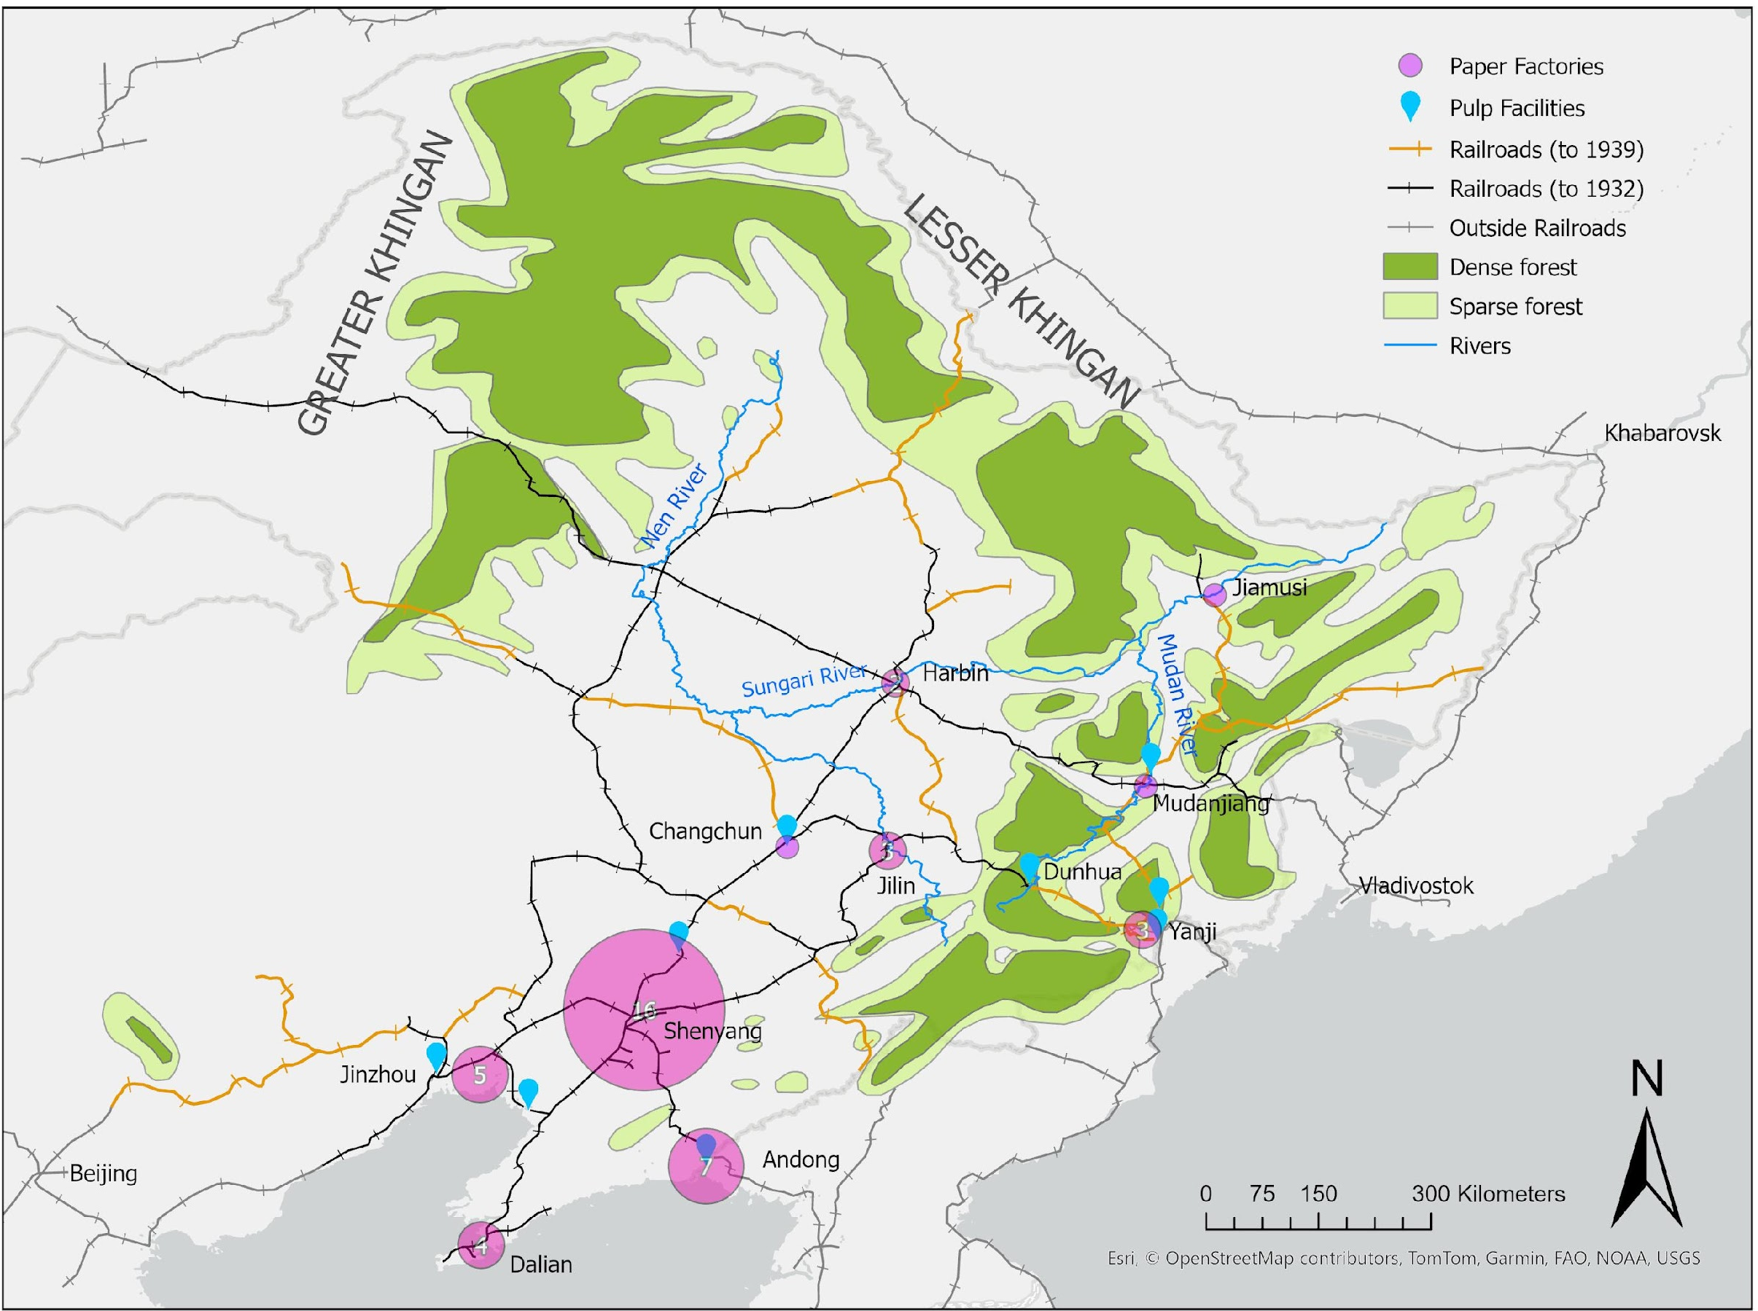
Paper industrialization1932-1945
Notes:
Added in approximate factory locations
Magenta circles are clustered representations of individual sites – a number of 5 means there were five facilities in the vicinity, and a magenta circle without a number represents a single facility.
Blue tabs represent individual pulp mills, which used wood but also created pulp from reeds and beanstalks.
Large expansion occurred in the more advanced, industrialized south (like the 16 facilities near Shenyang)
But the Japanese were also extremely successful in bringing in remote forest zones like around the Mudan River Valley (highlighted on the map)
An important factor was the growth of railroads from 1932 to 1939, which is shown in orange (which grew from 5,500 km to 10,000 km in track length from 1932 to 1939)
Even so, there were limits to fiber extraction and the Manchurian paper industry did not achieve its potential. As the Second World War widened and resources became even more critical to Japan, the authorities raised pulp production targets from 60,00 tons to 400,00 tons, [much of it earmarked for Japan], and tried to tap the farthest reaches of Manchurian forests by building three factories on the edges of the Khingan Mountains. Only one of these three facilities ever made it to production. [show].
-Various reasons led to failure: unrealistic timelines, the harsh cold climate, and much more [for projects under conditions of wartime shortages of paper, the cold harsh environments of this northern region, and other factors such as labor, infrastructure, and the targeted research needed to make Manchurian tree species suitable for pulp production.]
Though the creation of a functioning paper empire was not achieved, I argue that rapid paper industrialization left a legacy for the region: intensive, localized exploitation of forests; chemical pollution of rivers; shifts toward certain preferred tree species; and, most importantly, a long-term foundation for industrial and state control over natural resource in the region.
This presentation today is part of my dissertation which covers more broadly China’s modern paper industry through the lens of raw materials, and this was my first, humble foray into GIS methods, using truly the most basic of spatial tools. I look forward to your feedback and thoughts.
4’55”

Slide 7
Paper industrialization1932-1945
Notes:
Added in approximate factory locations
Magenta circles are clustered representations of individual sites – a number of 5 means there were five facilities in the vicinity, and a magenta circle without a number represents a single facility.
Blue tabs represent individual pulp mills, which used wood but also created pulp from reeds and beanstalks.
Large expansion occurred in the more advanced, industrialized south (like the 16 facilities near Shenyang)
But the Japanese were also extremely successful in bringing in remote forest zones like around the Mudan River Valley (highlighted on the map)
An important factor was the growth of railroads from 1932 to 1939, which is shown in orange (which grew from 5,500 km to 10,000 km in track length from 1932 to 1939)
Even so, there were limits to fiber extraction and the Manchurian paper industry did not achieve its potential. As the Second World War widened and resources became even more critical to Japan, the authorities raised pulp production targets from 60,00 tons to 400,00 tons, [much of it earmarked for Japan], and tried to tap the farthest reaches of Manchurian forests by building three factories on the edges of the Khingan Mountains. Only one of these three facilities ever made it to production. [show].
-Various reasons led to failure: unrealistic timelines, the harsh cold climate, and much more [for projects under conditions of wartime shortages of paper, the cold harsh environments of this northern region, and other factors such as labor, infrastructure, and the targeted research needed to make Manchurian tree species suitable for pulp production.]
Though the creation of a functioning paper empire was not achieved, I argue that rapid paper industrialization left a legacy for the region: intensive, localized exploitation of forests; chemical pollution of rivers; shifts toward certain preferred tree species; and, most importantly, a long-term foundation for industrial and state control over natural resource in the region.
This presentation today is part of my dissertation which covers more broadly China’s modern paper industry through the lens of raw materials, and this was my first, humble foray into GIS methods, using truly the most basic of spatial tools. I look forward to your feedback and thoughts.
4’55”

Slide 8
