Slide 1
Supporting Student Wellness
Development and Expansion of the Health and Wellness Collection at the Michigan State University Libraries

Slide 2
Who We Are
Andrea Kepsel Health Sciences Librarian akepsel@msu.edu
Iris Kovar-Gough Health Sciences Librarian iriskg@msu.edu

Slide 3
Introduction
Student health and wellness is directly tied to academic performance
The top 5 impediments to academic success, as reported by MSU students¹, are:
Stress
Anxiety
Sleep Difficulties
Depression
Attention Deficit Disorder
Other areas of importance include use of alcohol and other drugs, physical health, sexual health, and emotional wellness

Slide 4
Background
Prior to 2019 there was not a designated consumer health collection at the MSU Libraries
While some consumer-level materials were collected, they were shelved alongside professional-level health and medical materials in the main collection, with no single location for browsing
At the time, we were seeing increased importance placed upon the health and wellbeing of students at Michigan State University
An internal microgrant program at the MSU Libraries provided the perfect opportunity to develop the new student health and wellness collection
Our successful proposal presented an innovative project that supported the library’s mission and vision of being at the center of campus life and promoting equal access to information and spaces for all

Slide 5
Developing the Collection
Our development process included:
Writing and submitting a microgrant proposal to fund the purchase of a shelving unit and printing costs
Identifying a location for the collection
Performing an environmental scan of campus and community resources
Contacting campus partners for handouts
Selecting new print titles (CAPHIS², other libraries/guides)
Relocating existing materials
Developing a shelving and cataloging workflow with Technical Services for the new collection
Creating signage, shelf labels, location in catalog, promotional flyer

Slide 6
Key Features of the Collection
Considers health and wellness broadly and has materials on a wide of variety of topics
Low-barrier and stigma-free access to materials in a centralized location
Pairs books in the collection with informational handouts from campus and community organizations
Encourages informed health consumers and connects them to available services and support
Designed as a browsing collection and items have standard circulation rules
Eliminates restrictions such as in-building use or shorter check-out periods

Slide 7
Collection Debut – October 2019
Close up showing purple spine labels to easily identify books as part of the collection
Front and back of the shelving unit

Slide 8
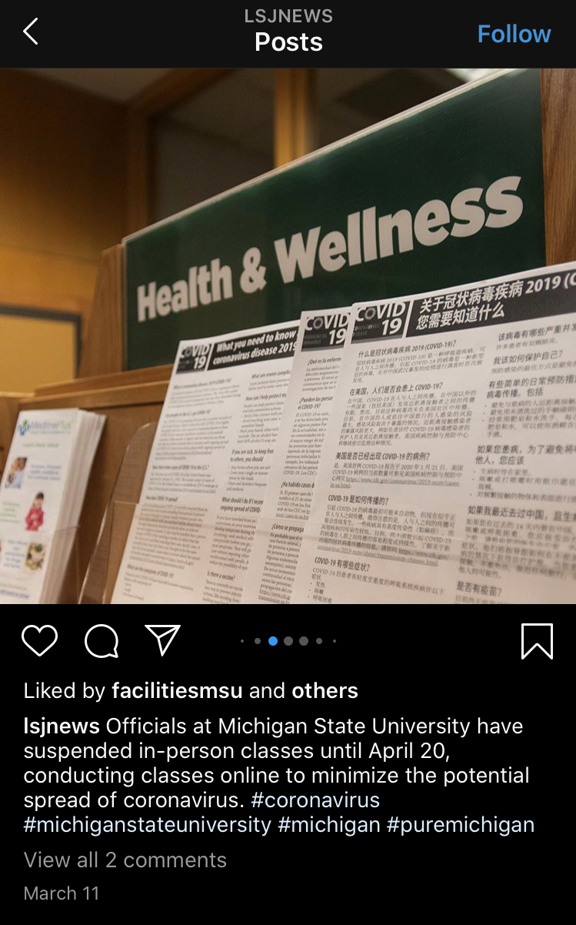
And Then…..COVID-19
We printed handouts in multiple languages on COVID from the CDC, and then everything shut down.
How do you have a successful print-only browsing collection when nobody is in the library?

Slide 9
Digital Additions
March and April 2020 we realized we needed to move to digital because of the ongoing closure of the physical library building
We purchased electronic duplicates of existing print titles and focused our collection development over the next 18 months on ebooks
This meant we kept the collection current and accessible despite the limitations of in-person contact
We also created a libguide for the collection³ listing both the print and electronic books and linking to MSU units and local organizations in our county that could support users (e.g. the MSU student food pantry and the Greater Lansing Food Bank)

Slide 10
Collection Usage
Print books = 117; 02/01/2024-02/01/2025 = 50 check outs from 42 books
This does not take into consideration in-library use or browsing activities of patrons
Ebooks = 61; 02/01/2024-02/01/2025 = 167 ebook online views + full downloads
LibGuide views since 02/01/2024 = 995 views
The highest number of monthly views was 148 in February 2025
Handouts have proven difficult to track usage of
Based on need to replenish, popular handouts are for the MSU Couple & Family Therapy Clinic, Student Legal Services, and the Student Veterans Resource Center
Limitations & Food for Thought: Are usage statistics meaningful for a browsing collection? How would one measure the impact of handouts for community organizations?

Slide 11
Collection Subjects

Slide 12
Top 10 Print Books By Check Outs (2024-2025)
Endure: Mind, Body, and the Curiously Elastic Limits of Human Performance
Renters’ Rights
Quiet Your Mind & Get to Sleep: Solutions to Insomnia for Those With Depression, Anxiety, or Chronic Pain
Overcoming Unwanted Intrusive Thoughts: A CBT-Based Guide to Getting Over Frightening, Obsessive, or Disturbing Thoughts
One Year Wiser: An Illustrated Guide to Mindfulness
Goodnight Mind: Turn Off Your Noisy Thoughts & Get a Good Night’s Sleep
Essentials of Managing Stress
Eating Disorders: Your Questions Answered
Crip Up the Kitchen: Tools, Tips, and Recipes for the Disabled Cook
A Quick & Easy Guide to Asexuality

Slide 13
University Health and Wellbeing
We began a partnership with MSU University Health and Wellbeing (UHW)⁴ in 2024.
UHW visited the library for a tour and to learn about library health and wellness resources
Following a restructuring of their office, UHW was pursuing new collaboration opportunities
Met with members of the Health Promotion & Engagement team to discuss synergies and envision ways to cross-promote our collection and their programming and support
Outcomes from UHW meetings include:
Expanded focus of collection to all campus community, not just students
Review of collection by UHW experts and suggestions for titles to purchase
Monthly ‘Shelf Care’ book recommendations

Slide 14
Shelf Care
UHW experts provide a book recommendation related to the monthly cross-campus health promotion theme
Written recommendations are similar to what you may find in a bookstore or public library
The selected book is highlighted alongside the ‘Shelf Care’ and health promotion flyers
The aim is to increase discoverability of the collection and refer users to relevant UHW supports and programs

Slide 15
Changes Since 2020
Removed ‘student’ from the name of the collection so it is attractive to all campus users
Added books on health topics from different life stages (not just student/young adult ages) including books on menopause and parenting
Revising subjects on the guide and signage
Changed ‘women’s health’ to ‘sexual health’ to be more inclusive
Removed ‘sexuality’ section and moved books to ‘sexual health’ (and some to LGBTQIA2S+)
Stronger ties with university health and wellness division to integrate their programming and supports into the collection information. Starting with the "shelf care" book recommendations, information flyers on monthly themes like flu and cold season or responsible drinking behaviors.

Slide 16
What We Learned
Tracking usage is complex, especially with a collection originally designed for browsing
No way to measure print books that are not checked out
Measuring usage of ebooks is not straightforward, but did show they are not as popular as the print titles
Documenting meaningful usage of handouts is challenging
Communication is key
There are many people involved in getting books on shelves
Frequent and repeated outreach and promotion leads to collection success
Flexibility and adaptation is necessary

Slide 17
Future Directions
Implement the "stall stories" from UHW into all the bathrooms of the Main Library
Increase collaboration with UHW to include programming at the Main Library and support mutually beneficial outreach strategies
Continue to grow the print collection on topics that resonate with our campus community and uplift the values of UHW and MSU's mission to support student and employee success
Find ways to demonstrate the value of the collection and the role of the Libraries as a connector to supports and services at MSU and the broader community

Slide 18
References
The State of Spartan Health 2024: Impediments to Academic Success
Medical Library Association Consumer and Patient Health Information Services Book List
MSU Libraries Health and Wellness Libguide
MSU University Health and Wellbeing – About Us

