Slide 1
100-mile radius
Enforcement Zone
Author: Shawn Sun, Sadiiq Mohamed, Anirit Bansal
Sponsor: Project on Government Oversight
Notes:
Sadiiq

Slide 2
About the Team & Sponsors
About Team:
Why 100 mile zone?
What were our objectives?
Sponsor:
Project On Government Oversight (POGO)
Notes:
As minority community members, we've experienced the impact of our skin color, making us keenly aware of social inequalities. We chose to focus on the 100-mile border zone in Washington to address disparities and advocate for minority rights. Our motivation is social justice and equality.
Gap in knowledge about what is happening on the Northern Border (mentioned first meeting)
Raise awareness to the general public using data already available.
Provide a proposal for what a “reasonable distance” should be across WA.
Provide a StoryMap with the new proposed “reasonable distance” and analysis as to why we chose this number.
Incorporate the analysis of current “reasonable distance” and its current effects.
Create a workflow document for the process of our research and recommendations
Provide any additional resources requested or suggested during meeting.
Nonpartisan independent group whose mission is to investigate and expose waste, corruption, abuse of power within government
Needs: develop proposals for what a “reasonable distance” should be across WA, based on data and research.
Goal/Purpose: provide foundation for reduction in the 100-mile zone that could serve as a model for other border regions.

Slide 3
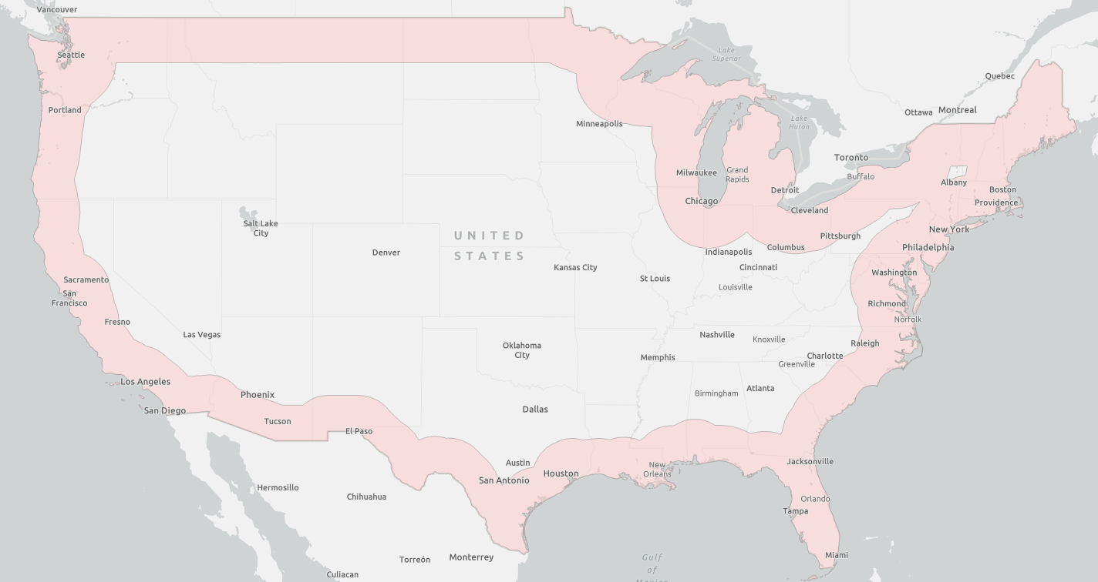
What is the 100-mile Enforcement Zone?
Enforced by U.S Customs and Border Protection (CBP)
Initial placement of border zone is in 1950s:
This is from any external boundaries, except for Michigan, which extends from lake.
Homeland security was an extra layer that allows for reasonable mile distance.
Notes:
Shawn
Supposed to determine the “reasonable distance” by considering local factors, including topography, population density, possible inconvenience to the traveling public, and border activity. (ACLU Michigan)
Has the authority to stop and search all vehicles within the zone.

Slide 4
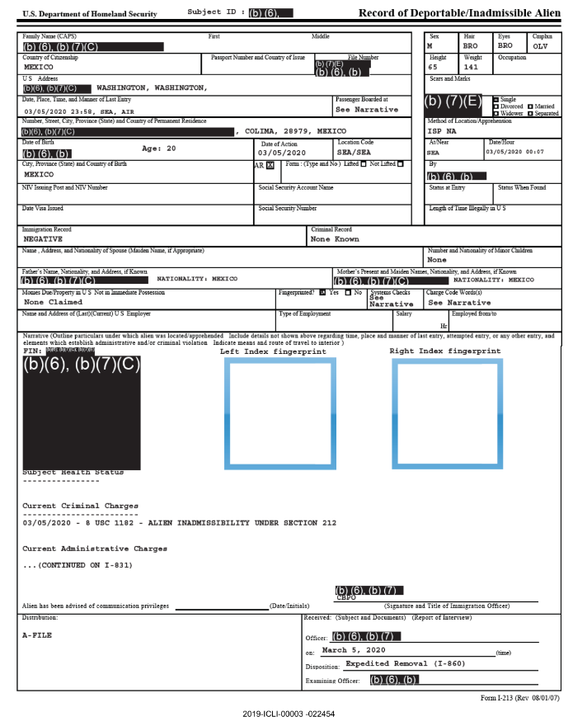
Resources Used (Data)
I-213 “Record of Deportable/Inadmissible Alien” forms
documenting apprehensions by US Immigration and Customs Enforcement (ICE) and Customs and Border Protection (CBP) of who they deem deportable (Center for Human Rights)
This form is primarily used to document encounters with immigration officers.
Population data
Shapefiles
Notes:
Sadiiq

Slide 5
Driving Questions:
What was the distribution of country of current citizenship amongst those been arrested by CBP or ICE officers?
What areas within the 100-mile radius had the most arrest by CBP or ICE officer? And how far are these counties from the border?
How has new and advanced technology help revolutionize security and resources available to CBP and ICE officers?
Notes:
Anirit

Slide 6
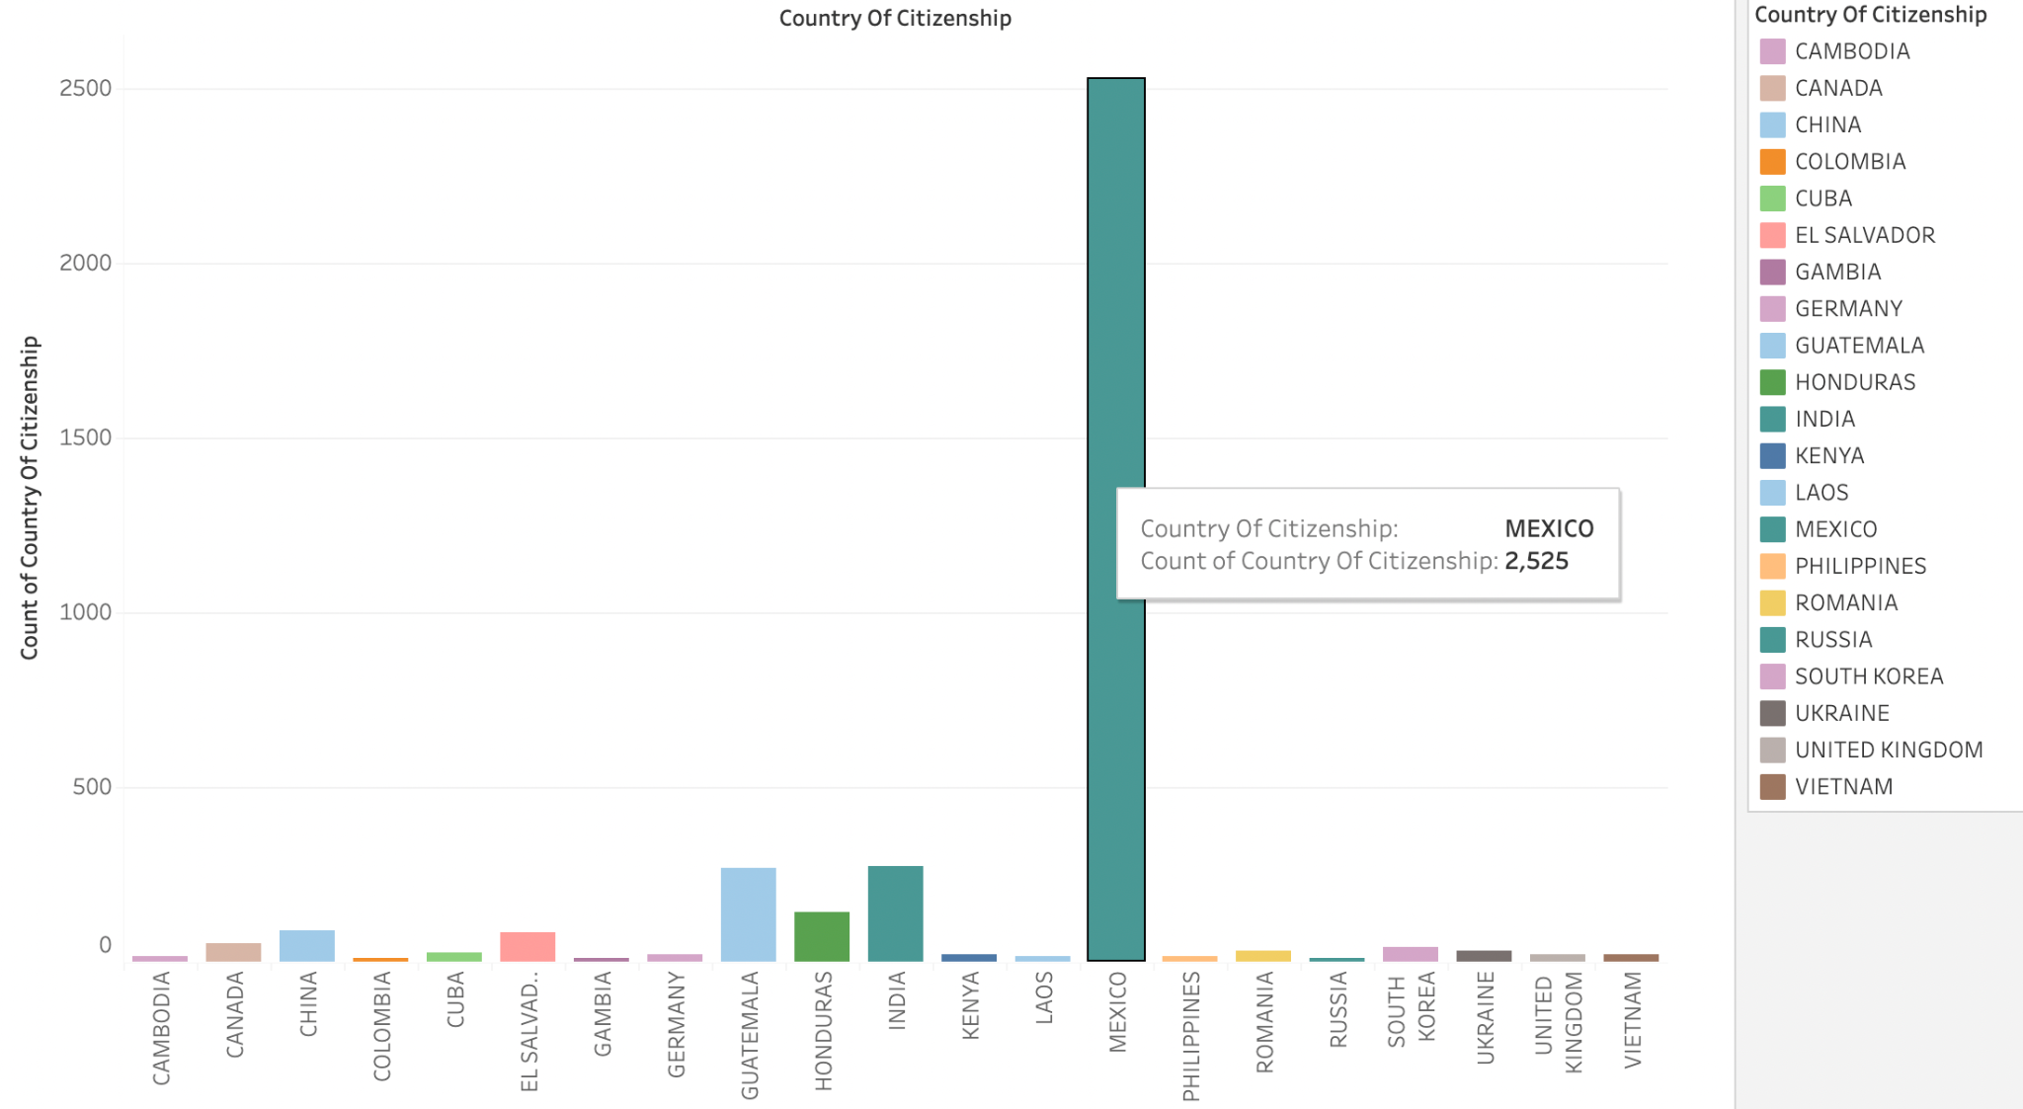
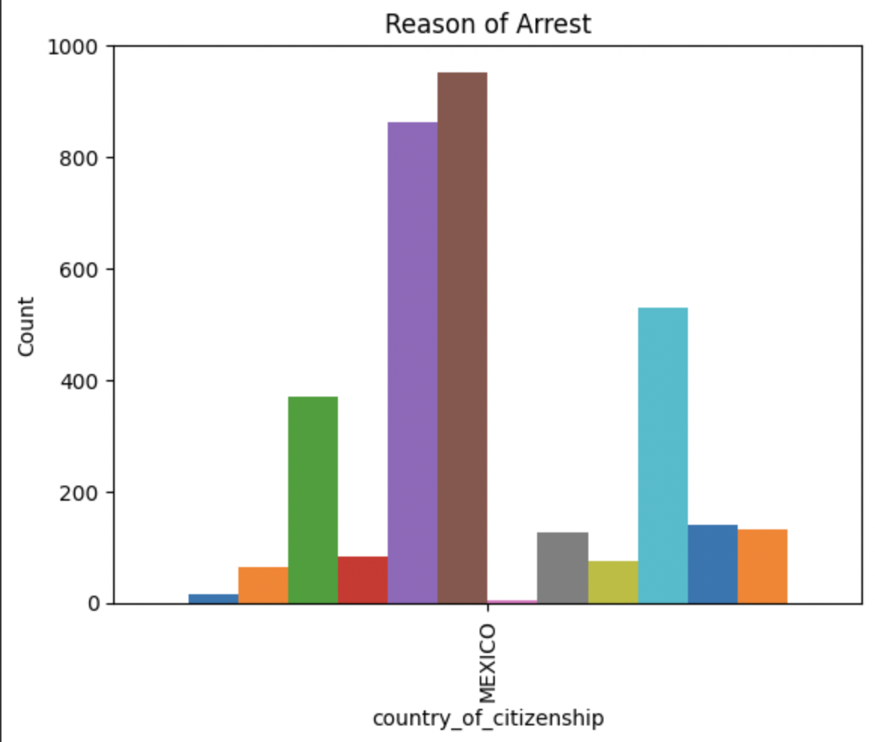
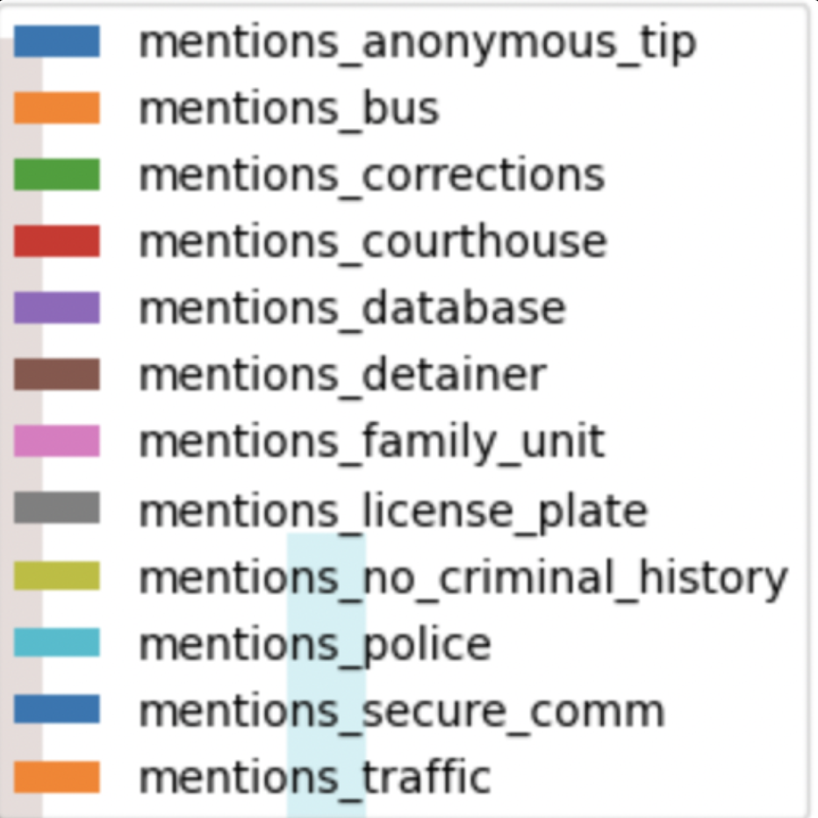
1. What was the distribution of country of current citizenship amongst those been arrested by CBP or ICE officers?
59% of I-213 arrest help Mexican Citizenships
Specifically, 1621 forms out of 2743 forms
Notes:
Anirit

Slide 7
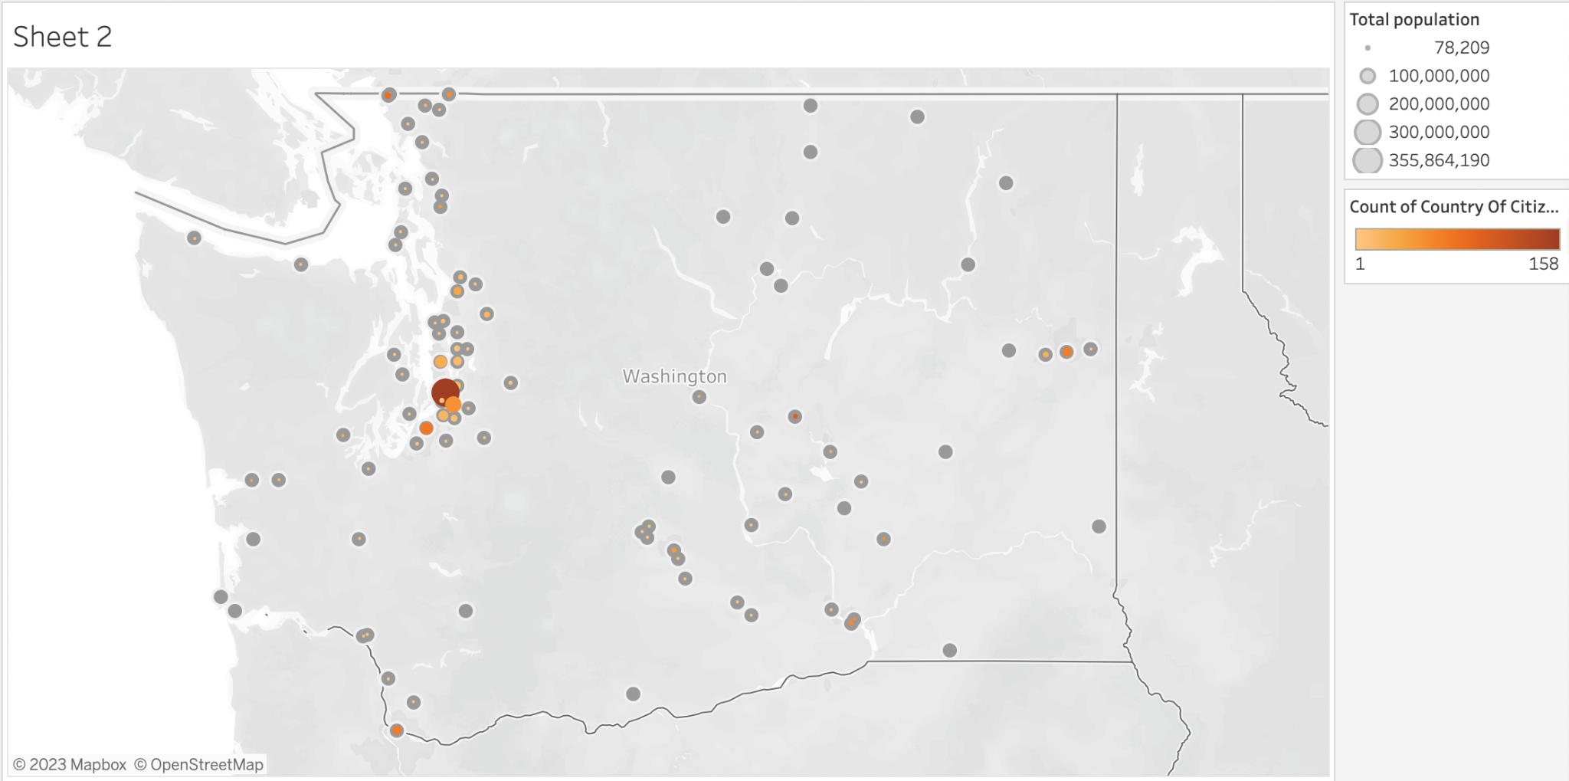

Slide 8
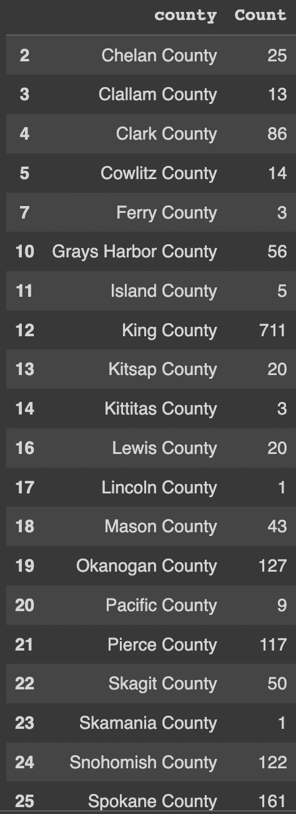
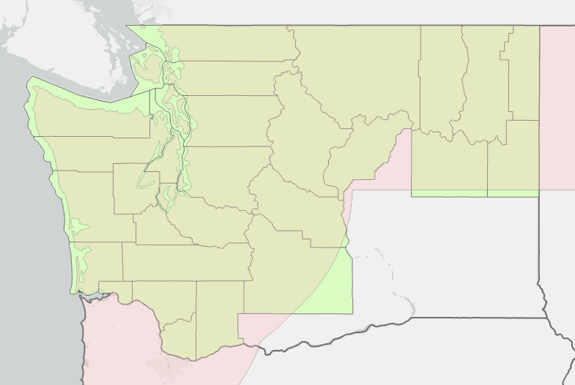
2. What areas within the 100-mile radius had the most arrest by CBP or ICE officer?
39 total counties in WA state
28 counties fully covered by the enforcement zone
Notes:
Anirit

Slide 9
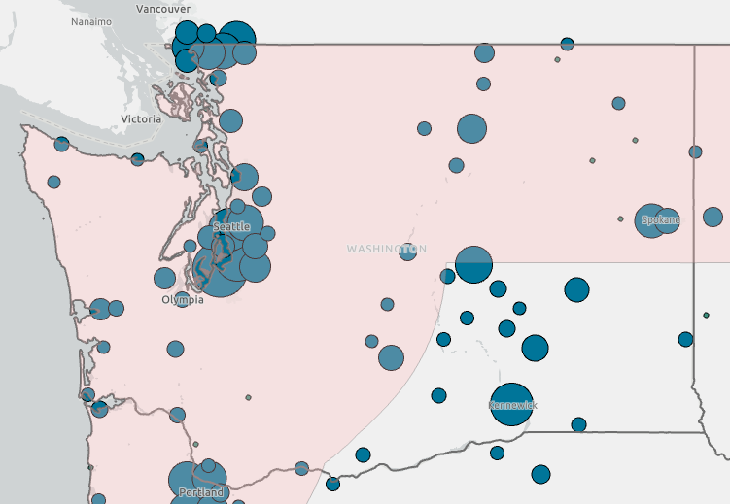
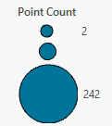
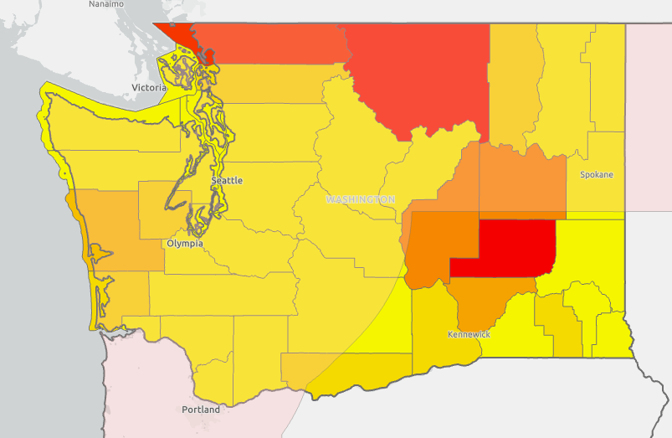
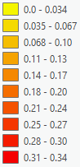
Spatial Trends of The Arrest
Identify locations in which the arrests have been made throughout the region.
Concentration along Northern border and Seattle
Less arrests happening in coastal, eastern and inner regions within zone
Point aggregated and normalized by populations, to put in perspective of areas of highest apprehensions.
Significant regions: outside of 100 mile zone and Northern border area.
Apprehension Rate (%)
Notes:
Shawn

Slide 10
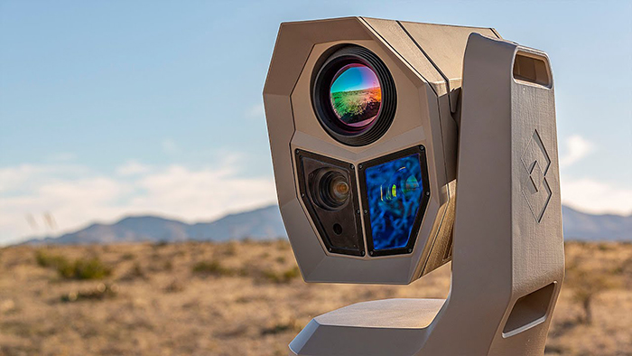
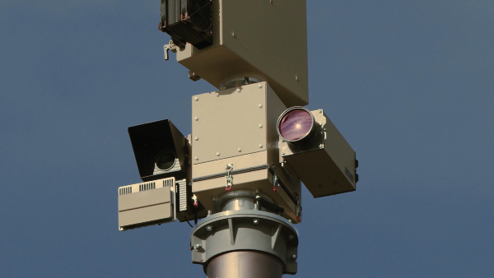
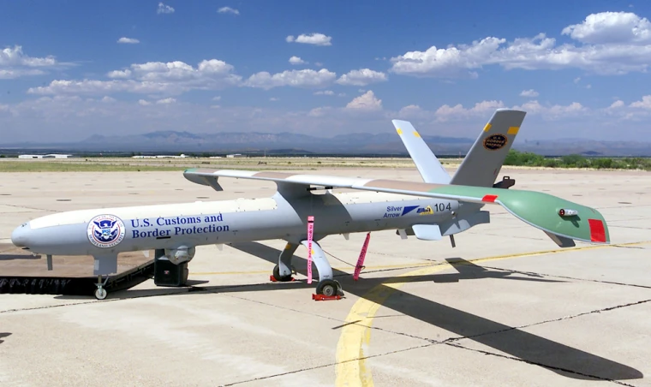
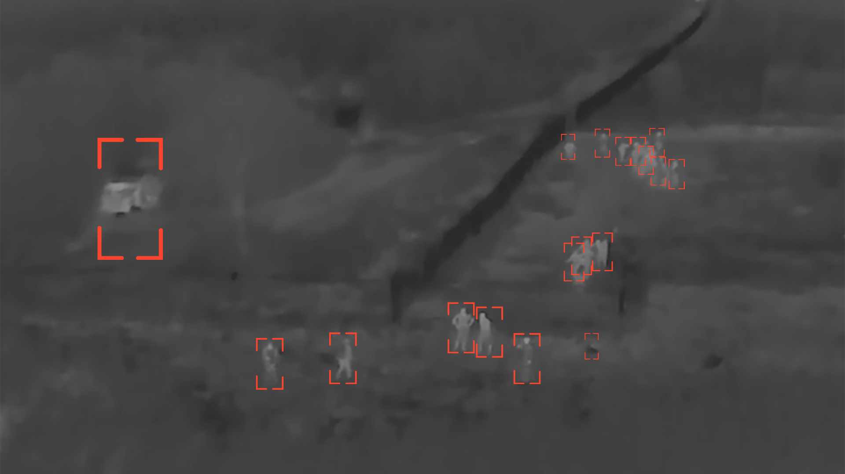
3. How has new and advanced technology help revolutionize security and resources available to CBP and ICE officers?
$16.5 Billion
Funding for CBP (2023), which is 170 million increase from last year (2022)
$8.42 Billion
Funding for ICE (2023)
$800 Million
Increase in Budget of ICE ($630 million) and CBP ($170 million) compare to 2022FY
$535 Million
For Border Security Technology
Surveillance Used: cameras, sensors, radar systems, and unmanned aerial vehicles (UAV), advanced video analytics and machine learning algorithms for analyzing surveillance footage and identify potential threats.
CBP Budget (Senate Appropriations Committee ) | Technology Budget (White House Fact Sheet) | Surveillance | UAV | Border Security Radar | FLIR | Object Detection Technology
Notes:
Sadiiq

Slide 11
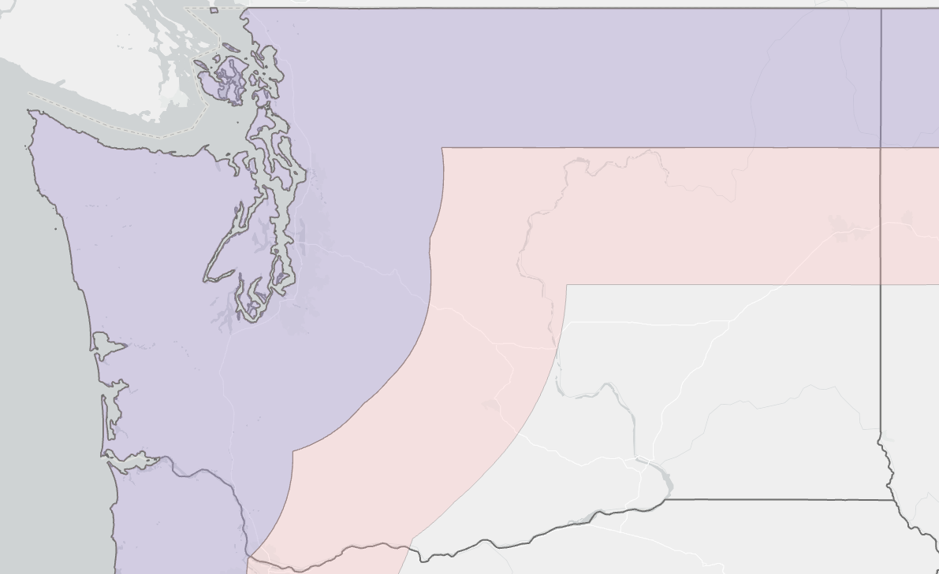
Proposal
50 Miles
100 Miles
Notes:
ALL of us

Slide 12
Conclusions
Few research done about the topic
Michigan - American Civil Liberties Union
Washington - University of Washington Center for Human Rights
Analyzed why the current zone is problematic, from their study of data.
However, no spatials analysis to prove why the reduction is necessary and possible.
Further analysis
Focus on Temporal analysis
Division of ICE and CBP
Division of coastal, border region.
Questions?
Notes:
Shawn

Slide 13
References
American Civil Liberties Union Michigan. (2021). The Border’s Long Shadow. ACLU Michigan. https://www.aclumich.org/en/publications/borders-long-shadow
Neff, P. (2021) WA state I-213 apprehensions. UWCHR. Retrieved May 5, 2023, from https://uwchr.github.io/i-213-analysis/map-wa.html.
Estimated number of people per square mile, between 2017-2021. PolicyMap, https://www.policymap.com/ (based on data from PolicyMap and U.S. Bureau of the Census; accessed 17 May 2020)
Protecting immigrant rights: Is Washington’s Law Working? Center for Human Rights. (2021, August 11). https://jsis.washington.edu/humanrights/2021/08/11/protecting-immigrant-rights-is-washingtons-law-working/
Homeland Security, 2023 - appropriations.senate.gov. (n.d.). https://www.appropriations.senate.gov/imo/media/doc/FY23%20BILL%20HIGHLIGHTS_DHS1.pdf
U.S. Border Patrol Technology. U.S. Customs and Border Protection. (n.d.). https://www.cbp.gov/border-security/along-us-borders/us-border-patrol-technology
Notes:
Shawn

Slide 14
Acknowledgements
Chris Rickerd - POGO
Katherine Hawkins - POGO
Sarah Turberville - POGO
Phil Neff - Center for Human Rights
Suzanne Davies Withers - Mentor
humanitarianparoles@gmail.com
Katherine.Hawkins@pogo.org
sturberville@pogo.org
philneff@uw.edu
swithers@uw.edu
Notes:
Shawn

