Slide 1
Stress Less
Connect, Relax, and Find Your Place
Ohio State University Libraries
April 2025
BTAA Student Wellness Symposium
Notes:
Stephanie

Slide 2
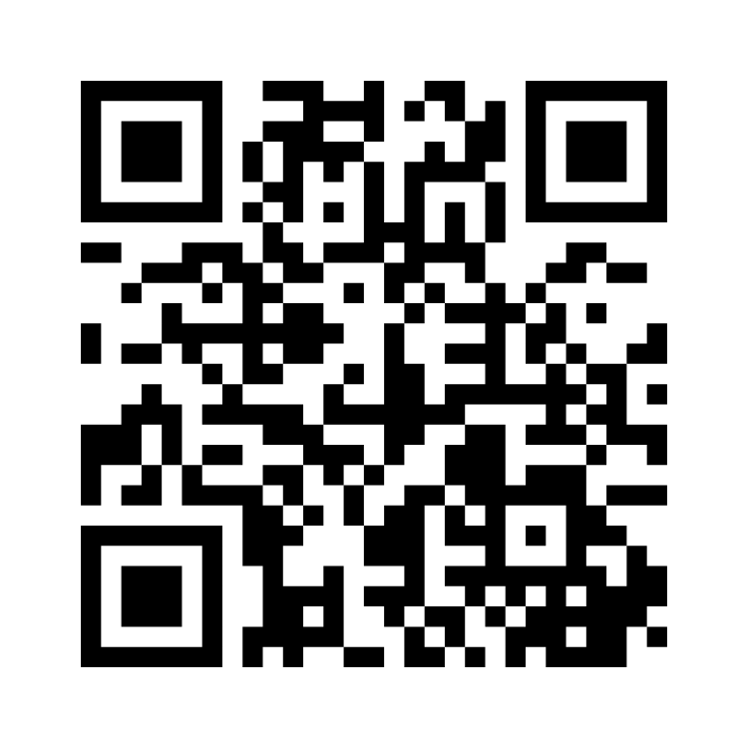
Poll Which character do you relate to today?
Menti.com
Enter voting code 6106 7658
Notes:
https://www.menti.com/al6d2a2xo9s4

Slide 3
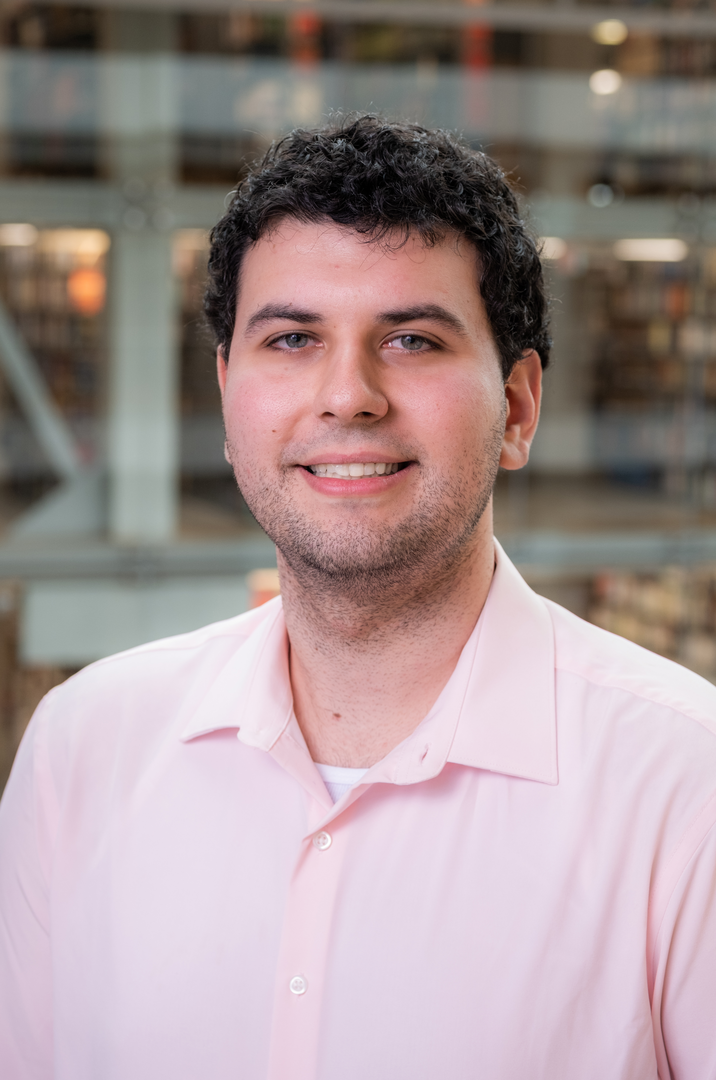
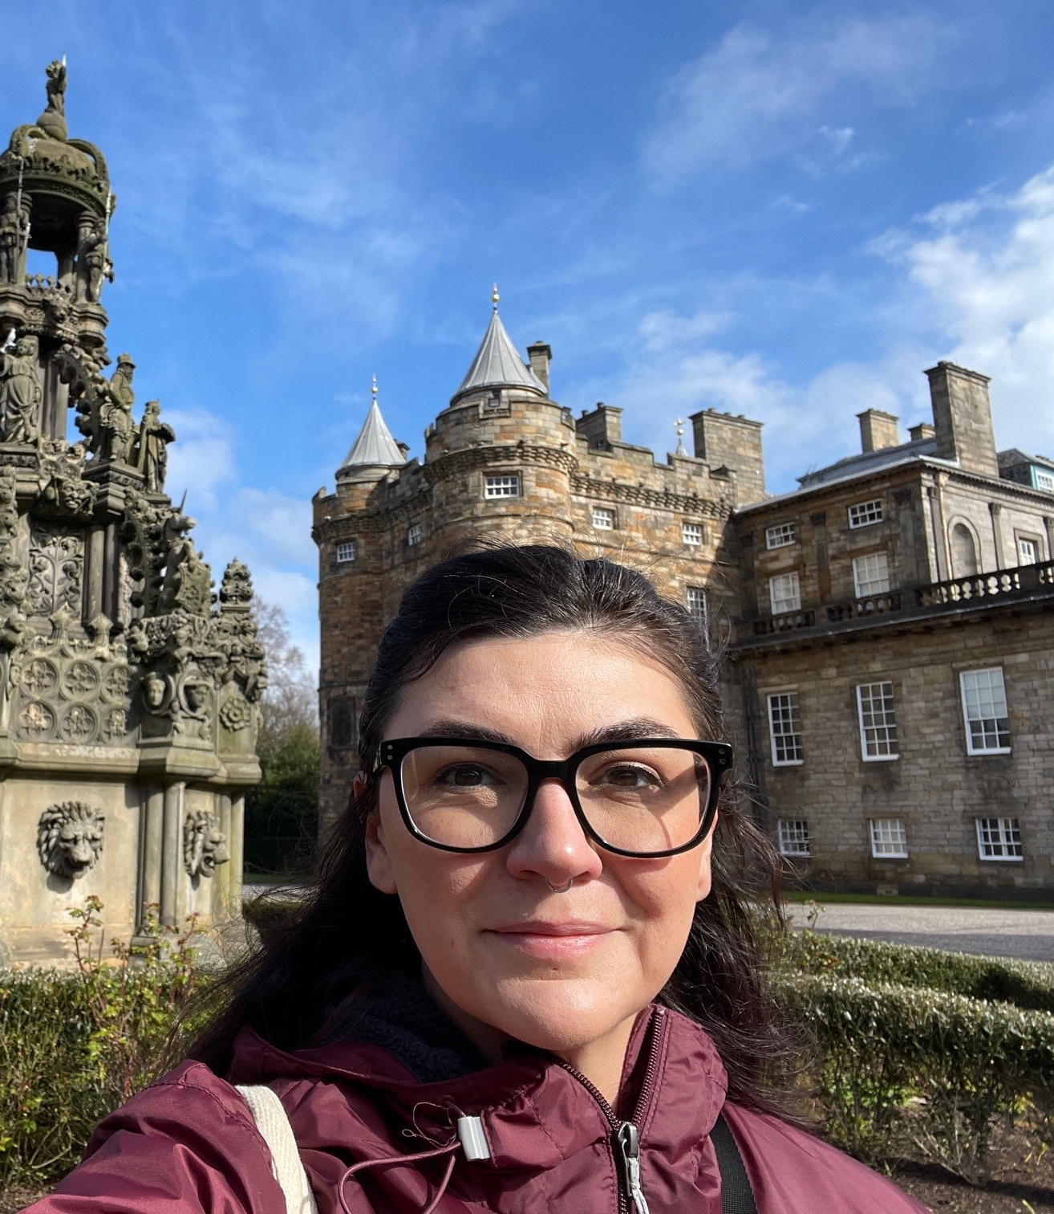
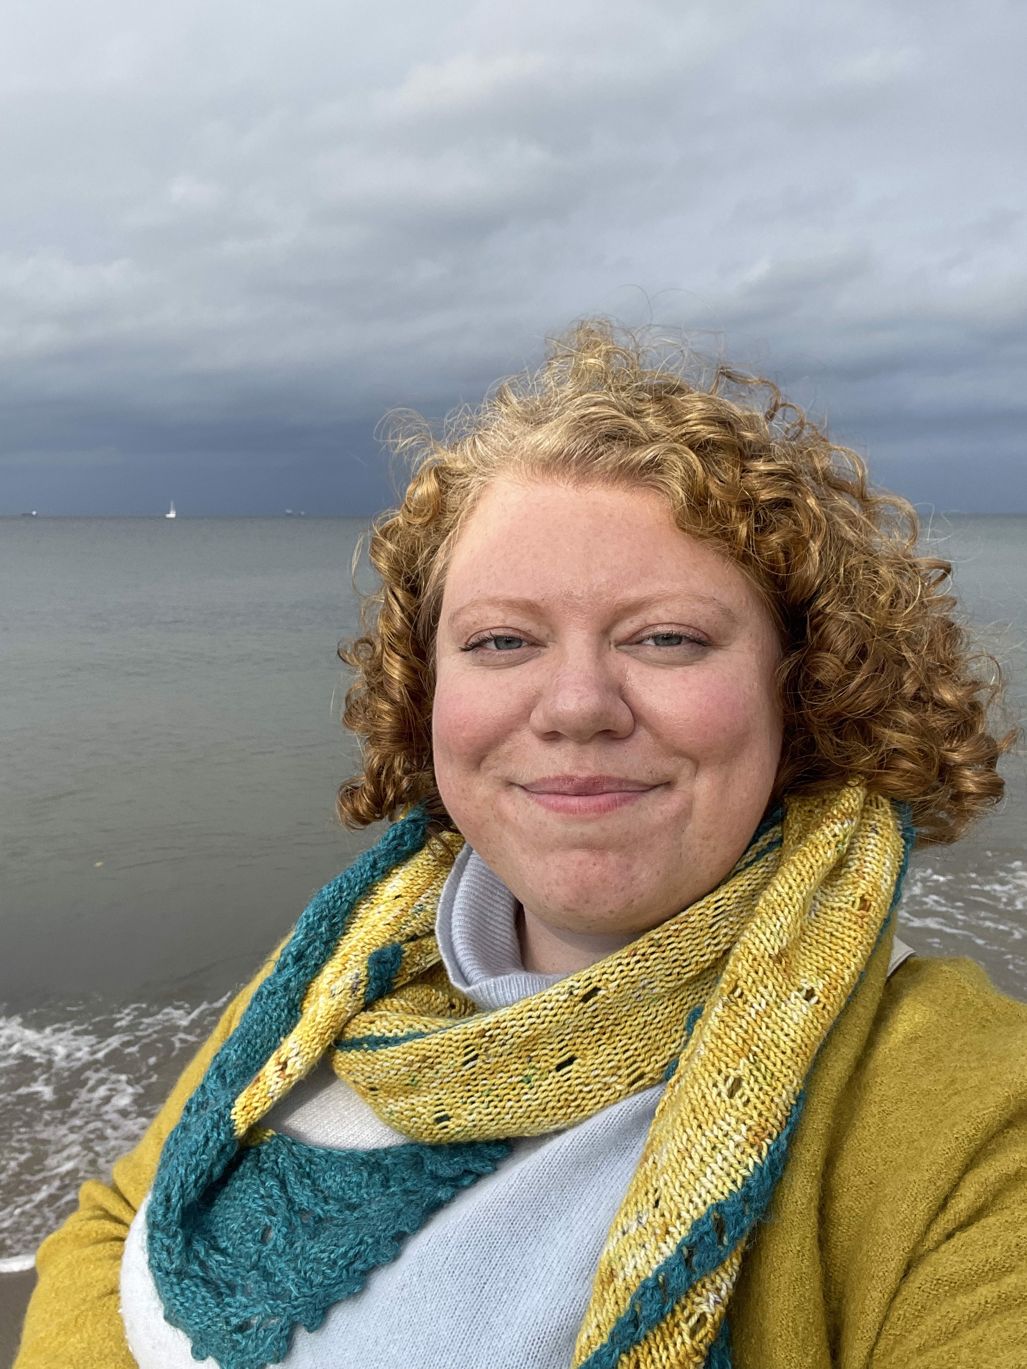
OUR TEAM
Stephanie Founds
Hanna Primeau
Angel Gondek
Chris Seifert
she/her
First Year Experience Specialist
Founds.8@osu.edu
she /her
Instructional Designer
Primeau.8@osu.edu
she/her
Evening Supervisor
Gondek.7@osu.edu
he/him
Teaching & Learning Assistant
Seifert.148@osu.edu

Slide 4
Agenda
01
02
03
04
05
Background
Library Quest
Brain Breaks
Takeaways
Questions

Slide 5
01
Background
Notes:
Stephanie

Slide 6
A Mental Health Crisis
41 percent positive for depression
36 percent for anxiety
14 percent for suicidal ideation
Source: 2022-2023 Healthy Minds Study
Notes:
The study assessed students across hundreds of American colleges
compared to 21 percent, 22 percent, and 10 percent, respectively, in 2014.
(N=76406)

Slide 7
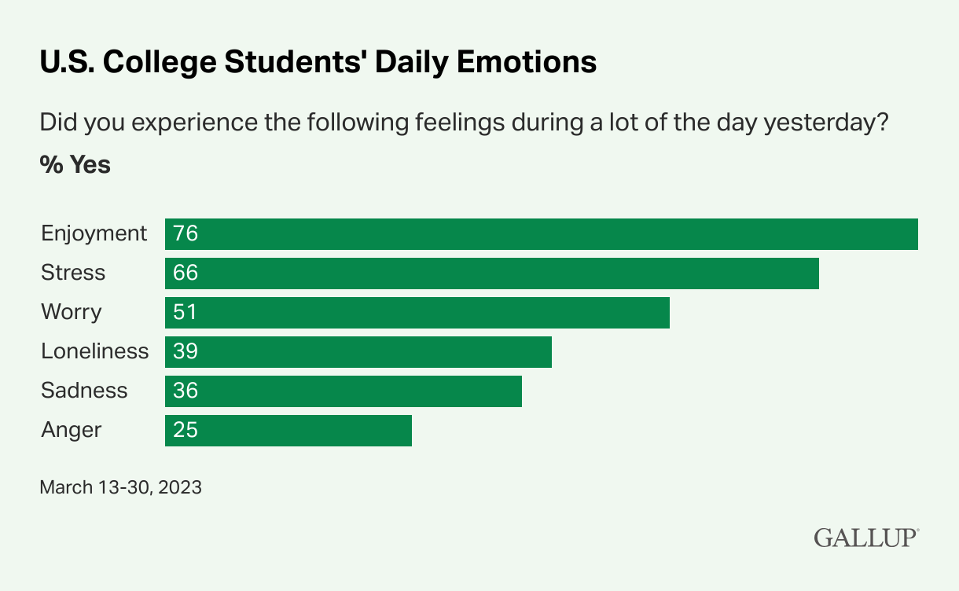
College Students Experience High Levels of Worry and Stress. For more info, click here

Slide 8
Well-Being
5 Major Types
Health
Emotional
Stress management, relaxation, resilience
Physical
Healthy living, exercise
Social
Meaningful relationships and connections
Workplace
Enrichment and growth through purpose
Societal
Participation in thriving communities
Mental and physical health
Happiness
High life satisfaction
Ability to manage stress
Prosperity
Sense of meaning or purpose
Source: Psychology Today

Slide 9
Our Programmatic Approach
Support Student Well-Being at Ohio State University Libraries
Library Quest
Brain Breaks
Explore library spaces to find the “Goldilocks” fit
Connect with library personnel
High engagement purposeful breaks to reduce stress
Make connections with library personnel and other campus groups

Slide 10
02
Notes:
Hanna

Slide 11
The Campaign
Library Anxiety
Embolden students to ask for assistance, explore unfamiliar places, form positive information seeking behaviors.
Connect Communities
Increase social capital, welcome newcomers, encourage interactions with different groups.
Library as Experience
Demonstrate an inclusive, collaborative, adaptable, community center, or third space.
Notes:
Hanna

Slide 12
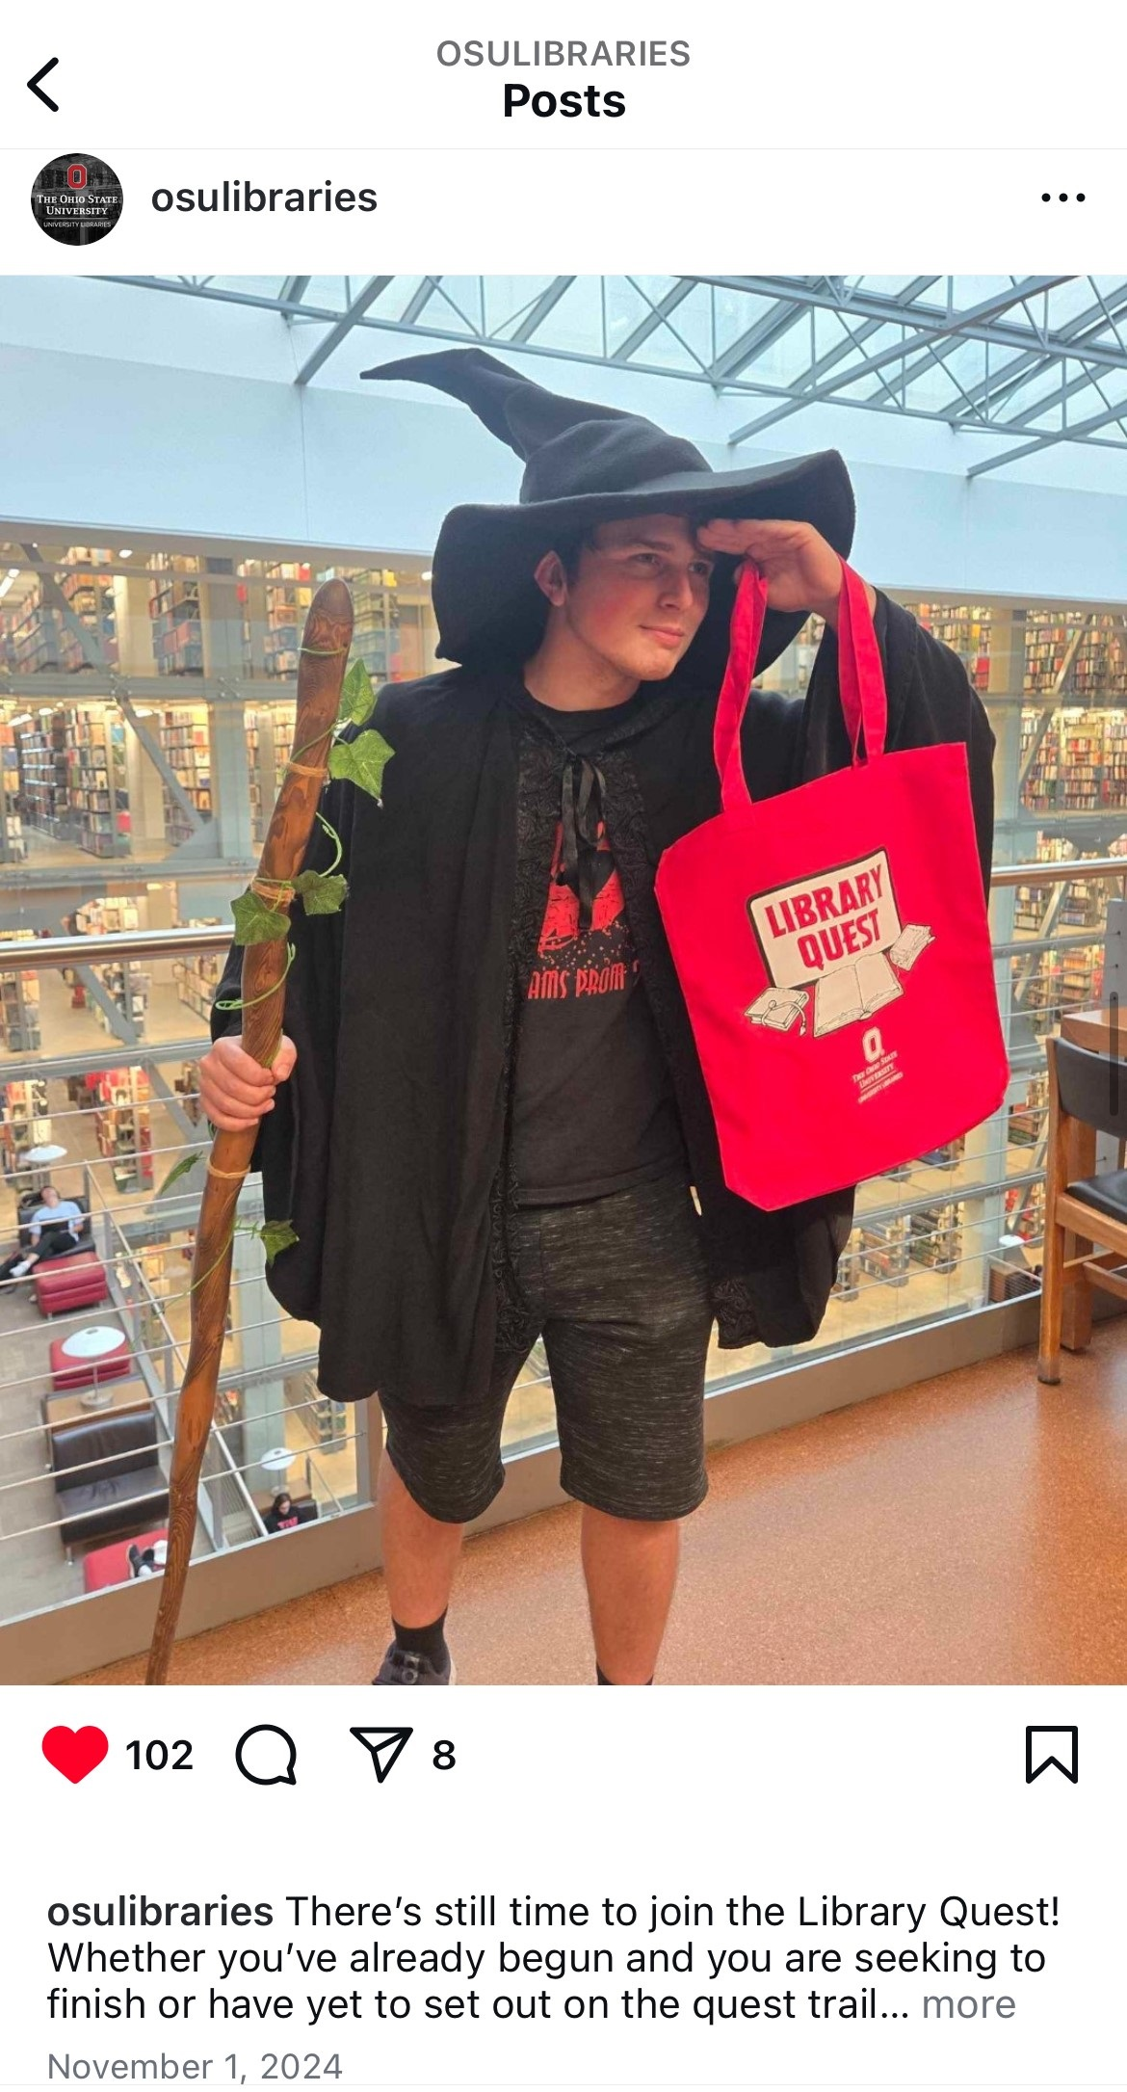
Bringing the Party Together
Stephanie and Angel
From a Library Lens
Self-directed (scalable)
Gamification
Hanna
Program automation
Data Collection
Library Marketing
Logo and badges
Promoting to students
Prizes
Notes:
Hanna

Slide 13
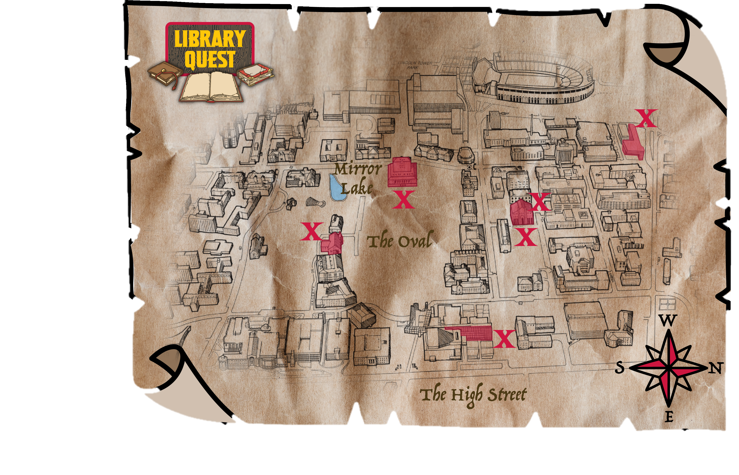
The Quest
Notes:
Hanna

Slide 14
Mastering the Dungeon
Scan QR code at each location to collect a badge.
Collect all six badges
Student participants visit Library locations individually, or as a group
Collect your loot!
Notes:
Hanna

Slide 15
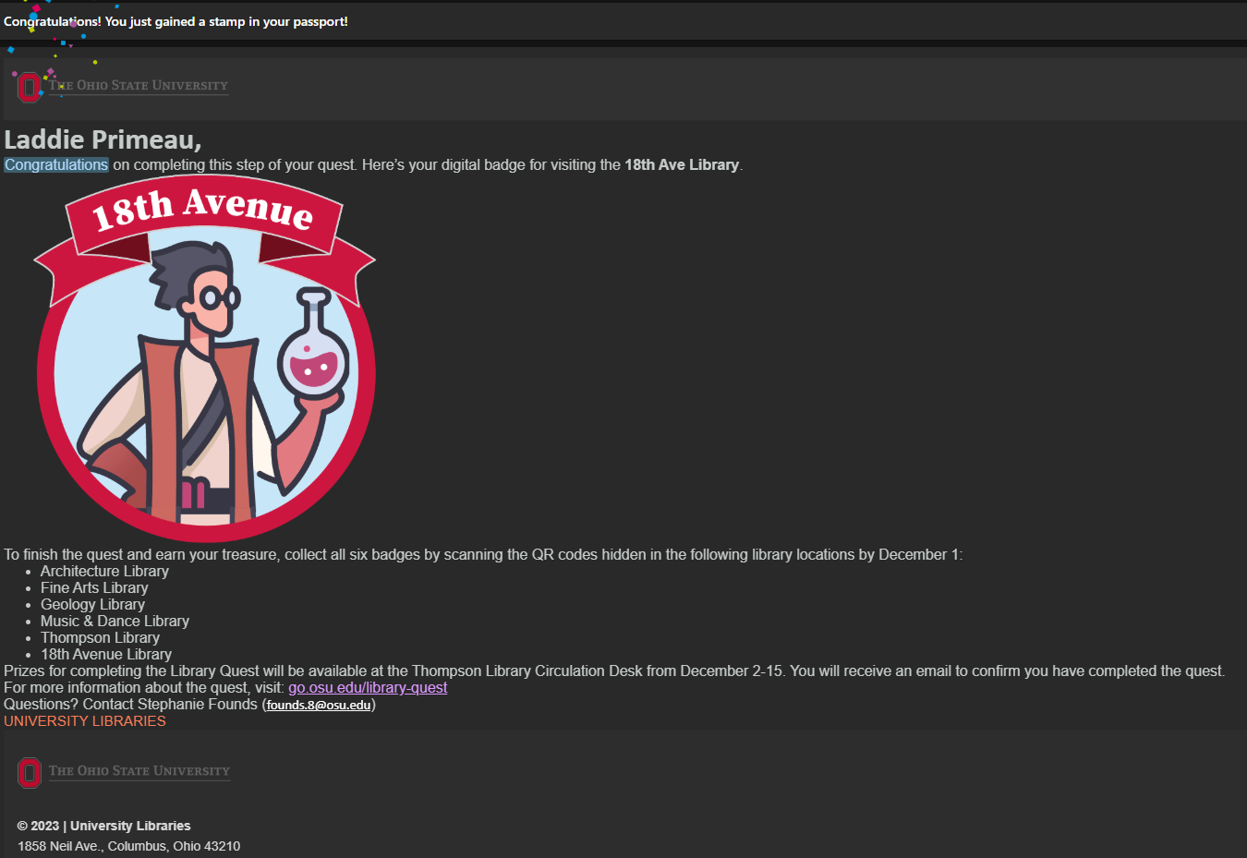
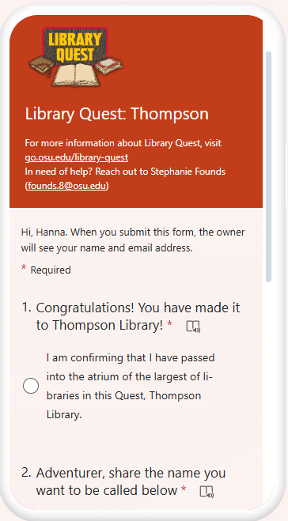
How does it work?
Student finds location
Power Automate takes over
QR Code Scans
Directed to Microsoft Forms
Their name is cross refferenced from the master excel sheet.
If their name exists, they get a check box for their new destination, if it doesn’t a new entry is made
Seeks out sign with QR code
A confirmation E-mail shows up in their inbox
Notes:
Hanna

Slide 16
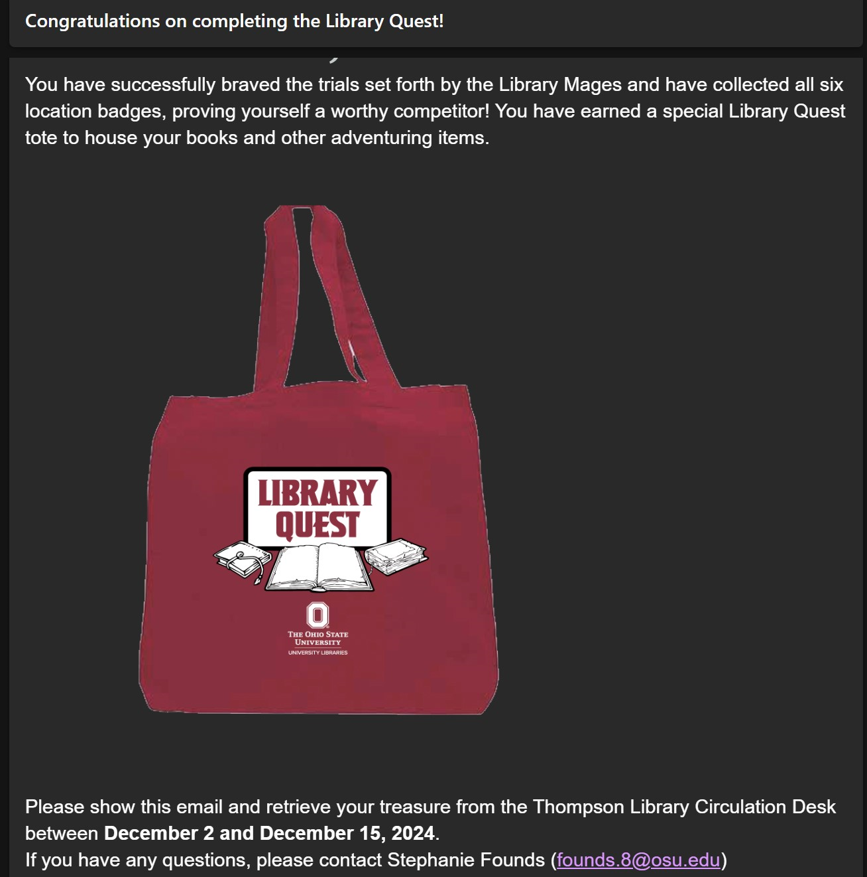
How does it work?
Repeat 5X
Show up to retrieve prize
A power automate checks the excel sheet for completion of previous locations; Highlights in Green when all are completed
Their name is cross referenced from the master excel sheet
A congratulatory completion email shows up in their inbox
Prize acquired!
Notes:
HANNA

Slide 17
Microsoft Connections
Power Automate
If this; Then that
IF Triggers can be from any type of Microsoft tool
Forms
Excel
Can read,transform and apply information from forms
Can input from forms, can double check data from excel
Outlook
Can send emails from personal or generic email, with input from other Microsoft tools, such as forms
Notes:
HANNA

Slide 18
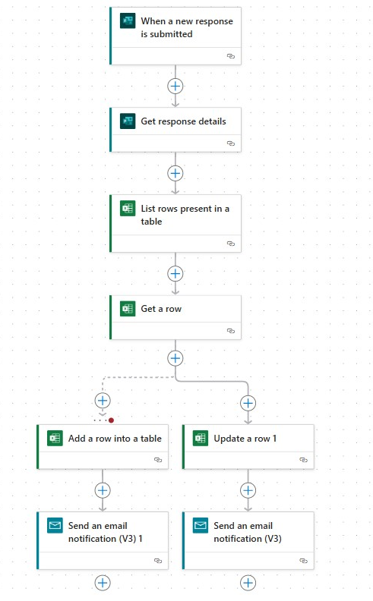
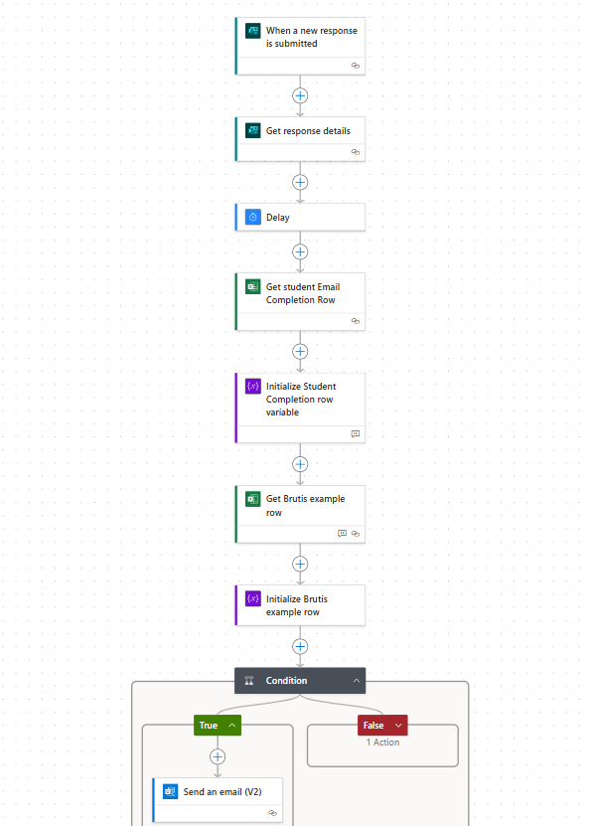
AT THE SAME TIME
Notes:
HAANNA
One set of each of these for each location

Slide 19
03
Brain Breaks
Notes:
Stephanie

Slide 20
How giving our brains a break helps
Pre-frontal cortex
Taking a break allows us to
The PFC is involved when doing tasks that involve
Logic
Willpower
Executive functioning
Important and tiring stuff!
Improve physical and emotional health (movement breaks)
Prevent “decision fatigue”
Restore motivation
Increase productivity and creativity
Consolidate memories and improve learning
Source: Psychology Today

Slide 21
Overview
Same day, same time each week
Different activities each week
Drop-in, no registration
Goals:
Meet students where they are
Connect with students in person
Reduce library anxiety and provide a space to decompress from studying and coursework

Slide 22
Activity Categories
Connections
Board and card games
Book chat and teatime
Lunch with a librarian
Cookie decorating and hot chocolate
Creativity
Coloring
Puzzles
Crafting (fiber arts)
Painting flowerpots
Origami
Making bookmarks
Create a cryptid
Making kindness cards
Rock painting
Mindfulness
VR mindfulness games
Counseling and Consultation Services visit
Mindfulness games and activities

Slide 23
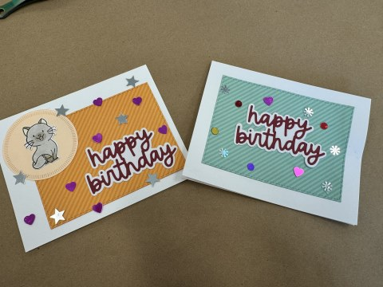
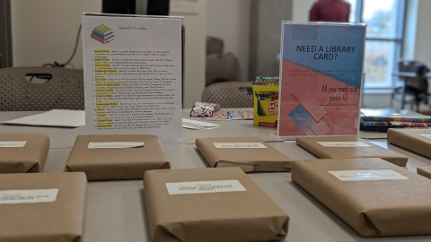
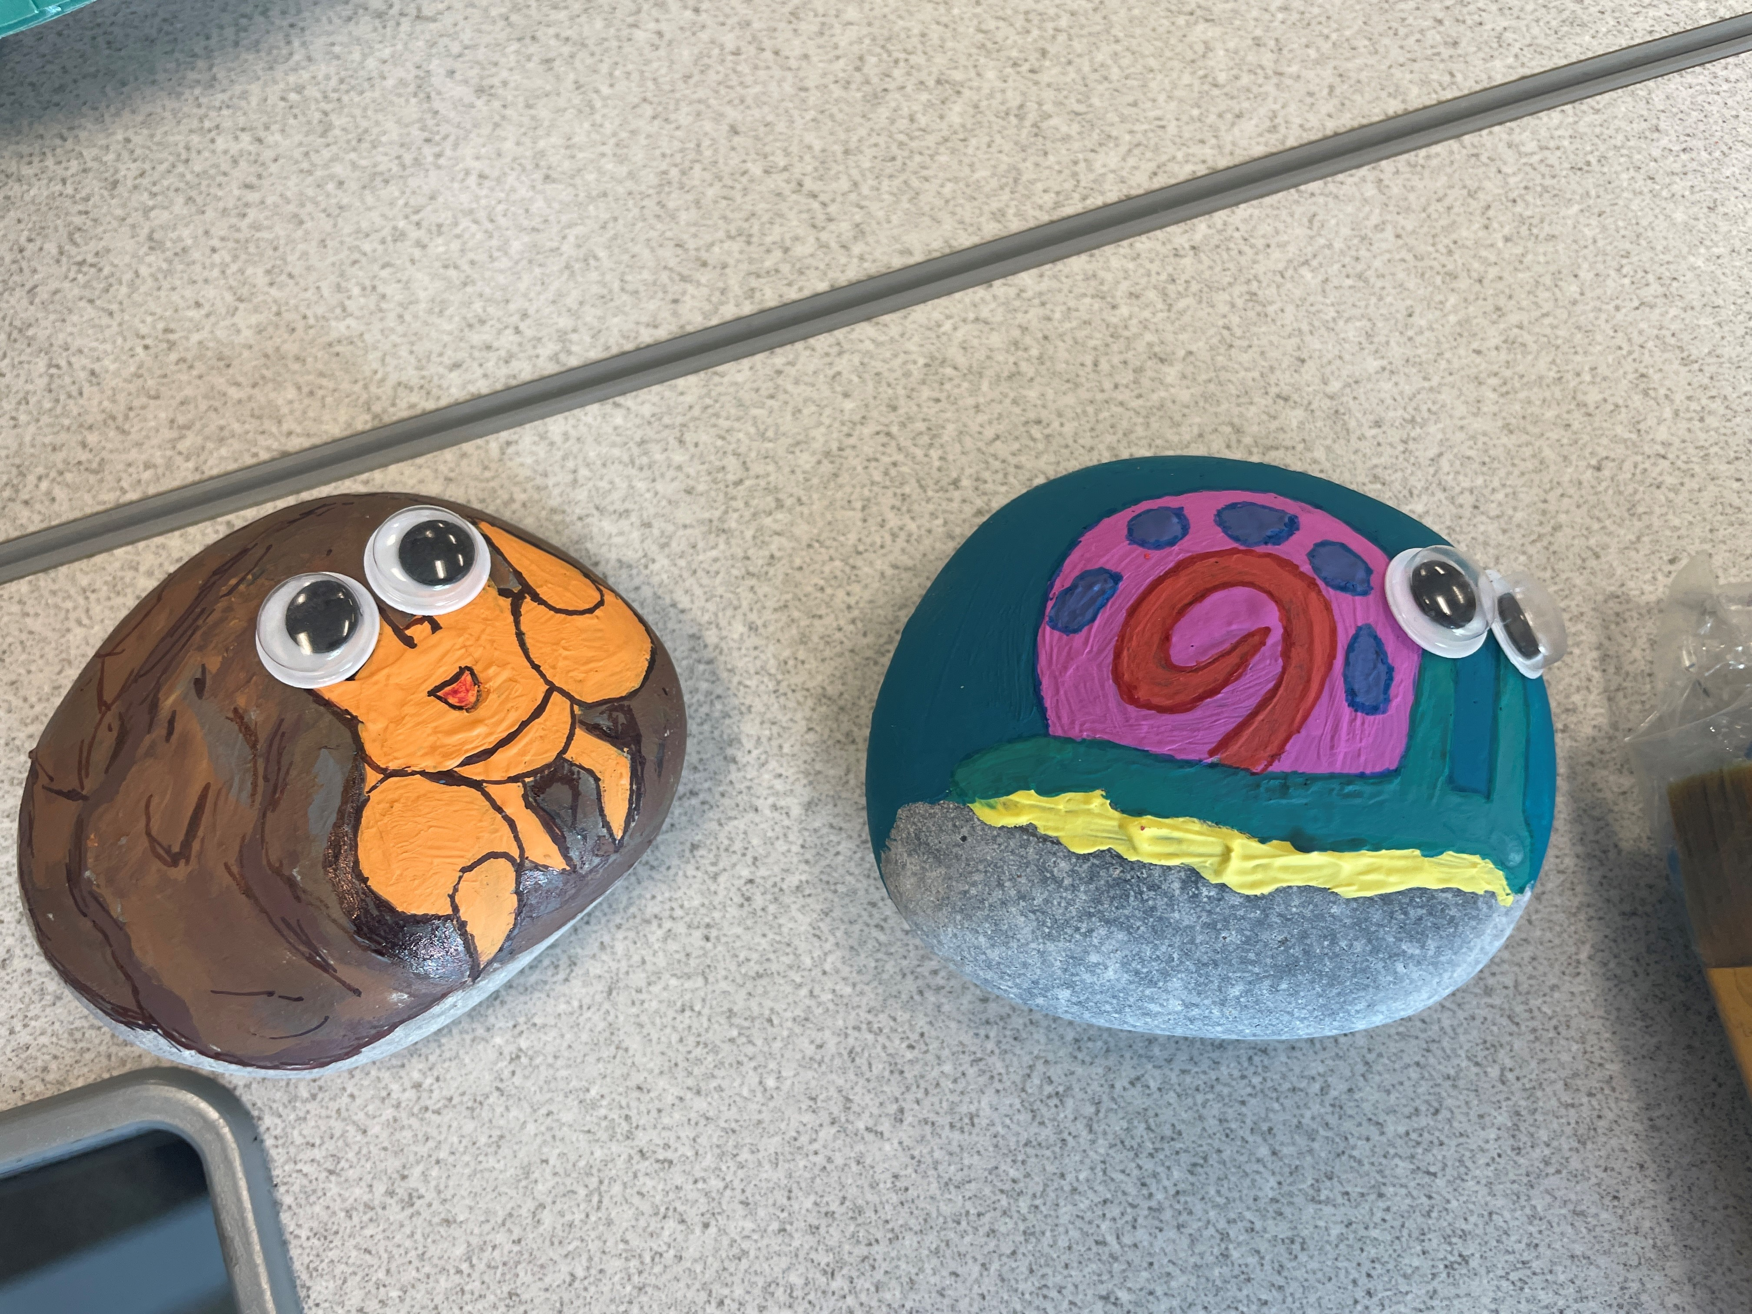
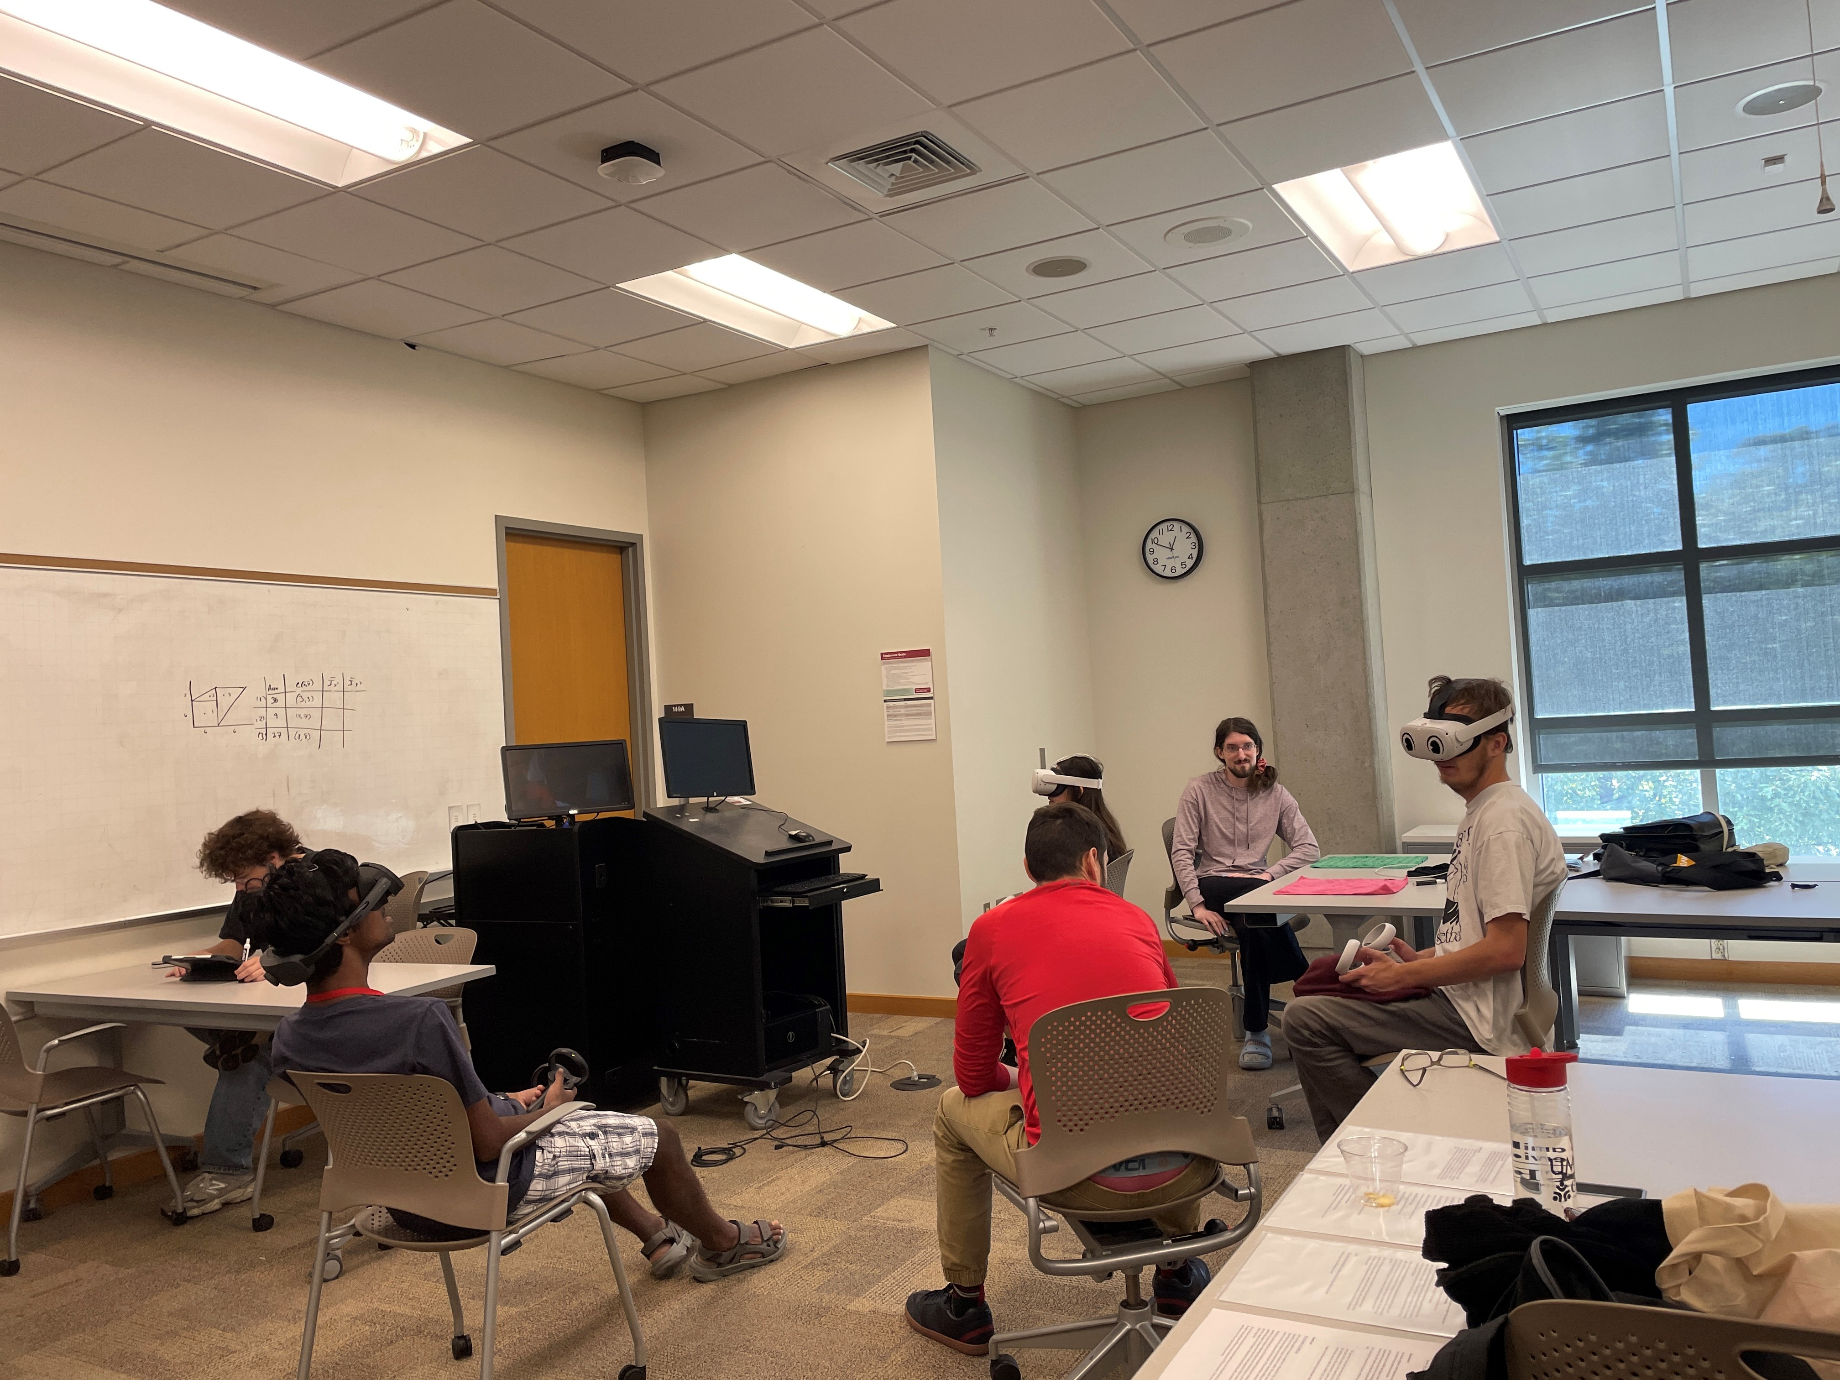
Photos
Notes:
Chris

Slide 24
Buckeye Paws

Slide 25
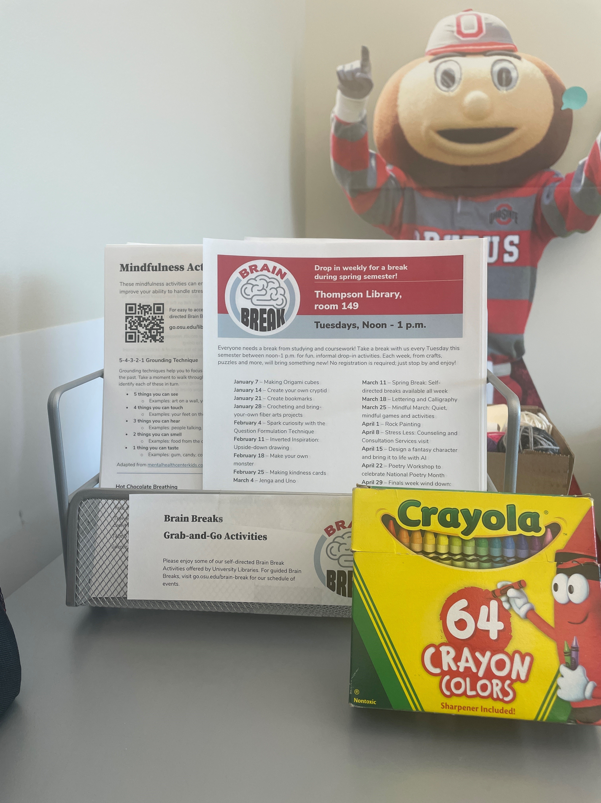
Grab-and-Go Activities
Piloted during Spring Break this semester
Coloring
Mindfulness
Music (ambient, study, meditative)
Puzzles (word, number)
Intended to reach students unable to join for guided breaks

Slide 26
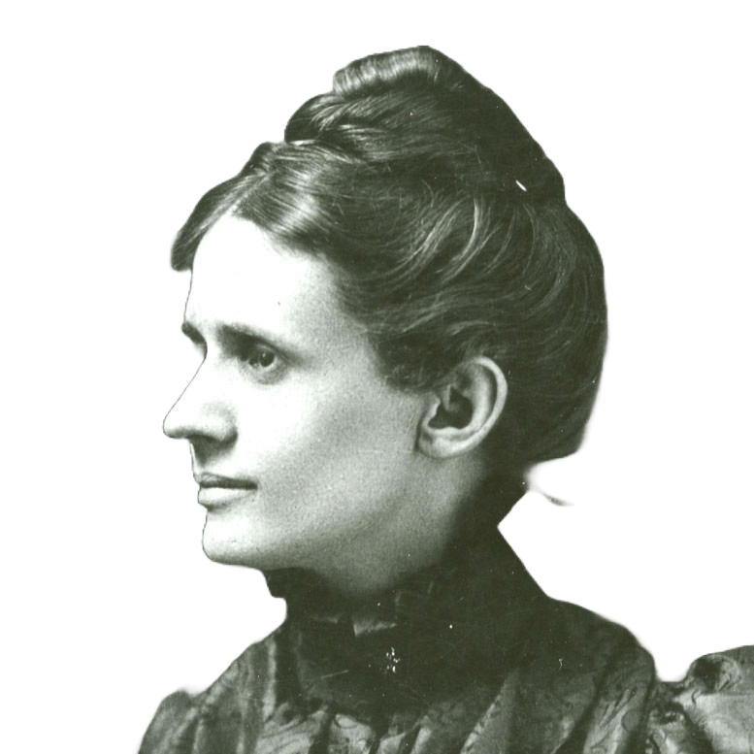
Repurpose and Adapt
You don’t need to reinvent the wheel.
Get creative with resources you already have.
Adapt materials you have created or repurpose them for something new.
What do your spaces look like?
Notes:
Chris

Slide 27
04
Takeaways
Notes:
Stephanie

Slide 28
Comments
"I loved finding all the libraries. I had no idea so many are on campus!”
“I had never been to most of the libraries so it was nice to have a reason to check them out.”
"This was pretty fun! I dressed up as an adventuring party with my friends and roamed the campus to find these!”

Slide 29
Future Directions
Library Quest
Brain Breaks
Increase the challenge!
Add new locations
Update prize or create prize tiers
Incorporate into Honors and Scholars Seminars courses
Expand options for self-directed (asynchronous) breaks
Better promotion
More student involvement

Slide 30
Our Takeaways
Use what you have
People, digital tools, partners
Dynamic and diverse team
Be flexible
Trying something new will mean trial and error
Student involvement
Bring students into the process when possible
Quality over Quantity
Balance programs for high touch and high volume

Slide 31
THANKS!
DO YOU HAVE ANY QUESTIONS?
Contact us:
Stephanie Founds.8@osu.edu
Hanna Primeau.8@osu.edu
Angel Gondek.7@osu.edu
Chris Seifert.148@osu.edu
Please keep this slide for attribution

