Slide 1
Activity: Impact Mapping
To visualize the impact of different project ideas; To create a shared mental model of project prioritizations.

Slide 2
Impact Mapping
Description
We will choose project ideas from our earlier activity to place on a collaboratively build scale, then place items on this scale to determine feasibility. This will allow us to see what project(s) to move forward with.

Slide 3
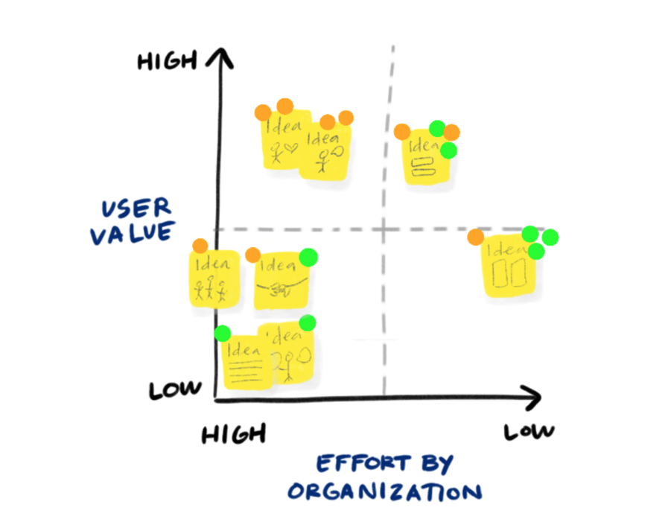

Slide 4
Impact Mapping Instructions
Agree on project ideas (based on earlier discussion)
Develop scale and criteria for map
Silently vote on project ideas
Collaboratively place ideas onto map for discussion.
Discussion

Slide 5
Selecting Project Ideas
Project 1
Project 2
Project 3
Project 4
Project 5
Project 6

Slide 6
Developing Scale & Criteria
Scale
Low to High
Numbers
Yes, No, Maybe
Criteria
Value to Online Students
Effort
Feasibility
Cost

Slide 7
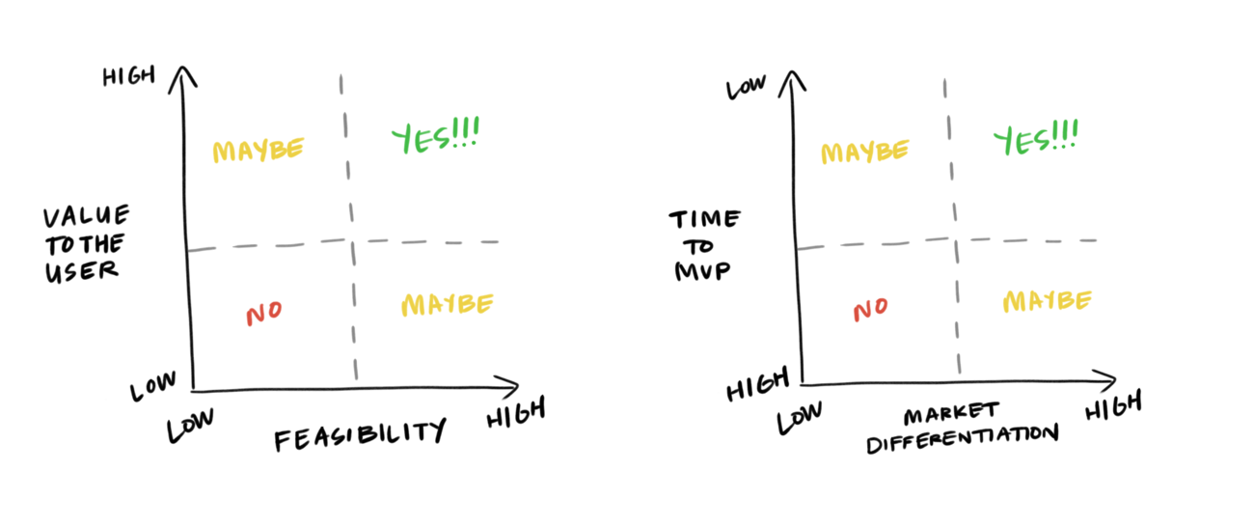
Developing Scale & Criteria

Slide 8
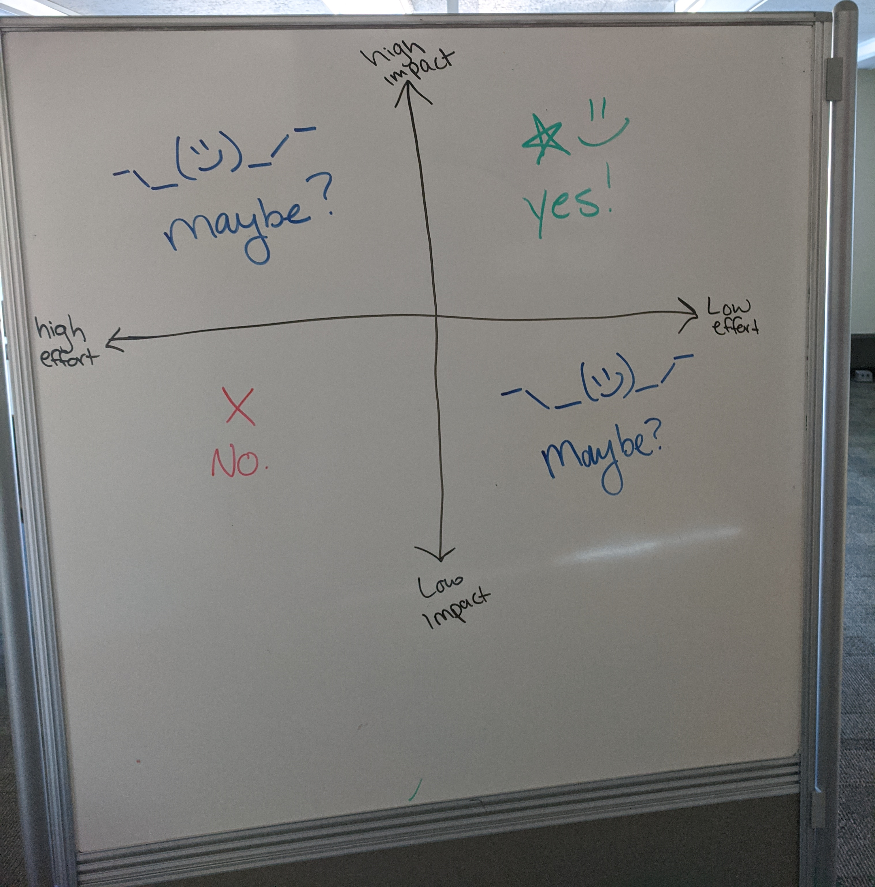
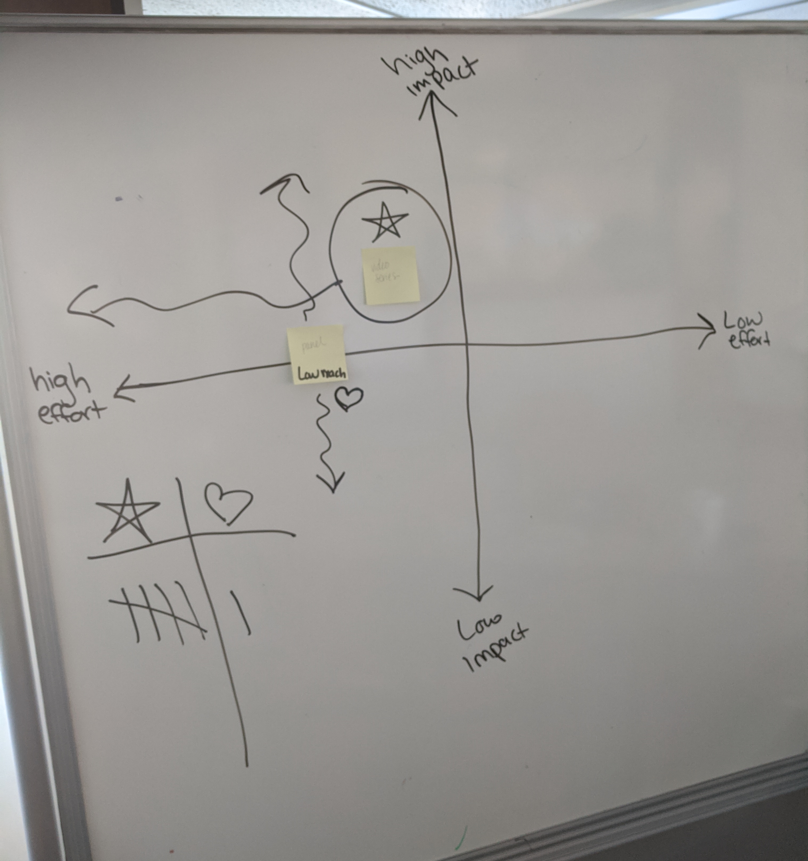

Slide 9
High
Criteria: Value to Online Student
Low
High
Criteria: Effort/Feasibility
Low

Slide 10
Discussion
What does this map show us about our ideas?
Do we agree with the ideas that ended up at the ends of the scales? Why did they end up there?
Based on your level of excitement/interest and the impact/effort scale, which project would you like to move forward on for development?

