Slide 1
VoxLens: Making Geospatial Data Visualizations Accessible to
Blind and Low-Vision Users
Ather Sharif

Slide 2

Hi, I’m Ather (he/him)
Ph.D. Candidate at the University of Washington (CSE) (Committee: Jacob Wobbrock [Chair], Jeffrey Heer, Richard Ladner, Joanne Woaik)
Research focus: Accessibility, Visualization, Personalization (Broadly Human-Computer Interaction)

Slide 3
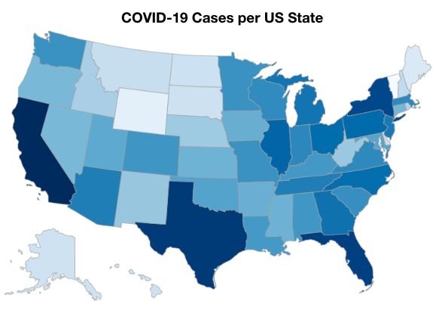

Slide 4
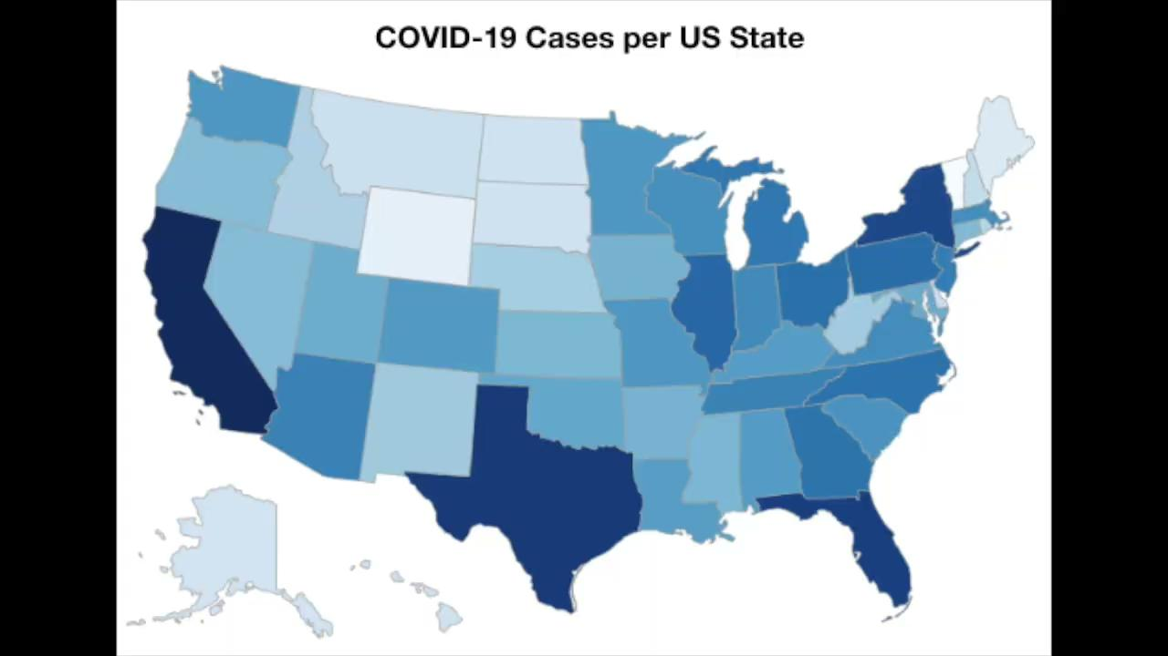

Slide 5
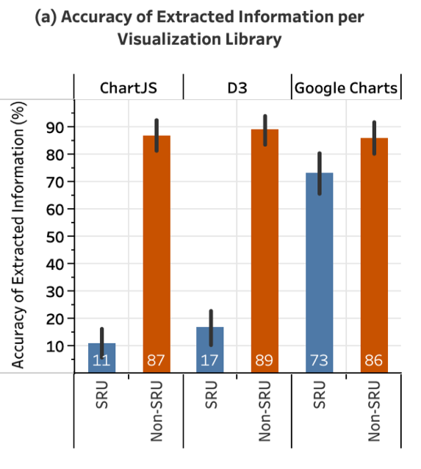
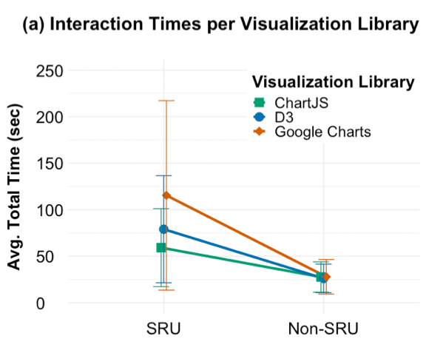
Due to the inaccessibility of online data visualizations, screen-reader users extracted information 62% less accurately and spent 211% more time than non-screen-reader users.*
* Sharif, A., Chintalapati, S. S., Wobbrock, J. O., & Reinecke, K. (2021, October). Understanding screen-reader users’ experiences with online data visualizations. In Proceedings of the 23rd International ACM SIGACCESS Conference on Computers and Accessibility (pp. 1-16).

Slide 6
Is this acceptable?
Clearly, the answer is no.

Slide 7
Common Practice: Alternative Text

Slide 8
Is alt-text sufficient?

Slide 9
VoxLens: Making Online Data Visualizations Accessible with an Interactive JavaScript Plug-In* † ‡
* Sharif, A., Wang, O. H., Muongchan, A. T., Reinecke, K., & Wobbrock, J. O. (2022, April). VoxLens: Making online data visualizations accessible with an interactive JavaScript plug-in. In Proceedings of the 2022 CHI conference on human factors in computing systems (pp. 1-19).
† Sharif, A., Zhang, A. M., Reinecke, K., & Wobbrock, J. O. (2023, April). Understanding and Improving Drilled-Down Information Extraction from Online Data Visualizations for Screen-Reader Users. In Proceedings of the 20th International Web for All Conference (pp. 18-31).
‡ Sharif, A., Zhong, R., & Wang, Y. (2023, October). Conveying Uncertainty in Data Visualizations to Screen-Reader Users Through Non-Visual Means. In Proceedings of the 25th International ACM SIGACCESS Conference on Computers and Accessibility (pp. 1-6).

Slide 10
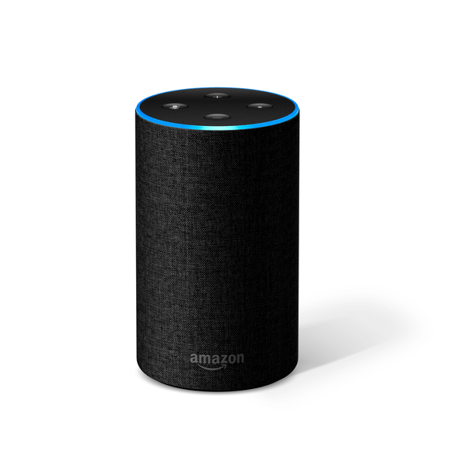
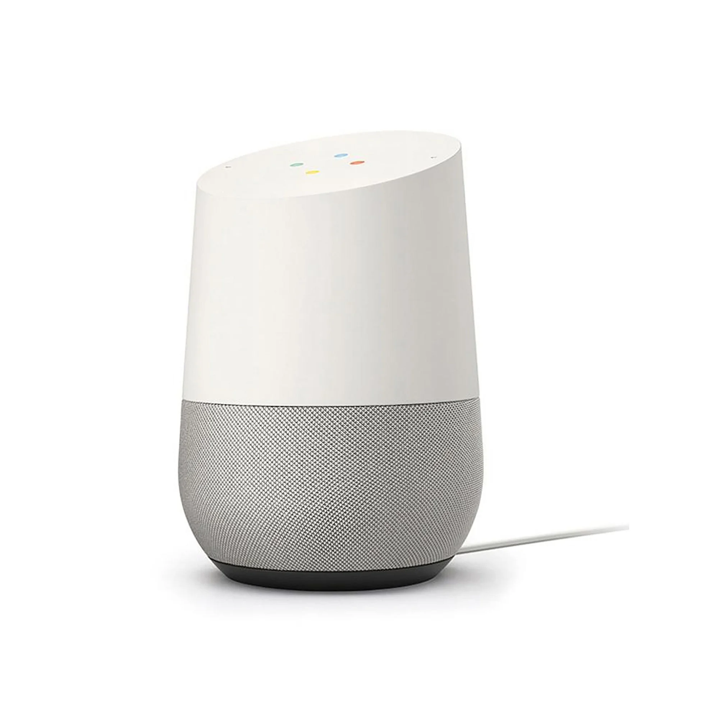


Slide 11
VoxLens is the first multimodal solution to enable blind and low-vision users to interact with and extract information from online data visualizations using voice-activated commands.

Slide 12


Slide 13
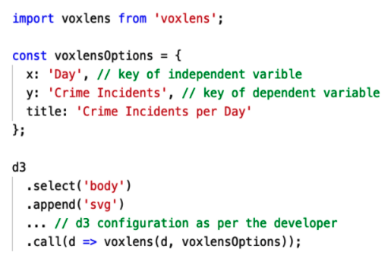
VoxLens only requires a single line of code for integration!

Slide 14
Key Results
62% less to 6% more
211% slower to 56% slower
Accuracy of extracted information compared to non-screen-reader users
Interaction times compared to non-screen-reader users

Slide 15
https://github.com/athersharif/voxlens

Slide 16
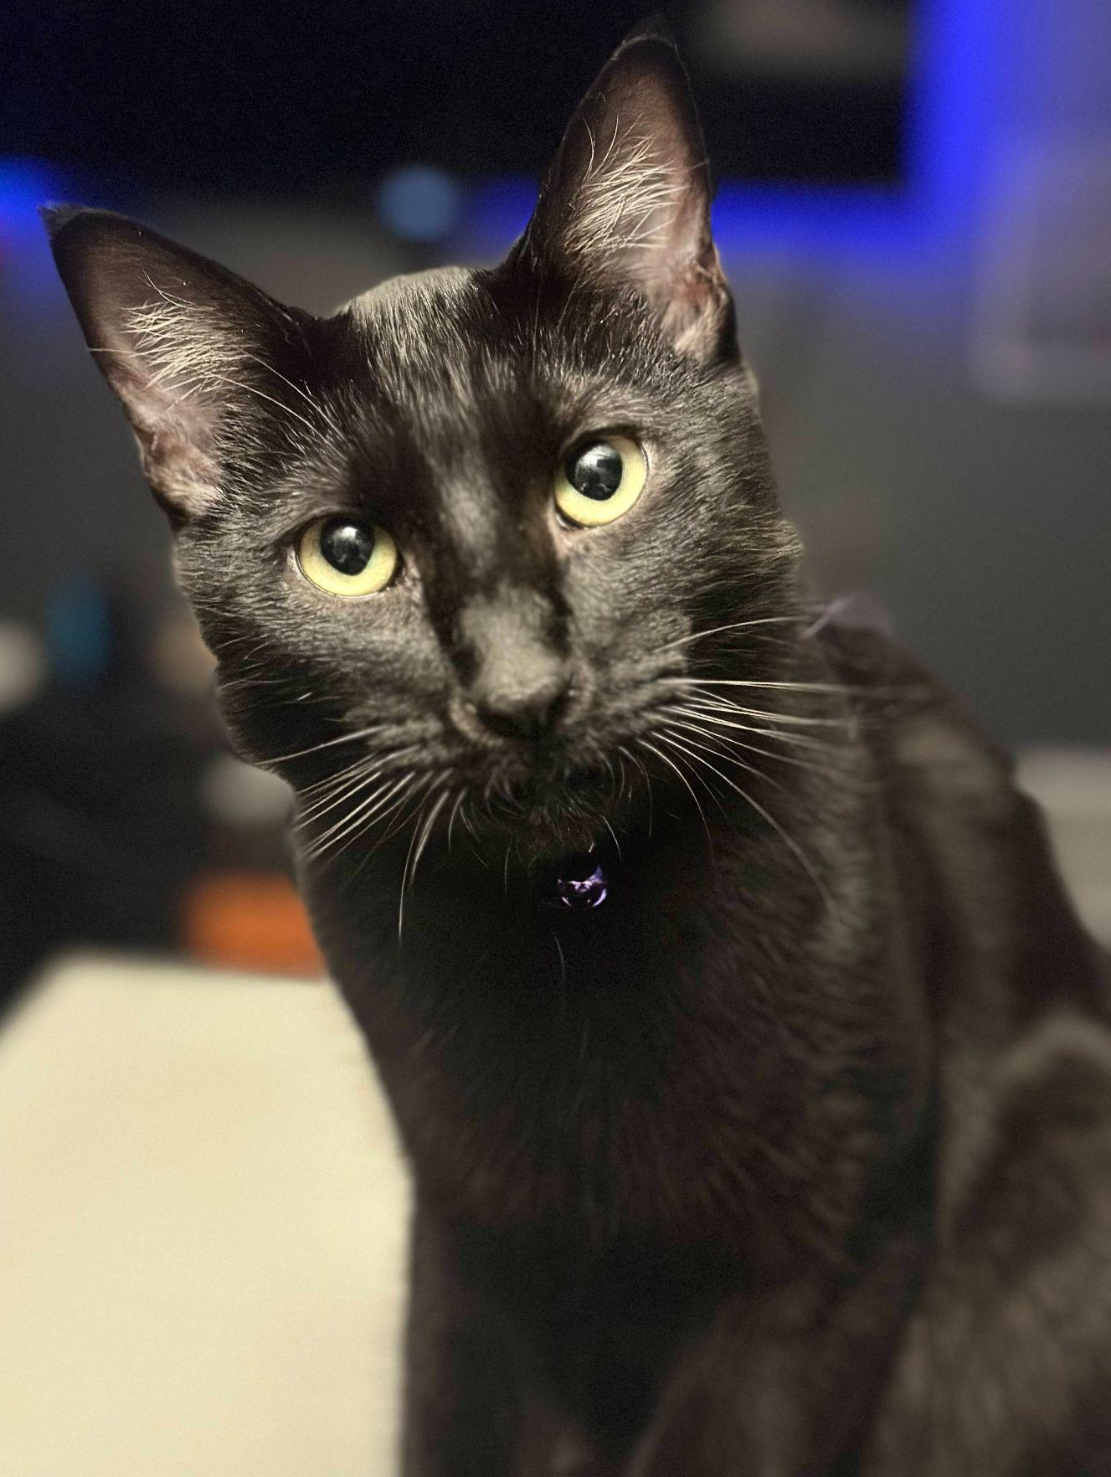

Thanks!
Do you have any questions?
ather@cs.washington.edu | athersharif.me

