Slide 1
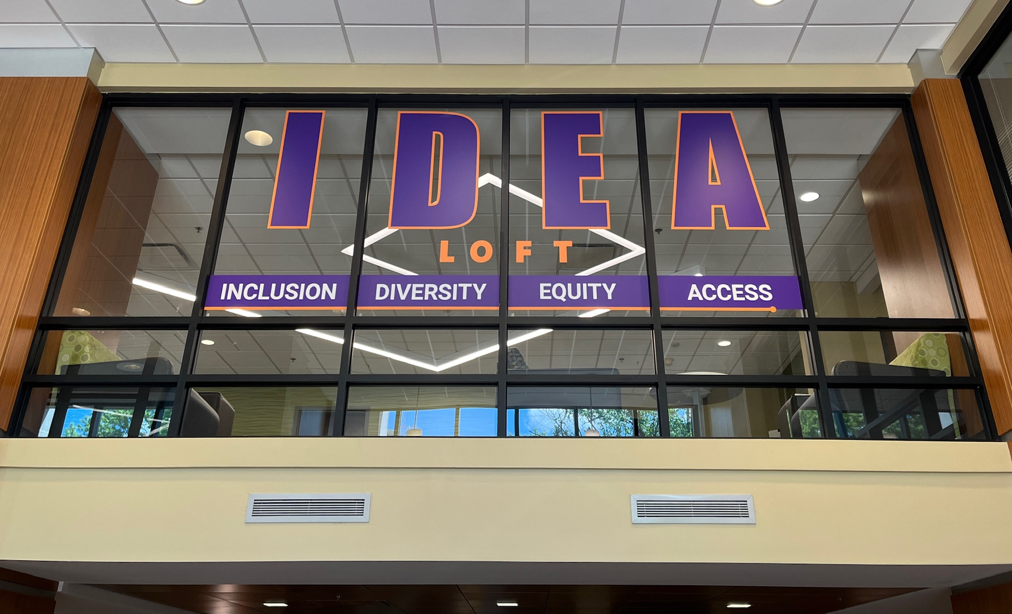
Kristen Strandberg, PhD Director of University Libraries University of Evansville
“The IDEA Loft: Establishing Browsable and Useful Resources for Diverse Student Needs”

Slide 2
Purpose:
The IDEA Loft provides hard copy books, magazines, pamphlets, and brochures for campus and community resources useful especially to students who are LGBTQ+, first generation, low income, international, and people of color, as well as those living with disabilities.

Slide 3
About us:
Private, non-profit
Liberal arts foundation; growing professional programs
Just over 2000 students, ¾ undergraduate

Slide 4
Demographic Identifier | % student body
Gender identity* | 61% female; 39% male
Race & Ethnicity | 71.5% White 8.2% International* 5.9% Hispanic/Latino 5.1% Black or African American 4.6% Two or more races 3.6% Asian 1.1% Unknown or other
Pell Eligible | 31.5%
First Generation Students | 19.7%
Utilizing Campus Disability Services | 12%

Slide 5
Goals | Furthers wellbeing by . . .
Designates the library as a safe, inclusive space | Fostering community and belonging
Provides resources directly useful to students | Establishing the library as a one-stop hub for seeking help
Demonstrates support for diversity initiatives across campus | Asserting that inclusivity and belonging important to us as a campus and are not confined to the DEI office.

Slide 6
Getting started
Books: existing collection and newly purchased
Featured collections rotate
Monthly themes include:
Resources for freshmen and first-generation students
Black History Month
Hispanic Heritage Month
Pride Month
Pamphlets for university and city-wide services
Title IX and regional domestic violence organization
Healthcare information
Academic support
Mental health resources

Slide 7
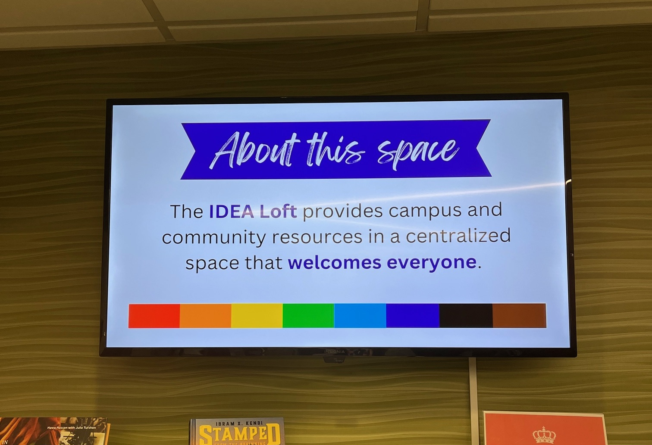
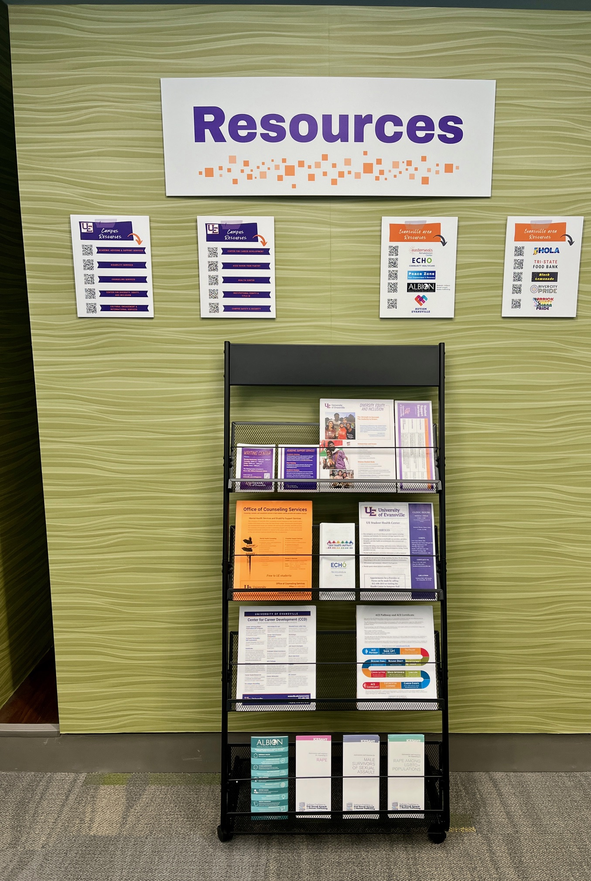
Initial funding
UE’s Center for Inclusive Excellence
$2000
Purchase of books, signage, pamphlet display, TV monitor

Slide 8
Further funding
Indiana Humanities
$1000 Advancing Racial Equity Collection Development Grant
Mix of fiction and non-fiction book titles

Slide 9
Usage and outcomes
Host events to increase awareness
Students often sit in the space to study or meet
Students and campus community members frequently browse the collection
Usage: books misplaced, brochures run low

Slide 10
Thank you!
Kristen Strandberg
ks532@evansville.edu

