Slide 1
Vision Card Activity

Slide 2
Vision cards in a variety of art styles and designs are on the next slides.
Take a look at the images and think about:
How or why you came to be in your program of study?
What are your career goals?
Where are you now in achieving your goals?
Select 2-3 images that resonate with you as a way to convey or describe your experience.
To select an image, click on the photo and copy it (Edit - Copy; CTRL+C; ⌘+C).
Paste it on your slide (Edit - Paste; CTRL+V; ⌘+V).
Resize the image on your slide so we can clearly see what you chose.
After a few minutes, we will take turns sharing our cards and what they represent for us.

Slide 3
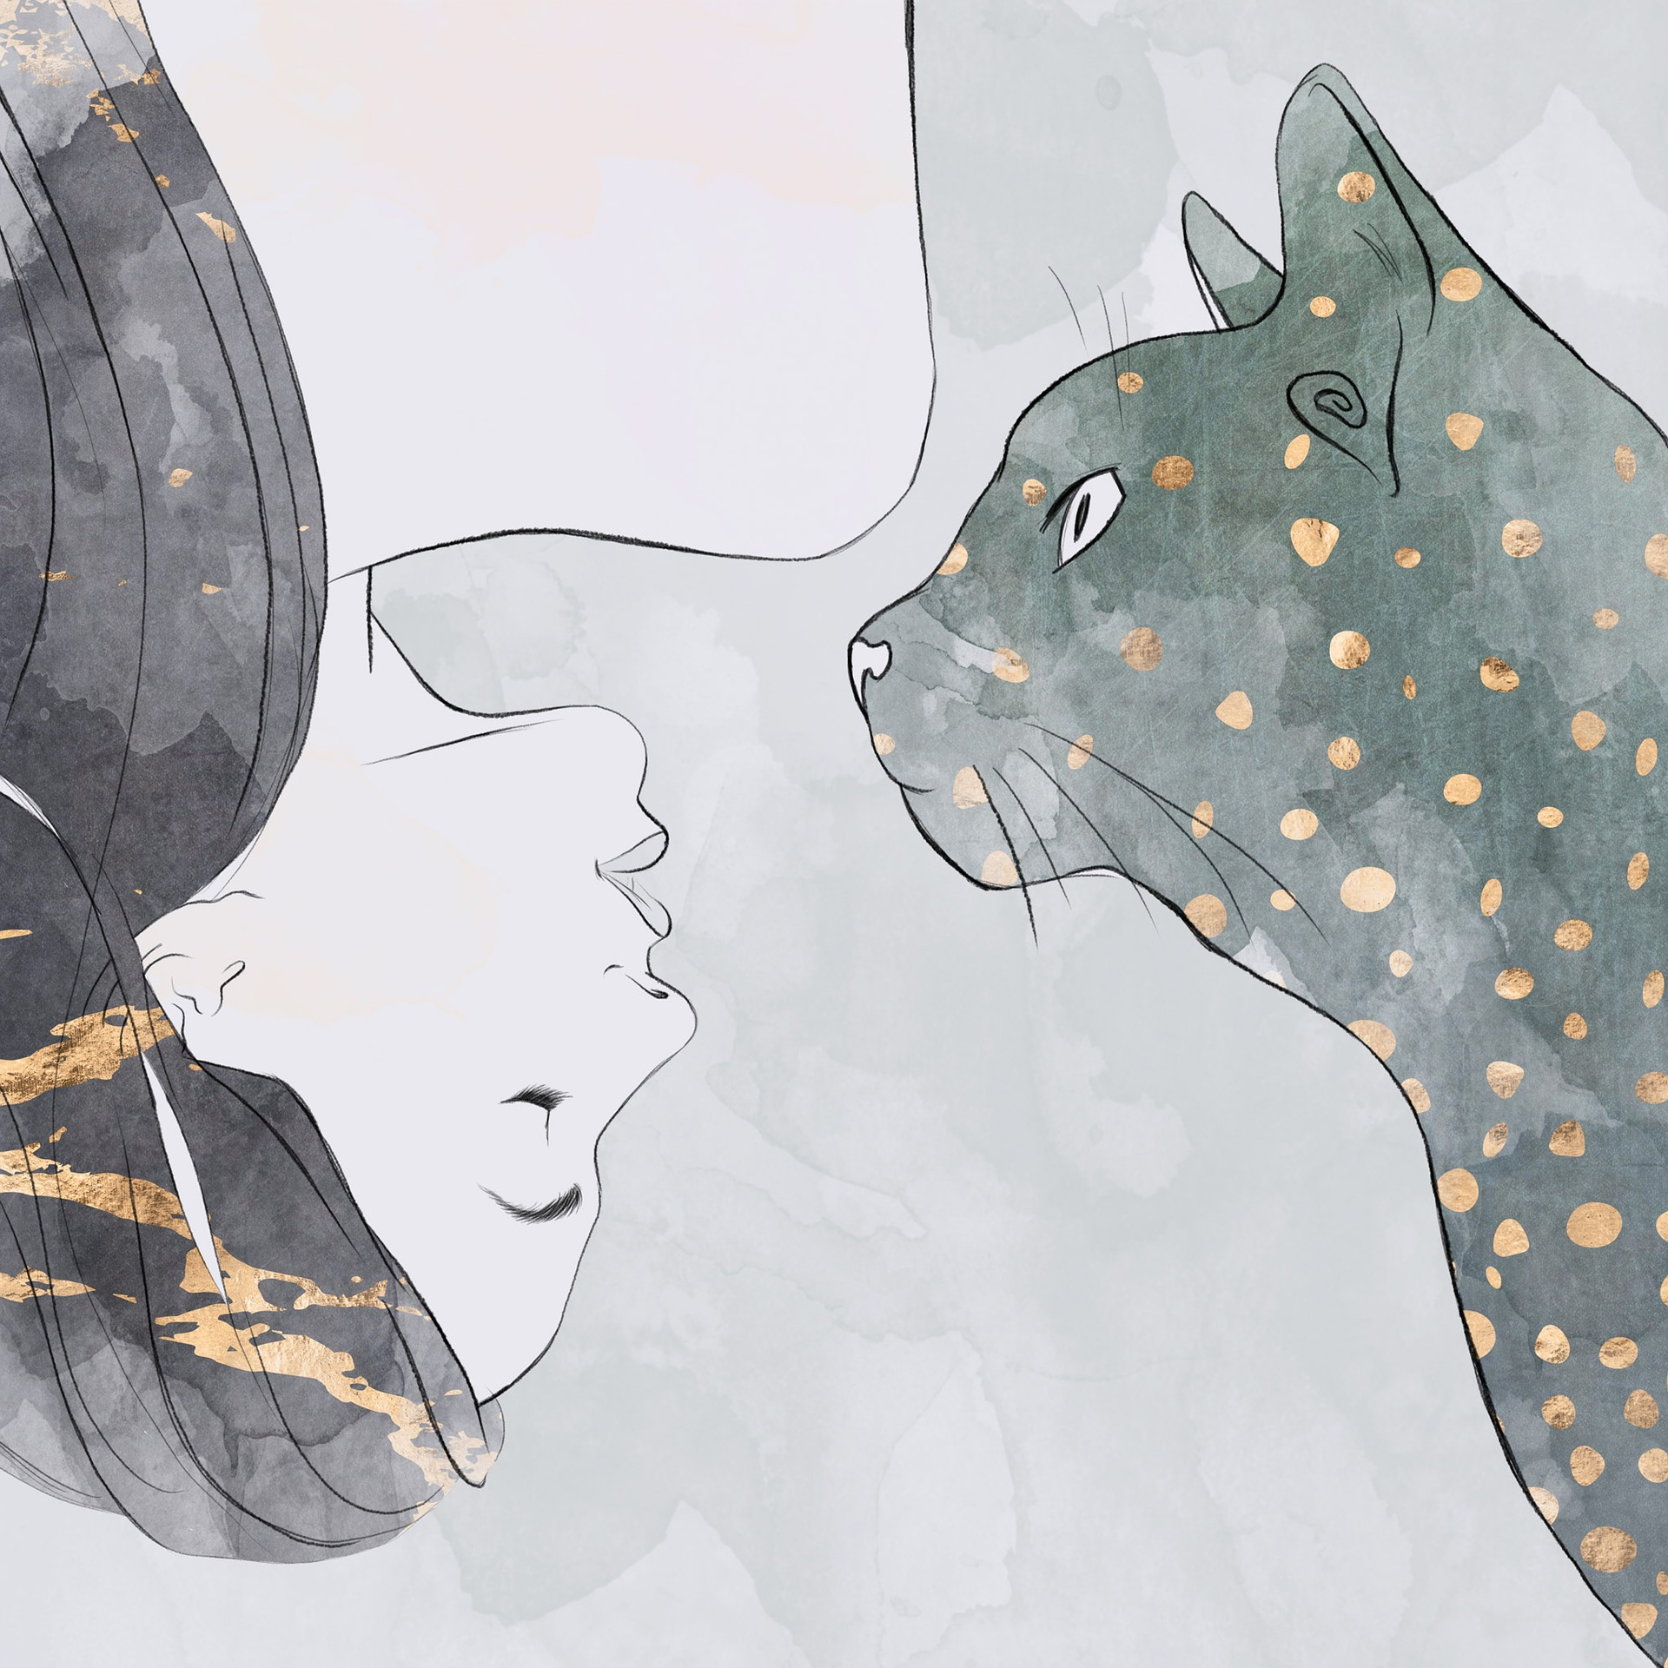
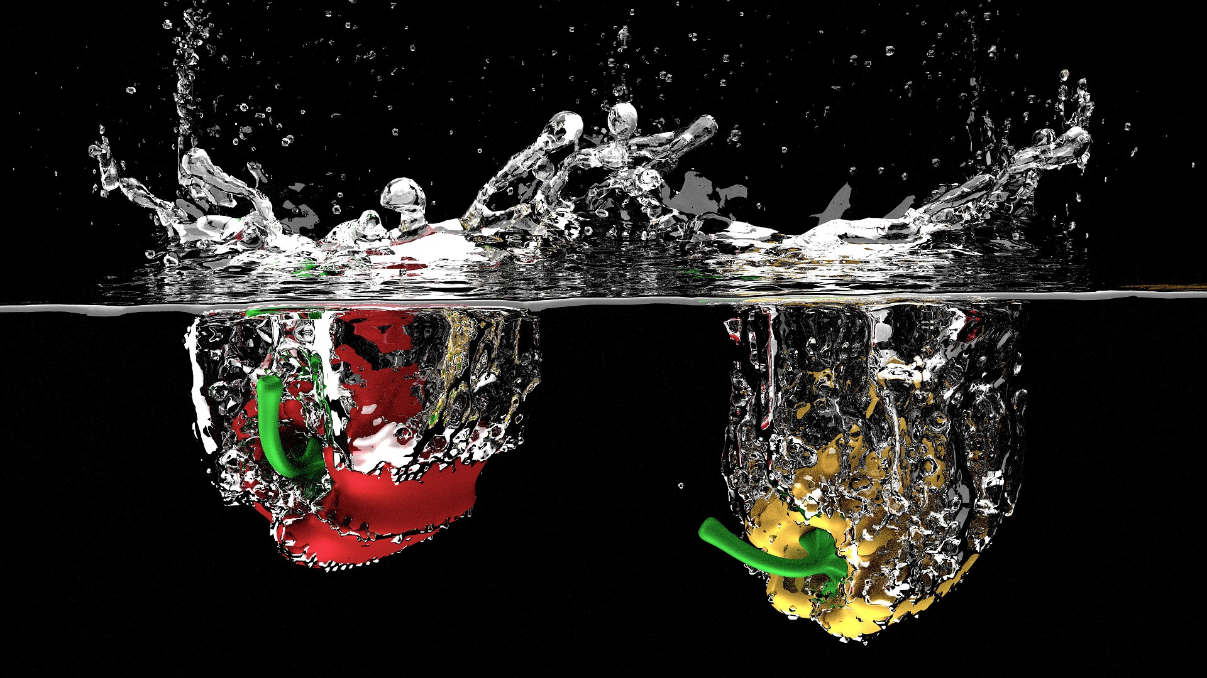
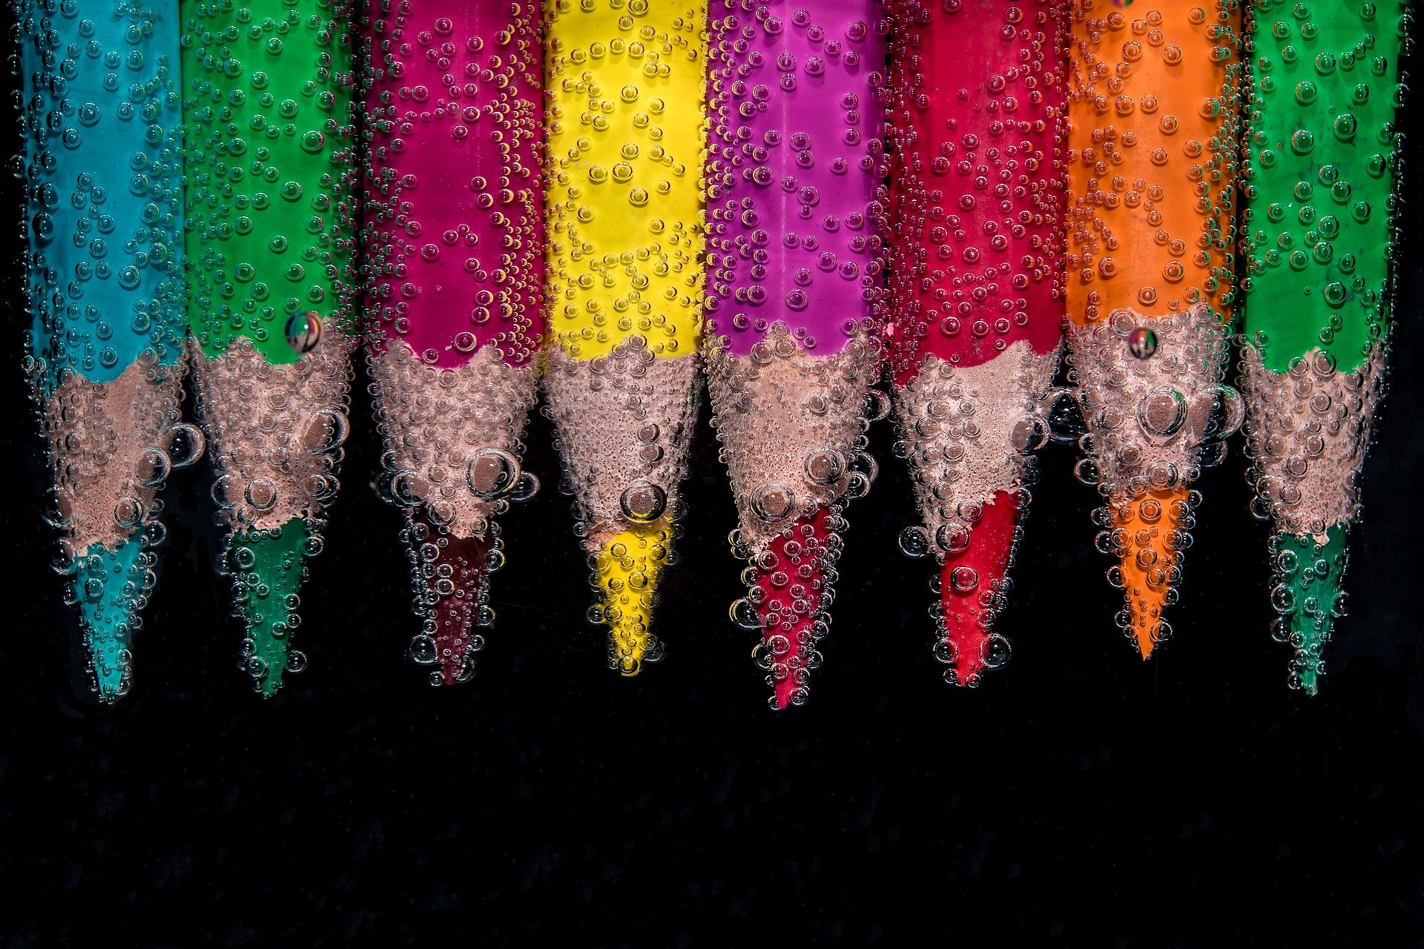

Slide 4
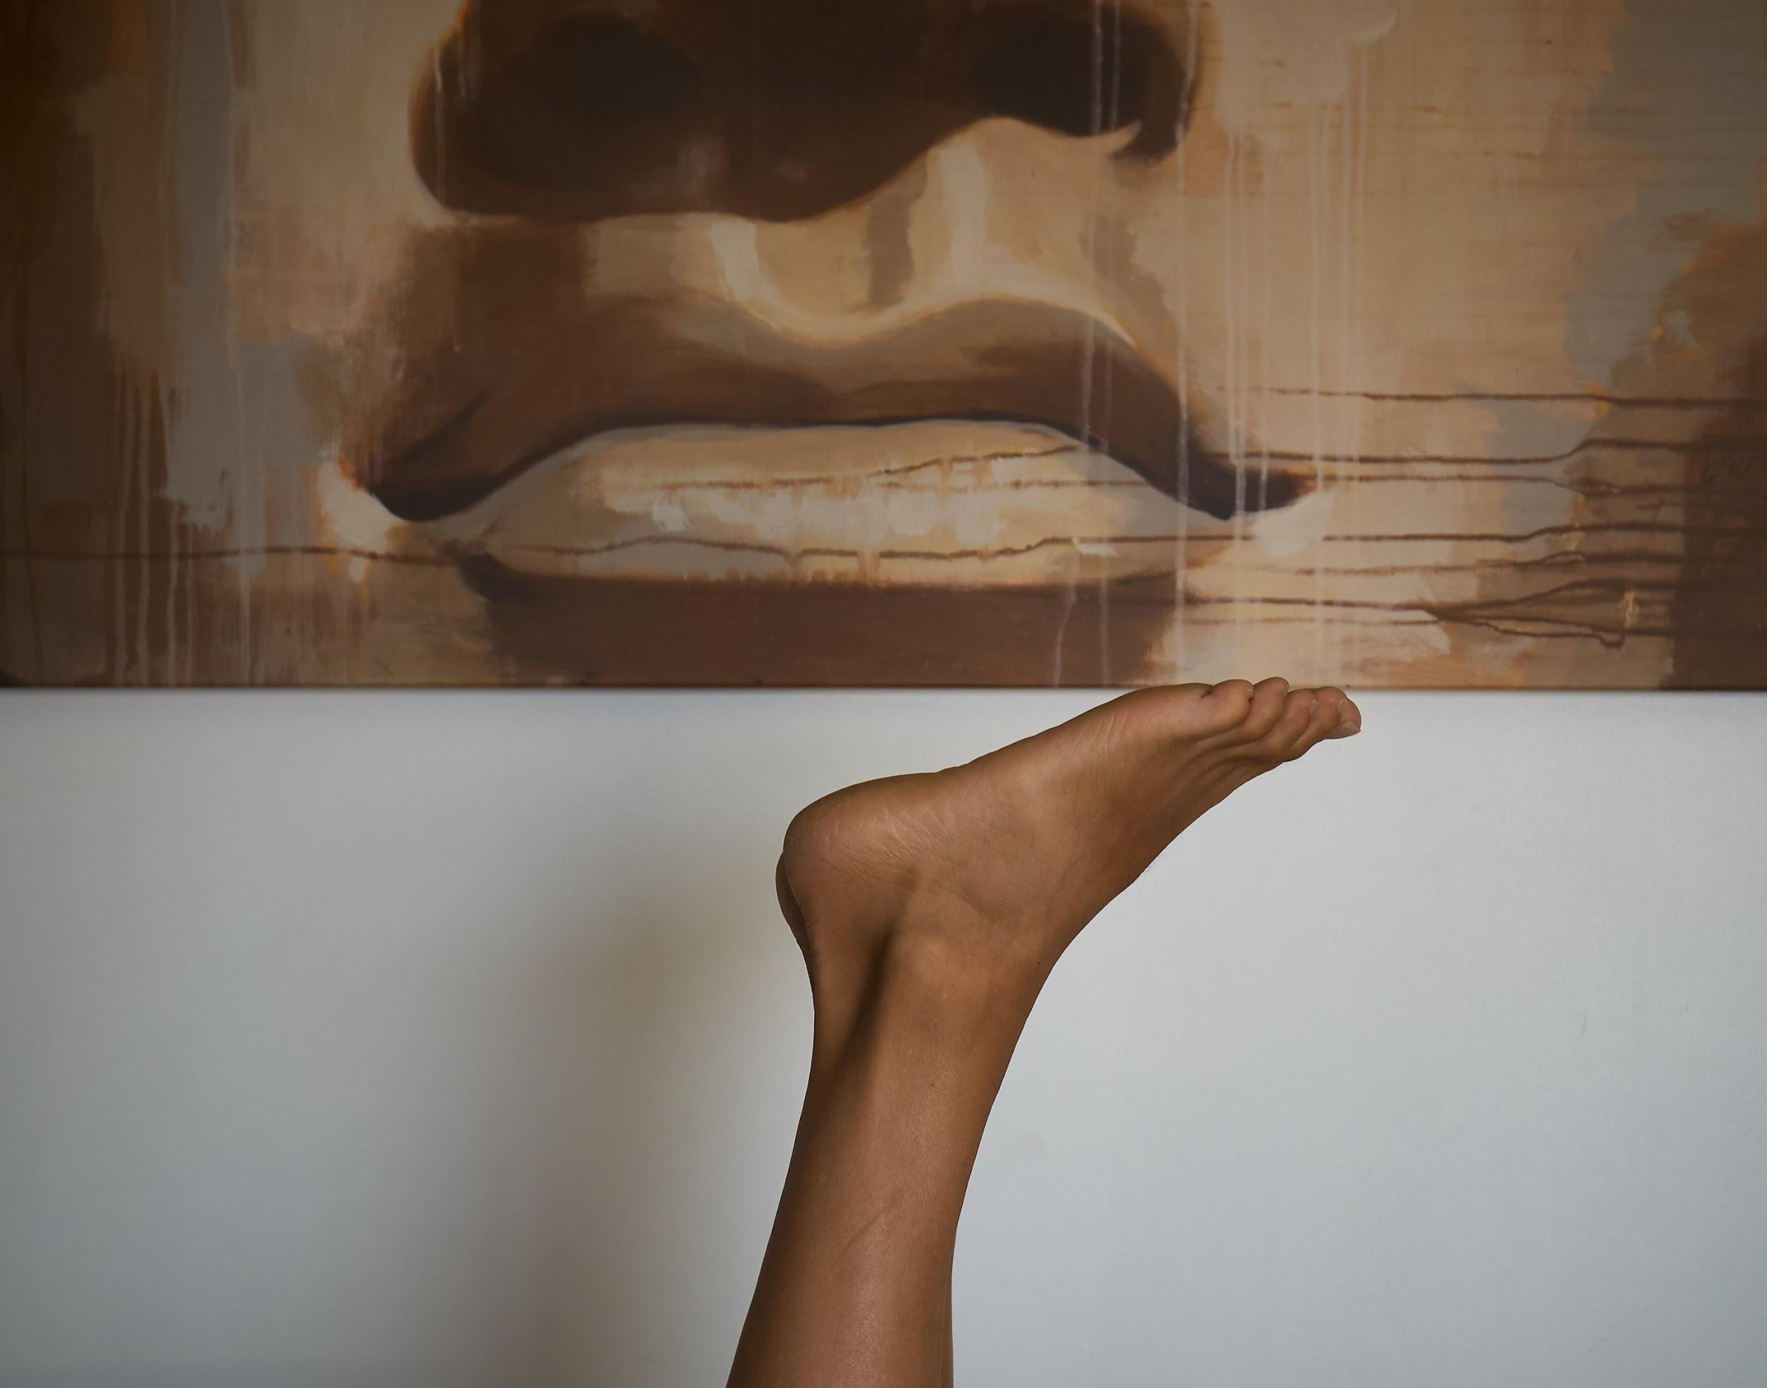
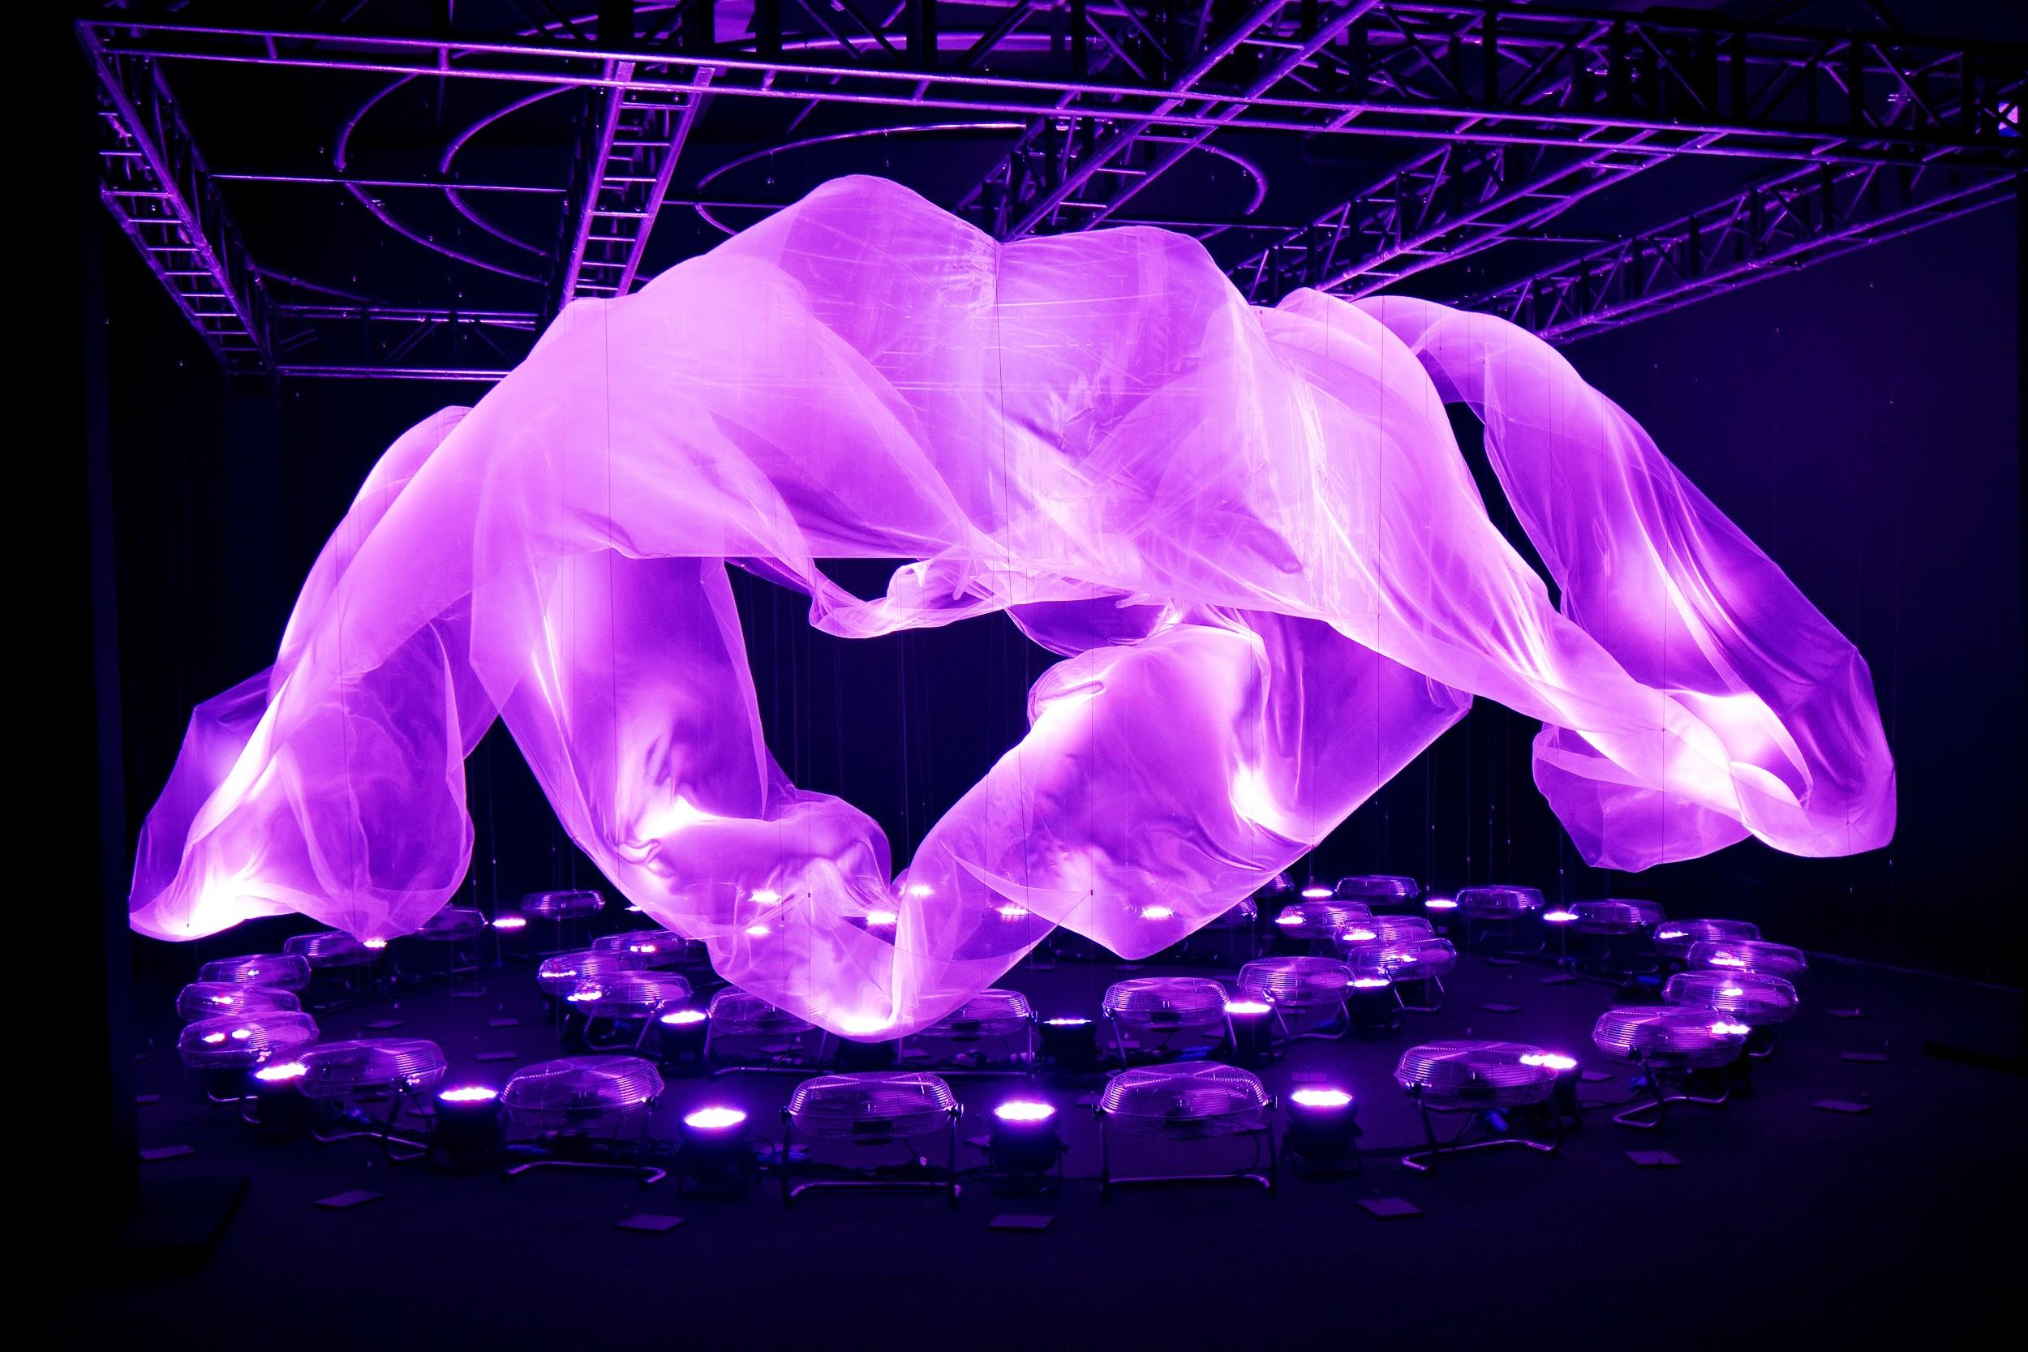
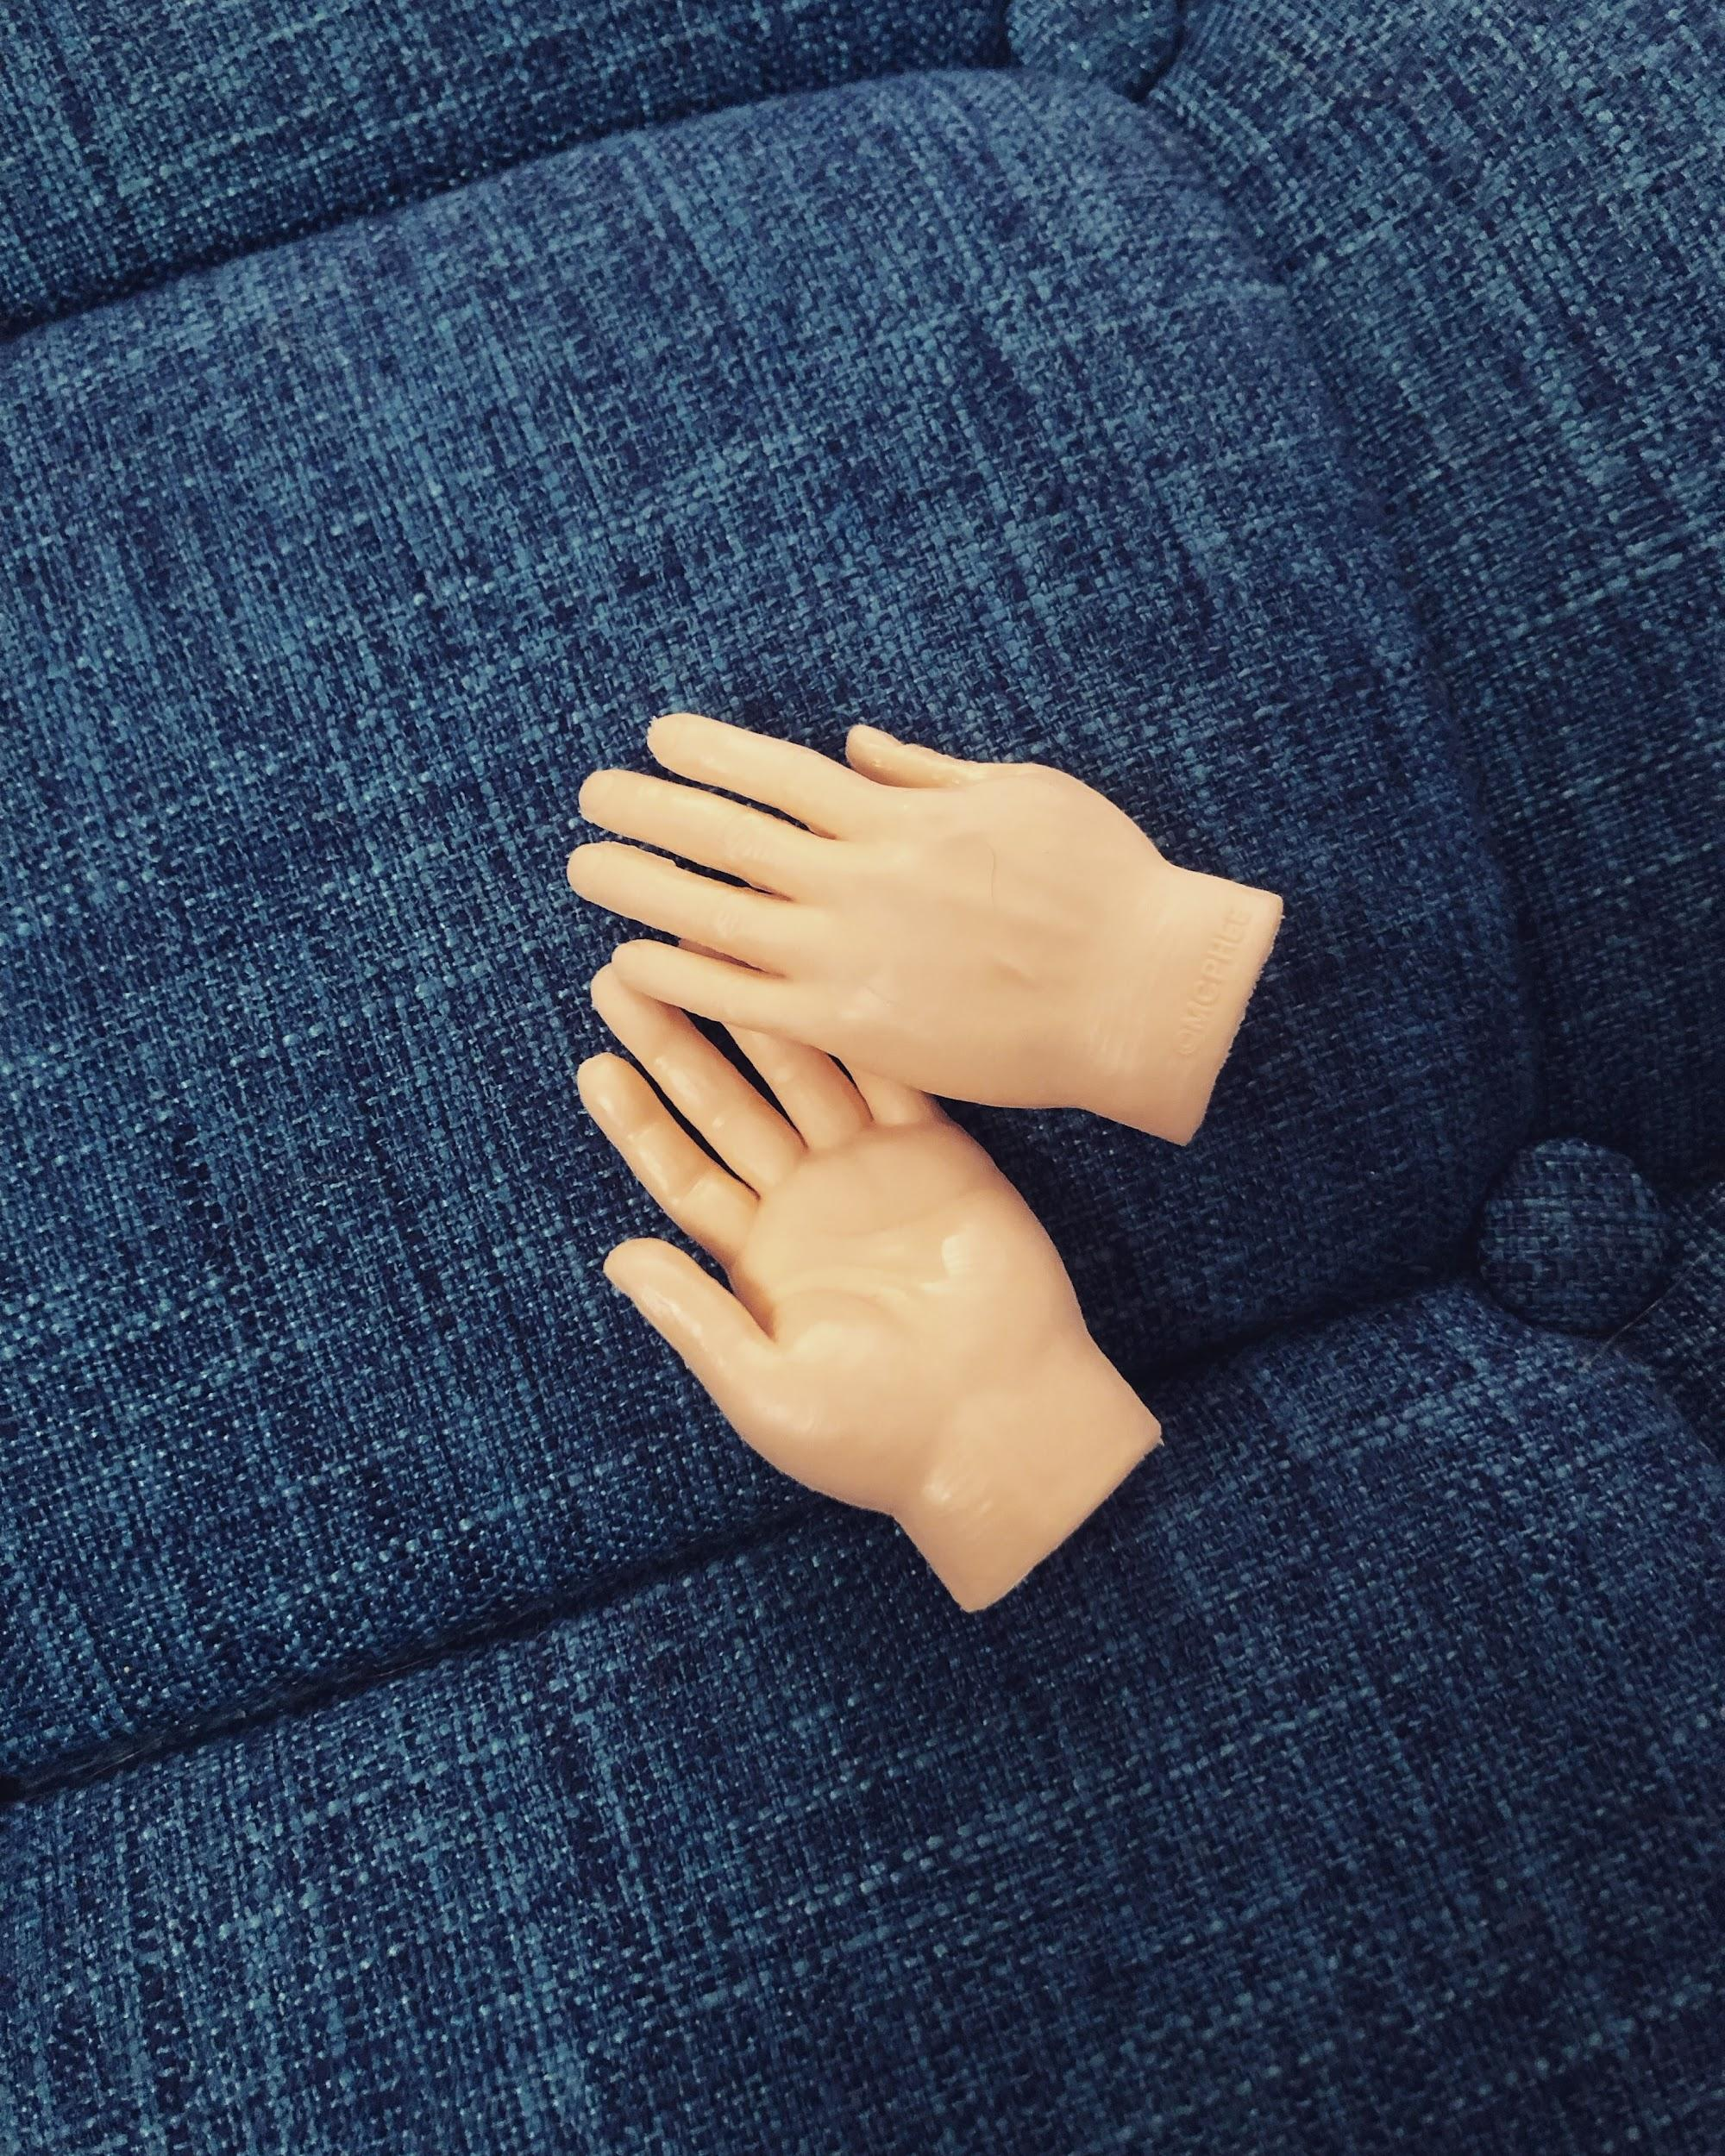
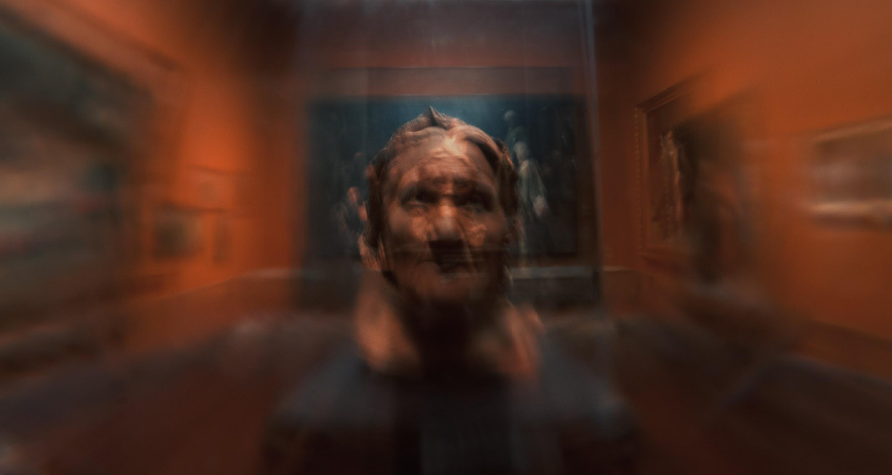
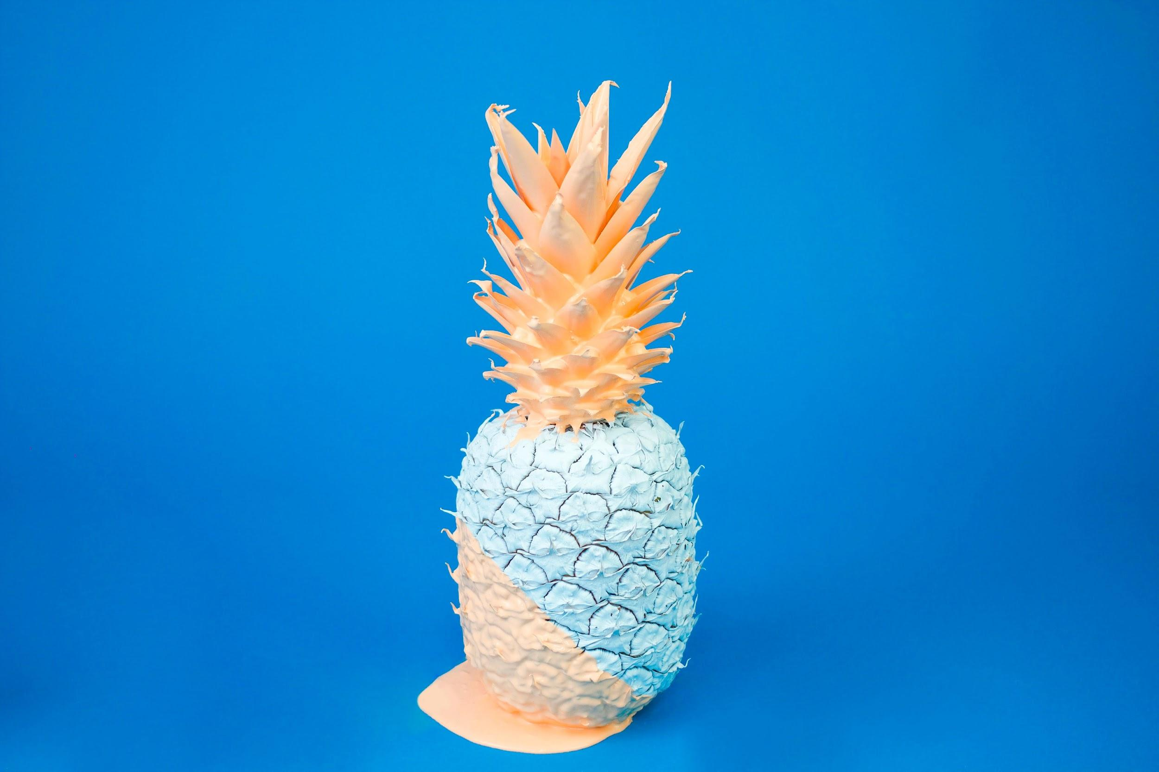

Slide 5
Example PDer

Slide 6
Participant 2

Slide 7
Participant 3

