Slide 1
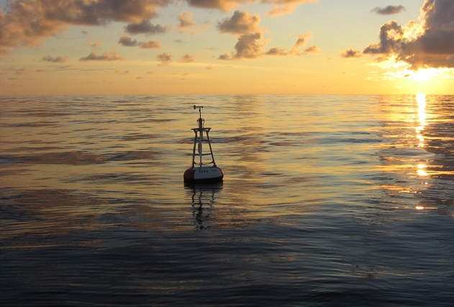
NOAA PLACES
Potential Location Assessment of Coastal and Estuarine Surveys
Caitlin Guerin, Nick Hanson, and Austin Hackett

Slide 2
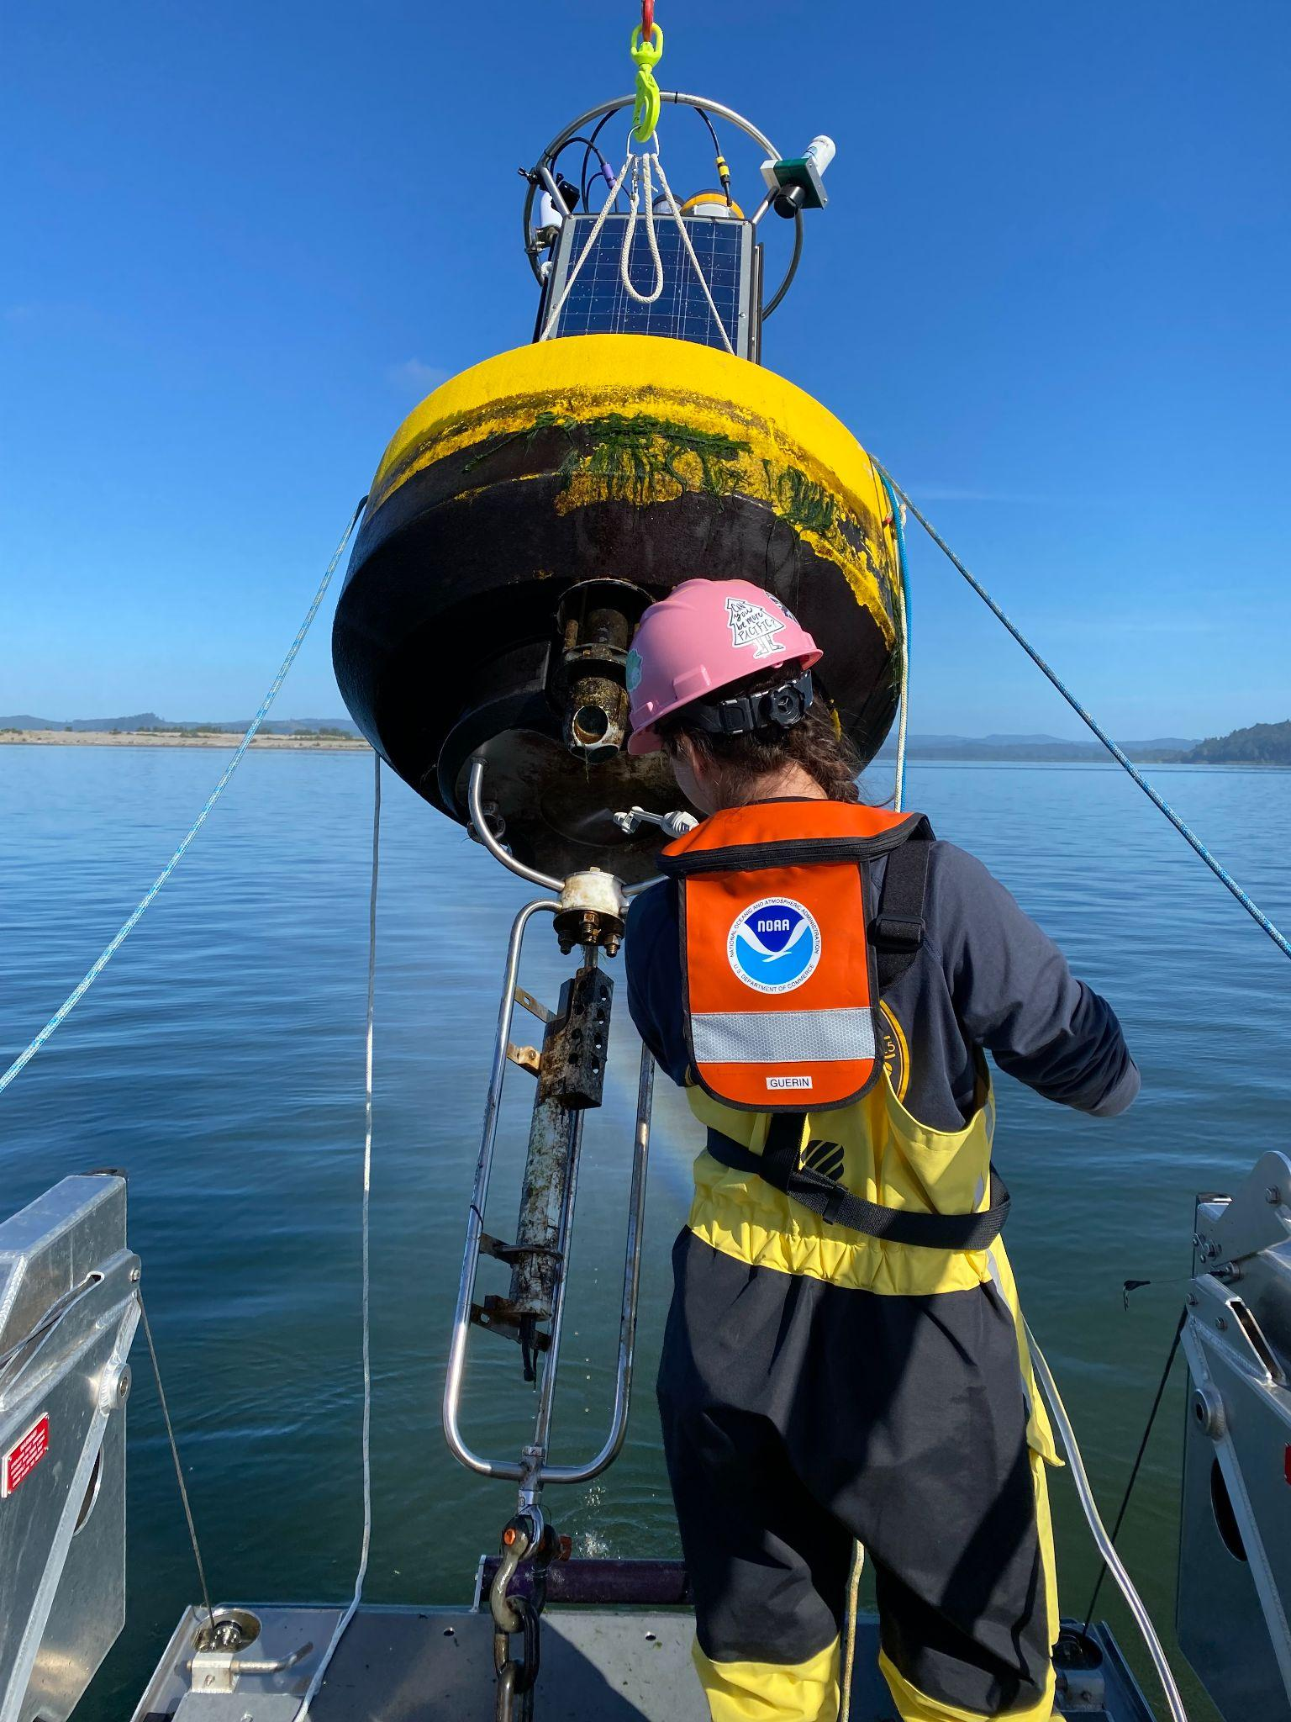
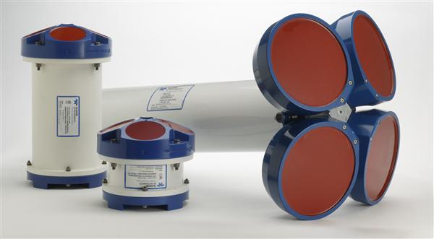
Project Description
Acoustic Doppler Current Profilers (ADCP’s) measure water current in distance/time.
How does NOAA decide where to conduct surveys?
Shipping
Tides
Allisions, collisions, groundings
Time since last survey. (1970)

Slide 3
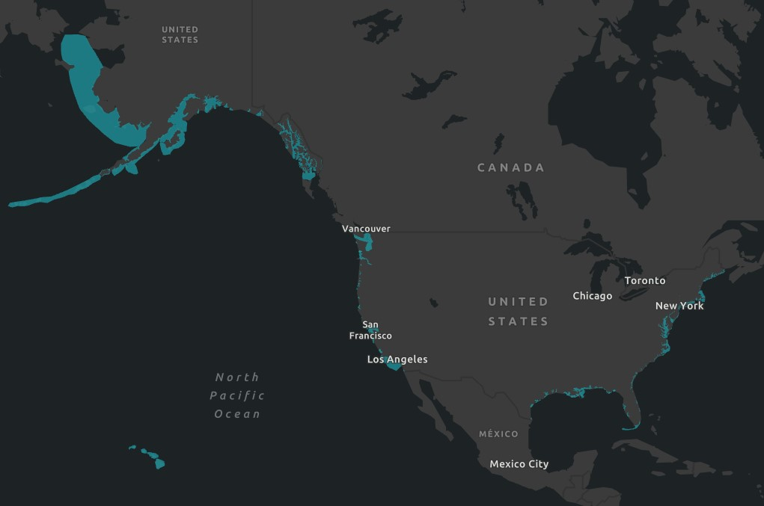
GIS Analysis
Aggregate points to Ocean Basins polygon layer.
Spatial join polygons to Basins.
Change Null to 0
Rasterize by parameters
Weighted overlay

Slide 4
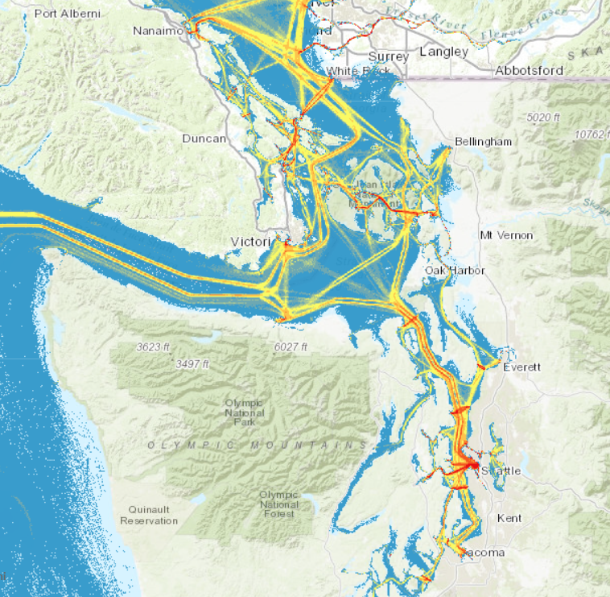
Challenges
AIS Data
Weighted Overlay and rasters
Available data

Slide 5
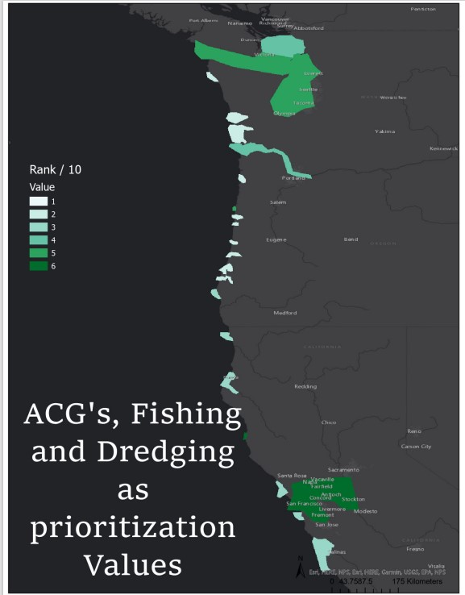
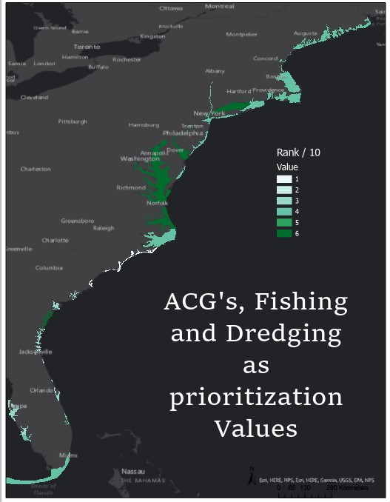
Current Results

Slide 6
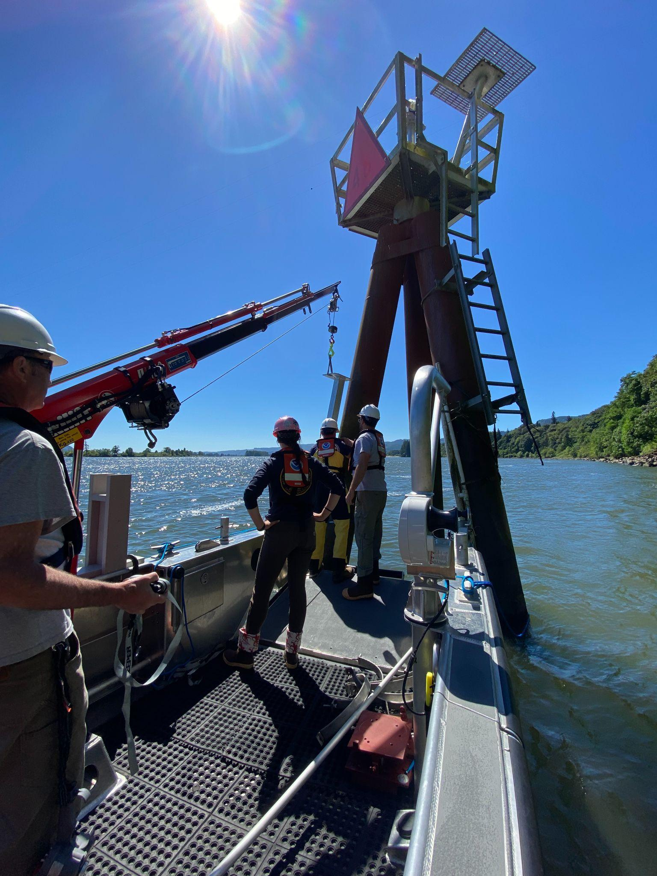
Thank you for listening!

