Slide 6
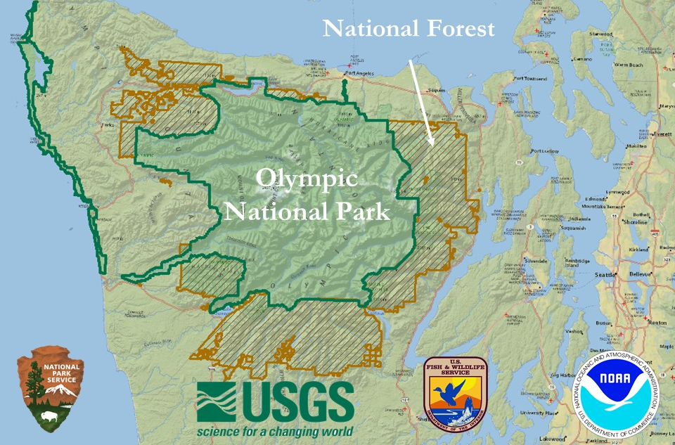

Slide 7
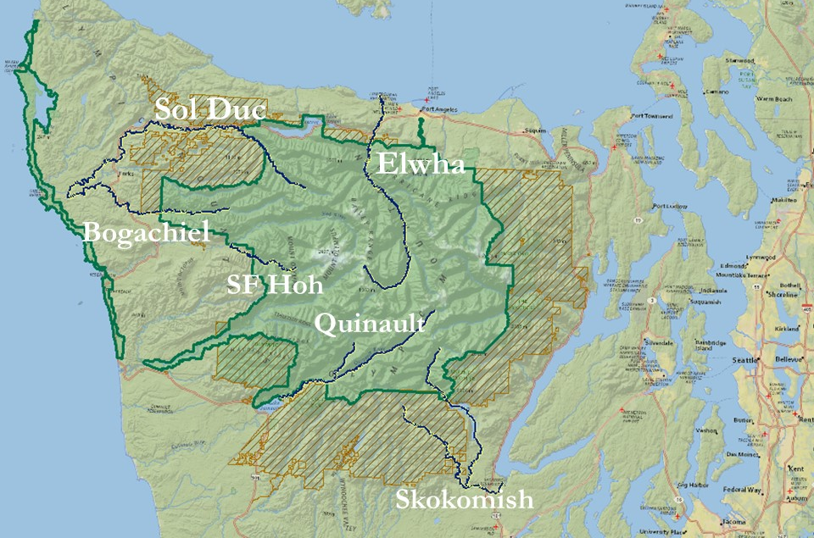

Slide 9
2. QA | QC
Data entry
Geospatial tests
Change tracking
1. Field Data
3. Linear Referencing

Slide 10
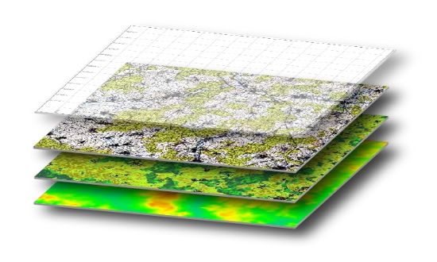
2. QA | QC
Data entry
Geospatial tests
Change tracking
1. Field Data
3. Linear Referencing
3. Georeferencing
Prepared Data
For data manipulation and visualization

Slide 11
Scale: Unbinned Survey Units

Slide 12
Scale: 1Km Bin Size

Slide 13
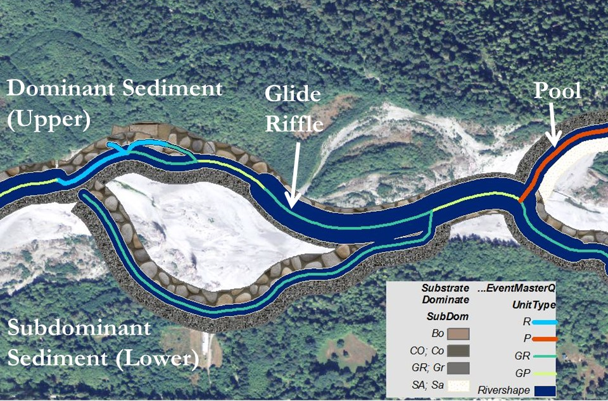
Quinault Main Channel
With side channels

Slide 14
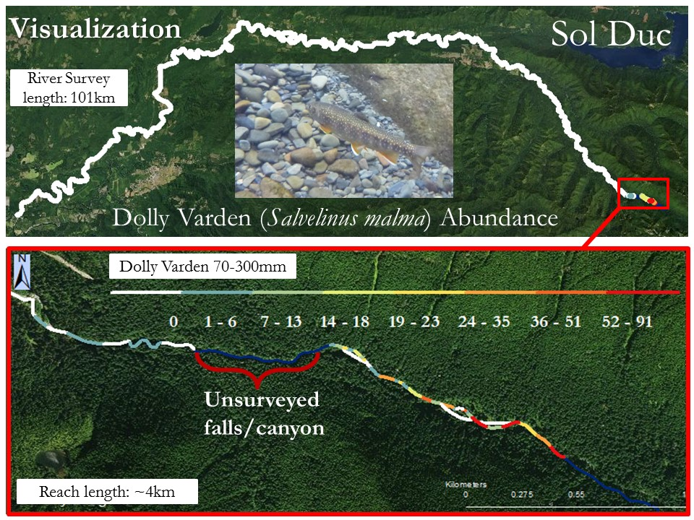

Slide 15
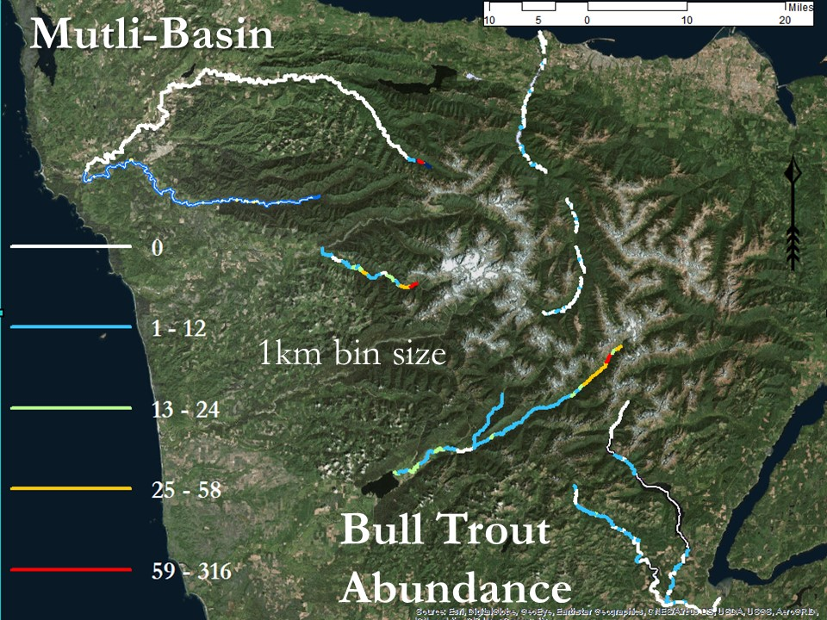

Slide 16
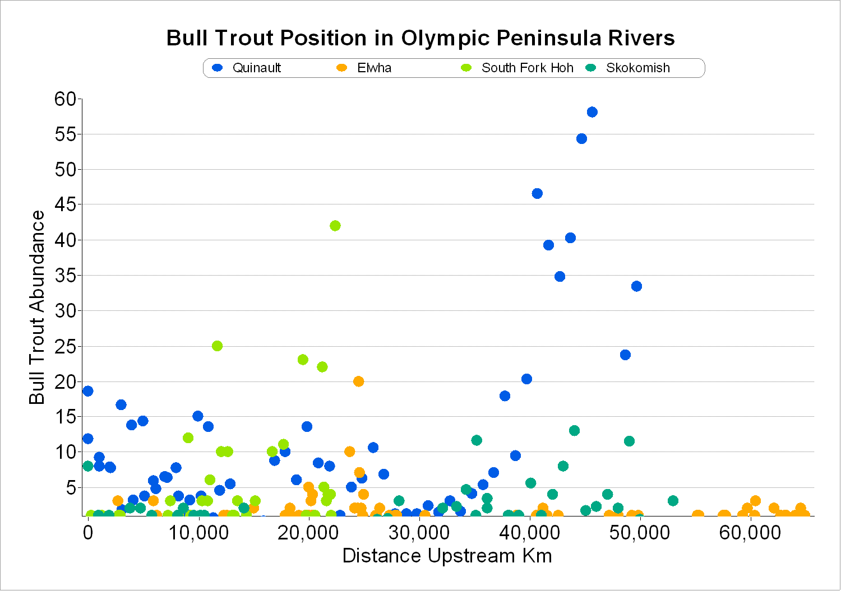
1km bin size

Slide 17
Web Map Products
Results
Exploration
Collaboration
Analytics
Arc Models
R & Python Scripts
Database Management
Shapefiles
Server hosting
QAQC
Standardized Processes
Stakeholder Input
Funders
Managers
PI’s
Data Entry
In-field Electronic
Idealized System
Prepared
Data

Slide 19
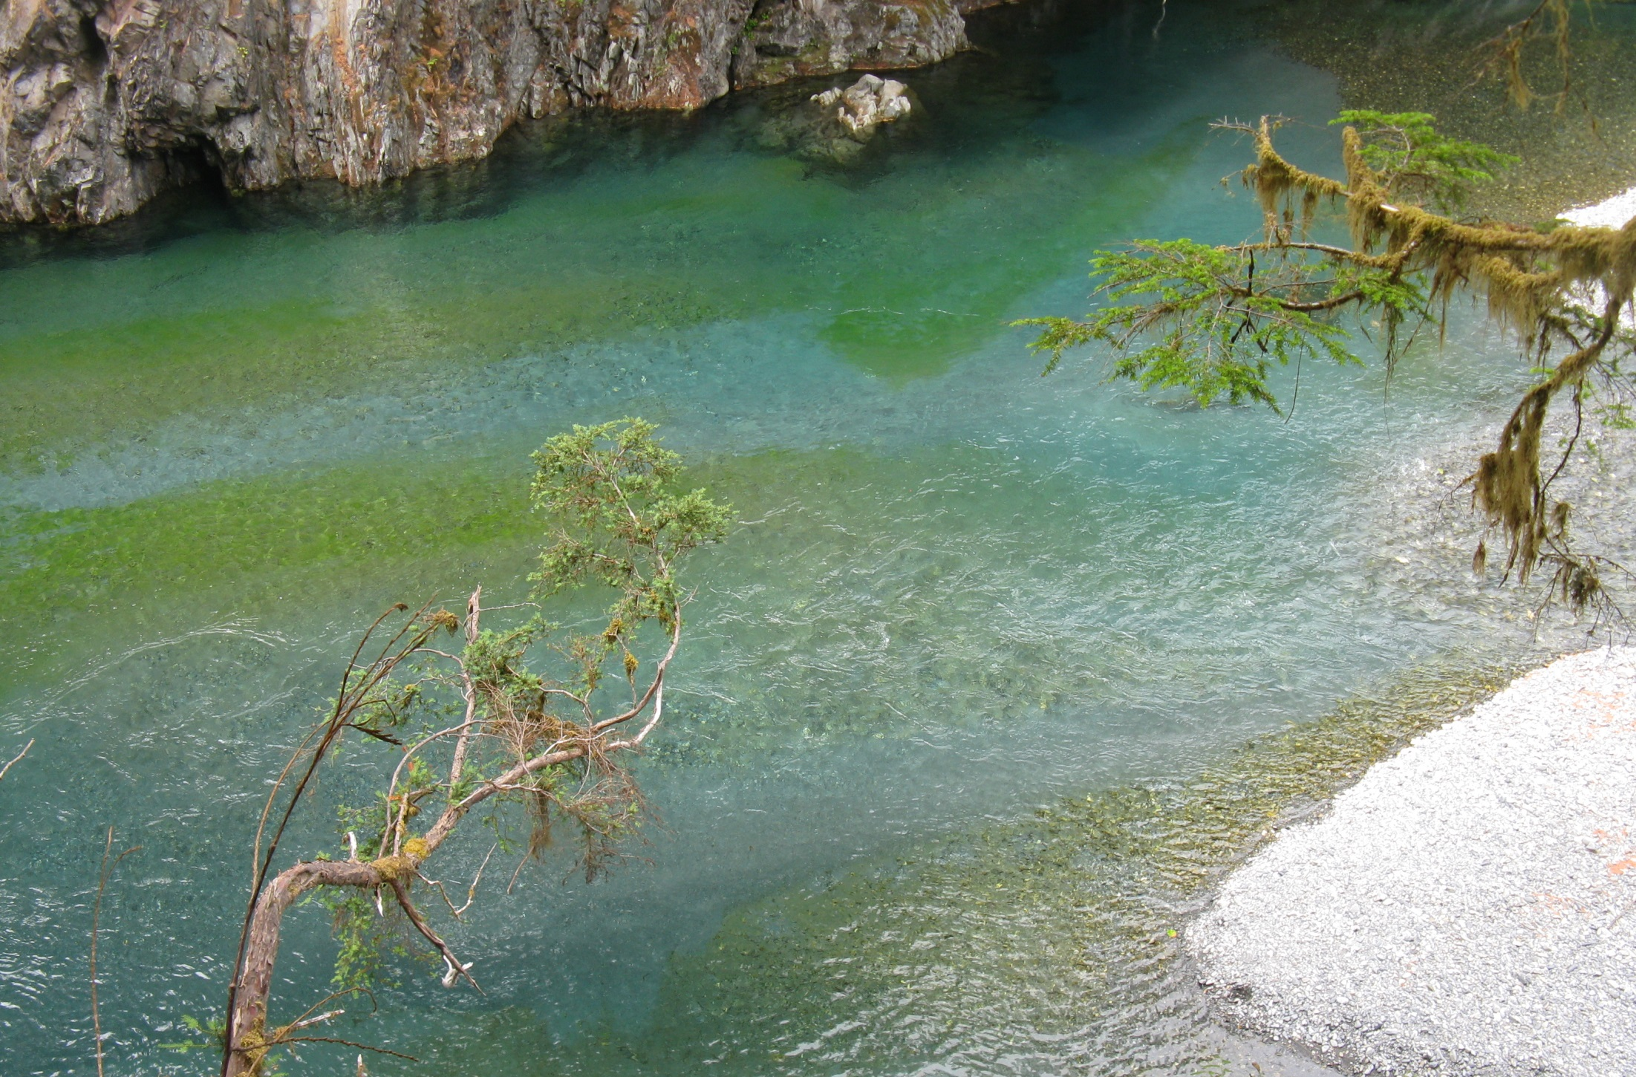

Slide 20
Thank You!
PI’s: Christian Torgersen & Jeff Duda
Trevor Eakes
U.S.G.S contractor, mycid@uw.edu

