Slide 1
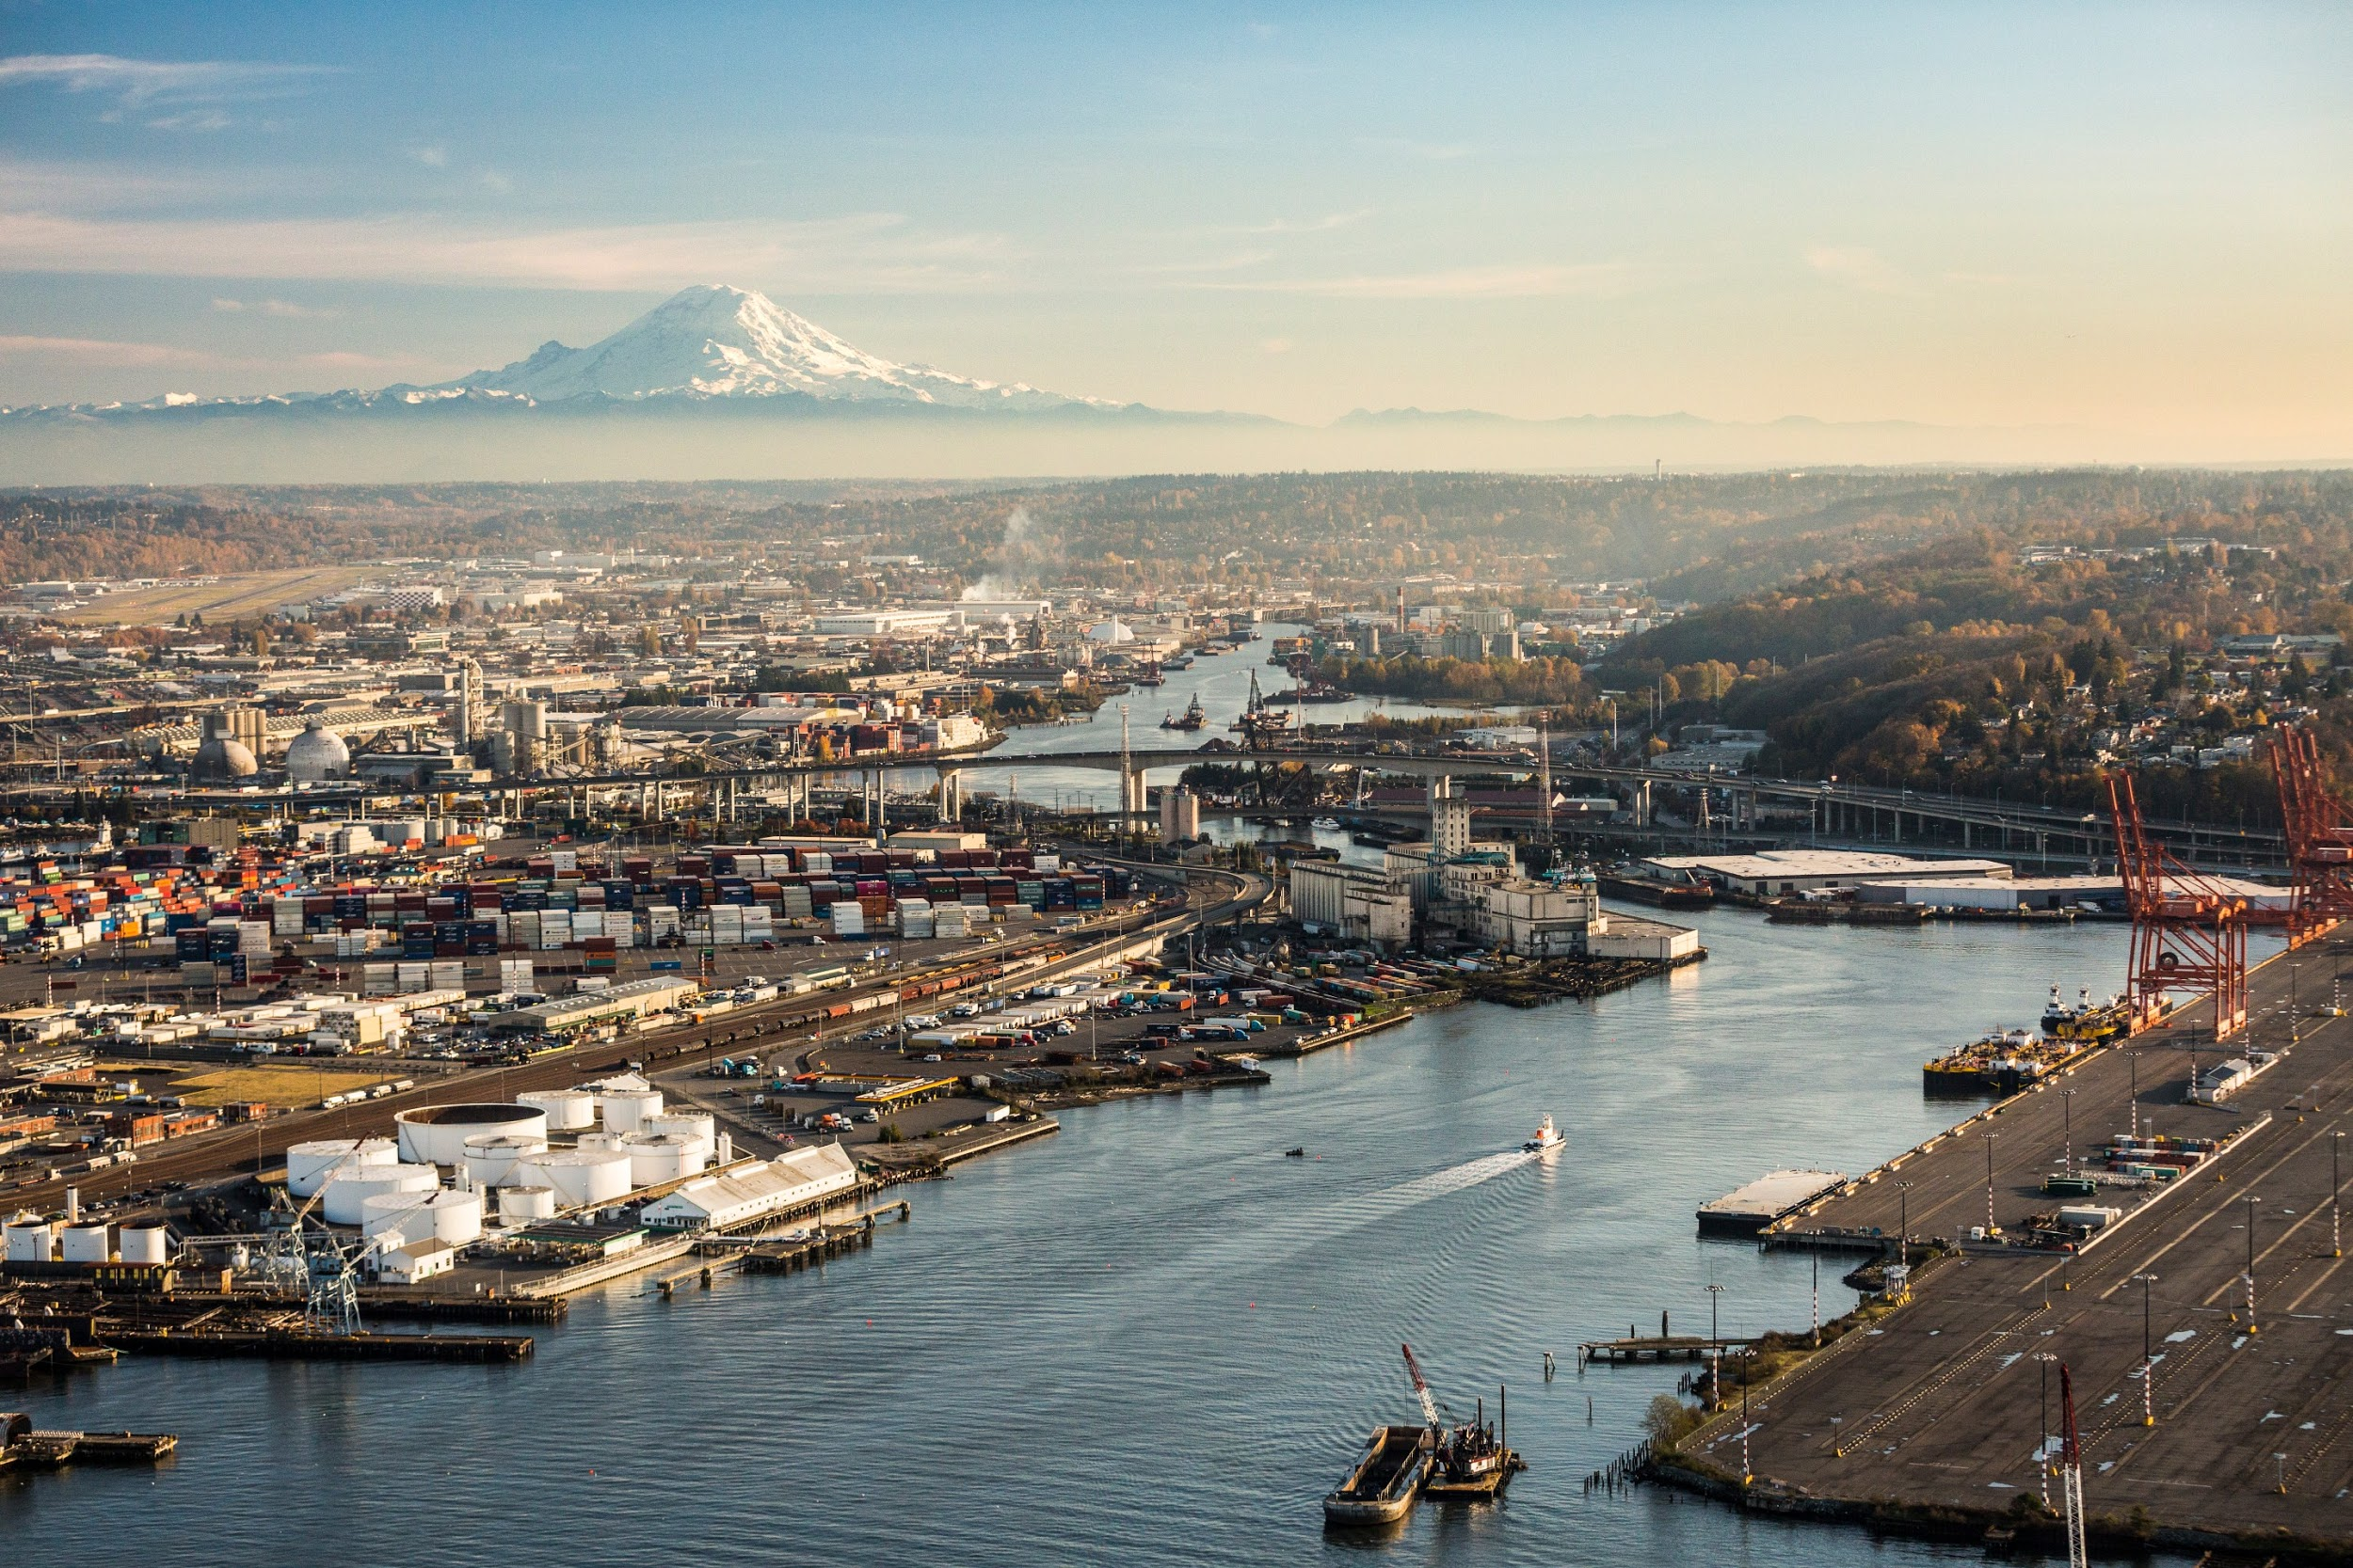
Climate Mapping for a Resilient Washington
Matthew Rogers
Research Scientist,
Climate Impacts Group
University of Washington
UW GIS Symposium,
25 May, 2023
Image ©CIG; with aerial support from LightHawk
Notes:
I’m showcasing how we used a data visualization as a tool to reduce barriers to understanding and using climate data

Slide 2
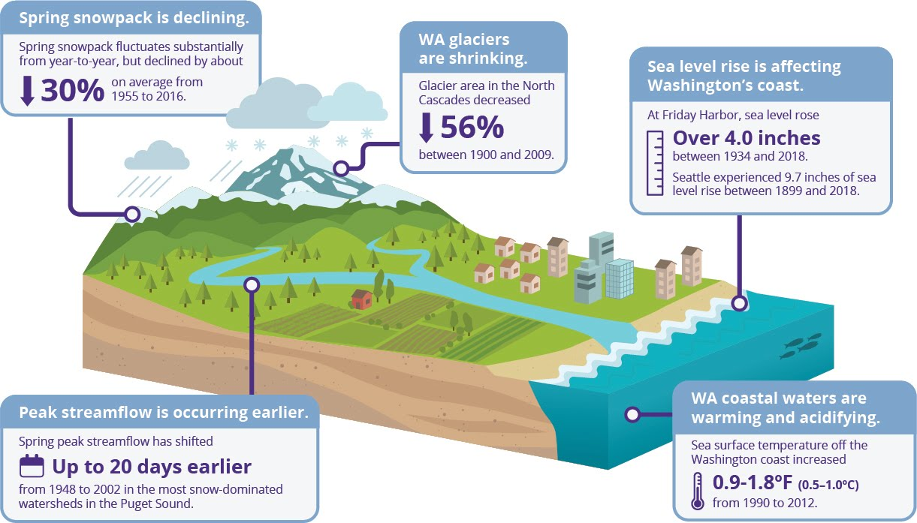

Slide 3
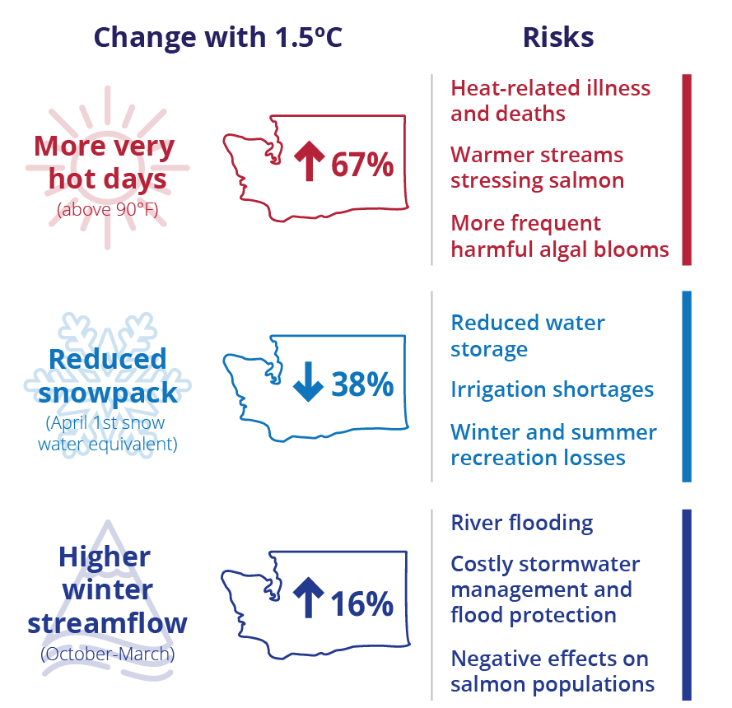
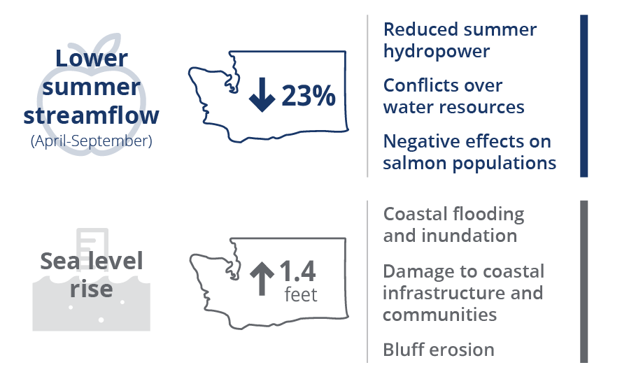
A small amount of additional warming will challenge Washington’s communities, economy and ecosystems
… but we’re on the path to more warming

Slide 4
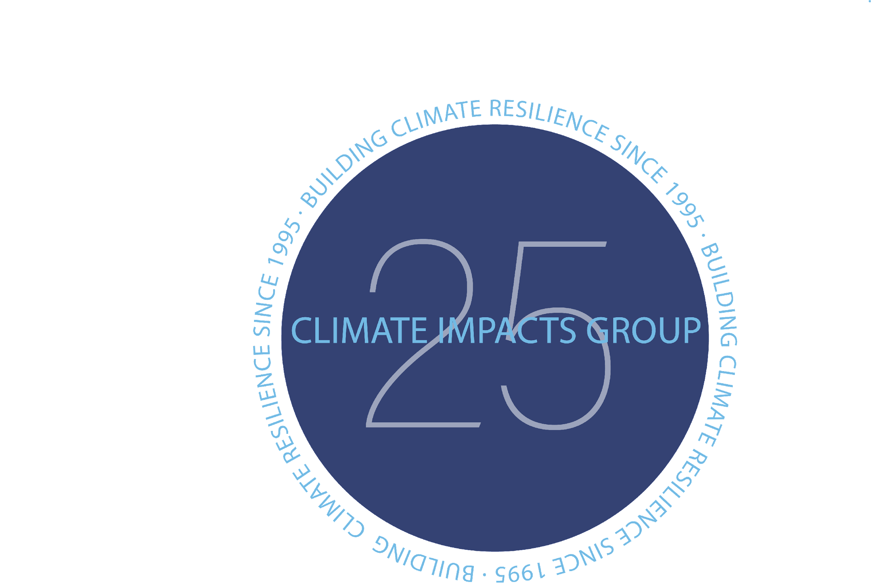
The University of Washington Climate Impacts Group builds climate resilience by advancing awareness of climate risks & supporting science-based action to manage those risks.
www.CIG.edu

Slide 5
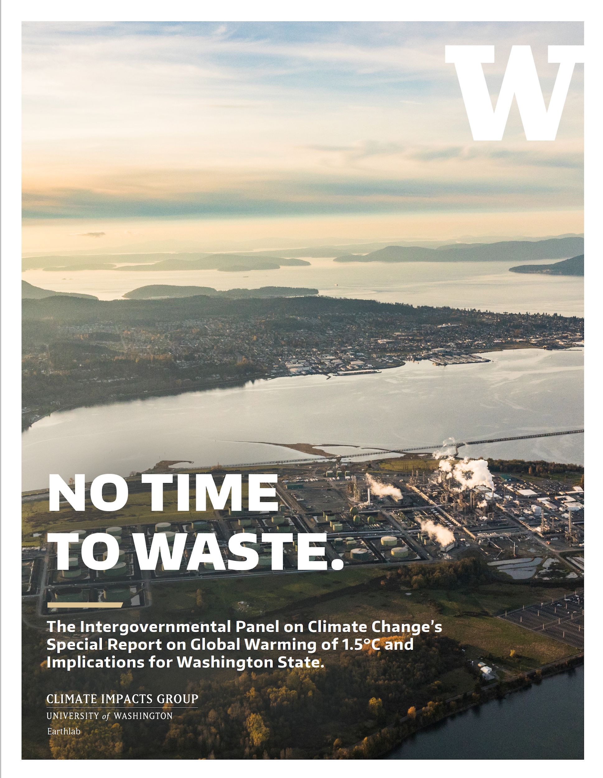
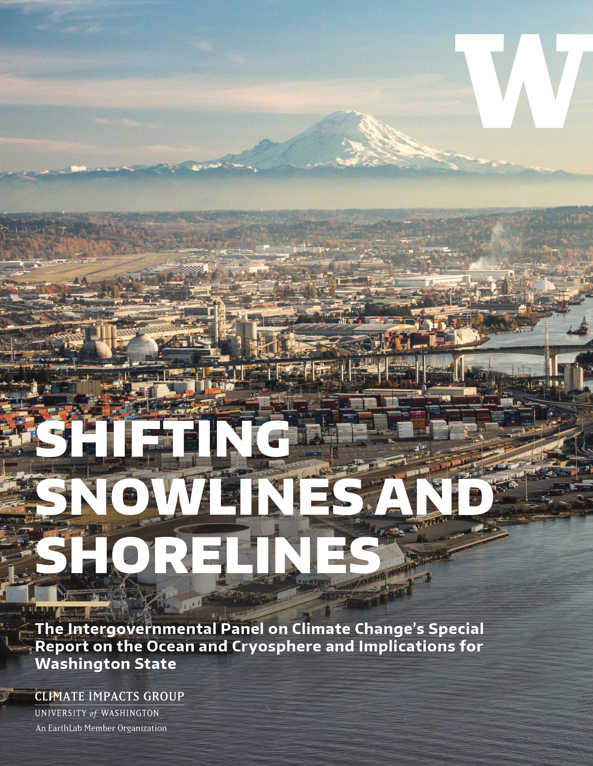
Available at CIG.uw.edu
Notes:
Among other things, we work to reduce barriers to understanding, accessing, and using climate projection information. Historically, we have done this through the publishing of reports specific to Washington State, and webtools that are specific to climate hazards such as extreme precipitation and sea level rise.

Slide 6
Gaps
The current availability of information on changes in the climate and climate-related hazards in Washington State is spotty – varying by hazard, sector, and location.
“The diversity of local impacts of a changing climate makes it challenging for state and local decision-makers to use this information to effectively plan for resilience and to strategically identify and prioritize risk-reduction activities…These data are often publicly available but difficult to access and use without substantial training and capacity.” ¹
Scientific and technical information, with minimal barriers to access, was commonly cited in recent reports on potential processes and approaches to build climate resilience in Washington^{2,3,4}
________________________
¹Raymond, C.L, T.P. Nadreau, M. Rogers, Z. Kearl. 2022. Biophysical Climate Risks and Economic Impacts for Washington State. Report prepared for the Washington State legislature. Climate Impacts Group, University of Washington, Seattle.
²Office of Financial Management.2020. Prioritizing Actions and Investments for Climate Resiliency in Washington. Report to the Legislature Ch. 357, Laws of 2020. ³Cascadia Policy Solutions 2021.Climate Governance Report
⁴Adelsman, H., & Ekrem, J. 2012. Preparing for a changing climate: Washington State’s integrated climate response strategy. Department of Ecology, Olympia, WA.
Notes:
As part of the 2021-2022 State Budget, CIG was tasked with providing “... an updated climate risk assessment designed to inform future updates to the statewide climate resilience strategy.”

Slide 7
Two Proposed Solutions
Option 1: Relative climate exposure across the state to inform statewide resilience policies and funding decisions;
Option 2: Climate exposure of local jurisdictions to enhance local awareness of climate risks and capacity to respond to state and federal policies, regulations, and funding opportunities.
Notes:
Office of the Governor
Washington Department of Fish and Wildlife
Department of Natural Resources
Emergency Management Department
Department of Ecology
Department of Health
Commerce Department
Interagency Climate Adaptation Network

Slide 8
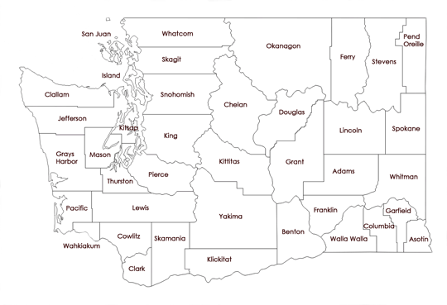
Easy access to relevant, local-scale climate impacts summaries and data
Promote Awareness
Inform Assessments
Aid in Planning
Notes:
We answered with a data viz!

Slide 9
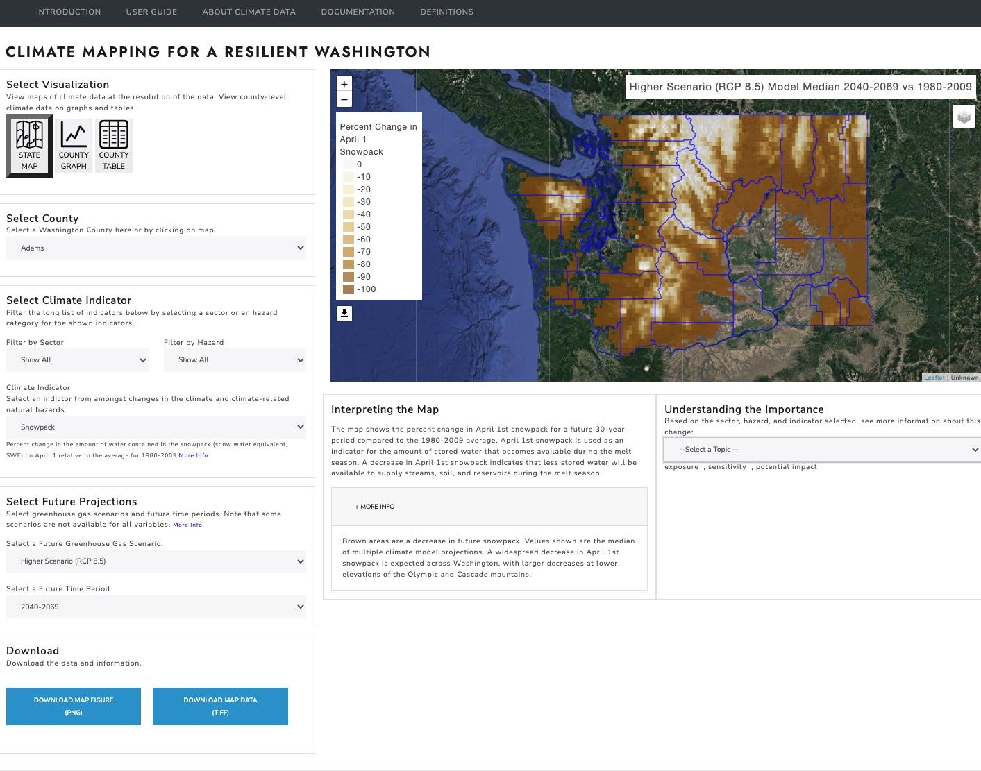
https://data.cig.uw.edu/climatemapping/
Notes:
After a year of iteration, seeking feedback, and a ton of data analysis, we arrived here! CIG utilized its internal expertise and scoping process to curate and compile the most relevant climate impactsprojection data into this webtool, Climate Mapping for a Resilient Washington (CMRW).
For webtool creation, there’s always a trade-off between customization and simplicity of use. After many many conversations, we ended up including 27 different indicators (e.g., change in snowpack, changes in streamflow, changes in extreme heat, changes in flooding) that are relevant to a variety of different planning sectors, including water resources, zoning and development, recreation, and agriculture among others.

Slide 10
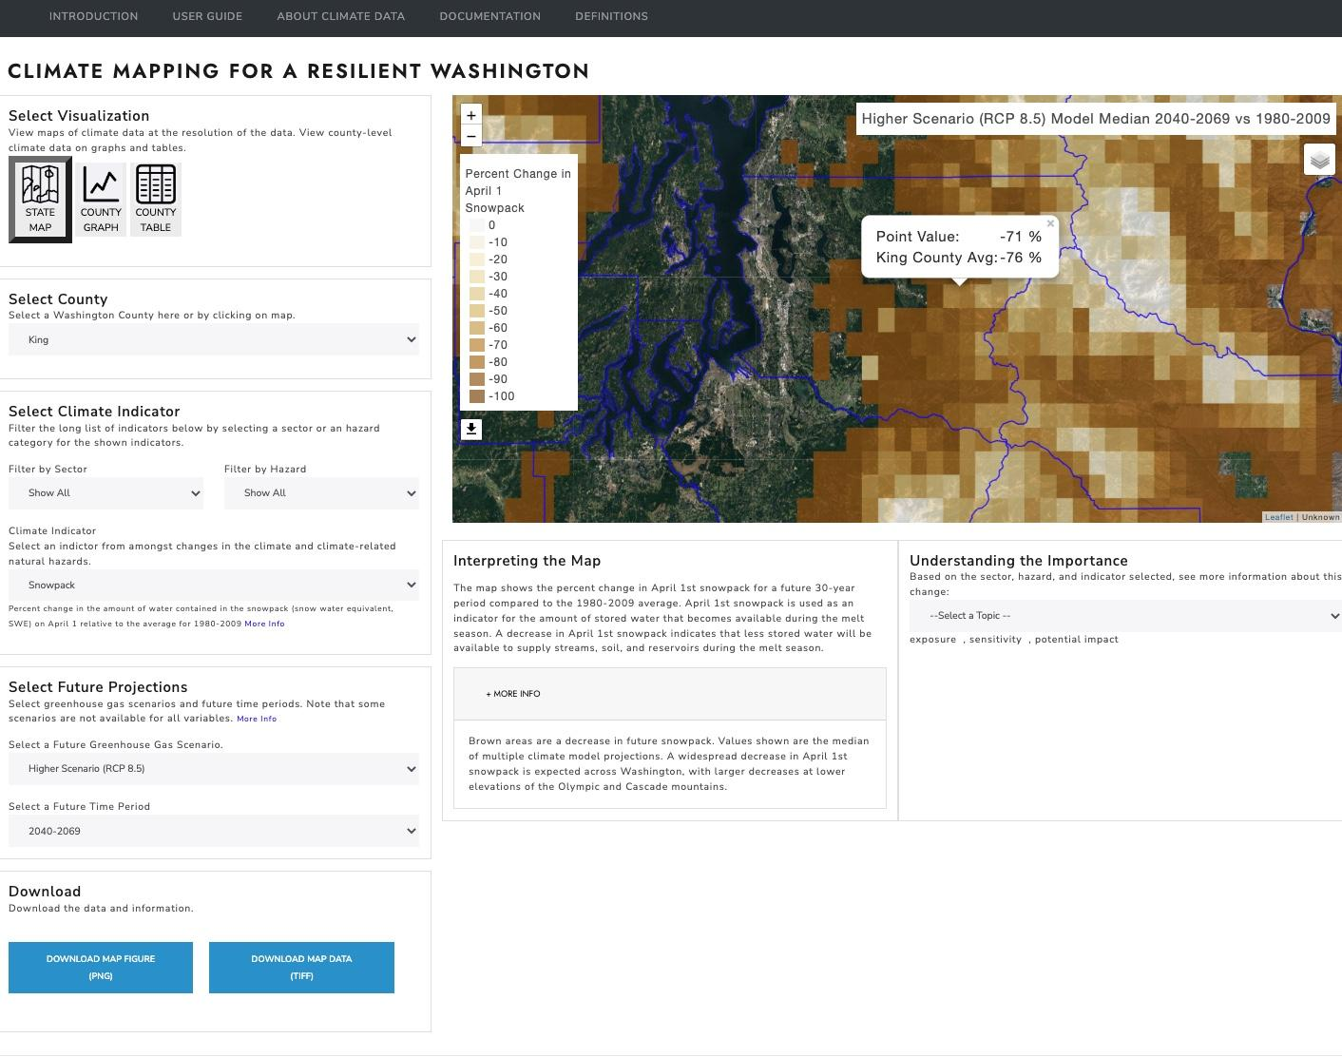
https://data.cig.uw.edu/climatemapping/
Notes:
Map is fully interactable and will give you both the county mean and point value for the climate indicator selected.

Slide 11
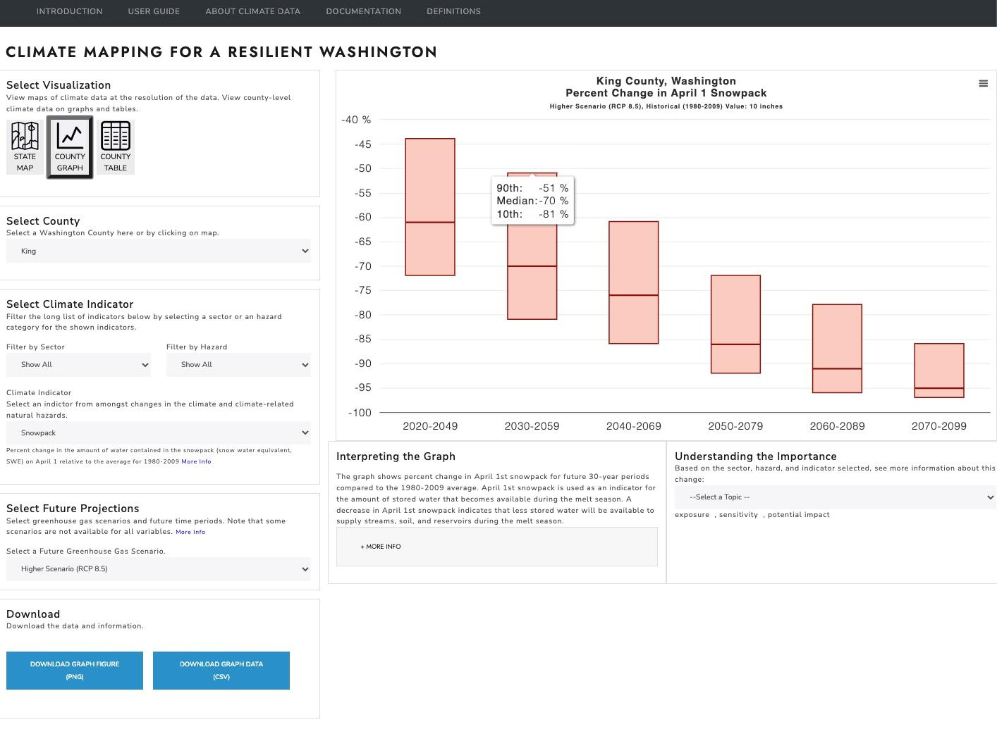
https://data.cig.uw.edu/climatemapping/

Slide 12
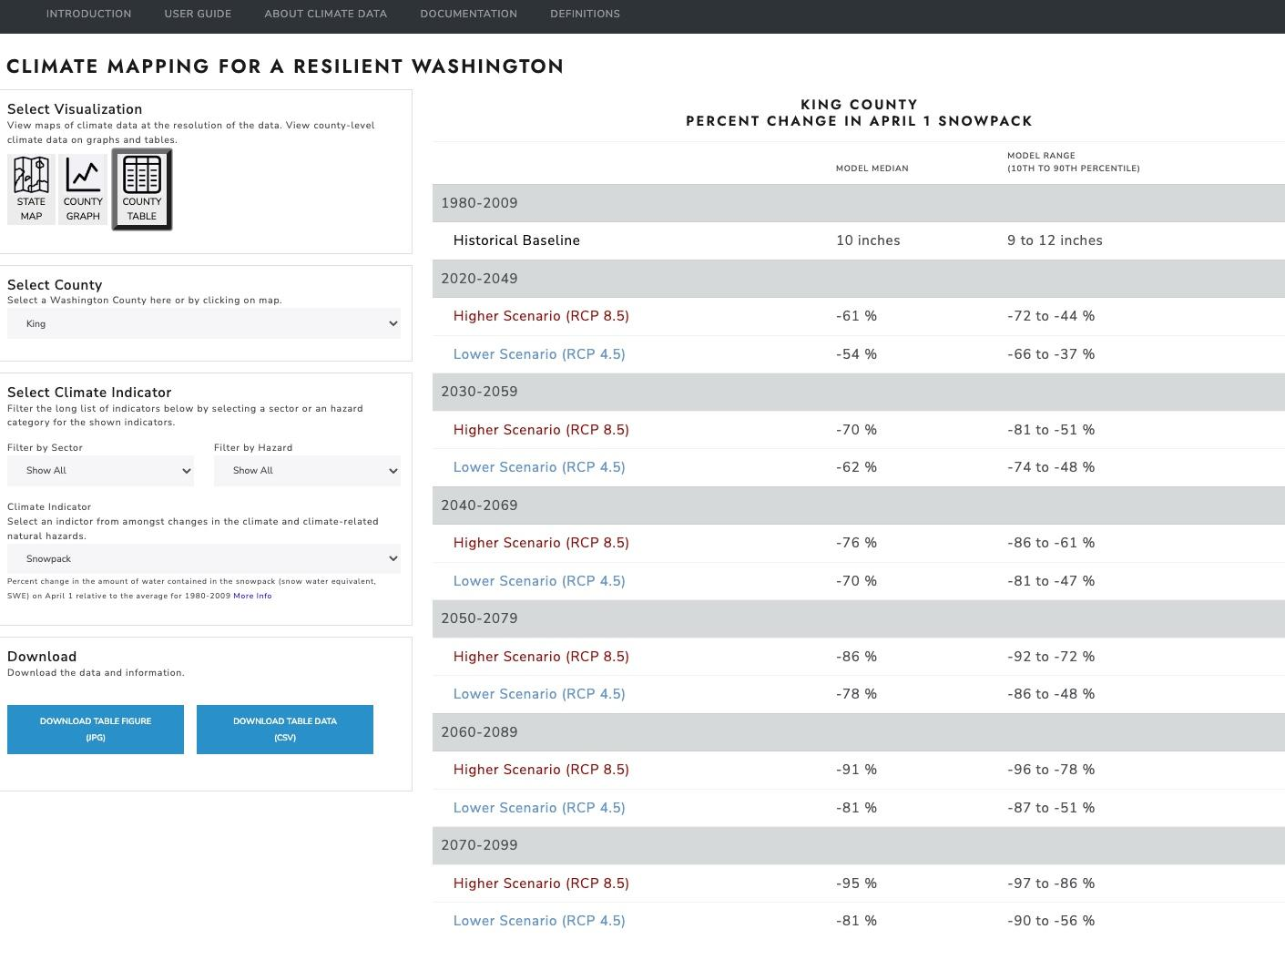
https://data.cig.uw.edu/climatemapping/
Notes:
All of this is downloadable, including the maps as .png and .tiff files, and the table as a .csv

Slide 13
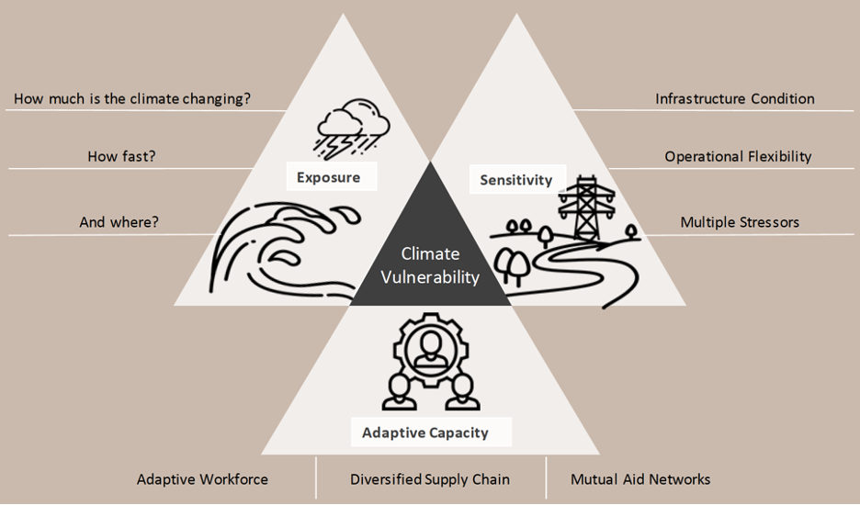
Climate change is not the whole story…
Notes:
Up till now, I’ve showcased how CMRW visualized how much, how fast, and where climate is changing. This isn’t the whole story though, and only gets at one piece of information that is necessary for assessing a community’s vulnerability.

Slide 14
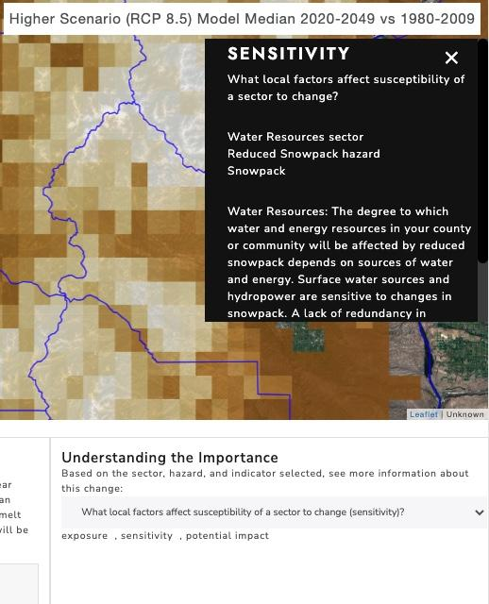
Climate change is not the whole story…
[Climate Impacts] “ …do not capture local variation in sub-populations, assets, or ecosystems that will be more sensitive, or susceptible, to these changes because of factors that predispose them to climate impacts, such as pre-existing conditions and non-climatic stressors.” ¹
“Local information on exposure and sensitivity is a product of a climate vulnerability assessment best derived from local data, knowledge, and expertise, and it is also critical for a comprehensive risk assessment.” ¹
¹Raymond, C.L, T.P. Nadreau, M. Rogers, Z. Kearl. 2022. Biophysical Climate Risks and Economic Impacts for Washington State. Report prepared for the Washington State legislature. Climate Impacts Group, University of Washington, Seattle.
Notes:
Information on biophysical climate impacts alone does not capture local variation in populations, assets, and ecosystems that will determine their vulnerability to climate hazards. Ultimately, the communities doing the planning will know the their sensitivities and capacity to adapt better than we will. But we can point them in a direction that may be useful.

Slide 15
Looking Forward
Integral part of the climate resilience element of the Department of Commerce’s comprehensive plan guidance
HB1181 - Improving the state's response to climate change by updating the state's planning framework.
Feedback from pilot programs using this for their comprehensive planning efforts has been positive!
Notes:
Creating a data viz is all well and good, but will it get use?

Slide 16
Matthew Rogers
UW Climate Impacts Group
@CIG_UW | rawrgers@uw.edu
cig.uw.edu

Slide 17
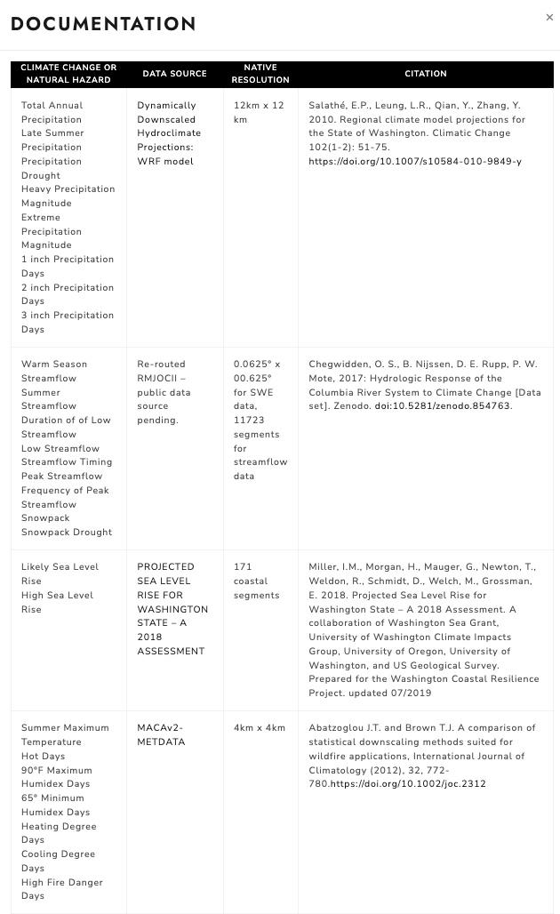
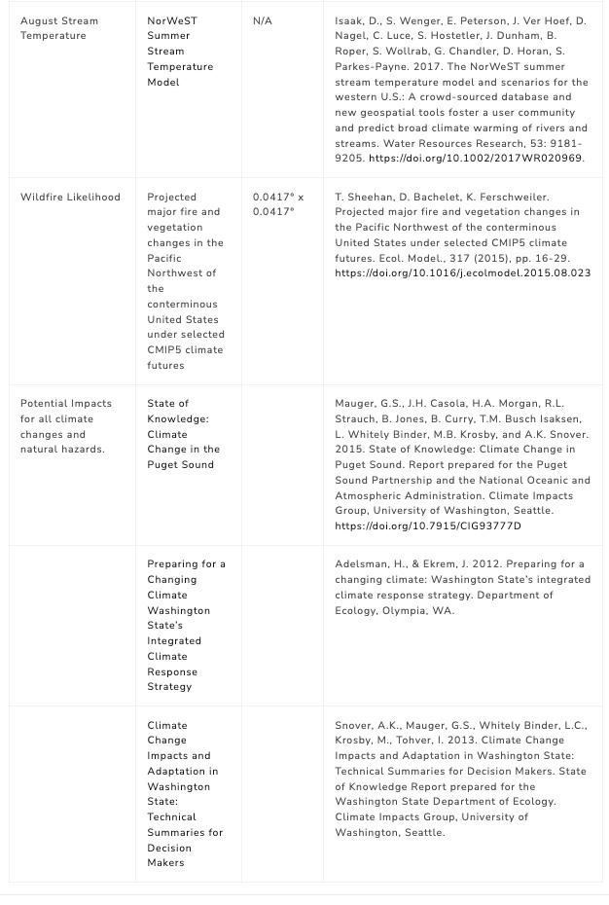
Data Sources

Slide 18
Metrics and Categories
Climate Hazards | Climate Indicators
Extreme Precipitation | Heavy Precipitation Magnitude (percent change) Extreme Precipitation Magnitude (percent change) 1 inch Precipitation Days (change in days) 2 inch Precipitation Days (change in days) 3 inch Precipitation Days (change in days)
Extreme Heat | Summer Maximum Temperature (change in °F) Hot Days (change in days) 90°F Maximum Humidex Days (change in days) 65°F Minimum Humidex Days (change in days) Heating Degree Days (change in degree-days) Cooling Degree Days (change in degree-days) August Stream Temperature (°F)
Drought | Total Annual Precipitation (percent change) Late Summer Precipitation (percent change) Precipitation Drought (likelihood) Warm Season Streamflow (percent change) Summer Streamflow (percent change) Duration of Low Streamflow (change in days) Low Streamflow (percent change) Streamflow Timing (ratio) Snowpack Drought (likelihood)
Flooding | Peak Streamflow (percent change) Frequency of Peak Streamflow (return interval)
Reduced Snowpack | Snowpack (percent change) Streamflow Timing (ratio)
Sea Level Rise | Likely Sea Level Rise (ft) High Sea Level Rise (ft)
Wildfire | High Fire Danger Days (change in days) Wildfire Likelihood (likelihood)
Sectors
Agriculture Ecosystems Human Health Buildings & Energy Zoning & Development Water Resources | Transportation Economic Development Emergency Management Cultural Resources & Practices Waste Management

Slide 19
Intended Audience and Uses
Climate communications and outreach products
Climate vulnerability assessments, resilience plans, and action plans
Climate resilience elements of state required plans
Climate considerations for state and federal grant applications

Slide 20
Other Webtool Products
Related Resources
CMRW provides information on many climate hazards at a high level. For a more in-depth assessment of climate hazards for Washington State, the Climate Impacts Group has other tools that are publicly available, including:
· Heavy Precipitation Projections for use in Stormwater Planning,
· Interactive Sea Level Rise Visualizations, and
· Tribal Climate Tool.

