Slide 1
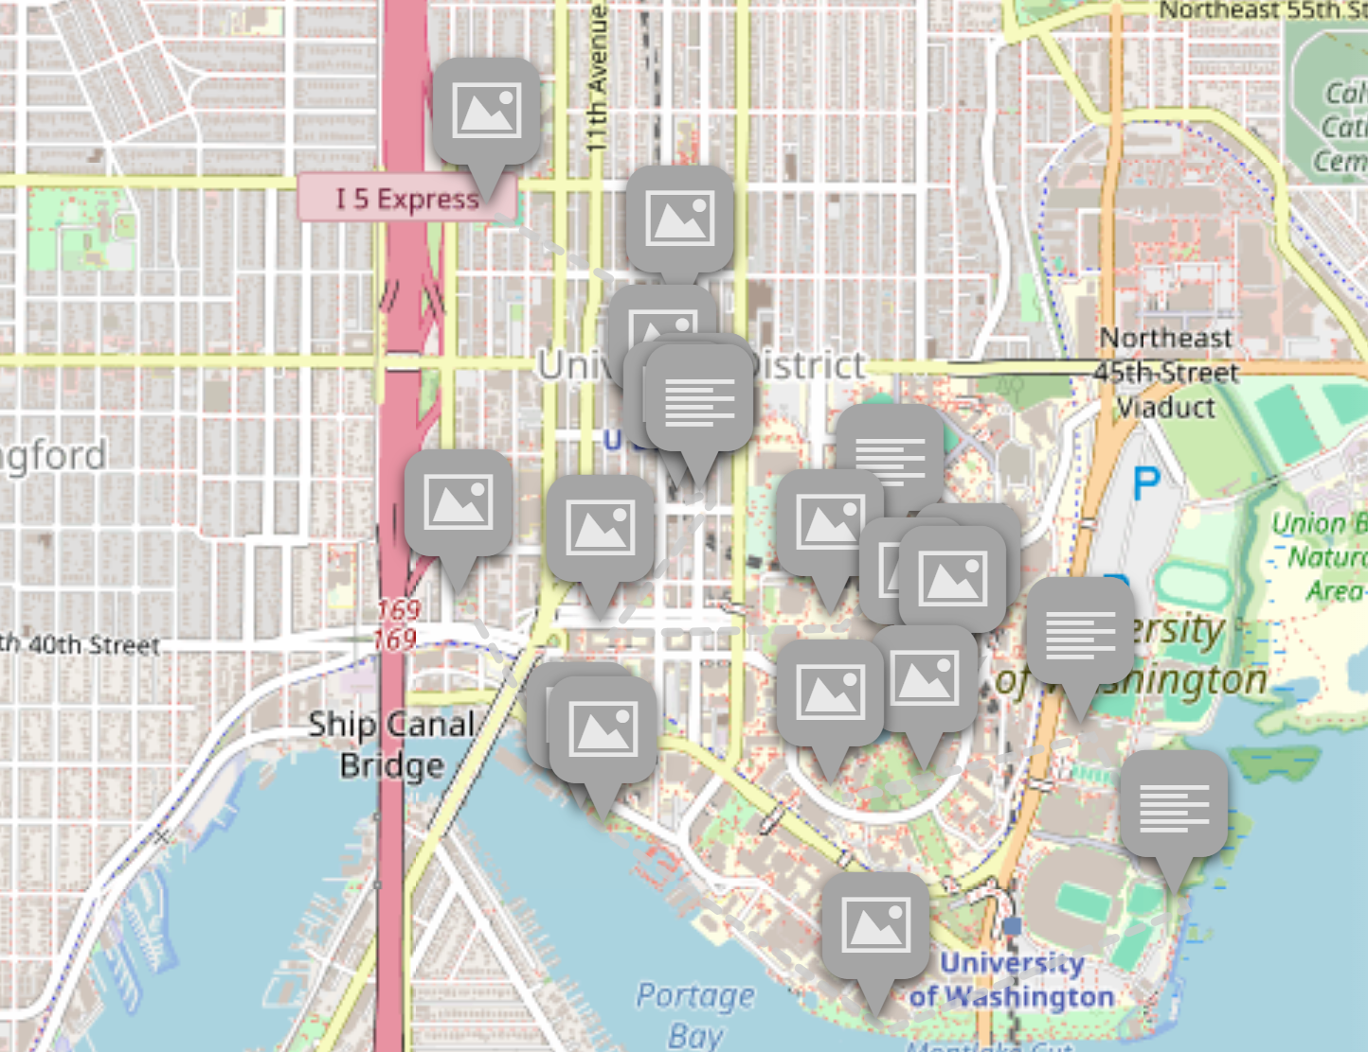
Geographies of Queer Joy
Lauren Levenston
Wi25 Geog 431

Slide 2
About the project
This project is meant to ‘queer’ the heteronormative city and university, and provide a corrective lens towards struggle-focused queer theory and queer geographies.
How do urban and educational landscapes shape the experiences of queer joy for students in University District, Seattle?

Slide 3
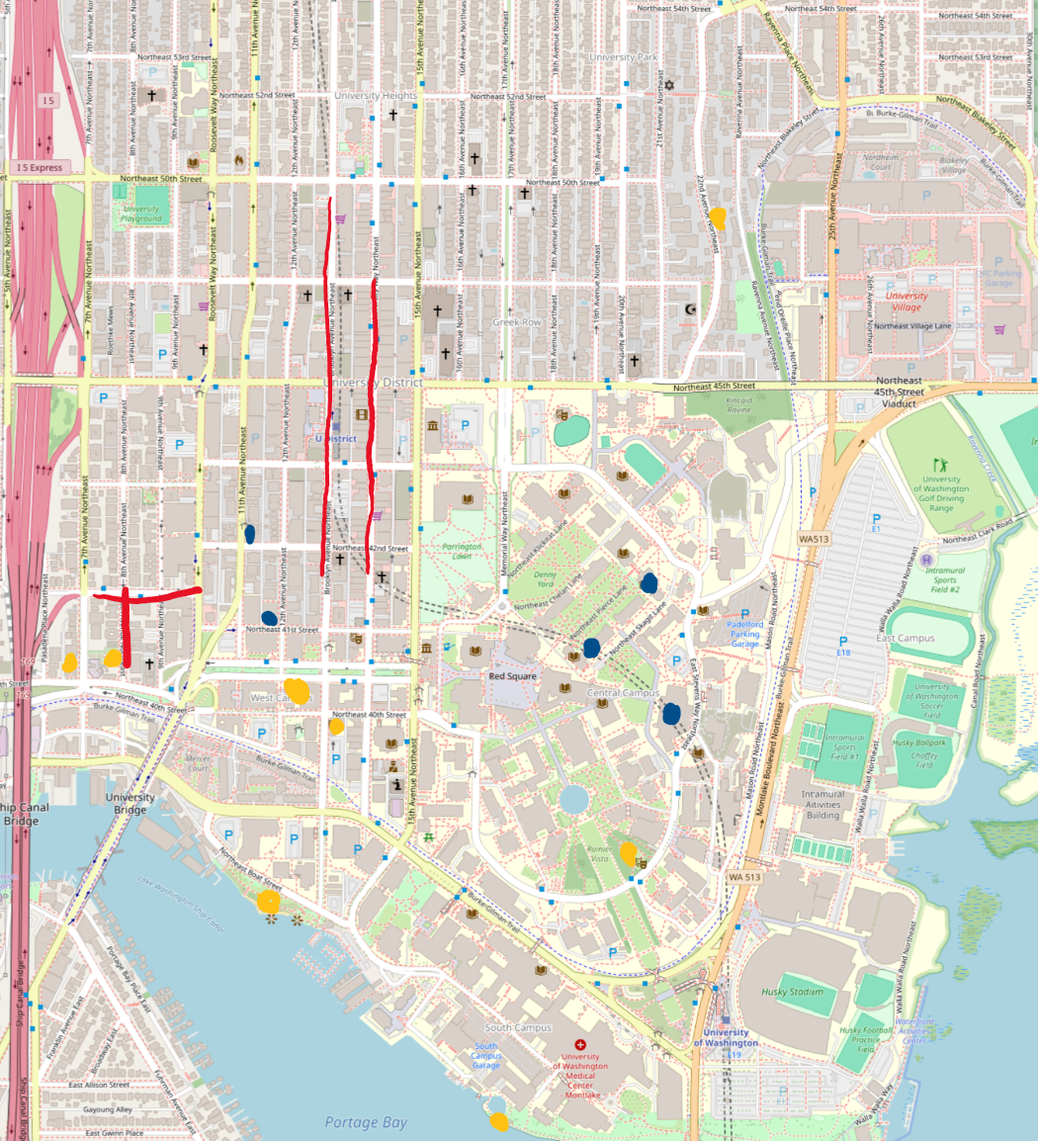
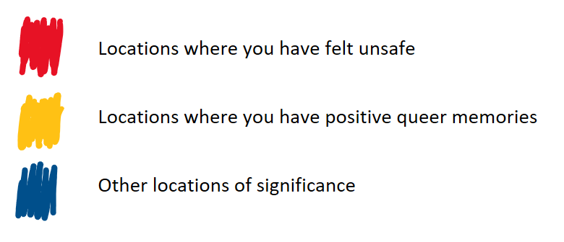
Methodology
Conversational peer interviews with queer UW students
  14 interviews total, 10-20 minutes
  Personal friends, members of queer spaces that I participate in, classmates from Geog 431
  Diversifying the pool: trans, non-binary, asexual, and BIPOC interviewees
First, more general questions about identity, belonging, safety, and queer joy. Then, interviewees presented with a map of the U District area and asked to color in locations that reminded them of queer joy and locations of uncomfortability.
My colored in map of U District

Slide 4
Interview Questions
After Presenting Map
Interview Process
Describe your identity (gender, sexual orientation, passions, what makes you you).
How does your identity impact the way you interact with your environment and others around you in public?
What factors play into whether or not you feel safe as a queer person in different settings?
Do you feel queer belonging at UW/U District? Why/why not?
Are there any specific organizations or spaces that you have found queer belonging in at UW/U District?
What does queer joy mean to you?
Are there any specific locations you associate with positive queer memories/queer joy? This could be regarding belonging, community, memories, etc.?
What is special to you about these places?
Are there any spaces where you have felt particularly unwelcome or uncomfortable because of your queer identity?
How have other identities you have (gender, race, age, family, education) impacted these experiences of belonging or unacceptance?

Slide 5
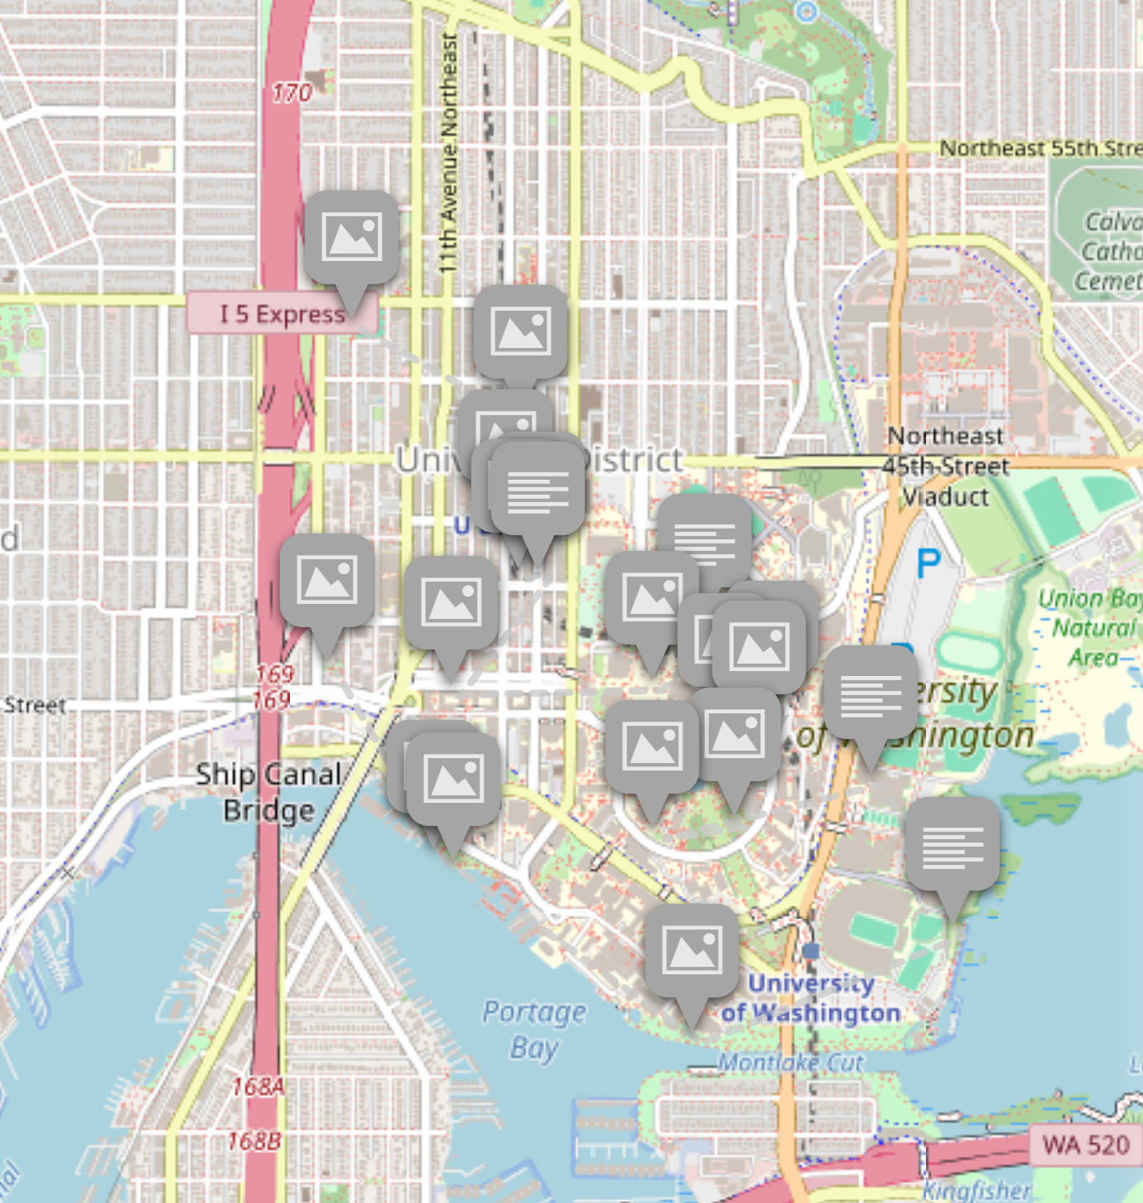
Queer Joy Map
This storymap shows how UW students’ experiences of queer joy are geographically distributed in U District. The map includes images, definitions of queer joy, poems, brief stories, and experiences with student organizations.
When getting feedback from my interviewees, the most rewarding part was hearing how meaningful seeing this project was to them, and how it made them happy seeing that queer joy is all around us.

Slide 6
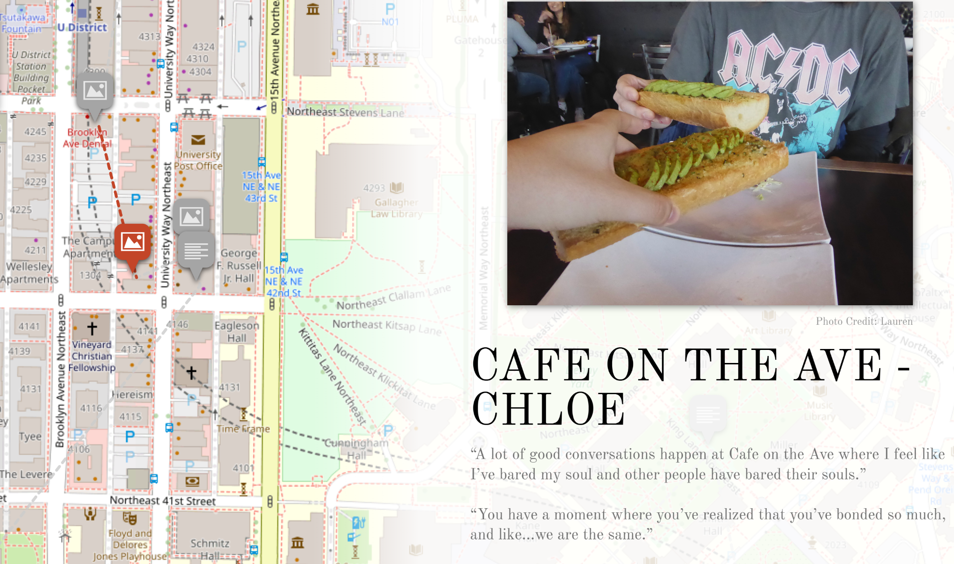

Slide 7
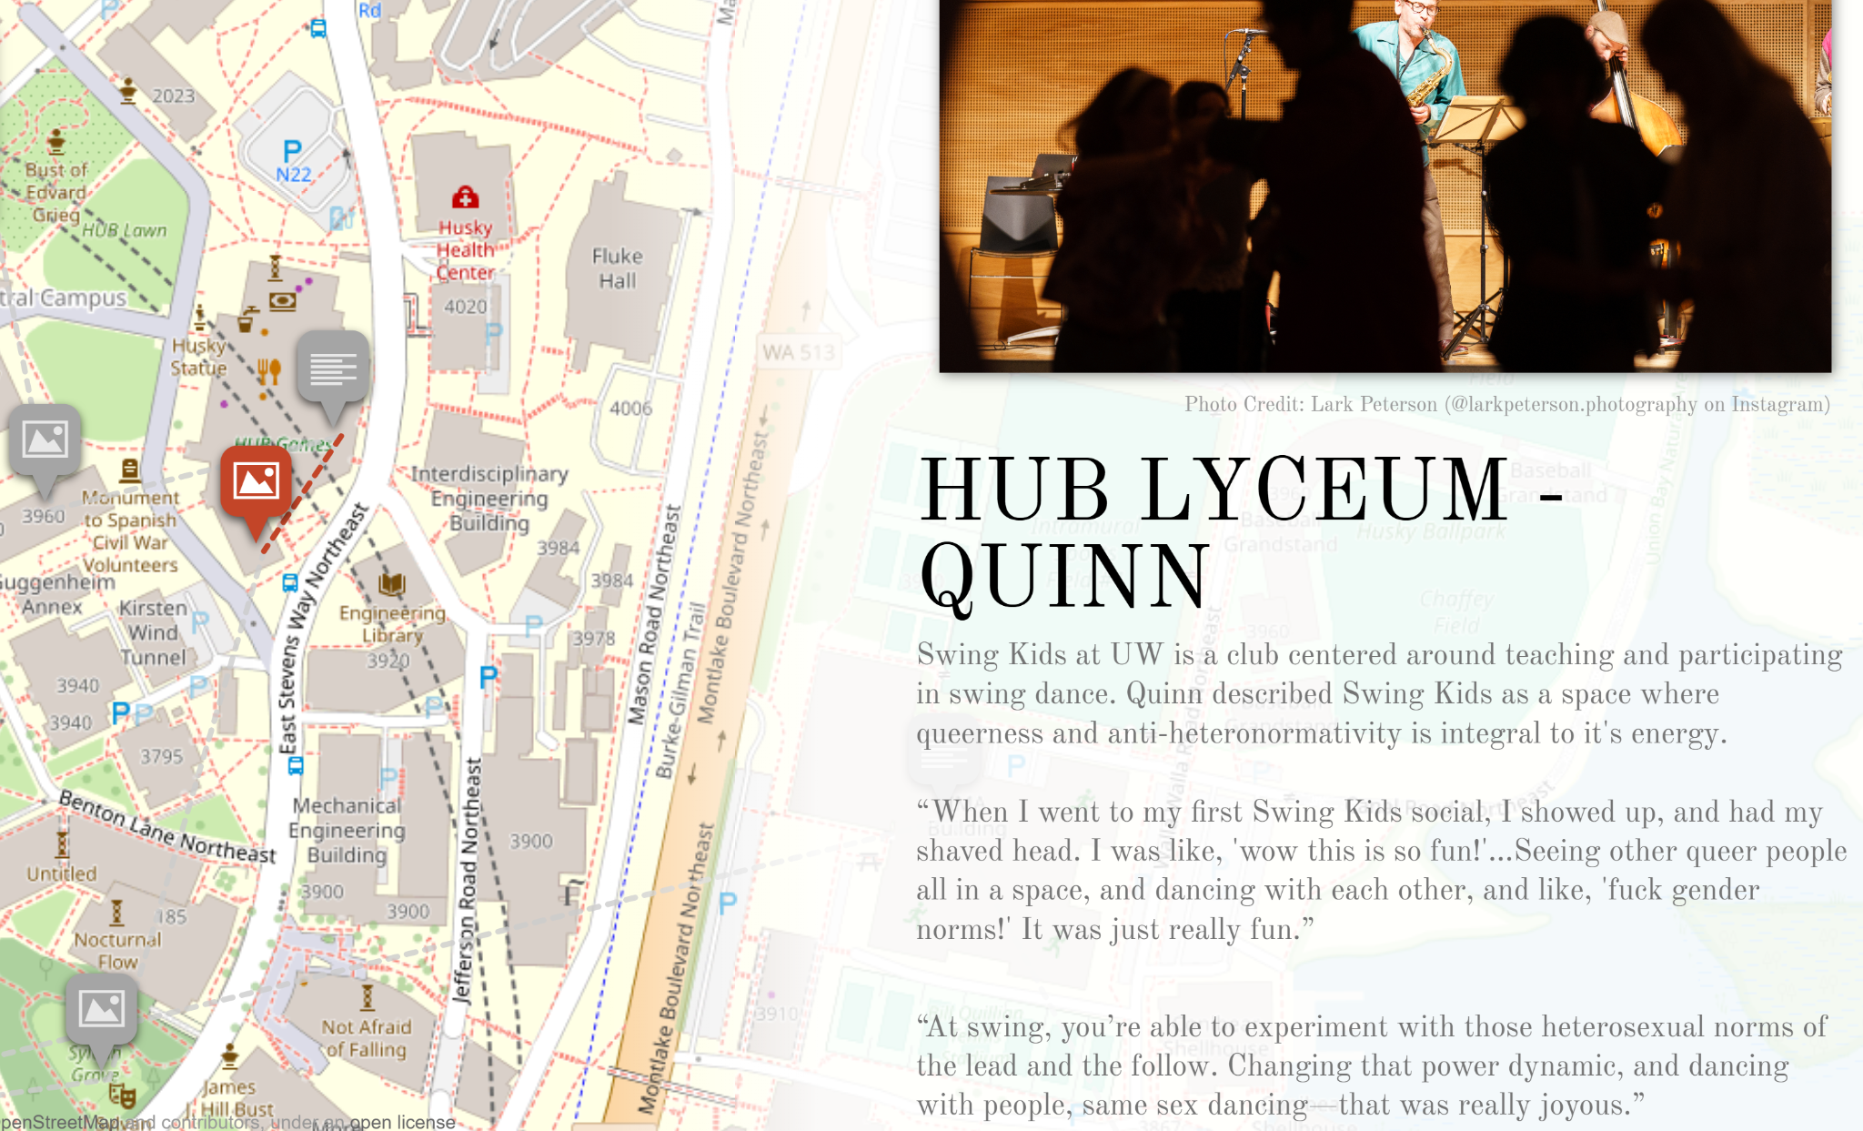

Slide 8
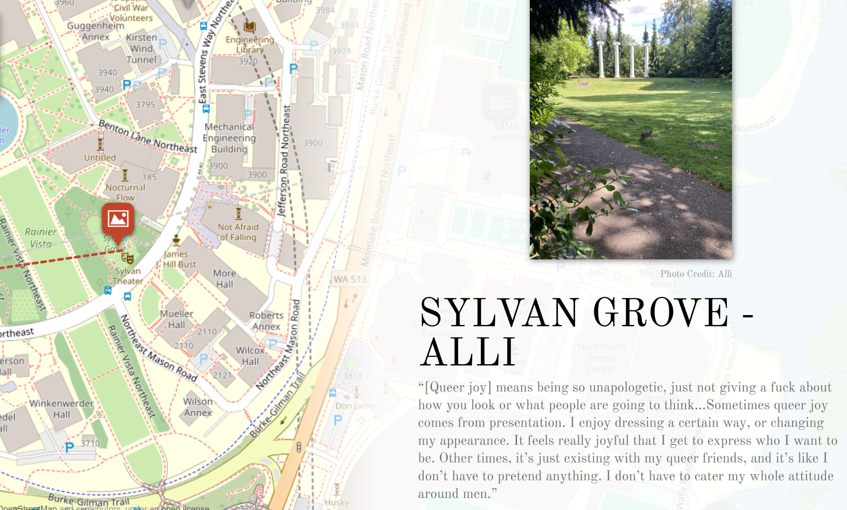

Slide 9
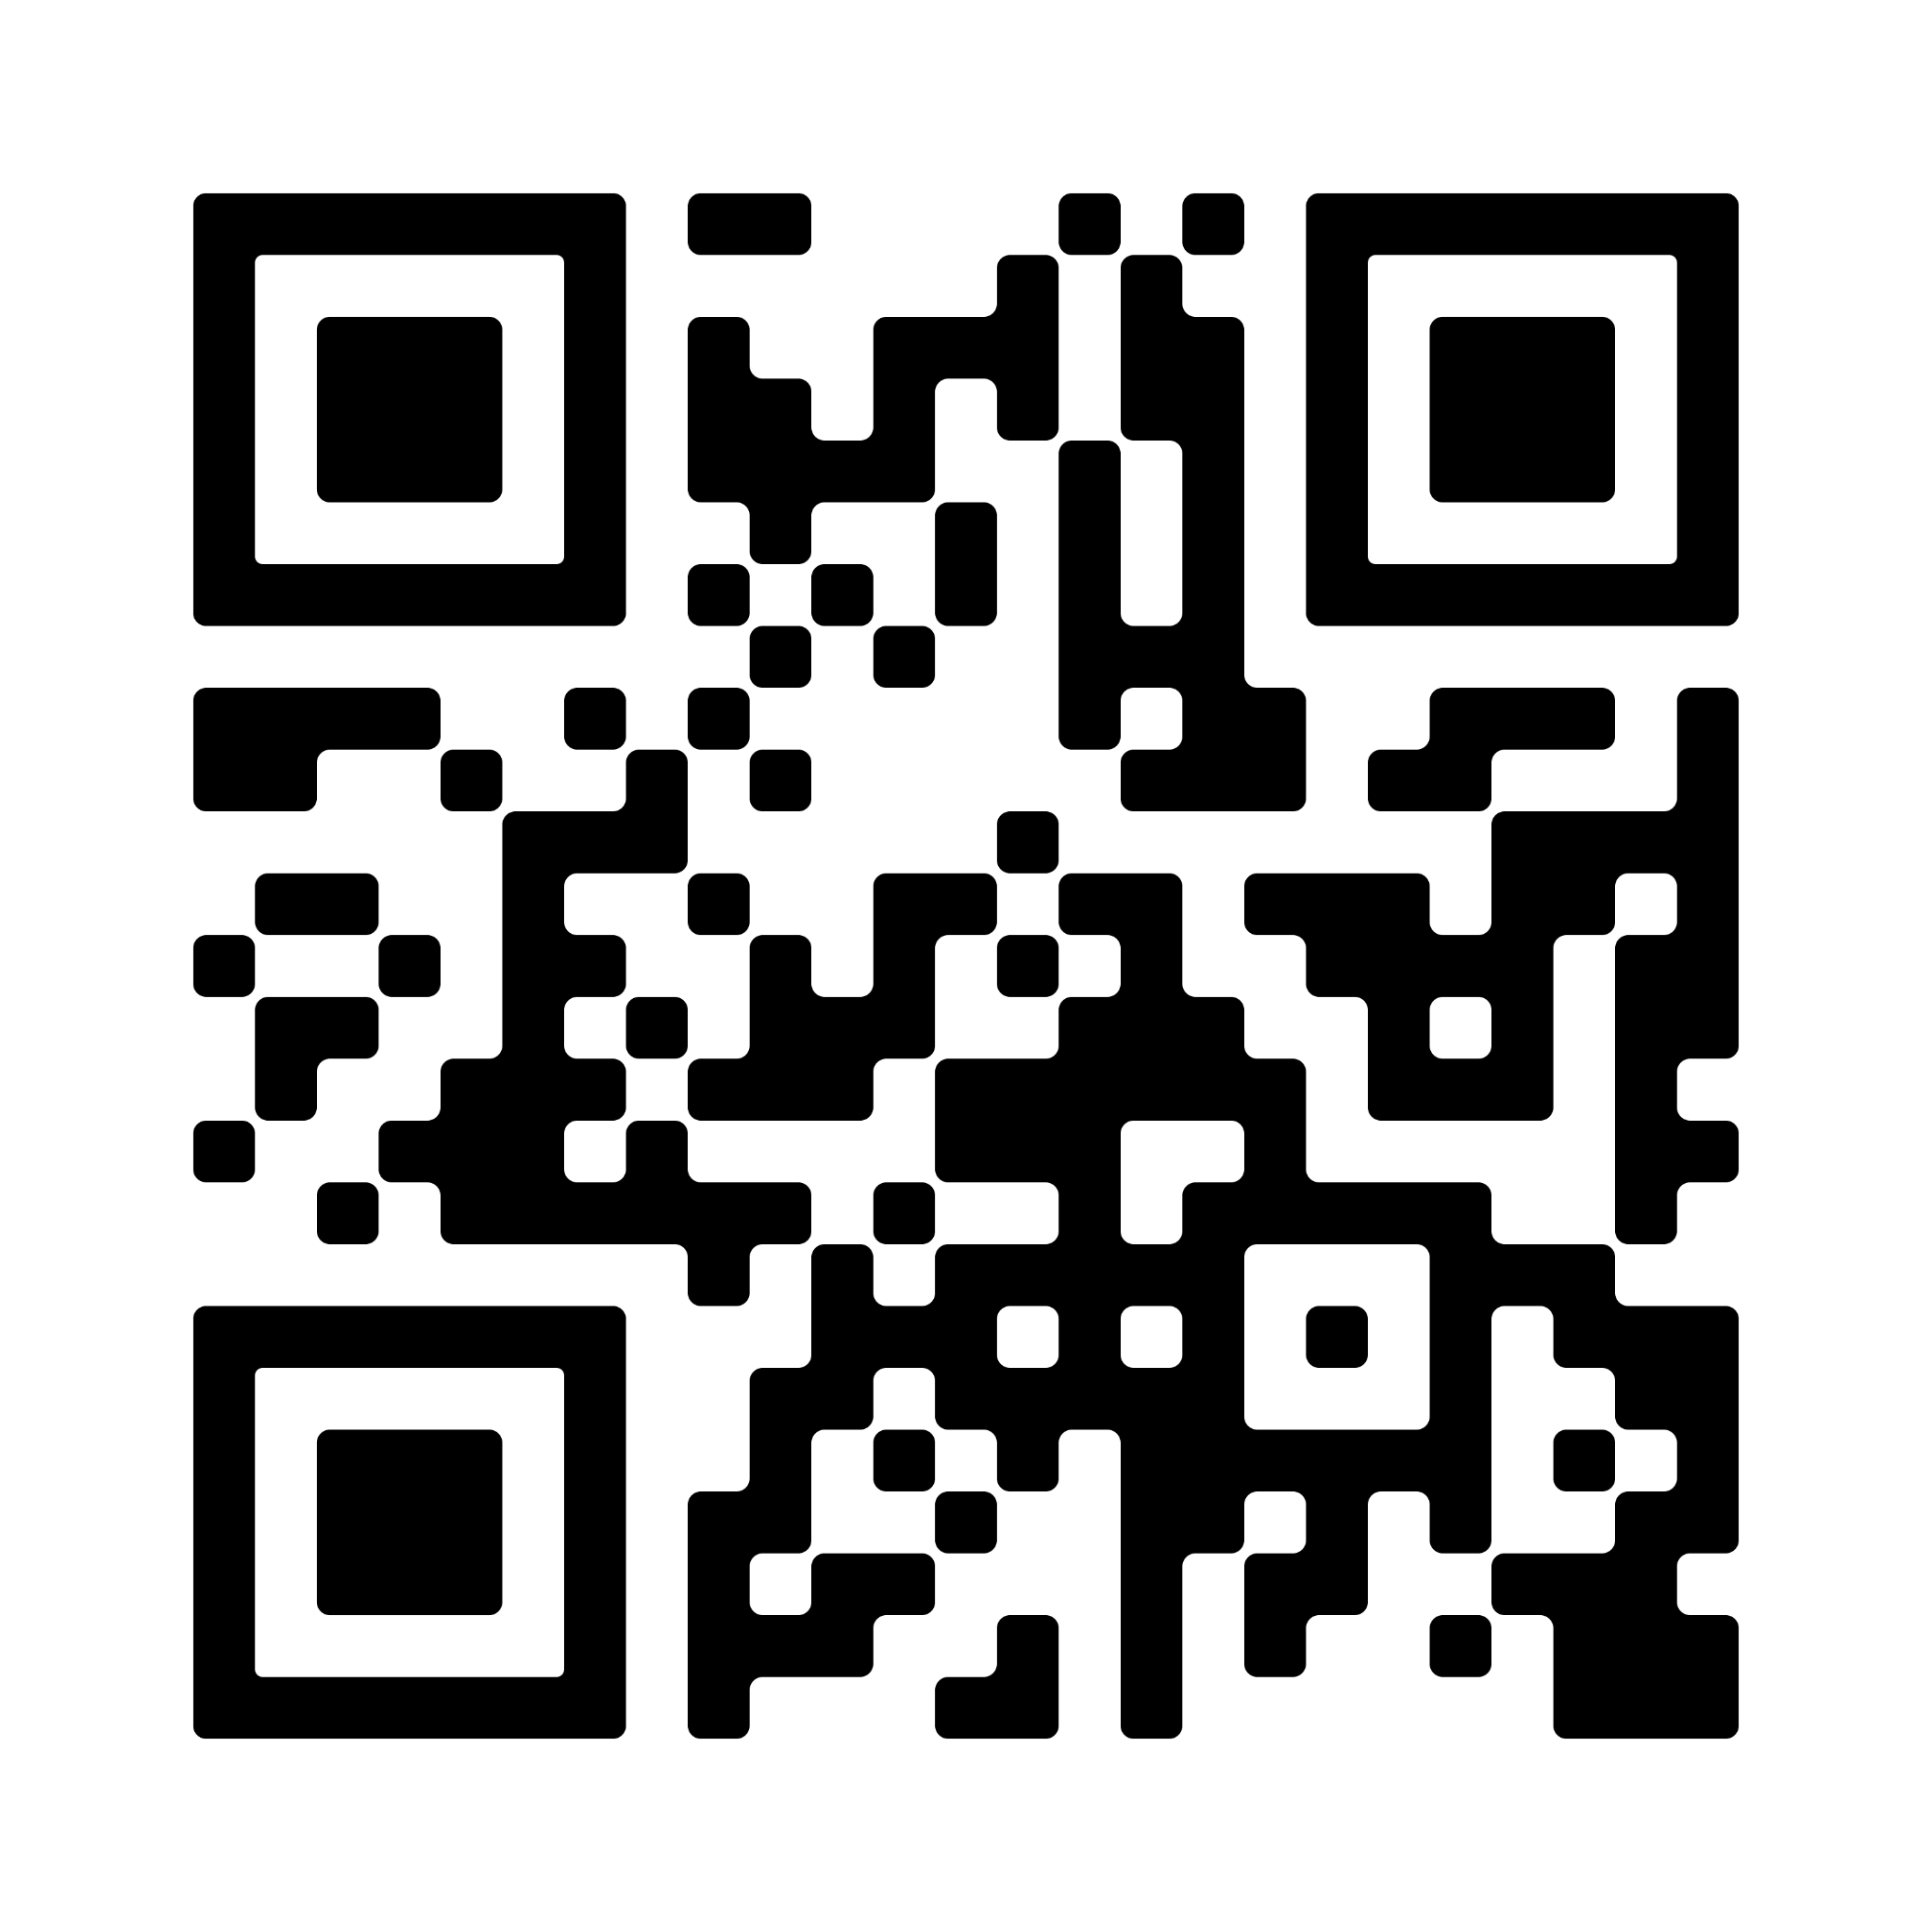
QR for Queer Joy Map!
Any follow ups - contact me!
Lauren Levenston
levens25@uw.edu
←
Scan to view interactive storymap!

