Slide 1
Micaela Deogracias, Outreach & Engagement Librarian
Christina Jones, Head, Education Library
Supporting Student Wellness at the Indiana University Bloomington
Education Library

Slide 2






Images by Noel Photos.

Slide 3


Images by Noel Photos.

Slide 4
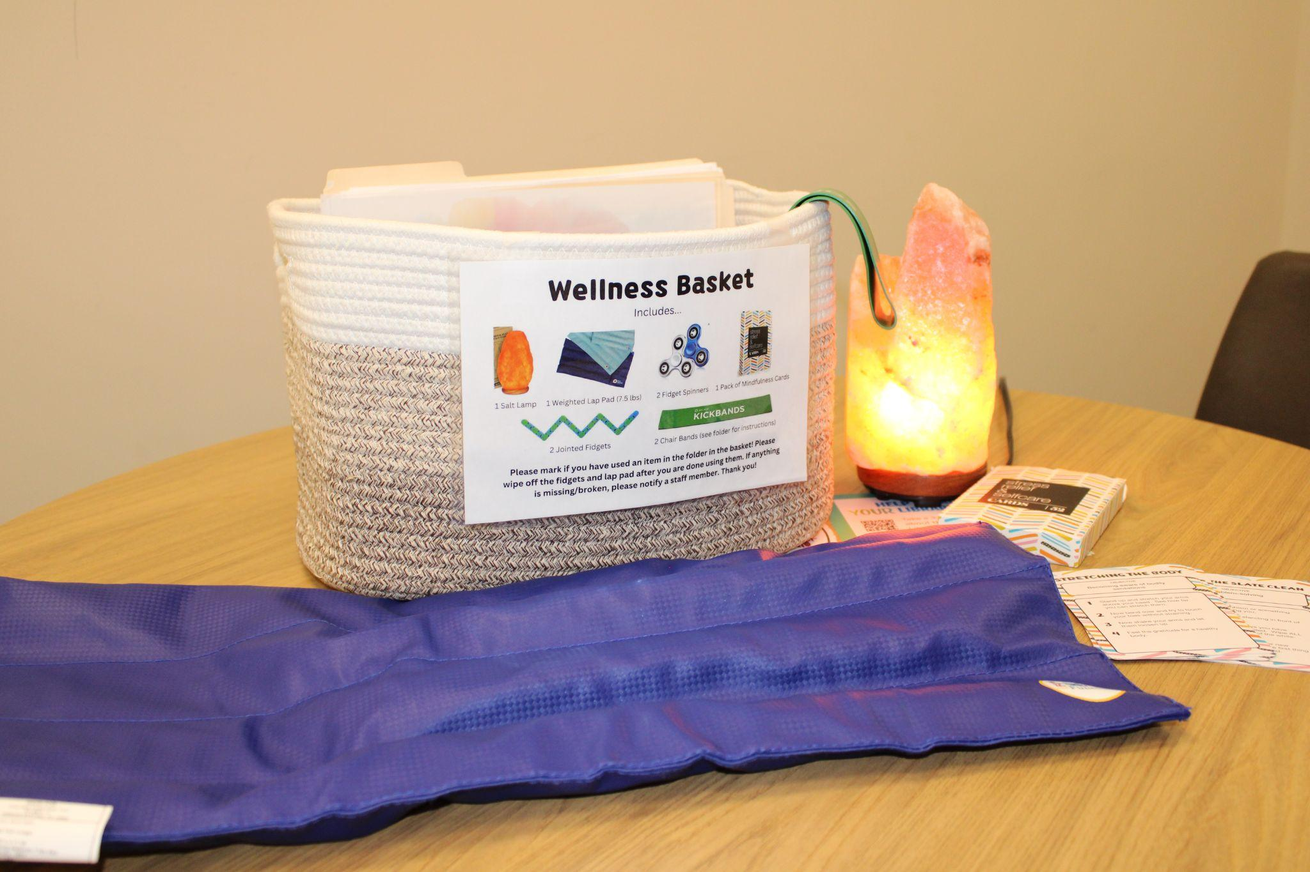
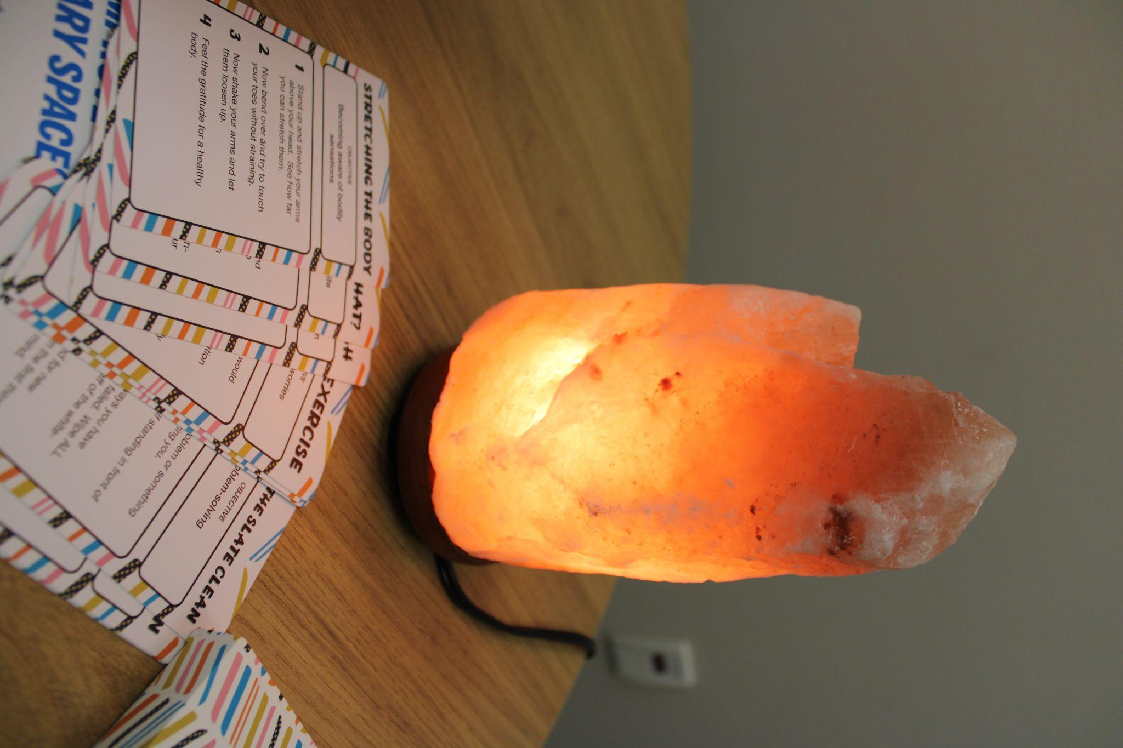

Slide 5
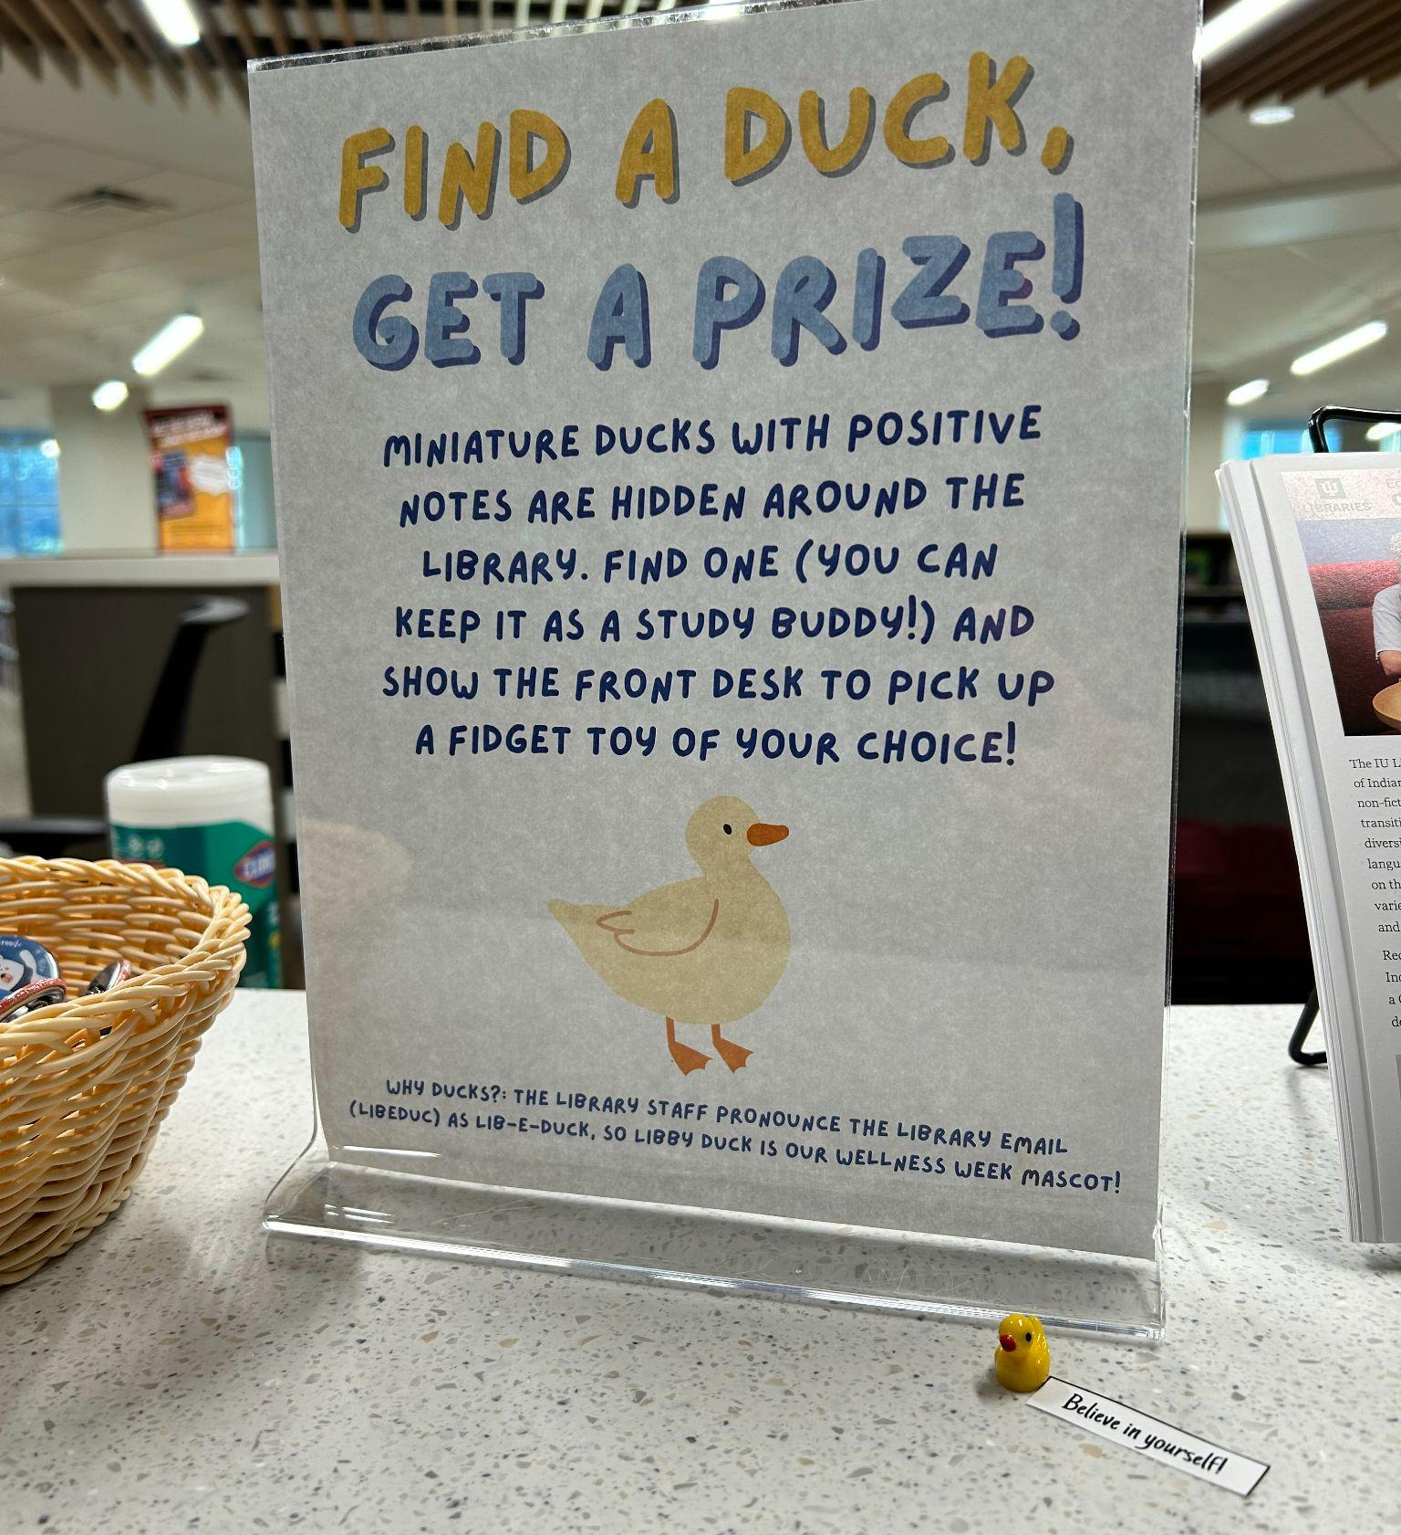
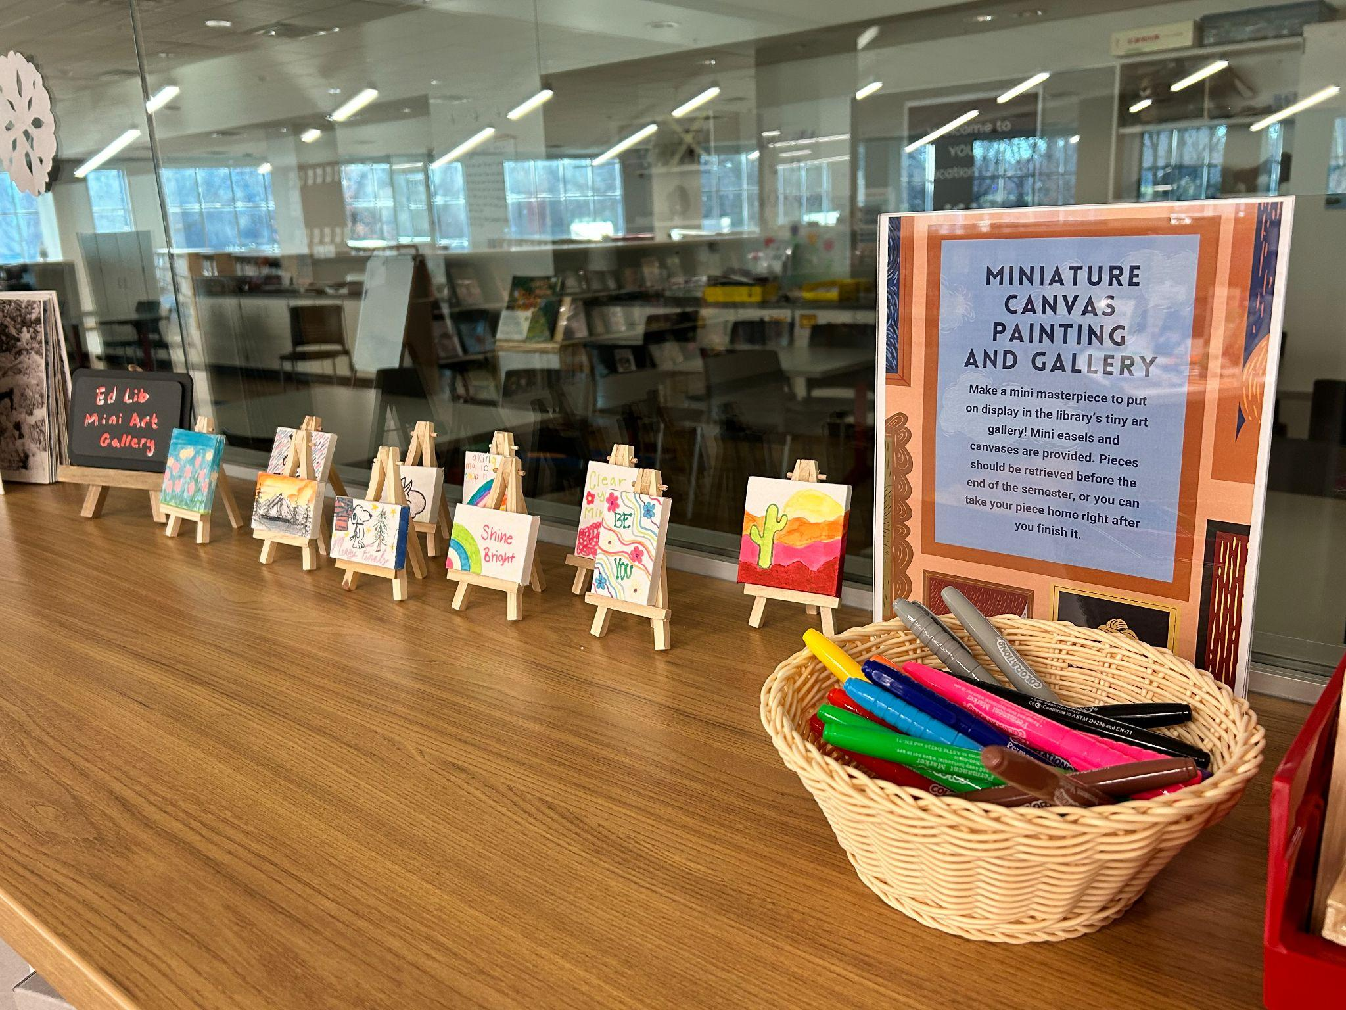
Programming

Slide 6
