Slide 1
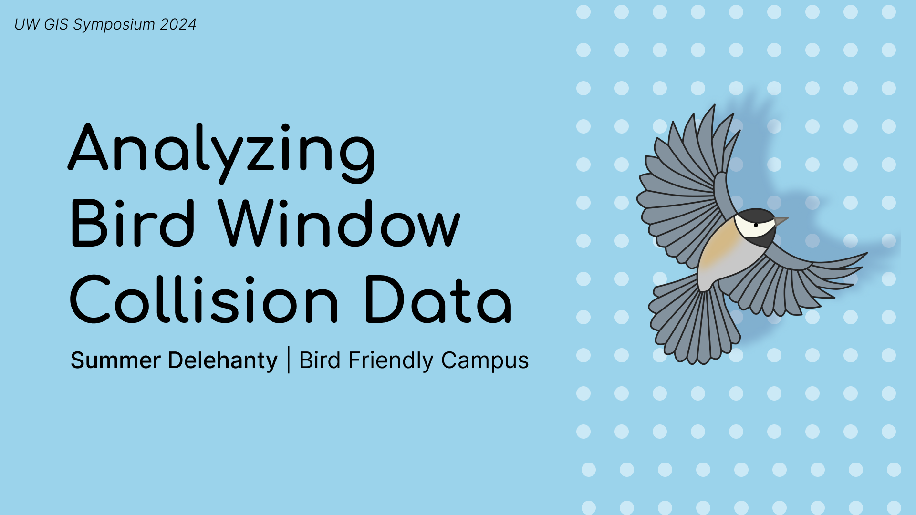
Bird Friendly Campus

Slide 2
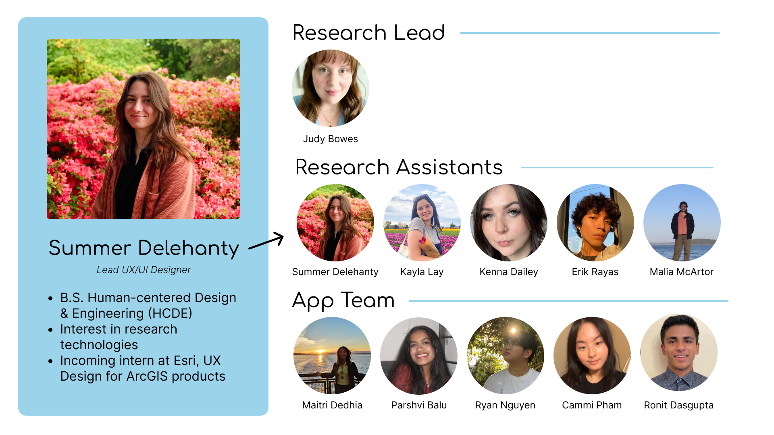

Slide 3
Make UW bird-friendly and more sustainable by evaluating campus for bird building collisions
Bird Friendly Campus

Slide 4
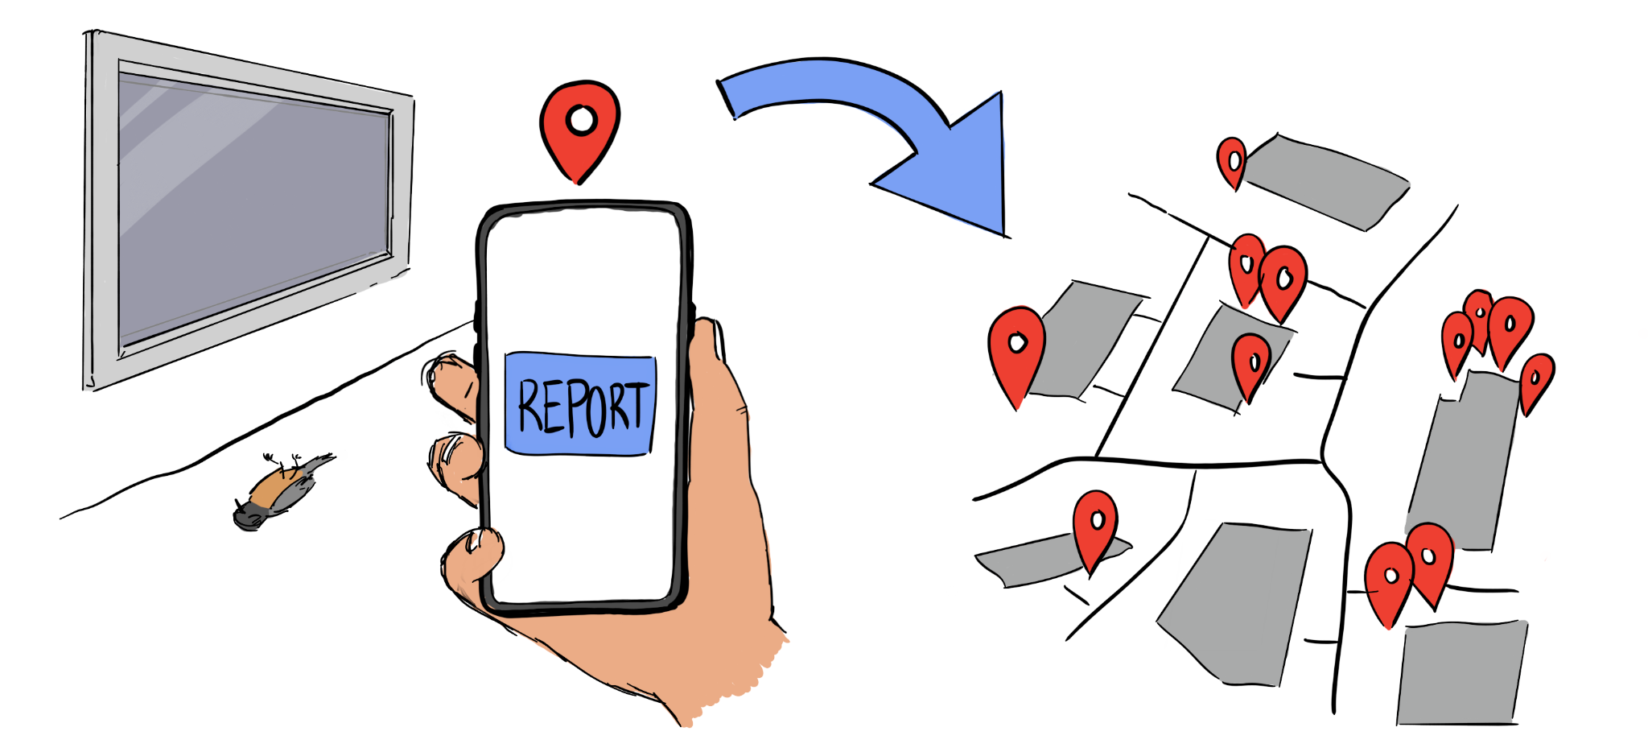
Volunteers report collisions on our app, Avian Impact
Bird Friendly Campus

Slide 5
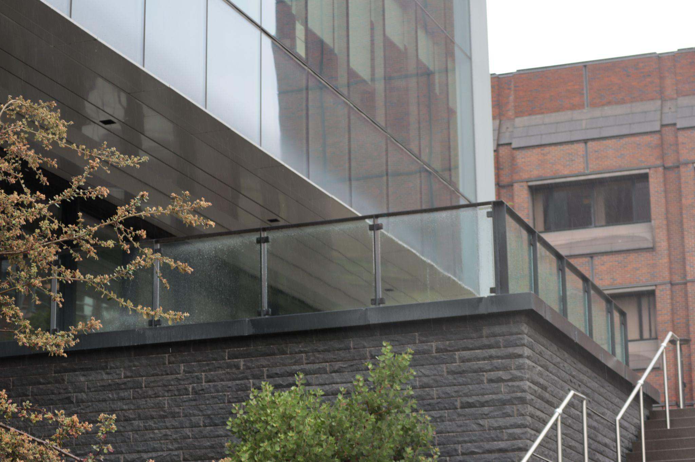
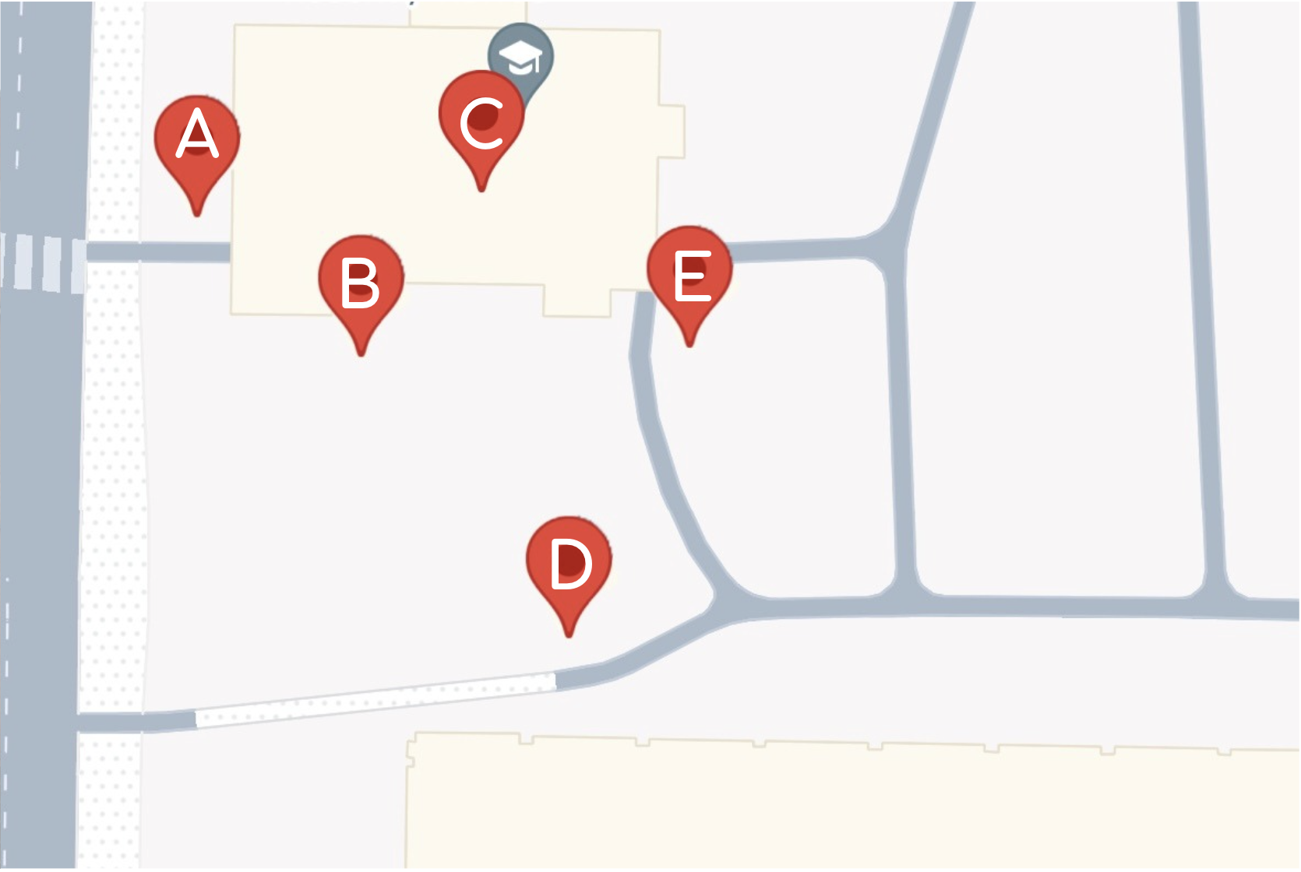
Which pin represents the glass railing?
Bird Friendly Campus

Slide 6
Which pin represents the glass railing?
Pin C
Bird Friendly Campus

Slide 7
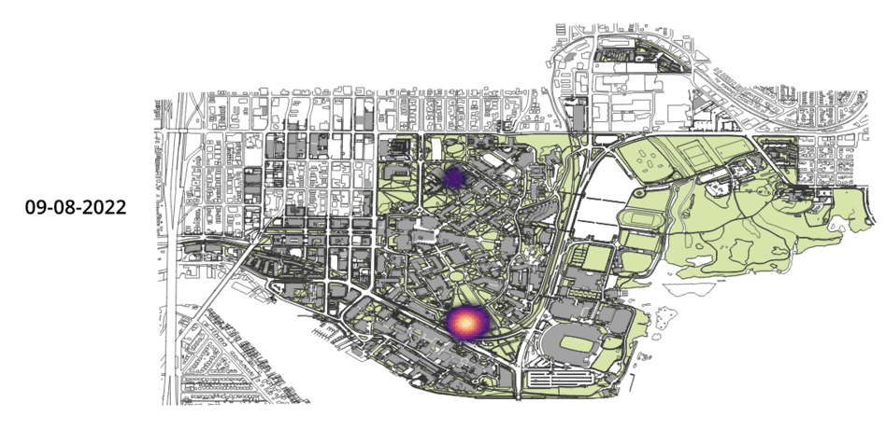
Bird Friendly Campus

Slide 8
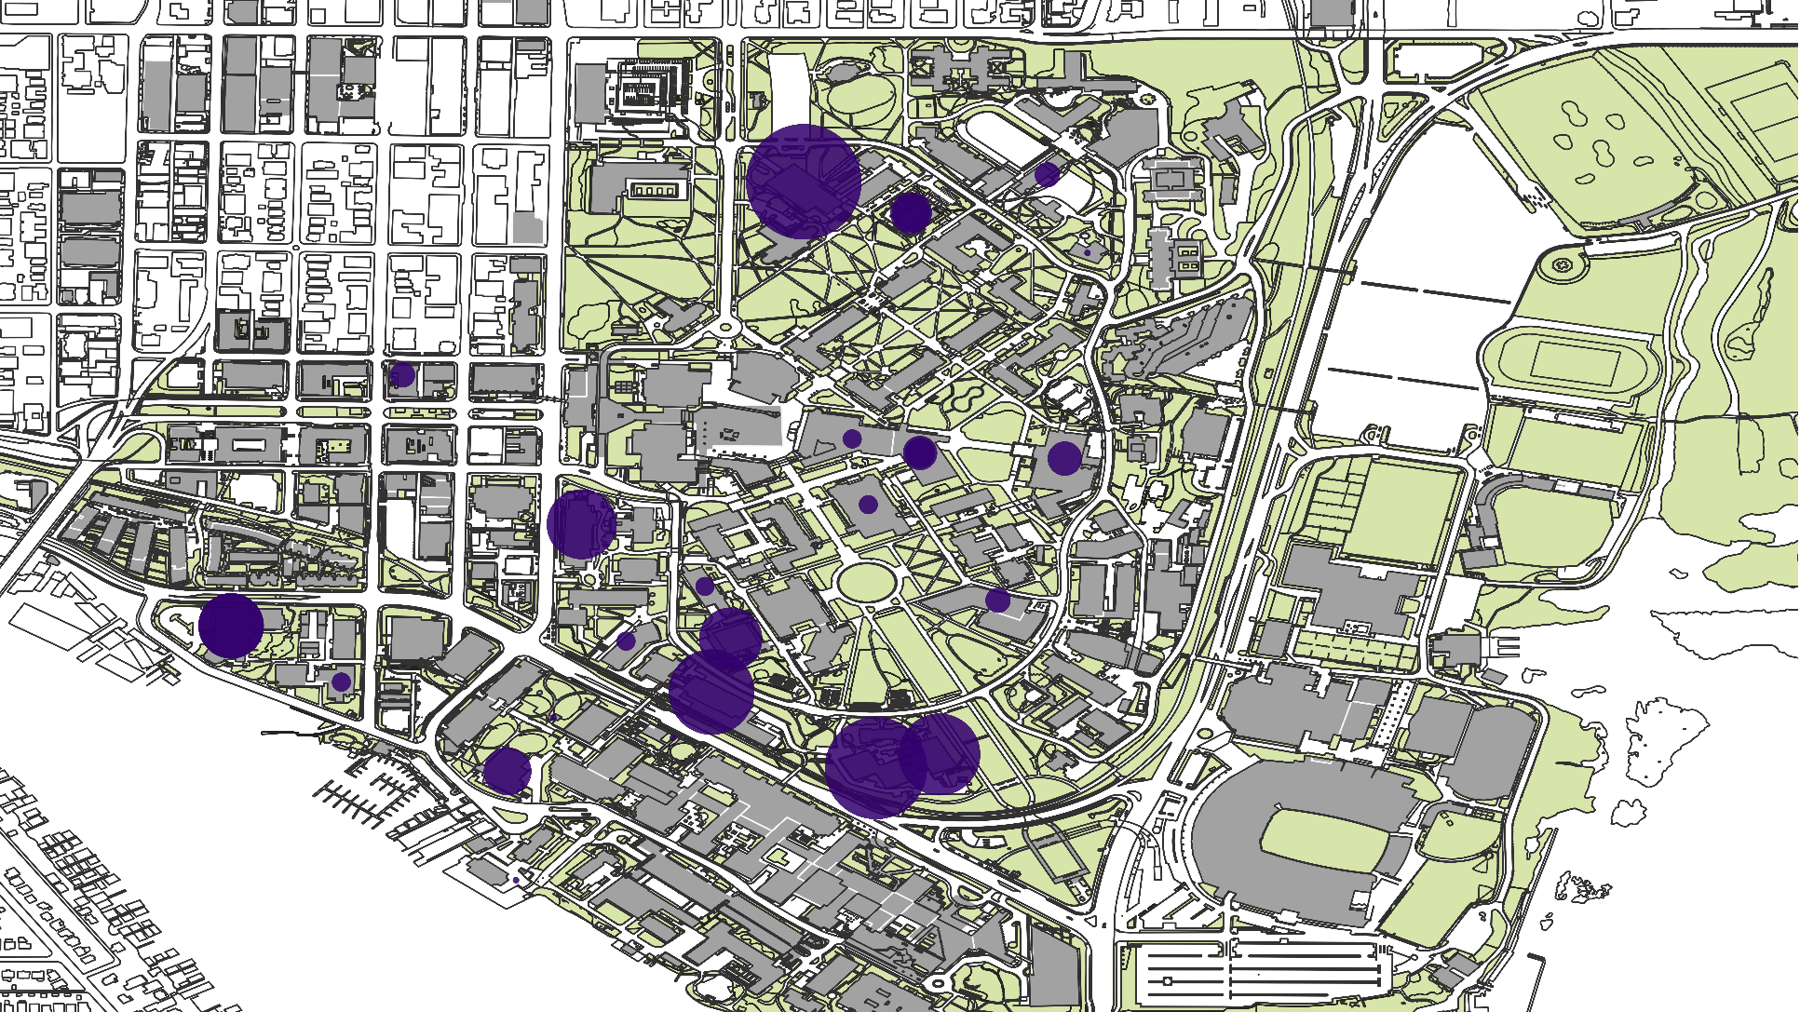
1
3
2
Bird Friendly Campus

Slide 9
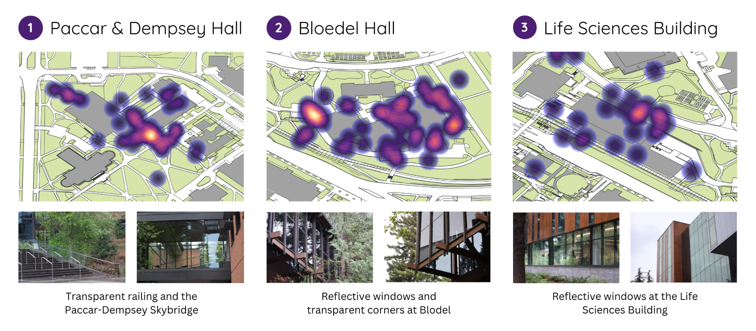
Bird Friendly Campus

Slide 10

Next Steps
Analyzing with tree data
  Looking at weather patterns
Crow distribution
Specific species (Varied Thrush)
Bird Friendly Campus

Slide 11
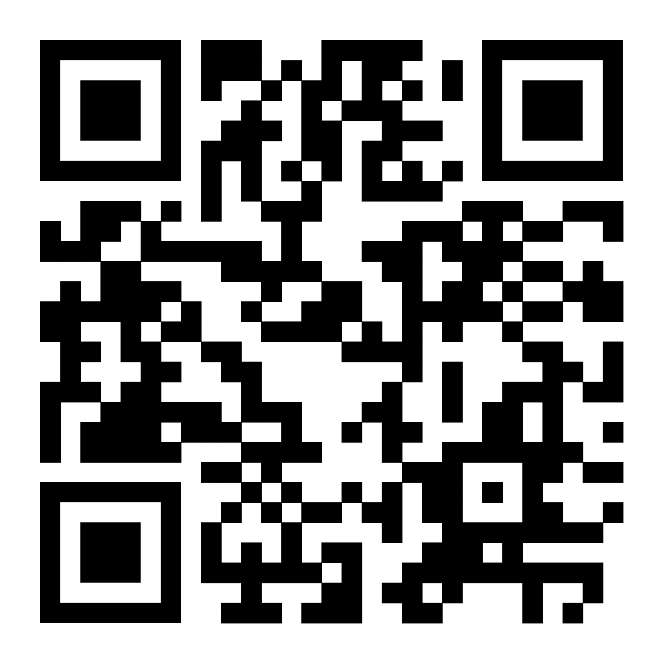
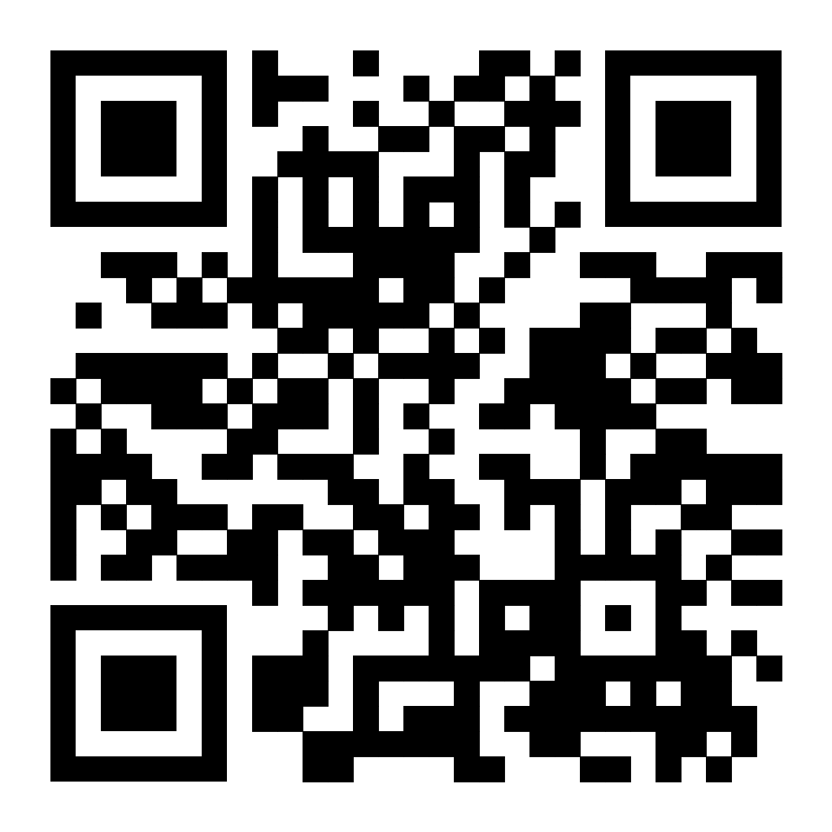
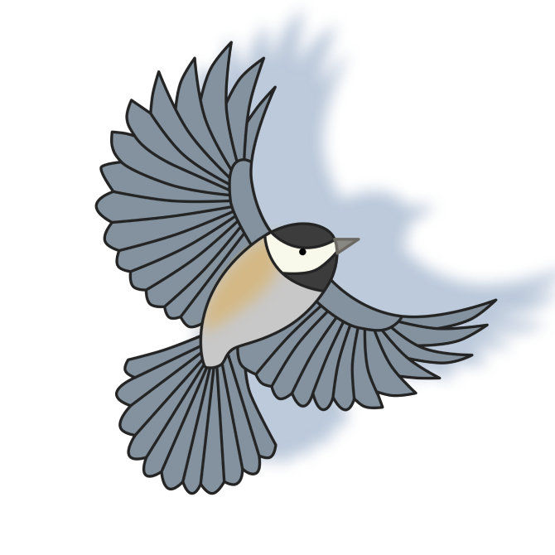

Our Website
Our App
Thank you!
Check out our gallery:
Gould Hall
M-F 10am - 5pm | Ends June 7
Bird Friendly Campus

