Slide 1
Geospatial Data Discovery & Access
and the
Matt Parsons
Geospatial Data and Maps Librarian
parsonsm@uw.edu
University of Washington Libraries
May 20, 2025
Notes:
Let’s start with some background and context. In August of 2024, the UW became one of the newest members of the Big Ten. I’d like to take some time to share with you one of the benefits of our new membership. Being in the Big Ten means that the UW has the opportunity to be participate in the Big Ten Academic Alliance (BTAA). The BTAA is a model of collaboration that advances academic missions, shares expertise, leverages resources and fosters collaboration on innovative programs among participating members.

Slide 2
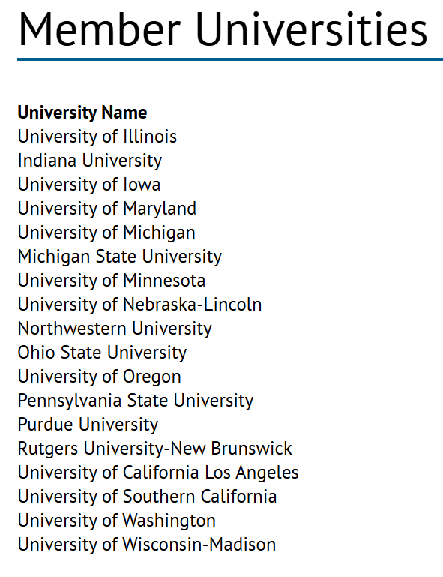
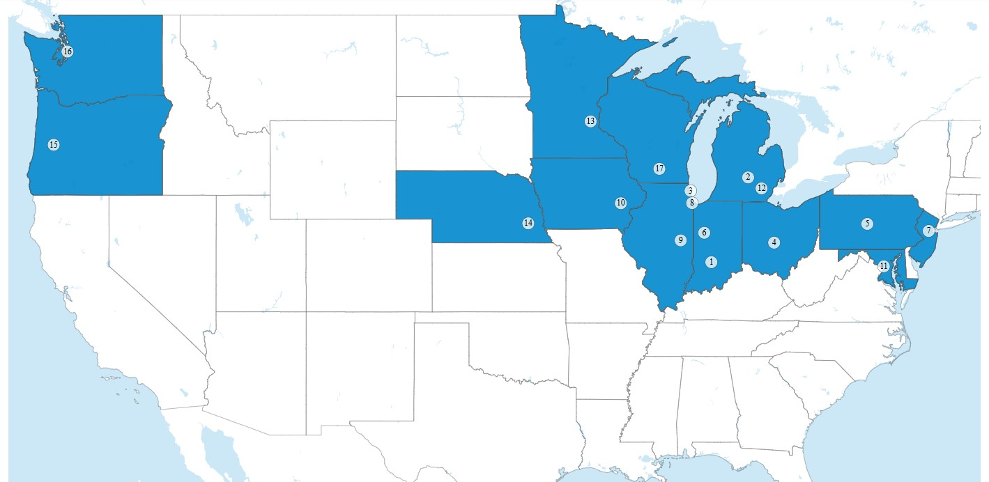
Notes:
Currently, there are 18 member universities in the BTAA. One of the BTAA initiatives is the BTAA Geospatial Information Network (GIN). 17 of the 18 BTAA universities comprise membership of the GIN. The University of Minnesota serves as the administrative and technical hub of the BTAA-GIN.

Slide 3
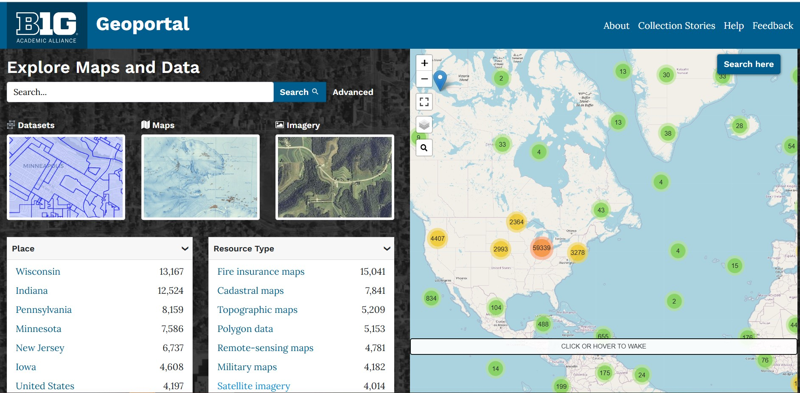
“The Big Ten Academic Alliance Geospatial Information Network (BTAA-GIN) is a collaboration of library-affiliated staff from the Big Ten Academic Alliance universities. We support geospatial research, foster connections among library professionals, and advance the development of open-source geospatial tools and resources.”
About the BTAA Geospatial Information Network (BTAA-GIN). (n.d.). https://gin.btaa.org/about/about-us/
Notes:
The BTAA-GIN is a collaboration of library affiliated individuals from the BTAA universities whose aim is to support geospatial researchers, make connections, and advance open-source geospatial tools. The GIN has two primary foci: Technical Infrastructure and Social Infrastructure. On the Technical side there is the BTAA Geoportal and open-source community contributions (GeoBlacklight, OpenGeoMetadata) and the Social side there is professional collaboration opportunities, an annual GIS conference, and other educational resources (tutorials, research guides).
The thing I want to primarily talk about and show all of you is the geoportal. The BTAA Geoportal aims to increase discovery of geospatial resources through a search and discovery application containing aggregated metadata records of maps, GIS data, web services, and more from sources related to the regions of BTAA institutions.

Slide 4
BTAA Geoportal
Over 100,000 records
Geospatial Data: Primarily from member institutional states
Scanned maps: Primarily from library collections
Web services: From multiple organizations and levels of government
Built on Geoblacklight
Aggregated metadata records
Searching by place, resource type, keywords, etc.
About the BTAA Geoportal. (n.d.). https://gin.btaa.org/technology/geoportal/
Notes:
Some more details about the BTAA Geoportal : over 100,000 records built on Geoblacklight:
GeoBlacklight is an open-source software application for discovering geospatial content, including GIS datasets, web services, and digitized paper maps. The GeoBlackligth platform offers previews, downloads, and access to data through web standards such as Web Mapping Services (WMS), Web Feature Services (WFS), the ArcGIS Rest API, and the International Image Interoperability Framework (IIIF).

Slide 5
BTAA-GIN Metadata Overview
Identify geospatial resource
Data Curator (U of Minnesota) obtains metadata: harvesting from APIs, from websites, and/or spreadsheets
Metadata processing: use of crosswalking to map metadata format with Geoportal’s schema, editing and validation
Ingestion into the Geoportal for search and discovery
https://docs.google.com/document/d/11pwm_G7OlaPsJ65ADHgrqB4UleGzF0r7e7wBKPgv_-4/edit?tab=t.0
Notes:
From BTAA-GIN Team Member Handbook

Slide 6
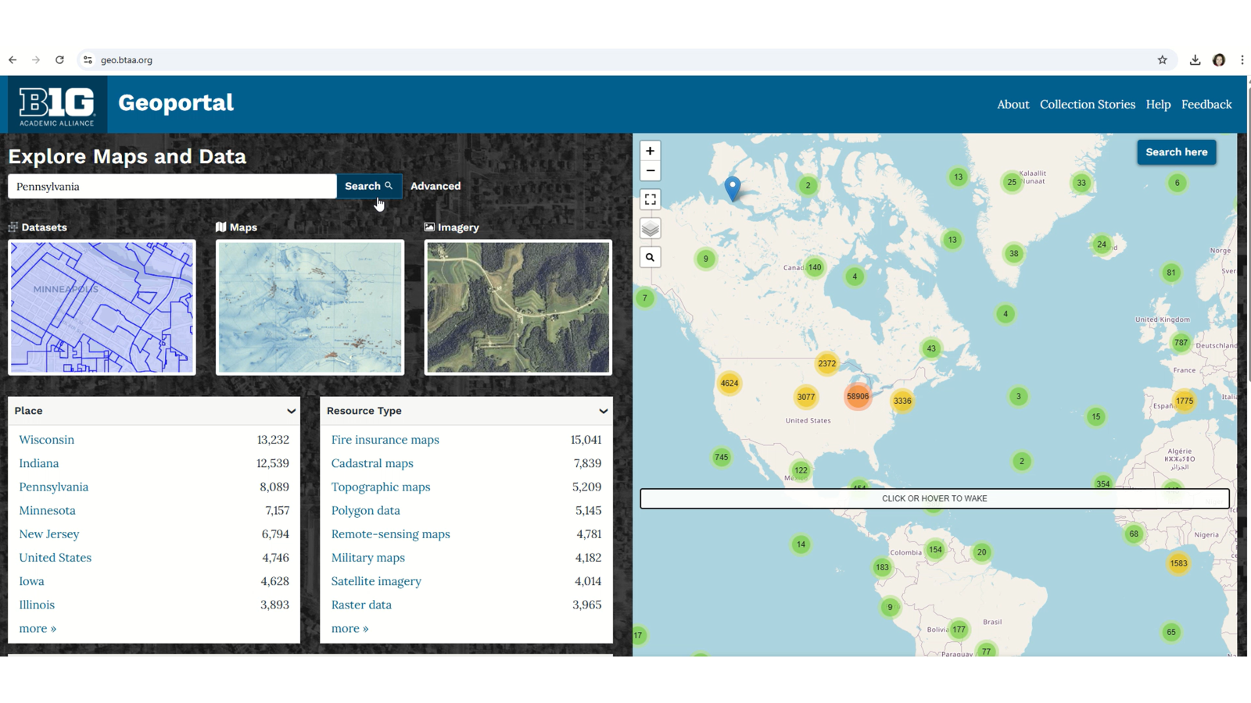
Search Strategies
Text
Wildcards (?, *)
Advanced
Facets
Map Search
BTAA Geoportal search strategies. (n.d). https://gin.btaa.org/guides/search-strategies/

Slide 7
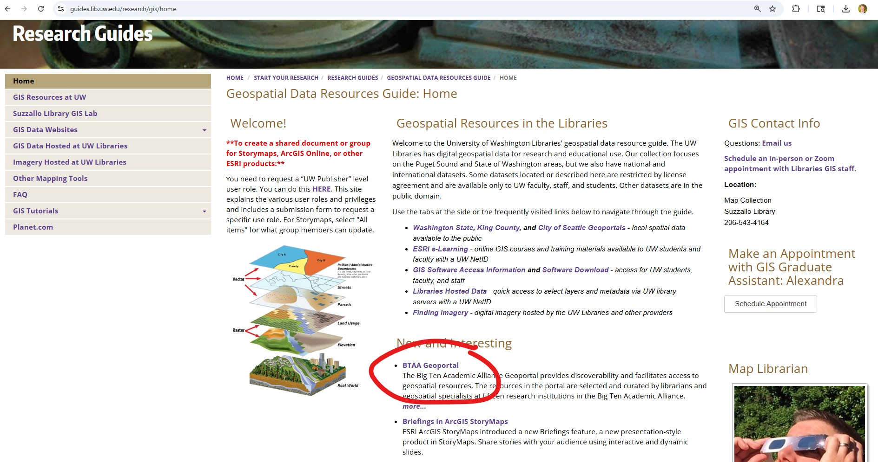
How do you find the BTAA-GIN Geoportal?
UW Libraries Geospatial Resources Guide: https://guides.lib.uw.edu/research/gis/home
https://geo.btaa.org/
Notes:
[LIVE DEMONSTRATION OF GEOPORTAL]

Slide 8
Thank you!
Matt Parsons
Geospatial Data and Maps Librarian
parsonsm@uw.edu
University of Washington Libraries
*Special thanks to Tara L. Anthony Geographic Information Systems (GIS) Specialist at the Donald W. Hamer Center for Maps and Geospatial Information, Pennsylvania State University, for allowing me to use and adapt her slide deck for this presentation.

