Slide 1
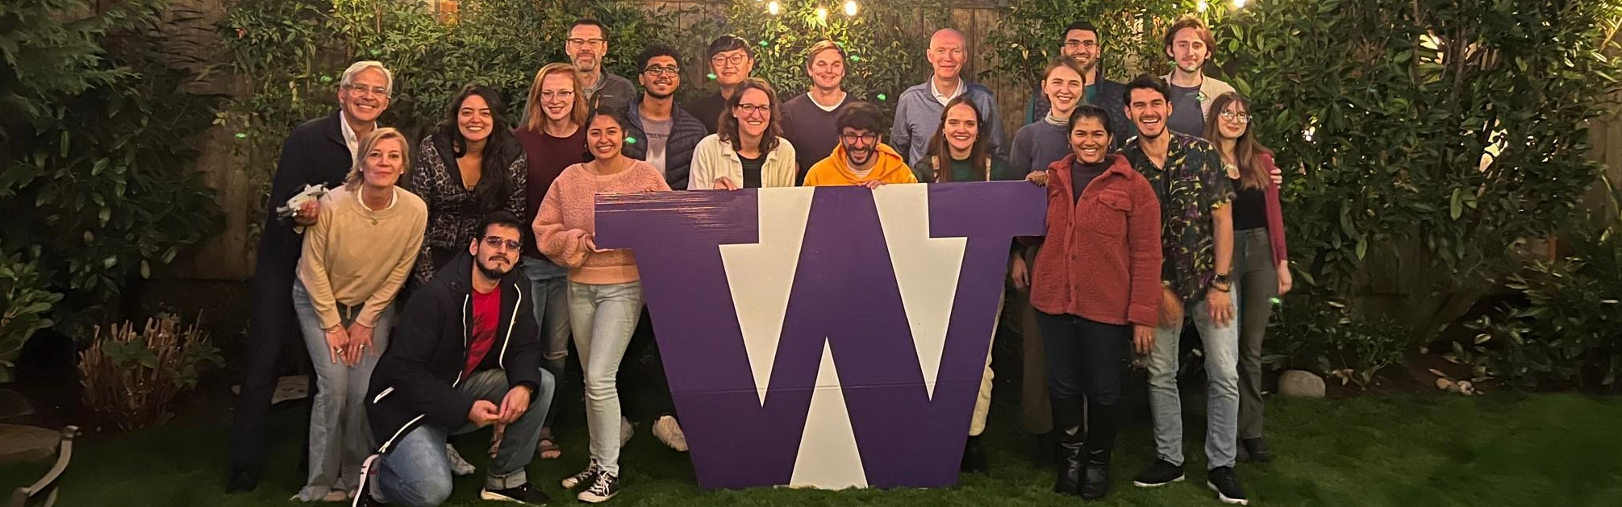
CEE – Geotechnical Group
Presented at the 2024 GIS Symposium – University of Washington
May/2024

Slide 2
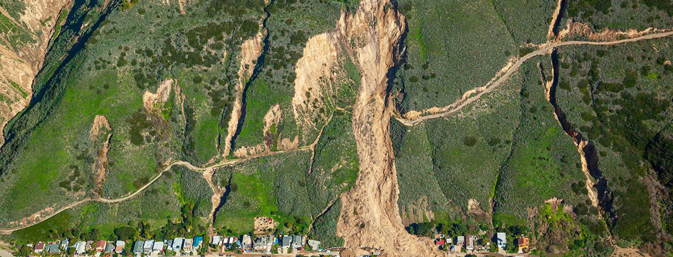


Natural Hazards
Students: Luis Angel Guerrero Hoyos, Daniel Acosta Reyes, and Nishanthi Perera
Advisor: Joseph Wartman
May 18, 2024
Notes:
Hello everyone, I will be talking on behalf of Joseph Wartman's research team which is focused on addressing natural hazards...

Slide 3

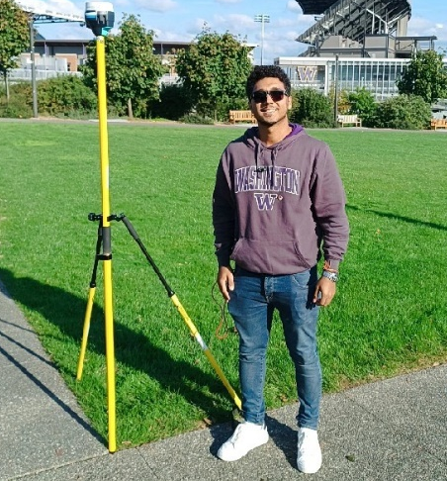
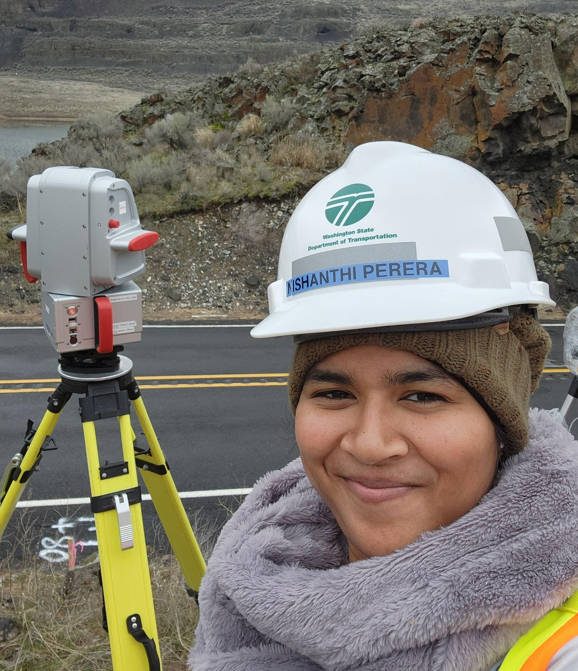
Geohazards Group
Landslides & Remote Sensing
Rockfall
Daniel Acosta Reyes
Graduate Student (PhD)
Luis Guerrero
Graduate Student (MS)
Nishanthi Perera
Graduate Student (PhD)
Notes:
… The team is conpounded by me...Luis Angel Guerrero Hoyos, Master's student and two PhD students Daniel Acosta and Nishanti Perera. Daniel and I are focusing on regional-scaled landslides assessment and remote sensing whereas Nishanti is focusing on rockfalls.

Slide 4
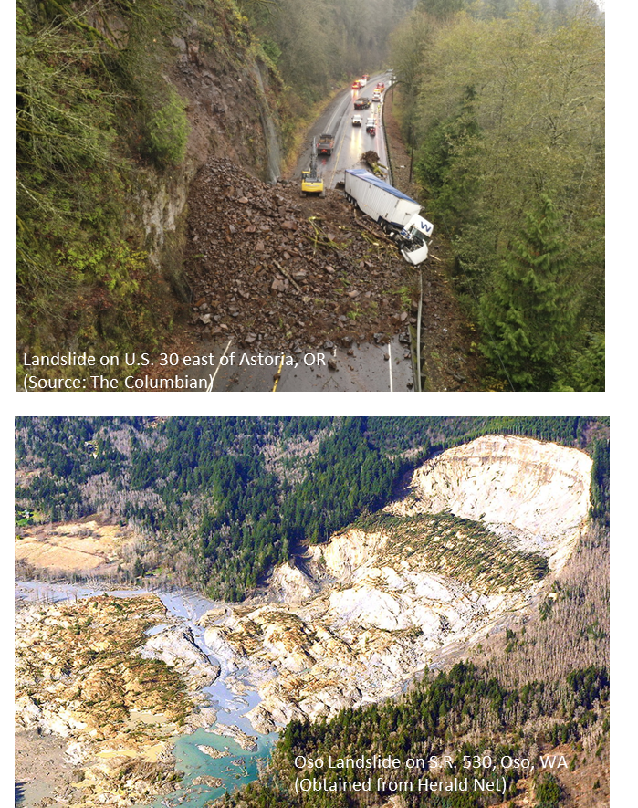
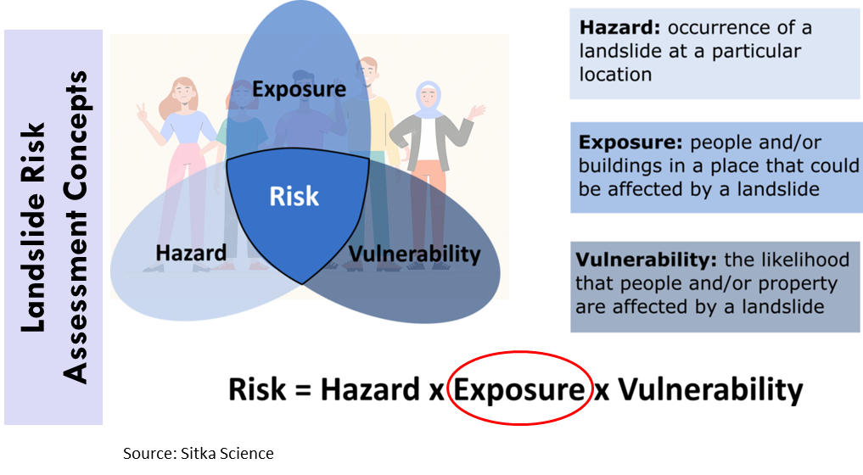
Landslides occur across all the United States
Oregon and Washington state rank among the most landslide-prone areas in the US!
Notes:
Landslides cause losses in term of both assets and human lives worldwide and in the US. According to the records, Oregon and Washington are among the topmost landslide-prone states.
- One of our group's research agendas estimates landslide hazard, exposure, and vulnerability. Combining these elements allows us to conduct a risk assessment.
- One recent work by Daniel Acosta focused on landslide exposure, which quantifies the number of buildings and people in landslide-susceptible areas.

Slide 5
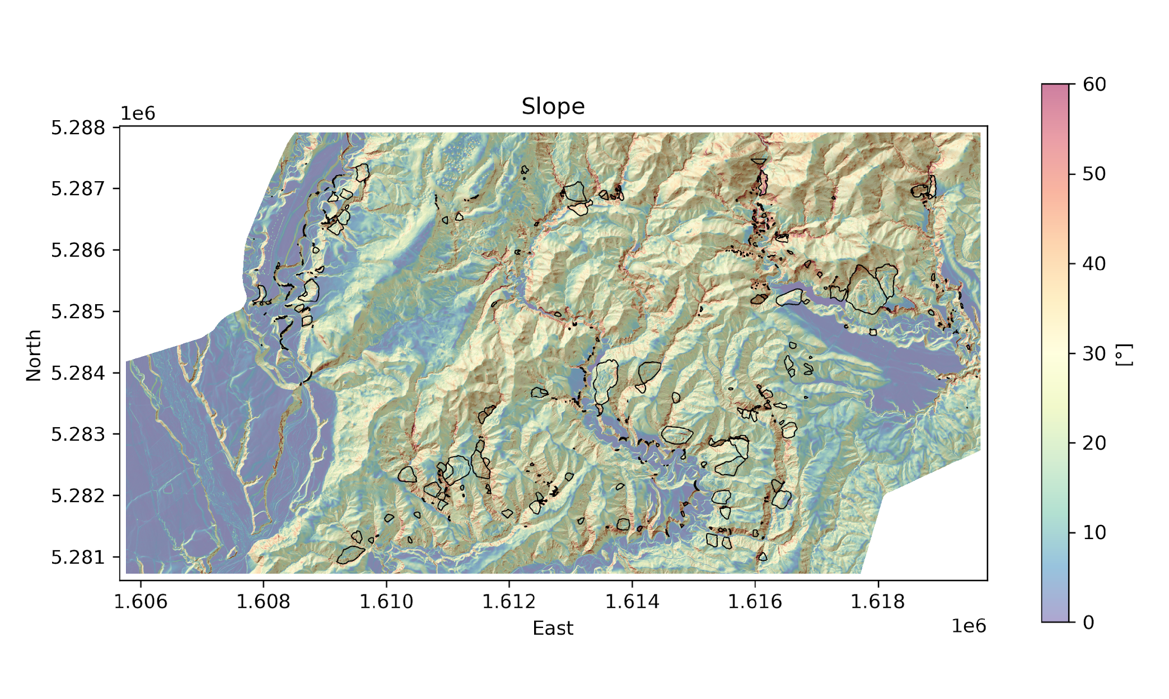
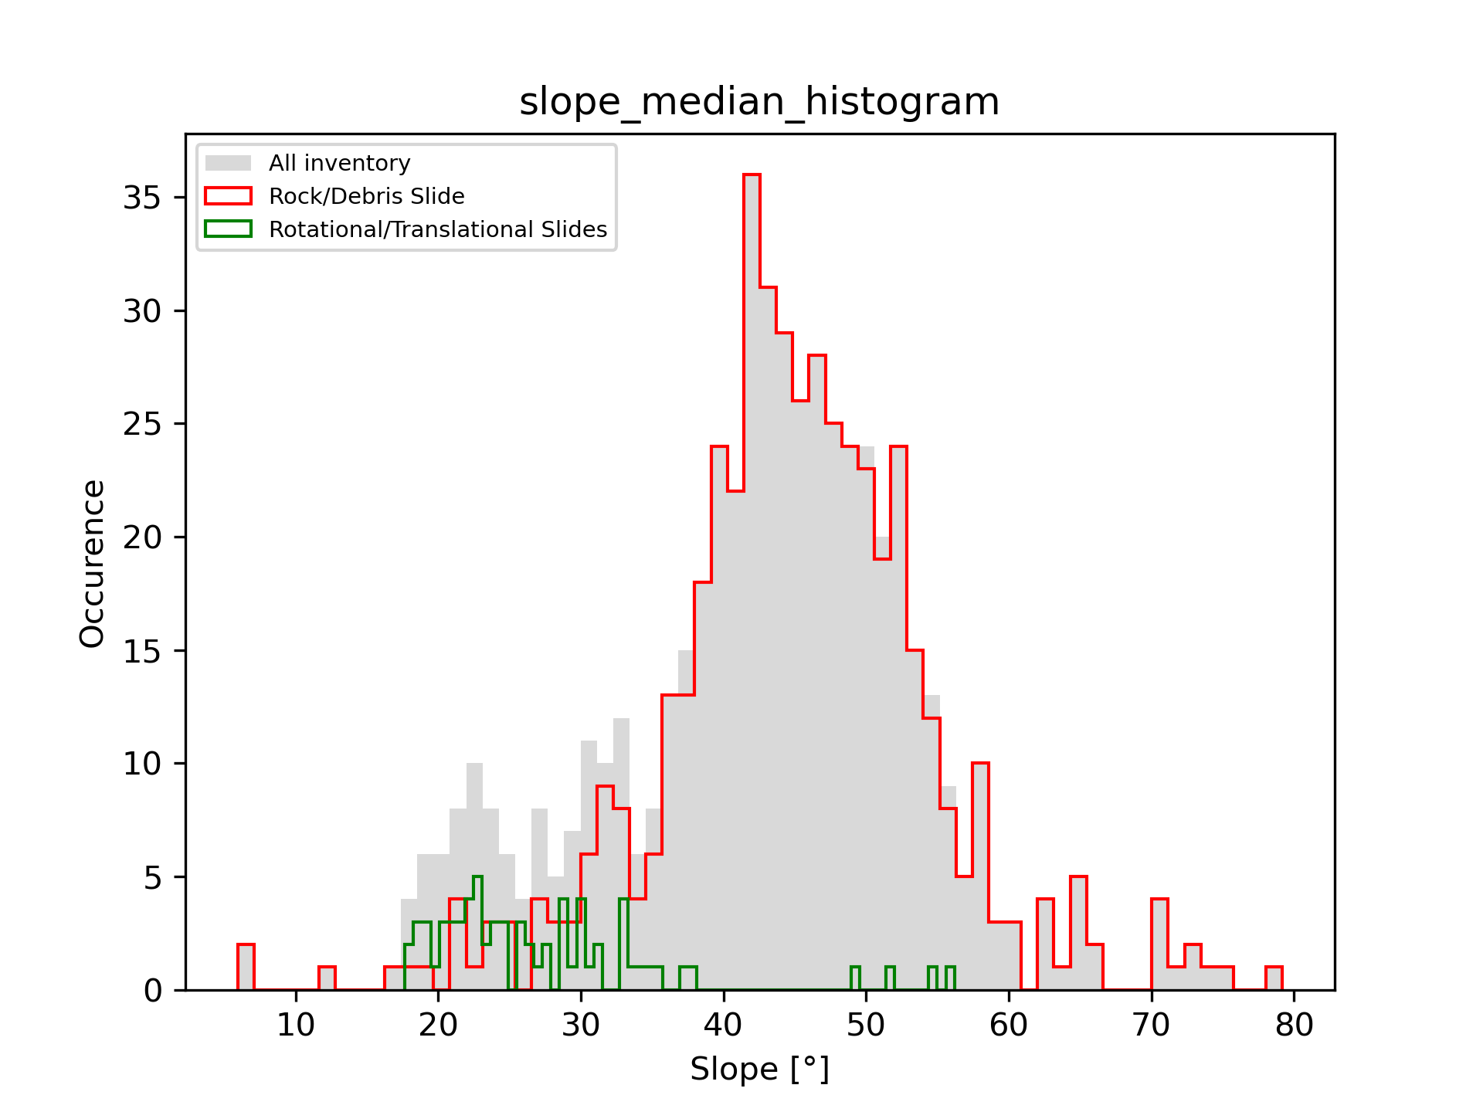
Pre-Existed Landslides vs Earthquake-Induced Landslides and Reactivations
Landslides Inventories (before & after earthquake).
Remote sensing (LiDAR, Ortho-imagery).
Elevation difference & Multimodal Model training.
Luis Guerrero, MS Graduate Student
Notes:
My research uses remote sensing technologies as LiDAR to address the landslies:
What:
1. Where specifically are earthquake-induced landslides likely to occur in a terrain already marked by and conditioned by existing landslides?
2. Will these earthquake-induced landslides evolve with time?
3. True or false: "Hazards following the EQ will continue for many years and need to be managed“?
With the use of remote sensing, landslide inventories, geospatial data analysis we are trying to determine the terrain features that are related to the pre-existed landslides and those induced by earthquakes

Slide 6
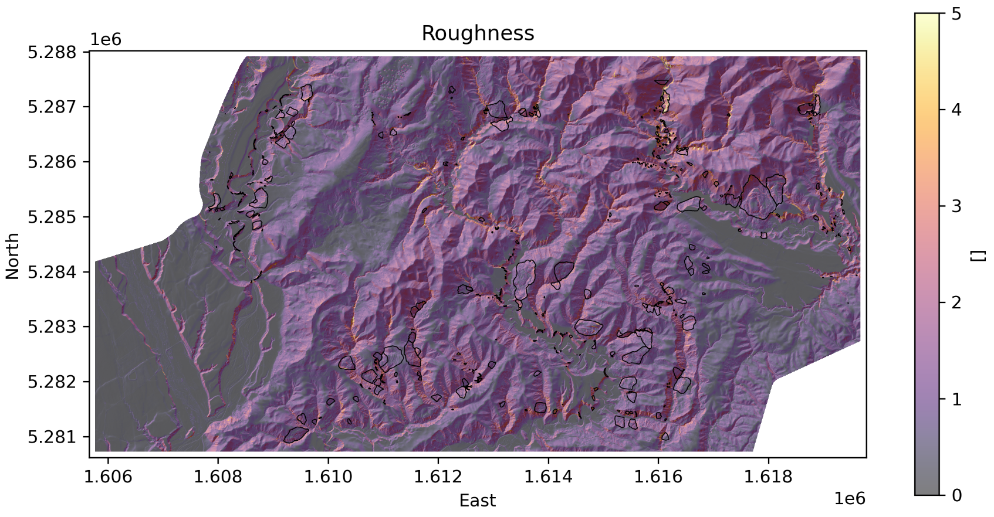
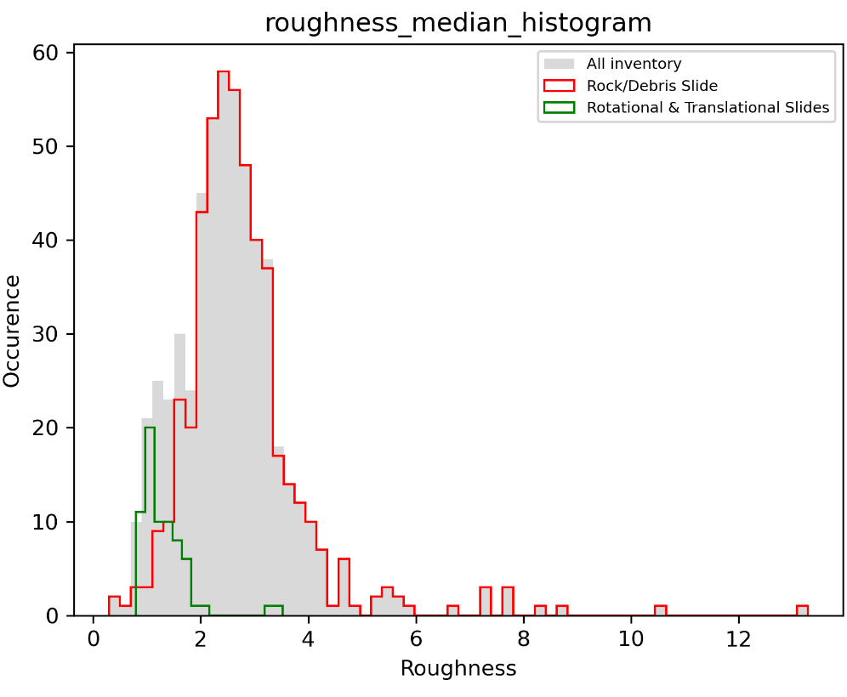
Pre-Existed Landslides vs Earthquake-Induced Landslides and Reactivations
Landslides Inventories (before & after earthquake).
Remote sensing (LiDAR, Ortho-imagery).
Elevation difference & Multimodal Model training.
Luis Guerrero, MS Graduate Student
Notes:
My research uses remote sensing technologies as LiDAR to address the landslies:
What:
1. Where specifically are earthquake-induced landslides likely to occur in a terrain already marked by and conditioned by existing landslides?
2. Will these earthquake-induced landslides evolve with time?
3. True or false: "Hazards following the EQ will continue for many years and need to be managed“?
With the use of remote sensing, landslide inventories, geospatial data analysis we are trying to determine the terrain features that are related to the pre-existed landslides and those induced by earthquakes

Slide 7
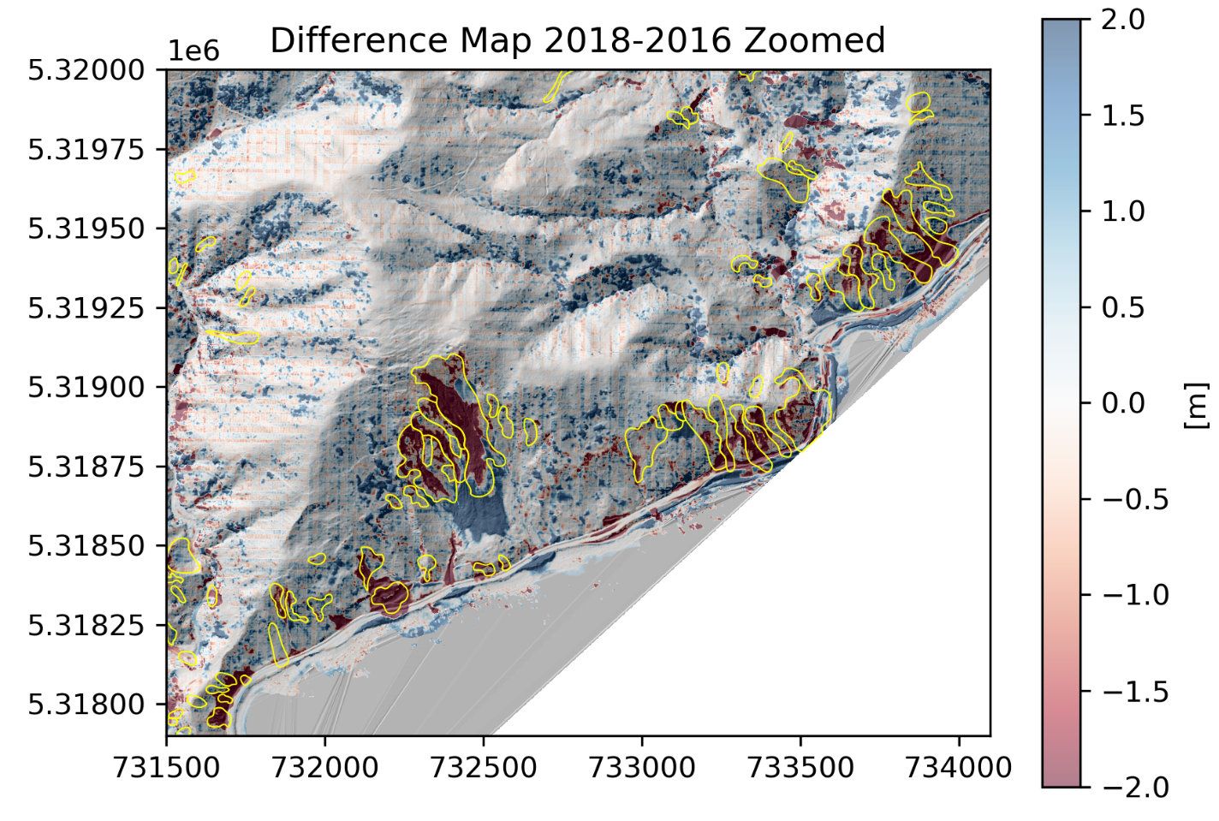
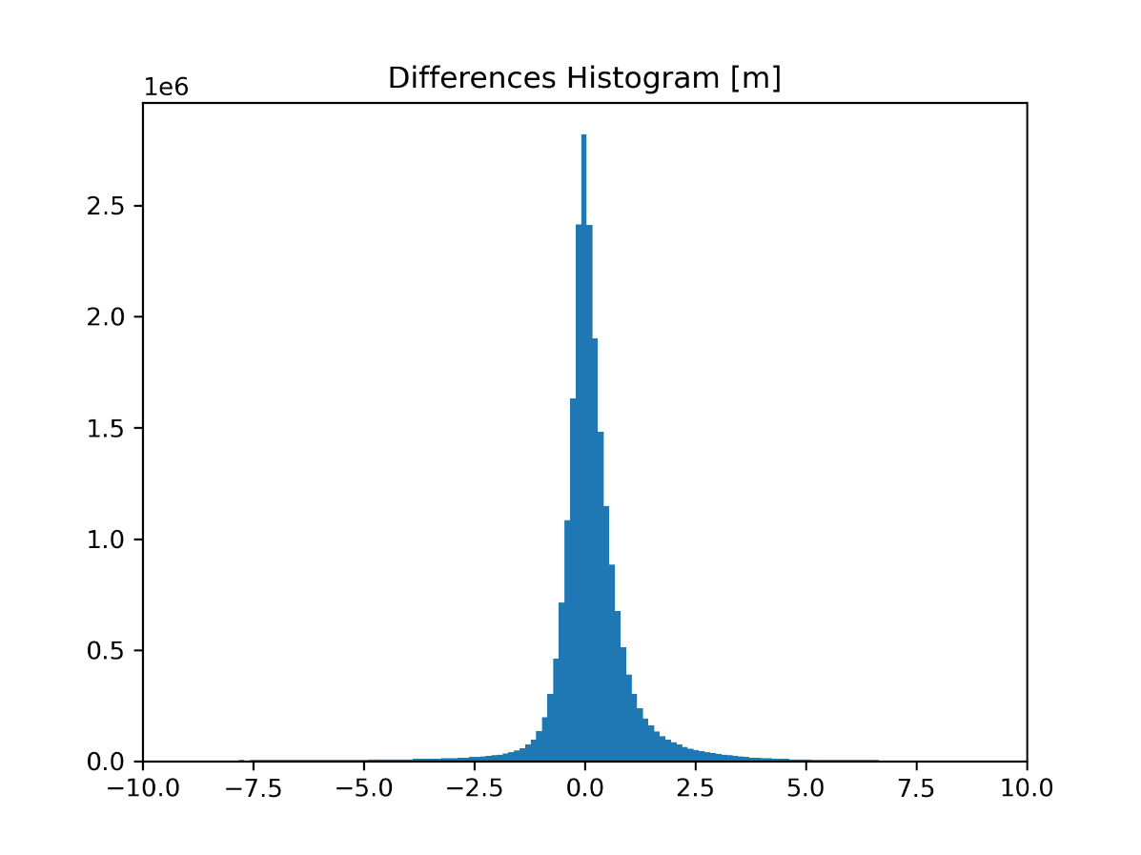
Pre-Existed Landslides vs Earthquake-Induced Landslides and Reactivations
Landslides Inventories (before & after earthquake).
Remote sensing (LiDAR, Ortho-imagery).
Elevation difference & Multimodal Model training.
Luis Guerrero, MS Graduate Student
Notes:
Then, using geospatial data analysis and Physics-based mode-specific models we aim to address the reactivations.
These images correspond to an analysis of the Kaikoura Earthquake in New Zealand capturing land movements two years after the 2016 earthquake.
And as we keep understanding impacts of landslides and slope displacements, Nishanthi Perrera will continue speaking about another type of landslide geohazard, for her research more focused on rockfalls.

Slide 8
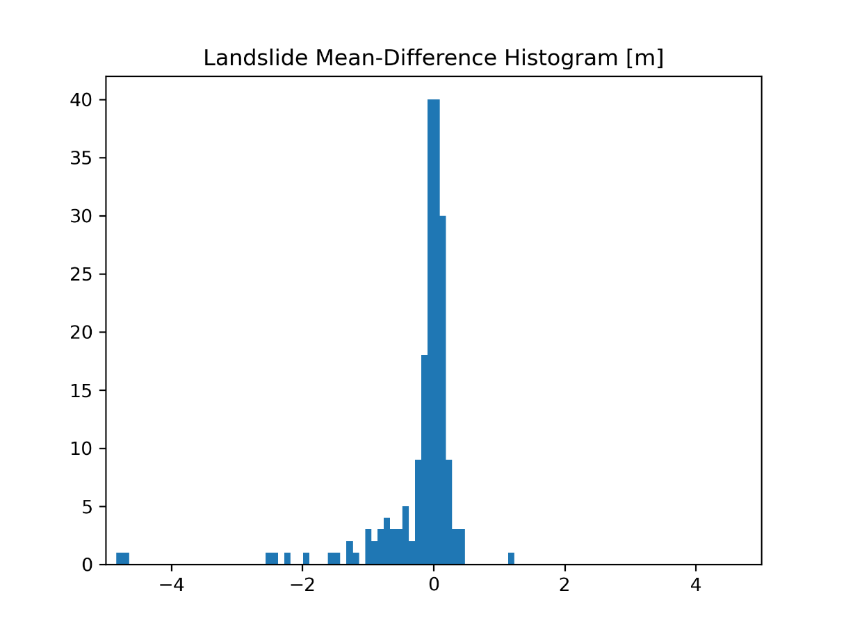
Pre-Existed Landslides vs Earthquake-Induced Landslides and Reactivations
Landslides Inventories (before & after earthquake).
Remote sensing (LiDAR, Ortho-imagery).
Elevation difference & Multimodal Model training.
Luis Guerrero, MS Graduate Student
Notes:
Then, using geospatial data analysis and Physics-based mode-specific models we aim to address the reactivations.
These images correspond to an analysis of the Kaikoura Earthquake in New Zealand capturing land movements two years after the 2016 earthquake.
And as we keep understanding impacts of landslides and slope displacements, Nishanthi Perrera will continue speaking about another type of landslide geohazard, for her research more focused on rockfalls.

Slide 9
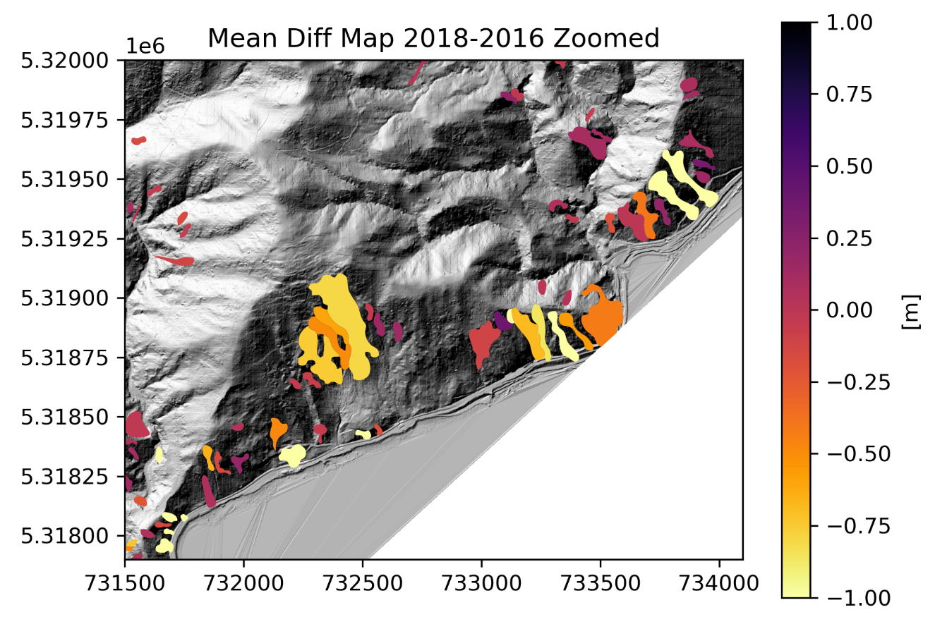
Pre-Existed Landslides vs Earthquake-Induced Landslides and Reactivations
Landslides Inventories (before & after earthquake).
Remote sensing (LiDAR, Ortho-imagery).
Elevation difference & Multimodal Model training.
Luis Guerrero, MS Graduate Student
Notes:
Then, using geospatial data analysis and Physics-based mode-specific models we aim to address the reactivations.
These images correspond to an analysis of the Kaikoura Earthquake in New Zealand capturing land movements two years after the 2016 earthquake.
And as we keep understanding impacts of landslides and slope displacements, Nishanthi Perrera will continue speaking about another type of landslide geohazard, for her research more focused on rockfalls.

Slide 10
Thank you!
Questions?

