Slide 1
Student Wellness & Academic Libraries Amber Butler & Sara Holder

Slide 2
Session Outline
2
About our book and what inspired it
Post-publication outcomes
How have wellness initiatives in academic libraries evolved
Future wellness initiatives in libraries
Questions

Slide 3
A little bit about the book
What’s in it and why we chose this topic

Slide 4
About the book
4
Published in 2020 by ACRL, the chapters were written in 2018/2019.
14 chapters covering topics from supporting Trans students, to cultivating Diversity and Inclusion, family study spaces, meditation rooms, digital wellness, therapy animals and more.
Authors were from various universities in the US and Canada.
Lasting relevance judging by topics that are being presented for this symposium
Need for support of student mental health and wellness needs outside of counseling centers

Slide 5
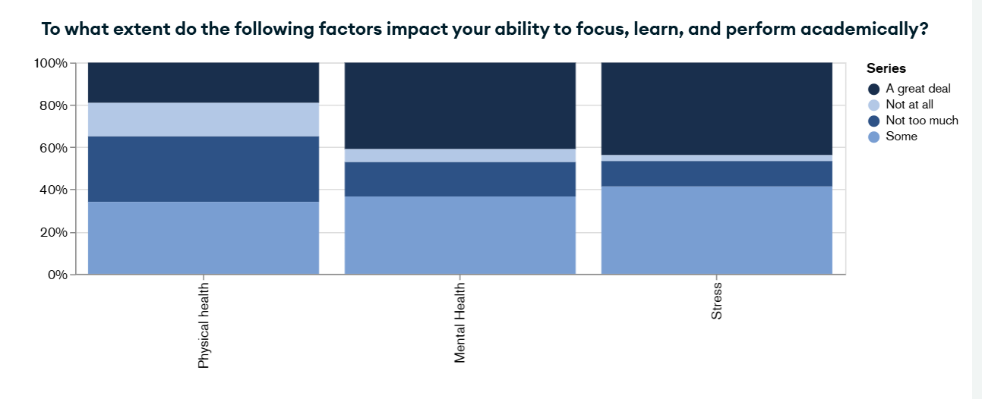
Effects on learning
From the 2024 Inside Higher Ed Student Voice Survey
Mental health and stress overwhelmingly affects learning (> 80%)
Physical health also factors in (> 60%)

Slide 6
Is addressing this a priority?
6
Strategic plans of the member universities of the BTAA mention mental health in some capacity.
Most having a goal related to student success that includes initiatives for improving student mental health and wellness.
Kudos to the University of Iowa – “holistic well-being” is part of their top-level goal related to success.

Slide 7
Anxiety, then and now
From the 2024 Center for Collegiate Mental Health Annual Report
Included a similar graph from the 2019 report in the book.
Anxiety continues to be a concern – generalized and social anxiety in particular.

Slide 8
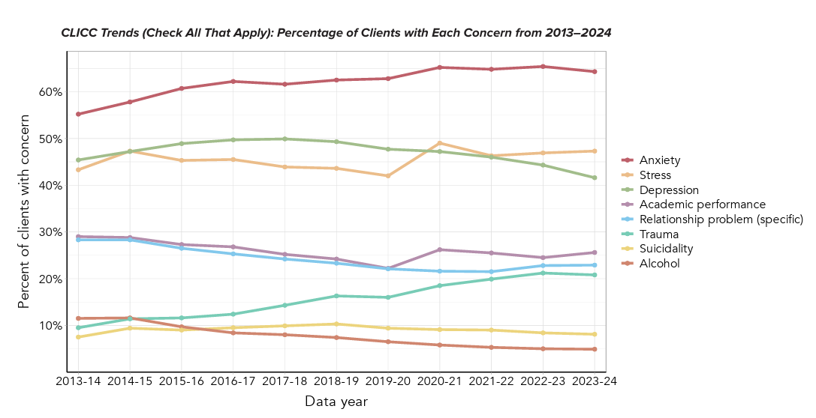
Not all bad news
Also from the 2024 Center for Collegiate Mental Health Annual Report
Clinician Index of Client Concerns (CLICC) records presenting concerns of counseling center clients during first appointment
Depression down markedly, suicidality and alcohol issues had a slight decrease

Slide 9
What’s come after
Citations and reviews

Slide 10
From the library literature
Student well-being matters: Academic library support for the whole student
M Bladek - The Journal of Academic Librarianship, 2021 - Elsevier
In response to a marked increase in the prevalence and severity of mental health problems among college students over the last decade, colleges and universities have been expanding their well-being initiatives and programs. No longer limited to health services departments, the support of student well-being has been taken up by multiple campus units, including academic libraries. As well-being has been shown to impact academic outcomes, the well-being initiatives libraries develop fit in with their commitment to enhance learning and student educational experience overall.
Privacy literacy: From doomscrolling to digital wellness
A Chisholm, S Hartman-Caverly - portal: Libraries and the Academy, 2022 - muse.jhu.edu
Personal technology use can significantly impact wellness. The transition to widespread remote learning, working, and socializing during the COVID-19 pandemic exacerbated society’s reliance on technology. This article presents a case study of how the authors applied their privacy scholarship to offer a responsive learning experience for students concerning the social implications of the pandemic.

Slide 11
From the health literature
Teaching Health Literacy and Digital Literacy Together at University Level: The FLOURISH Module
AF Smeaton - Health Education & Behavior, 2023 - journals.sagepub.com
Many universities have wellness programs to promote overall health and well-being. Using students’ own personal data as part of improving their own wellness would seem to be a natural fit given that most university students are already data and information literate. In this work, we aim to show how the interplay between health literacy and data literacy can be used and taught together. The method we use is the development and delivery of the FLOURISH module, an accredited, online-only but extra-curricular course that delivers practical tips in the areas that impact students’ everyday wellness including sleep, nutrition, work habits, procrastination, relationships with others, physical activity, positive psychology, critical thinking, and more.
Library as a Therapeutic Landscape Promoting Health and Well-Being to Chiropractic Students: A Descriptive Report
N Tukhareli - Journal of Chiropractic Humanities, 2024 - Elsevier
A comprehensive literature review and consultations with stakeholders were completed. A bibliotherapy program, which included the practice of using books and reading to promote mental health, well-being, and resilience for chiropractic students, was developed and launched in January 2020. The program included shared reading, reflection, and a guided group discussion. Short readings of various genres (i.e., poetry, fiction, nonfiction) were tailored specifically to address psychological, emotional, and social challenges facing students.

Slide 12
Evolution of wellness initiatives in libraries
2018 vs. 2025

Slide 13
What’s still going strong?
Anything involving animals
Cute and cuddly works best
Even scaly things seem to spark joy

Slide 14
What’s gaining ground/expanding
Partnerships with campus and external organizations
Health services, counseling centers, athletics, writing and presentation support units, student affairs, career centers
Brock University Library (St. Catherines, ON) has partnered with the Niagara Peninsula Conservation Authority to lend day-use passes to local conservation areas
Sensory & respite rooms
Support for student parents
Child-friendly study spaces
Loanable items for children and parents
Lactation spaces

Slide 15
New areas of focus
Basic needs support
Food pantries,
Nutrition education programs
Wellness services located inside the library
Carleton University (Ottawa, Ontario) Wellness Desk

Slide 16
Trauma Informed Librarianship
Principles
Safety – Emotional and physical safety for patrons and staff.
Trustworthiness & Transparency – Clear communication, consistent policies.
Peer Support – Encouraging community connection and mutual support.
Collaboration & Mutuality – Power-sharing between librarians and patrons.
Empowerment, Voice & Choice – Giving patrons control over their experience.
Cultural, Historical, & Gender Issues – Recognizing the impact of systemic trauma and respecting diversity.
Examples
Space Design
Staff Training
Policy and Procedure Adjustments
Programming
Empathetic Service

Slide 17
Coming soon
In libraries and across campus

Slide 18
Health and wellness on the horizon
18
Instead of waiting until students are in crisis, universities are increasingly focusing on prevention
Tech is playing a bigger role
Hiring diverse counseling staff and offering multilingual services.
Flexible deadlines, mental health days, and pass/fail options are being normalized
Early intervention systems using student data (e.g., missed classes, poor grades, or sudden isolation) to flag at-risk students.
More universities are treating mental health as a campus-wide responsibility

Slide 19
Audience poll

Slide 20
Focus on library staff wellness
Supporting students with mental health challenges can take its toll on library workers
Responding to incidents where students and faculty act inappropriately is a stressor
In the case of building issues and student behavior, this is especially stressful for more junior library employees or student library workers who are closer in age to the students
In an environment where we ask library employees to undertake this work, wellness considerations for staff must also take a high priority

Slide 21
Thank you and we welcome your questions!
Amber Butler
AmberButler@cunet.carleton.ca
Sara Holder
sholder@illinois.edu

