Slide 1
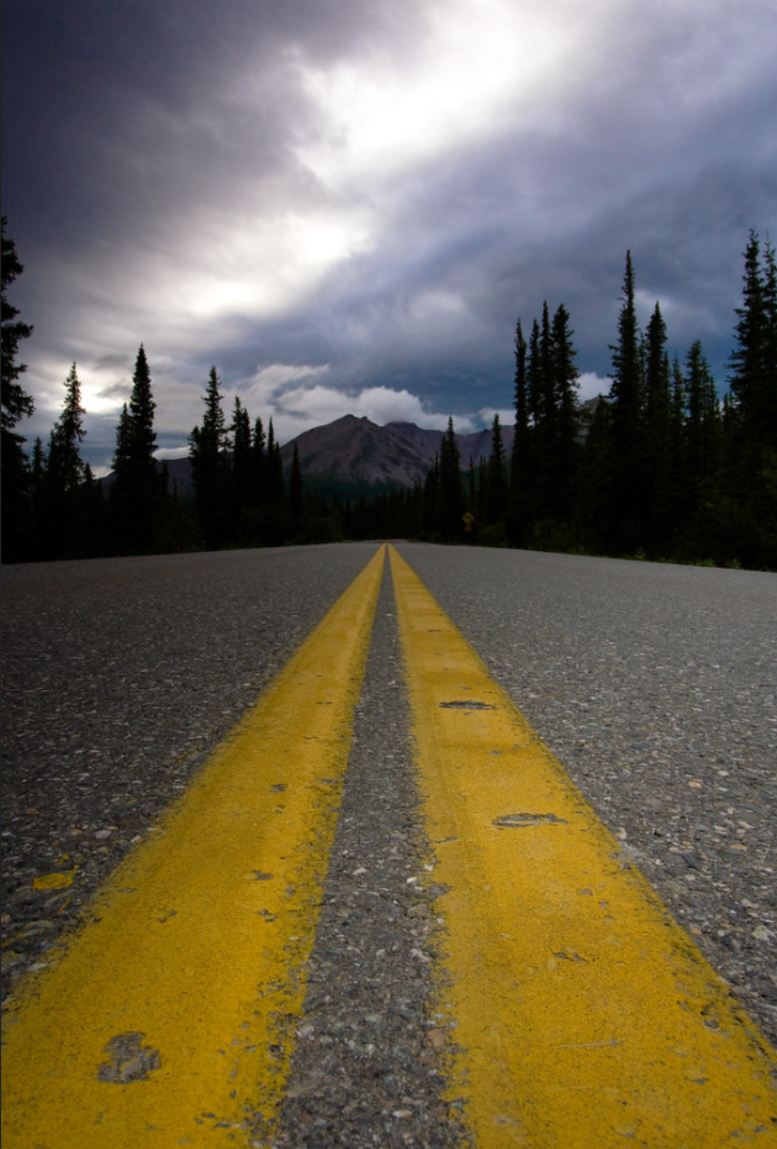
Habitat Fragmentation via Roadways in King County
By Brandy Eckman, Environmental Studies major, UWB

Slide 2
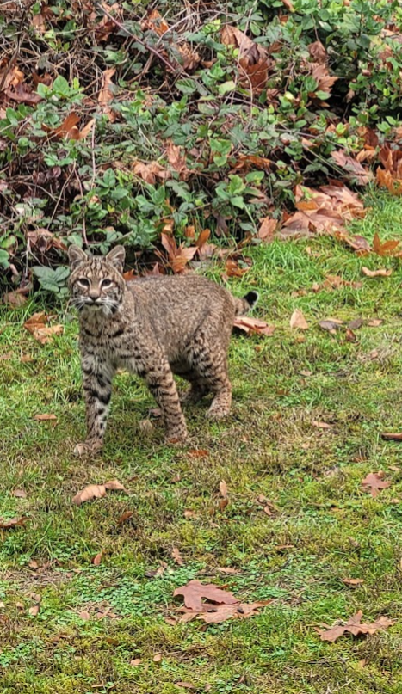
Habitat Fragmentation is a Big Problem
Presents a problem for both wildlife populations and biodiversity
Negatively affects species ability to feed, mate, move, and survive as well as their genetics
Some studies show that habitat fragmentation might be worse than habitat loss itself
Excessive fragmentation can drive extinction
Roadways and urbanization are two of the most common cases of habitat fragmentation

Slide 3
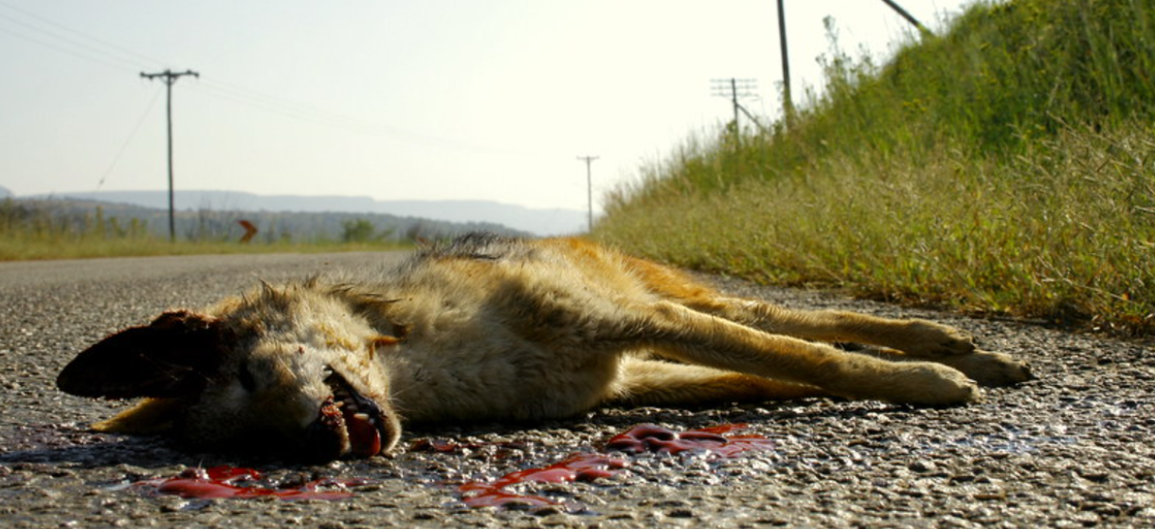
Fragmentation and Roadkill
A deadly side effect of fragmentation is roadkill, where an animal fails to cross from one habitat to another
Roadkill is an expensive problem – DOT estimates US cost is around $8 billion and 200 human lives, annually
Not to mention countless animal lives

Slide 4
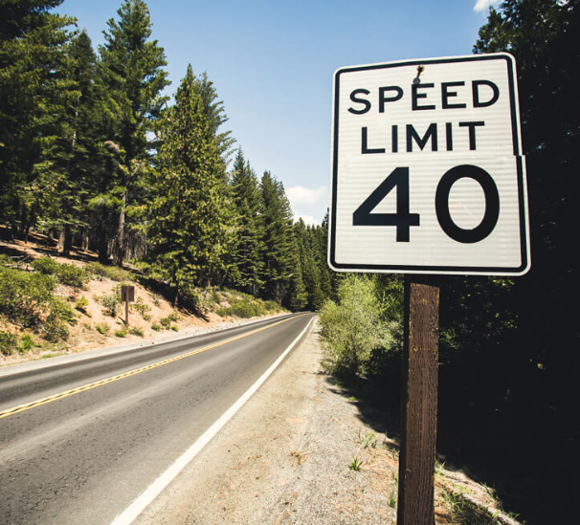
Two Solutions
The first solution is to lower speed limits in wildlife heavy areas
  This reduces the risk of fatalities for both humans and wildlife
The second is constructed wildlife crossings
  These provide a safe way for wildlife to cross the road without car interaction
The purpose of this study was to see how these solutions interacted with existing habitat

Slide 5
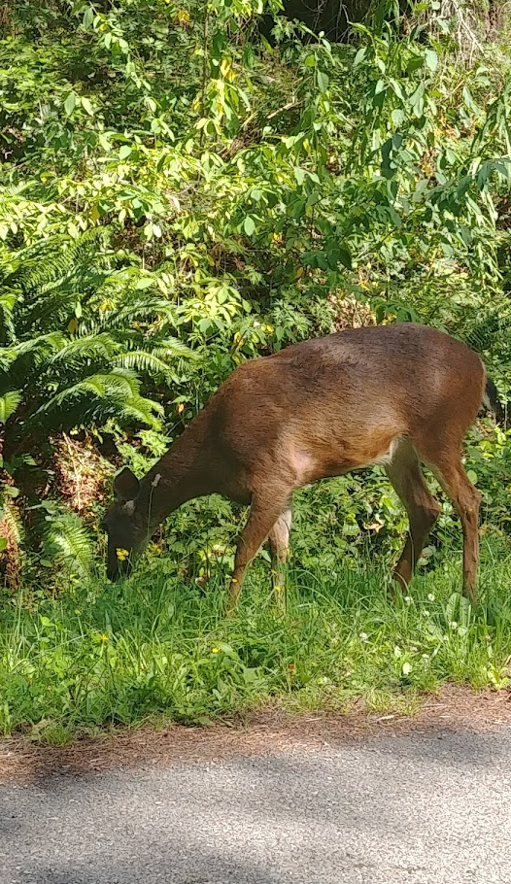
Methodology
Terrestrial animals only – no salmon crossings, etc.
Compiled areas that are viable habitat:
  Future and current conservation areas
  DNR/Public lands
  King County Parks
  WA State Parks
  Critical environmental sensitivity areas
  Species specific habitat
Sorted roadways by speed limit/risk
Analyzed general greenspaces
Analyzed specific habitat areas

Slide 6
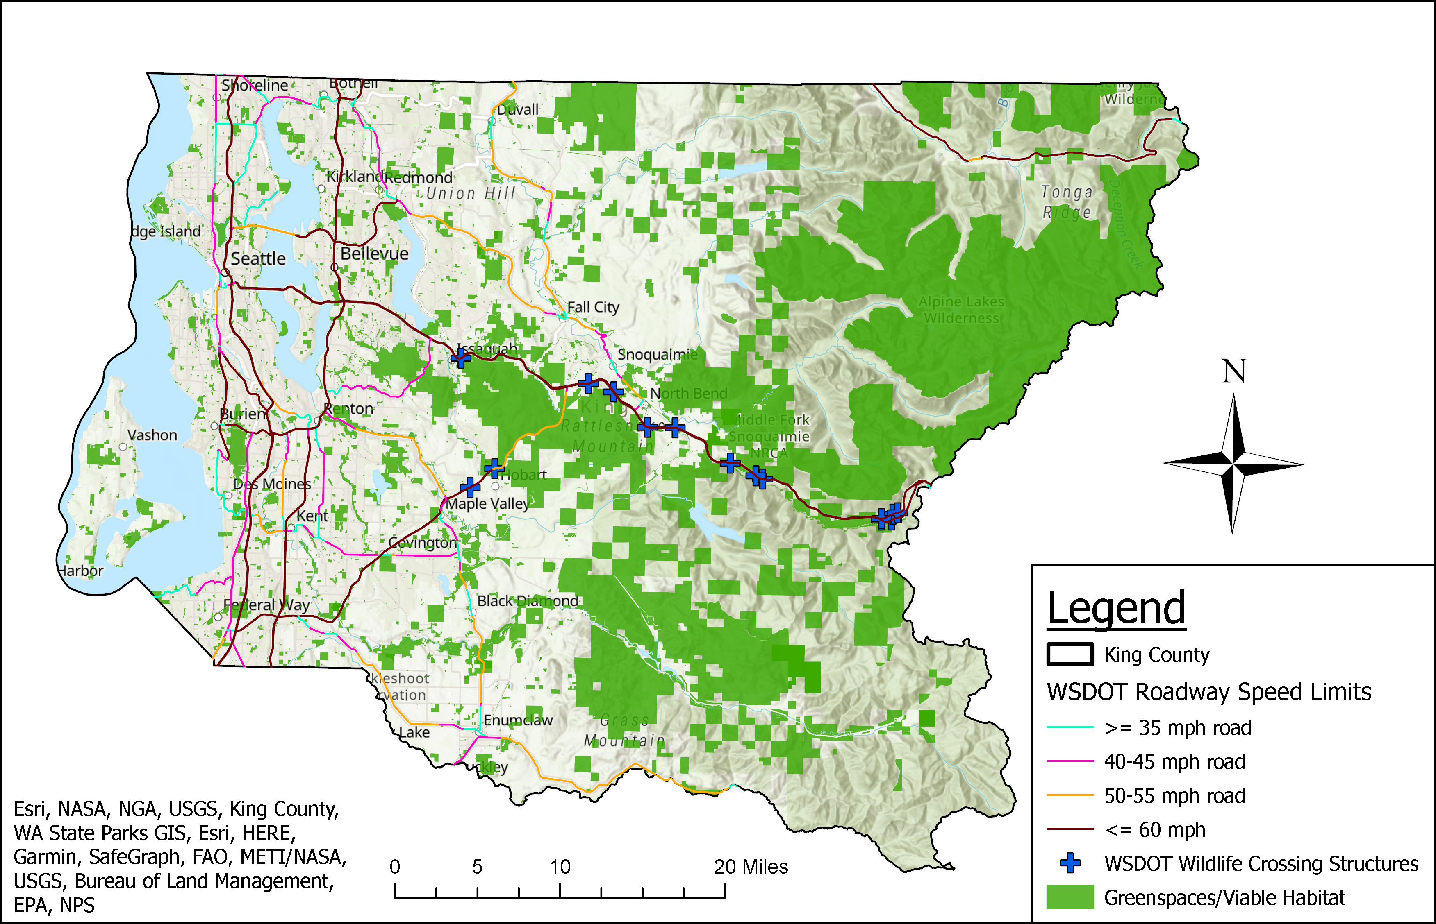
General Greenspace Habitat Analysis

Slide 7
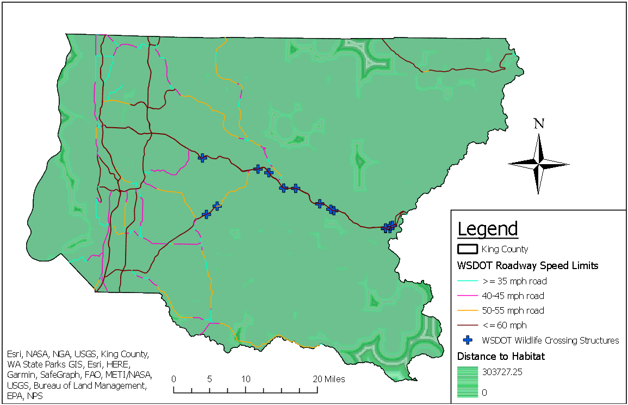
Distance to Habitat

Slide 8
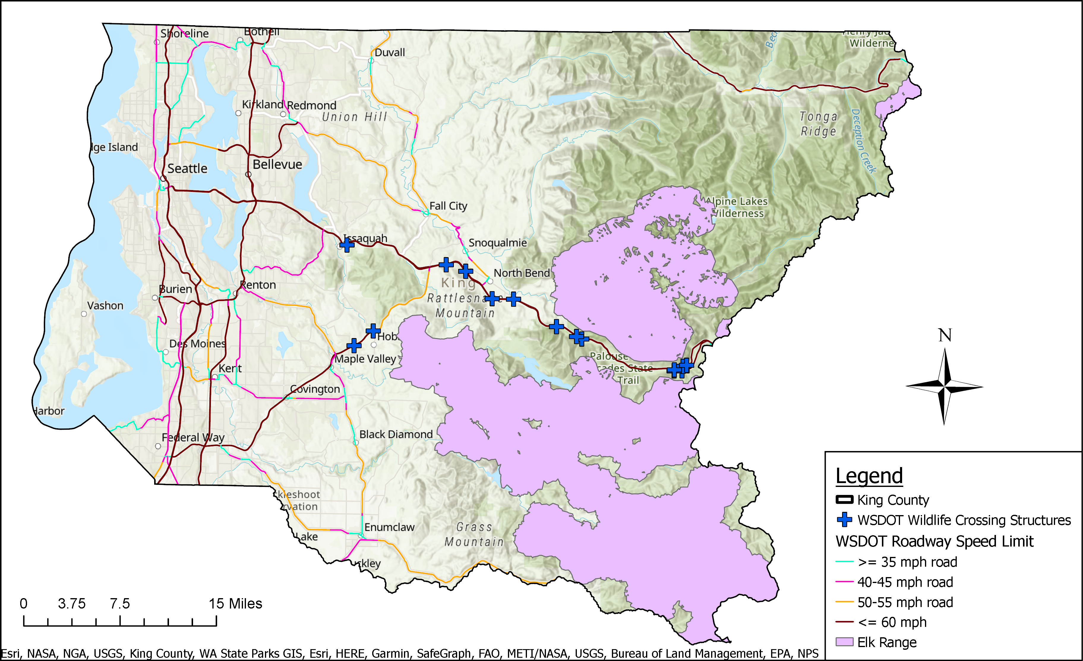
Specific Habitat - Elk

Slide 9
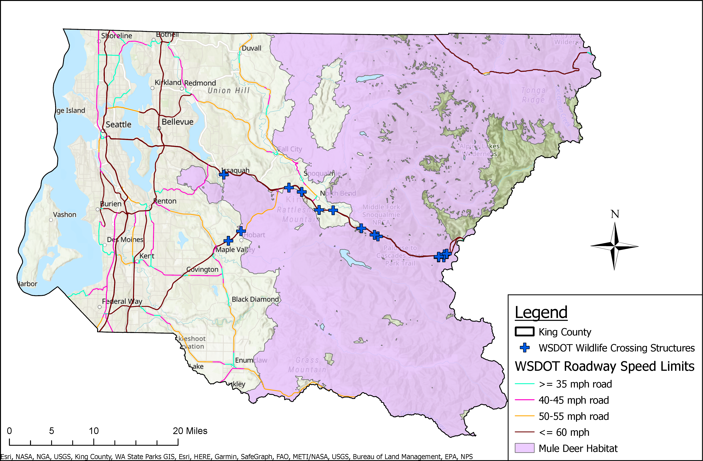
Specific Habitat – Mule Deer

Slide 10
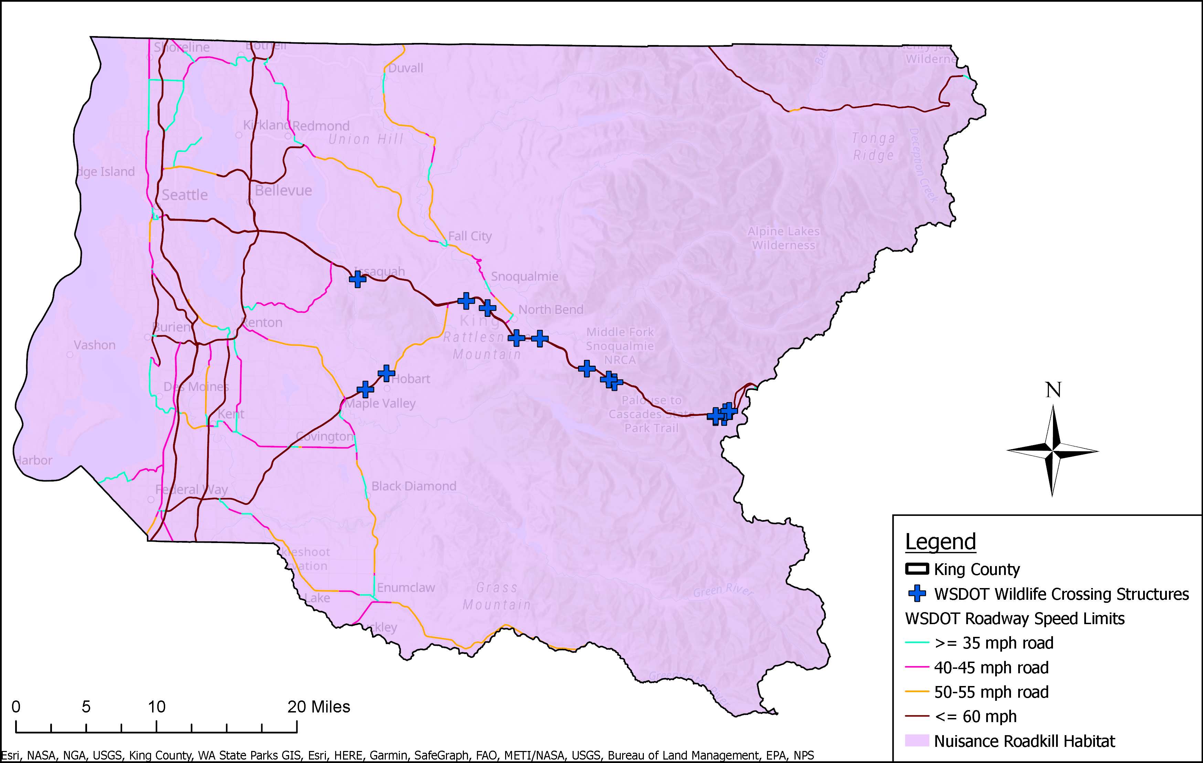
Specific Habitat - Nuisances

Slide 11
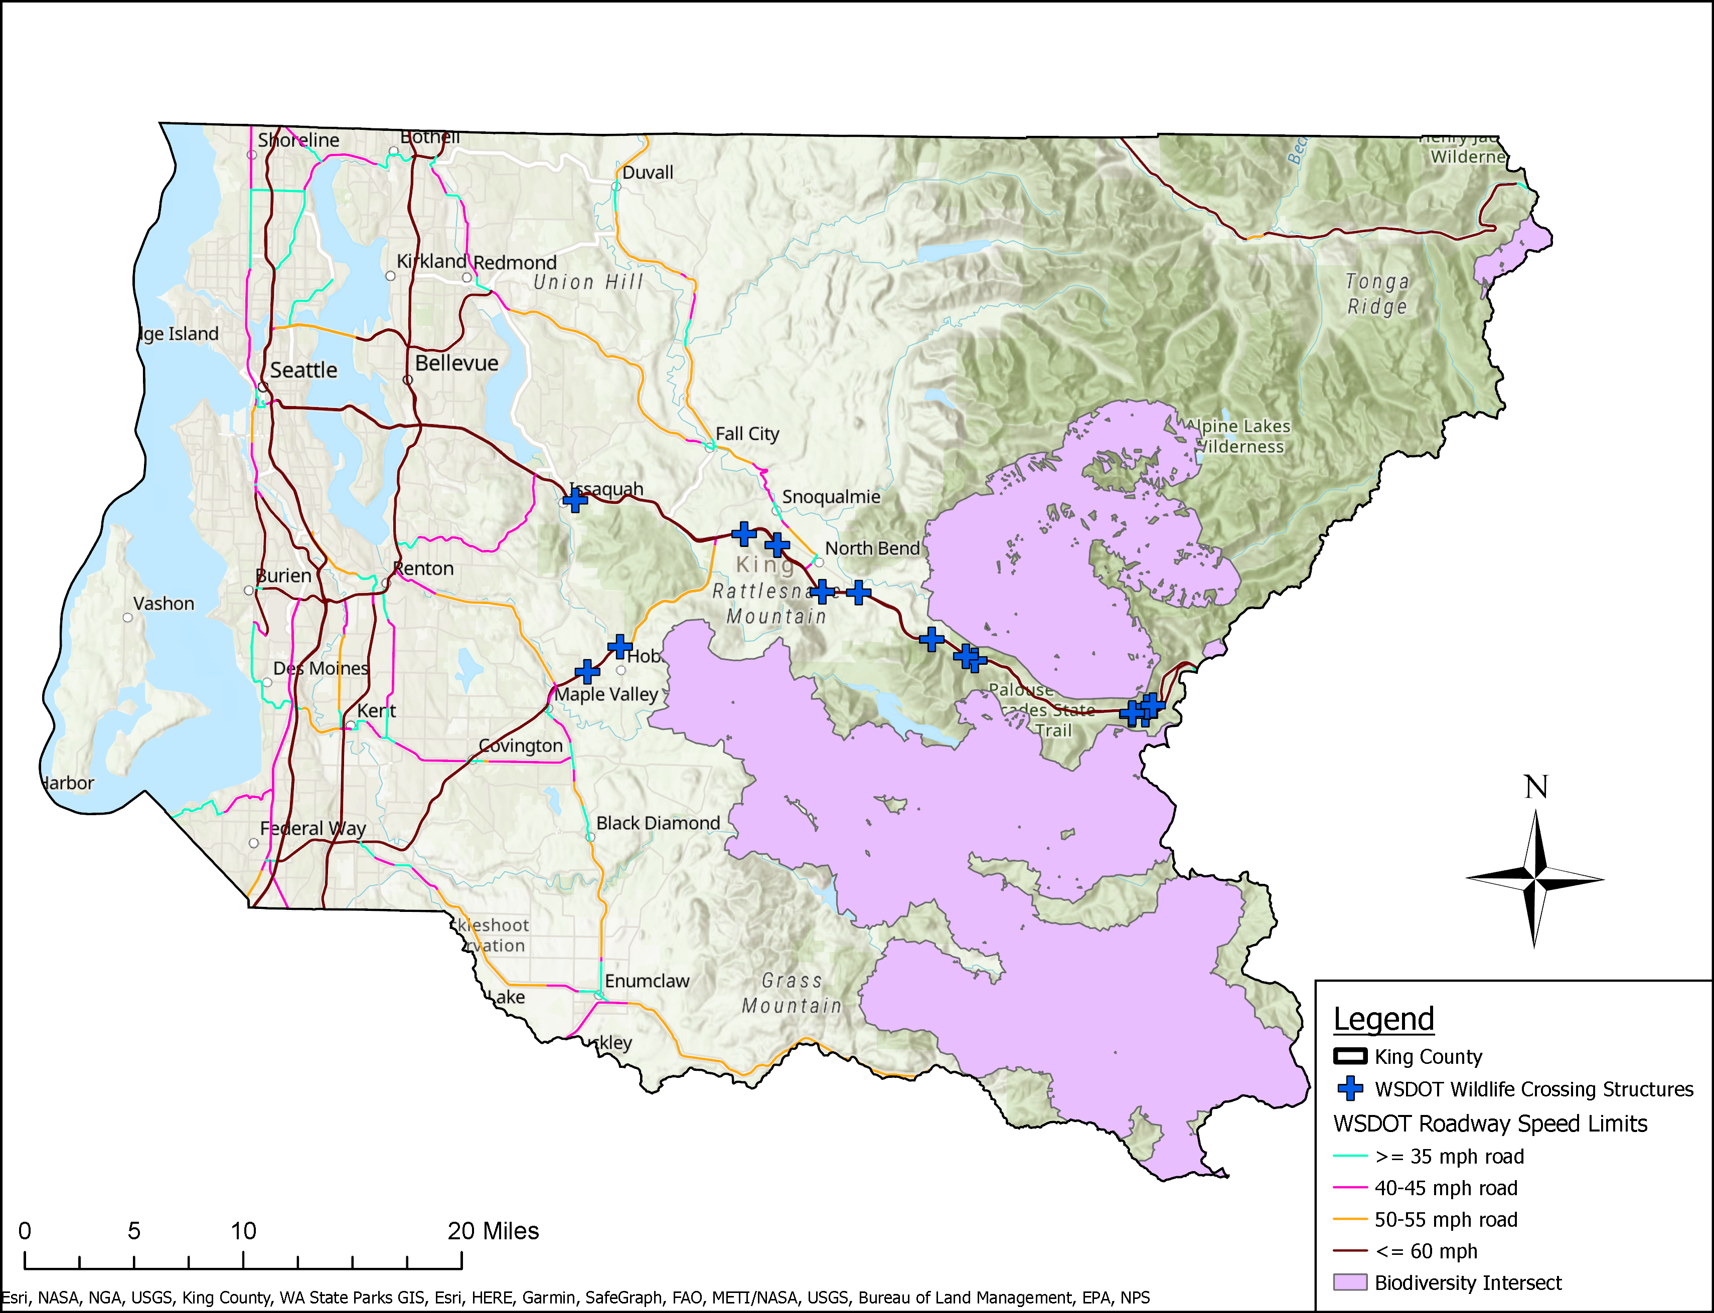
Biodiversity – Overlap Areas

Slide 12
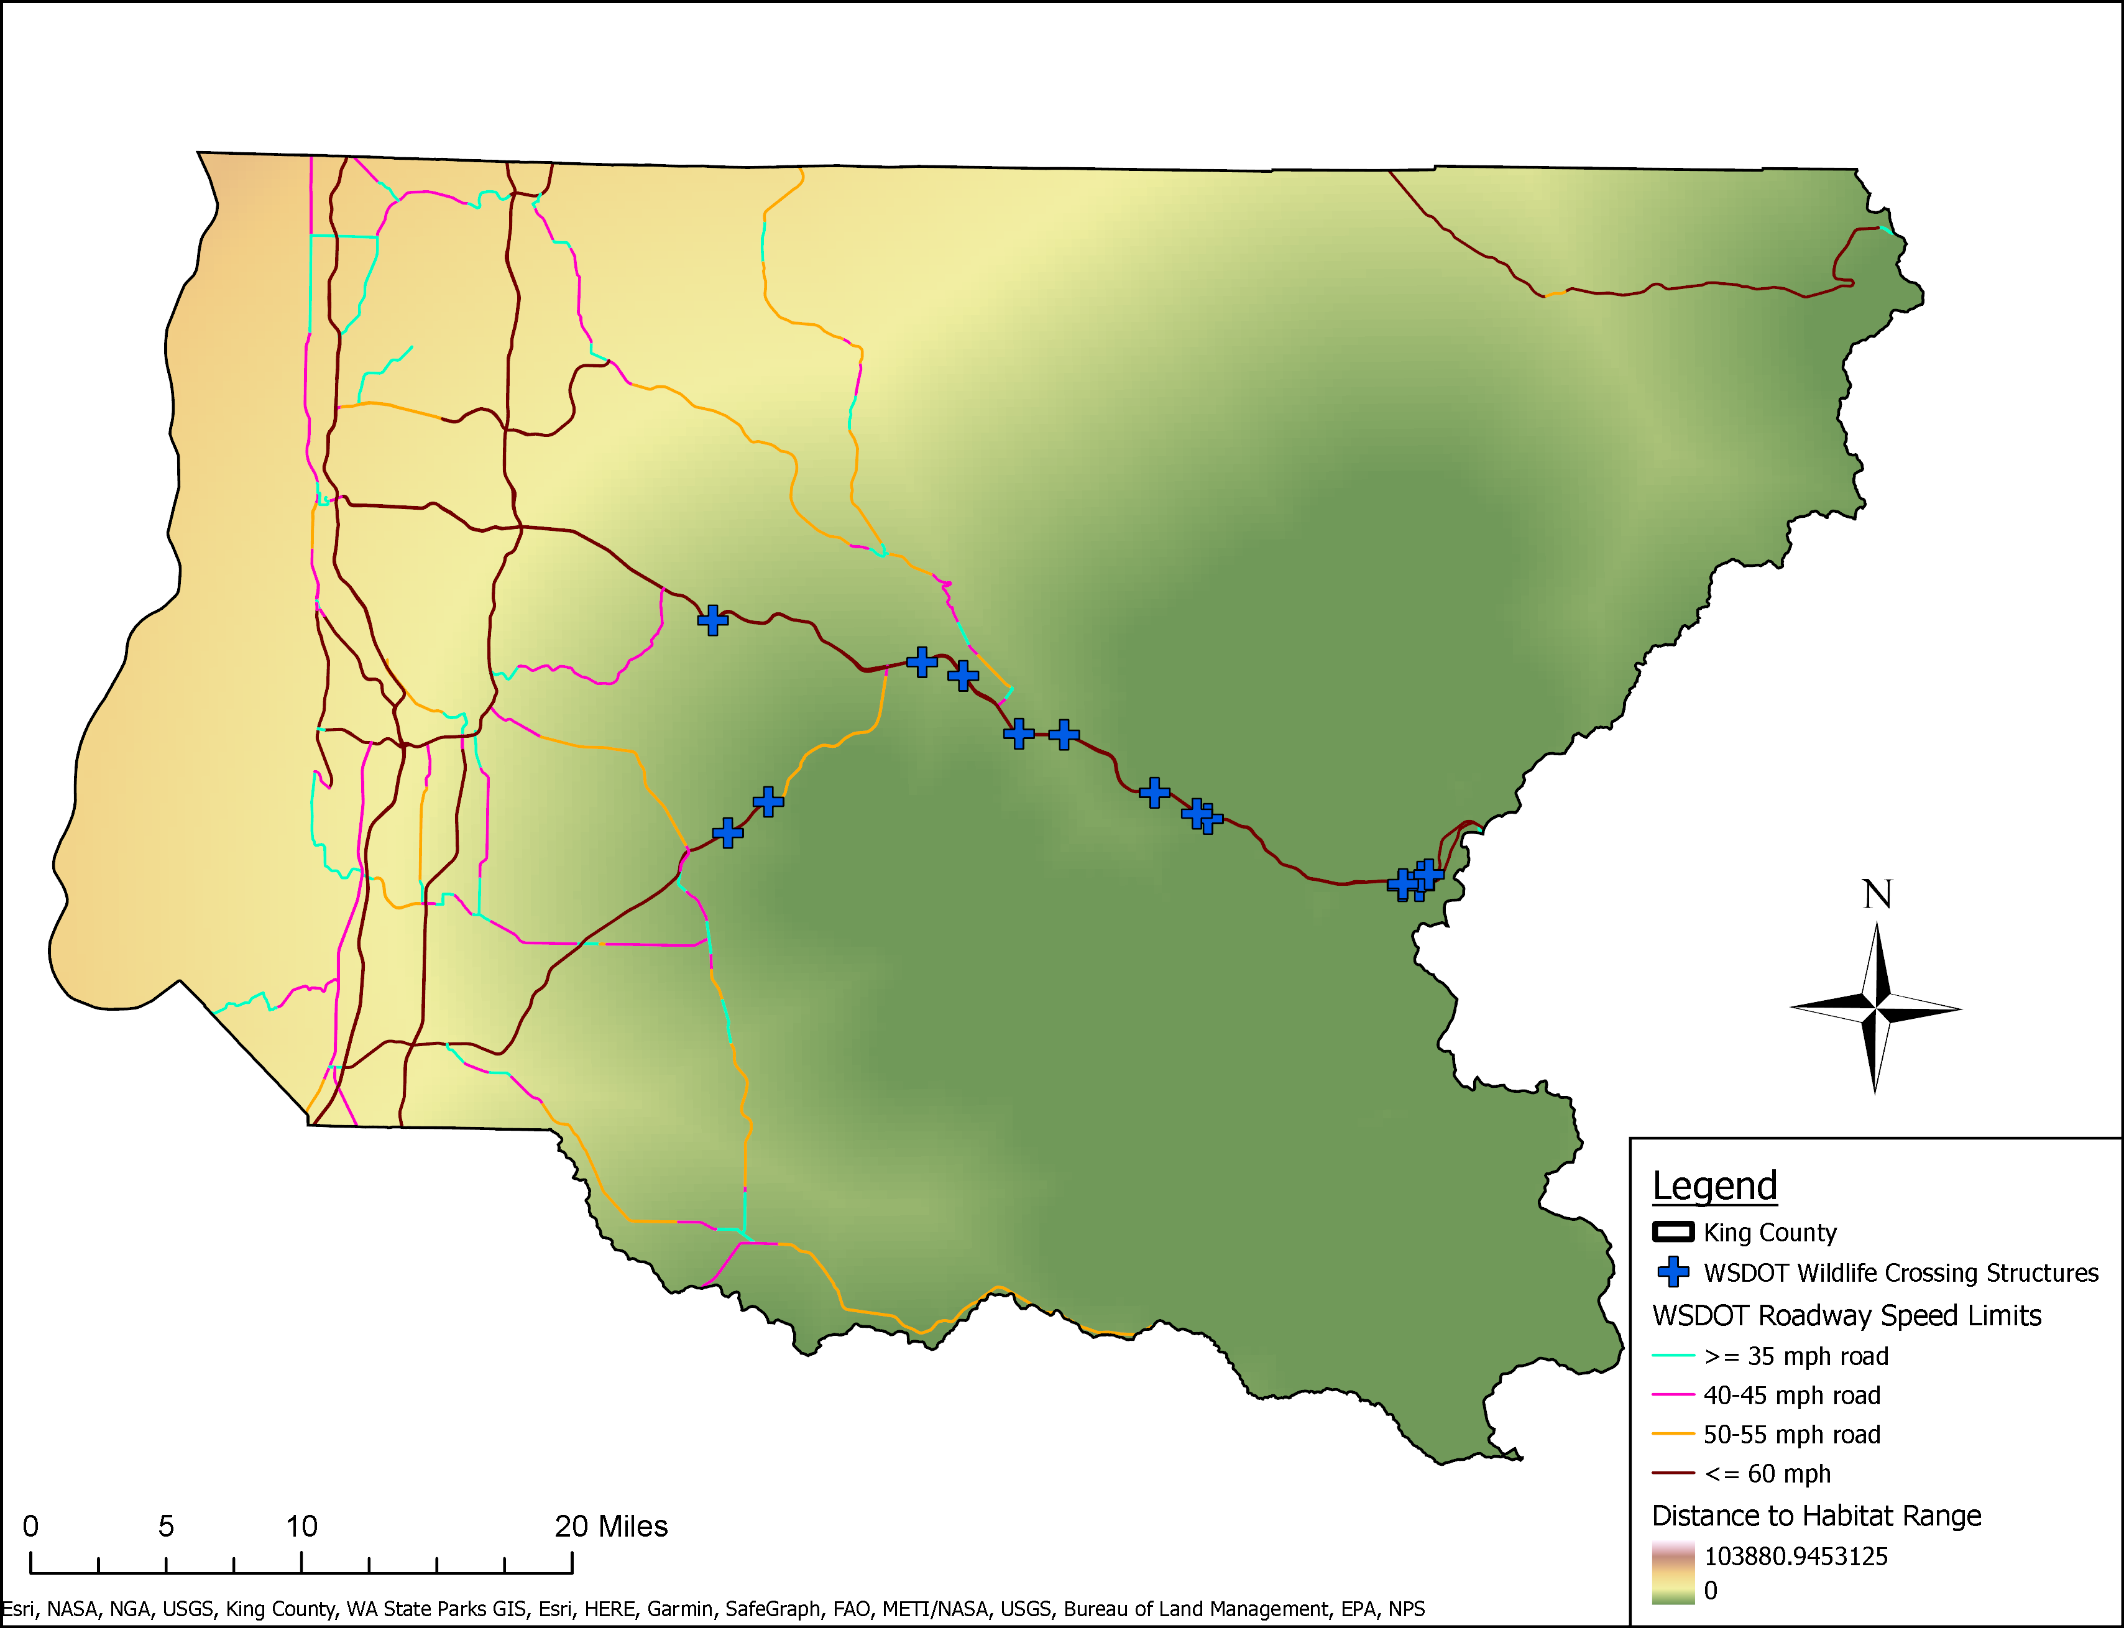
Biodiversity Area – Distance to Habitat

Slide 13
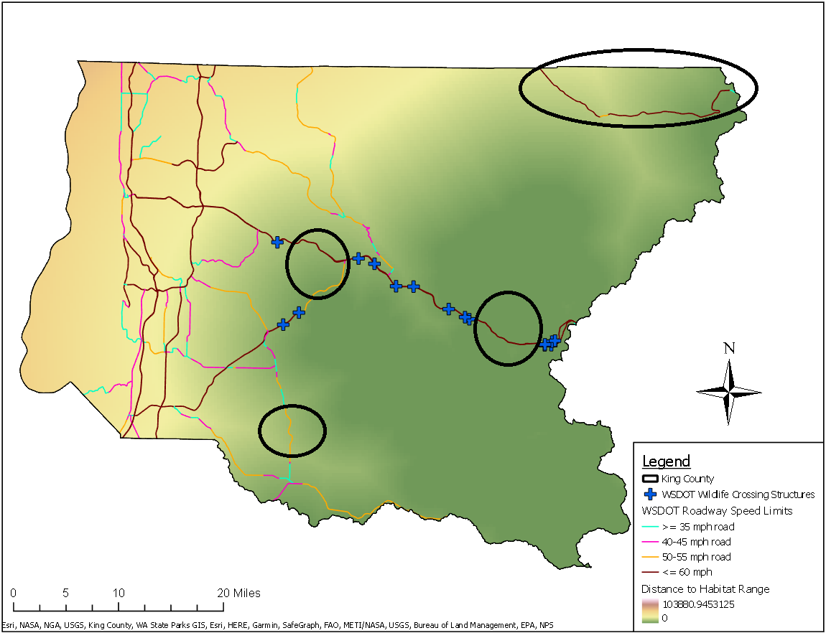
Results and Conclusions
Multispecies-wise
  WSDOT off to a good start
  Moving forward target gap areas/Highway 2
All habitat/greenspace-wise
  More work to do, consider lowering speed limit in high-risk, habitat-heavy areas
Fragmentation overall is extremely high with roads posing significant barriers
KC in partnership with WA needs to do a better job of evaluating how existing and new roadways are bisecting habitats

Slide 14
Many Thanks To:
Professor Jin-Kyu Jung – UWB
Professor Santiago Lopez - UWB

Slide 15
Sources
Apfelbaum, S., Rock, R., & Zoli, T. Z. (2021). A Simple Structure Supports a Complex Habitat in Wildlife Crossing Design. Ecological Restoration, p. 341-349.
Chetcuti, J., Kunin, W. E., & Bullock, J. M. (2022). Species' movement influence responses to habitat fragmentation. Diversity & Distributions, p2215-2228.
Collinson, W. J., Marneweck, C., & Davies‐Mostert, H. T. (2019). Protecting the protected: reducing wildlife roadkill in protected areas. Animal Conservation, p. 396-403.
Fahrig, L., & McGill, B. (2019). Habitat fragmentation: A long and tangled tale. Global Ecology & Biogeography, p. 33-41.
Griciuvienė, L., Janeliūnas, Ž., Jurgelevičius, V., & Paulauskas, A. (2021). The effects of habitat fragmentation on the genetic structure of wild boar (Sus scrofa) population in Lithuania. BMC Genomic Data, p. 1-8.

Slide 16
Sources
Humane Society. (2023). Drive safely: Give wildlife a “brake”. Retrieved from The Humane Society of the United States: https://www.humanesociety.org/resources/drive-safely-give-wildlife-brake
Perrin, A., Khimoun, A., Ollivier, A., Richard, Y., Pérez‐Rodríguez, A., Faivre, B., & Garnier, S. (2023). Habitat fragmentation matters more than habitat loss: The case of host–parasite interactions. Molecular Ecology, p951-969.
Skroch, M. (2021, May 10). Wildlife-Vehicle Collisions Are a Big and Costly Problem and Congress Can Help. Retrieved from PEW: https://www.pewtrusts.org/en/research-and-analysis/articles/2021/05/10/wildlife-vehicle-collisions-are-a-big-and-costly-problem-and-congress-can-help
Thompson, S. E., Chisholm, R. A., Rosindell, J., & Drake, J. (2019). Characterising extinction debt following habitat fragmentation using neutral theory. Ecology Letters, p. 2087-2096.

Slide 17
Thank you!

