Slide 1
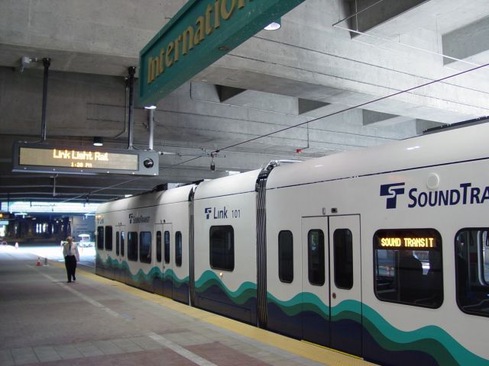
Comparing Rail Transit in Seattle, WA and Singapore
Crystal Tan
University of Washington, Geography

Slide 2
Introduction
Public transportation connects people without the reliance on personal vehicles
Benefits of public transit
  Reduce carbon emissions
  Decrease road congestion
  “The right to move” (Hawas et. al. 2016)

Slide 3
Why is Public Transportation Important in Seattle?
There are more people moving into suburban cities such as Kirkland, Lynwood, Renton, and Kent (Westneat 2021)
Main area of work still within City Center
Lack of public transit accessibility leads to increased car usage
  Results in increased road congestion

Slide 4
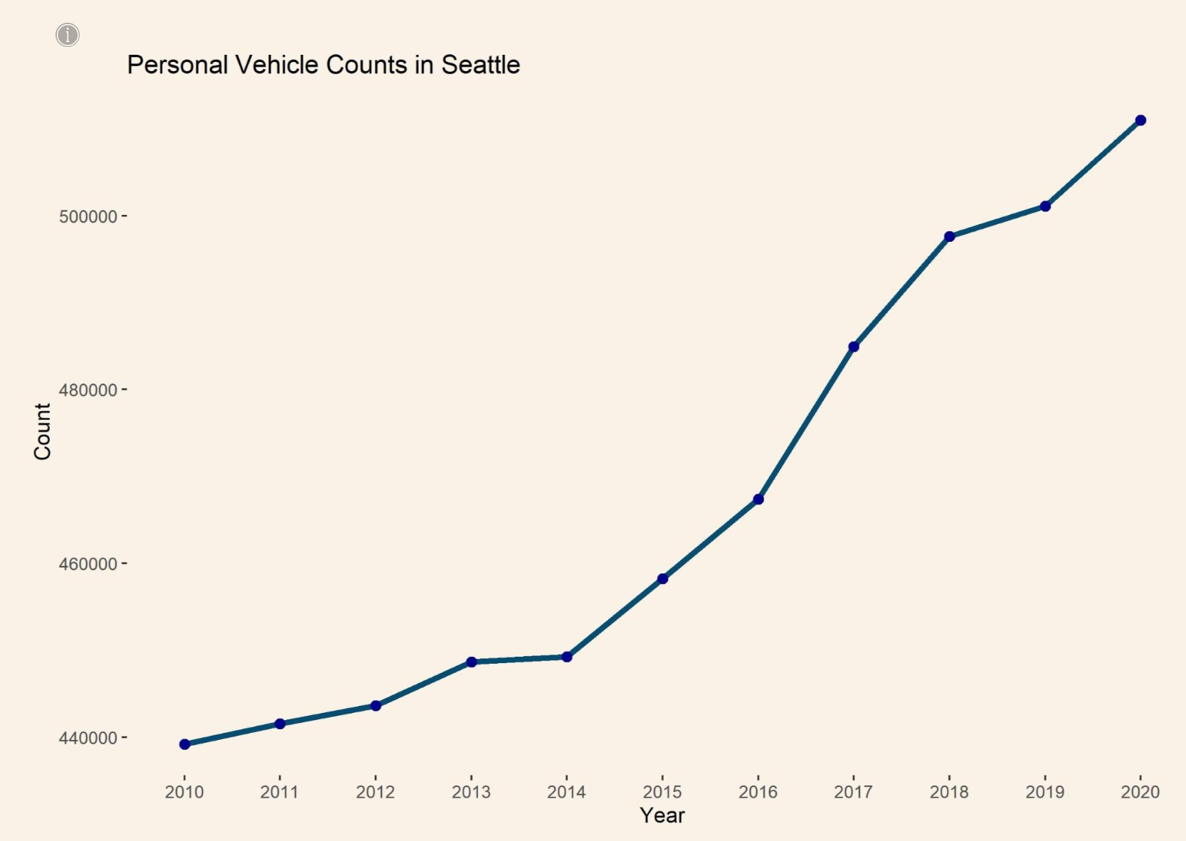
Data Source: American Community Survey
Chart of Vehicle Count in Seattle Made in R Studio

Slide 5
Why Singapore?
According to CNN, Singapore has the 6th best rail transit in the world
Small city state
  Area of Singapore is less than the Sound Transit District
In recent years, Seattle has been focusing on expanding the Light Rail above all other public transit
  Beneficial to look at an area where the rail system is one of the best globally
  We can compare the differences to find improvements in Seattle

Slide 6
Methodology
Plot the Link and Sounder stations along with their routes
Create a 0.5 mile buffer
  Represents 10 minute walk from the station
Add pharmacy locations within the Sound Transit station and record how many are within 10 minute walk from a station
  Accessibility can be measured with how easily a ‘significant location’ is reachable
Same will be done with stations in Singapore
To measure quality of transit we use access to transport, centrality, and accessibility measures (Puspas, 2020)

Slide 7
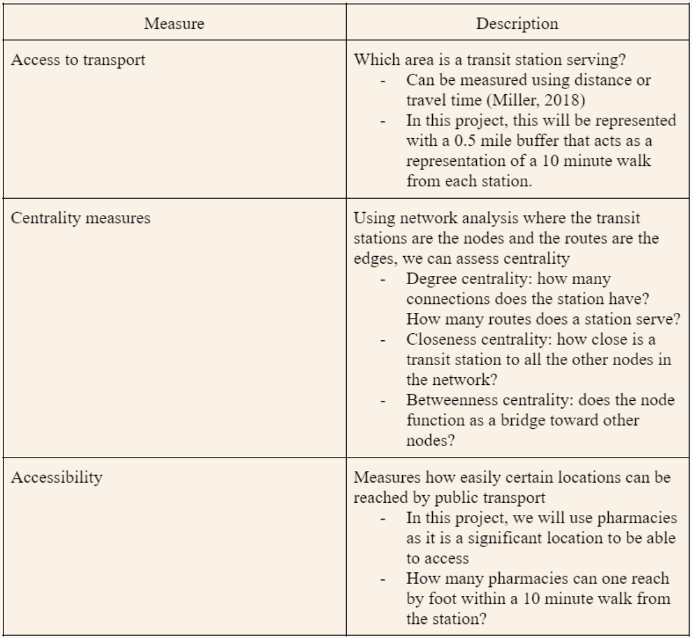

Slide 8
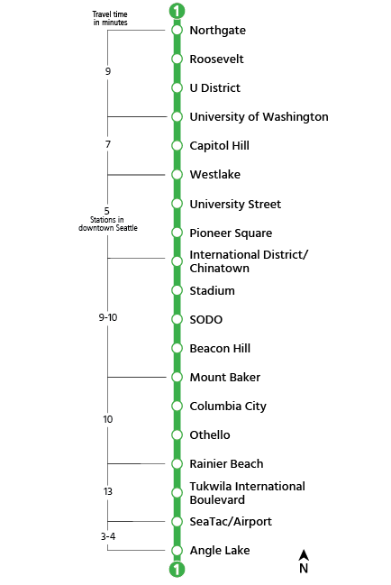
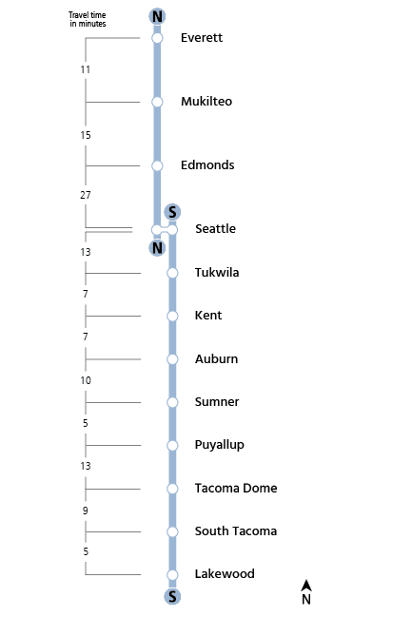
Rail Transit in Seattle
Link Light Rail Stations
Sounder Train Stations
Images from soundtransit.org

Slide 9
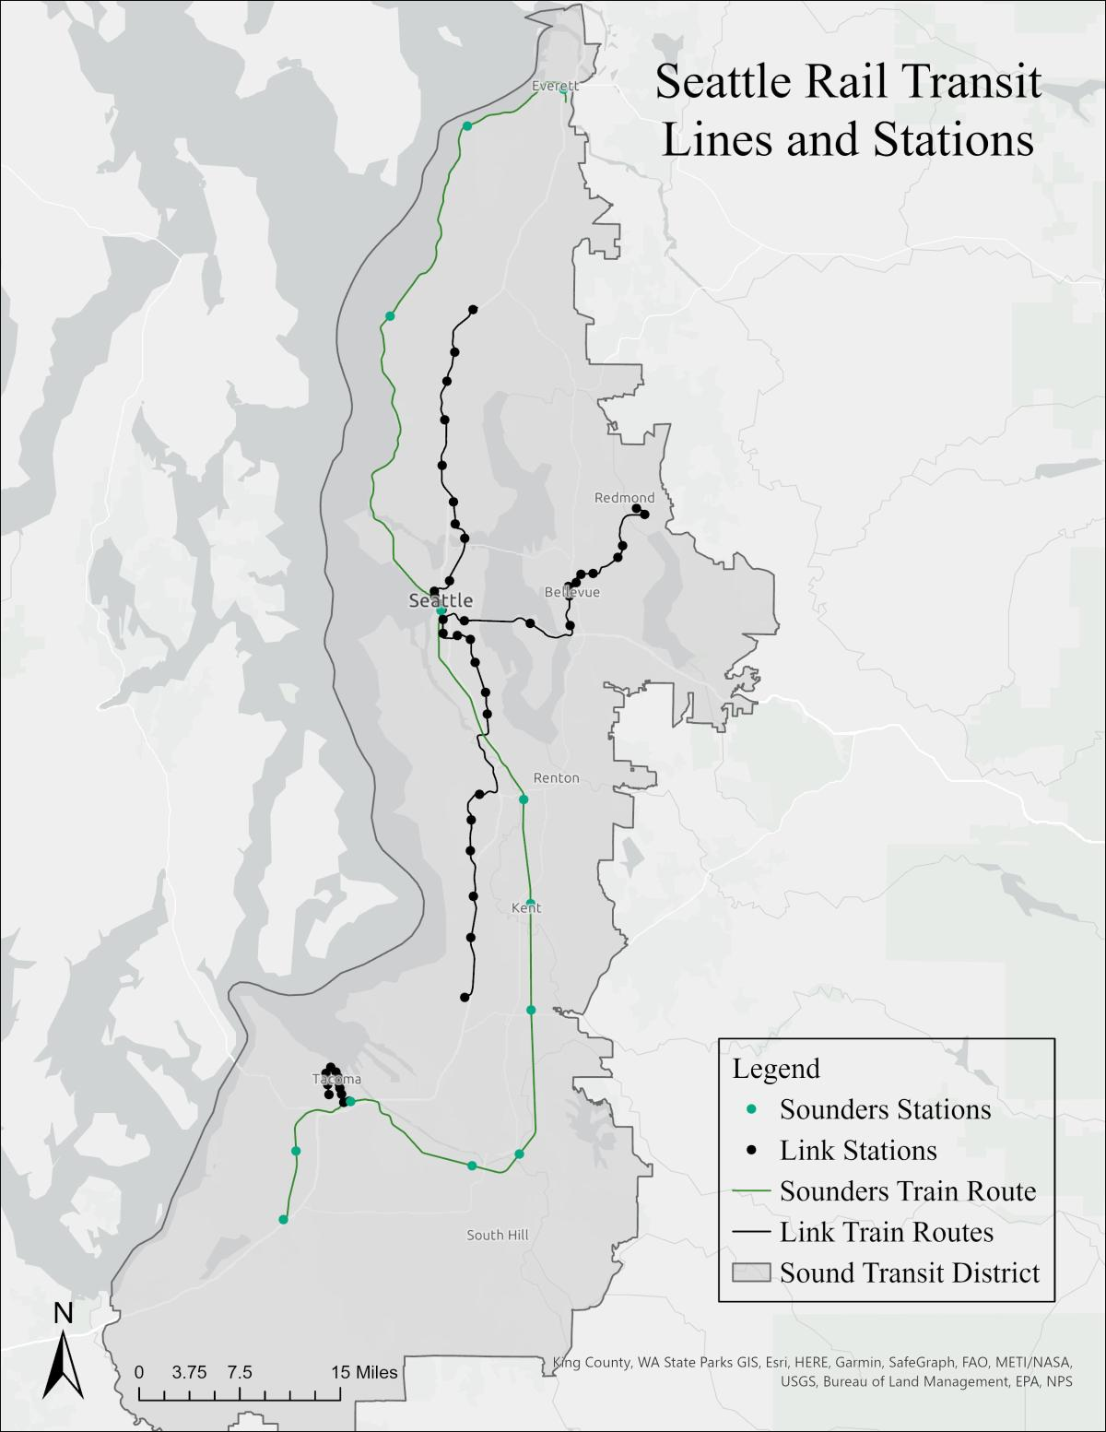
Data source: soundtransit.org
Map created in ArcGIS Pro

Slide 10
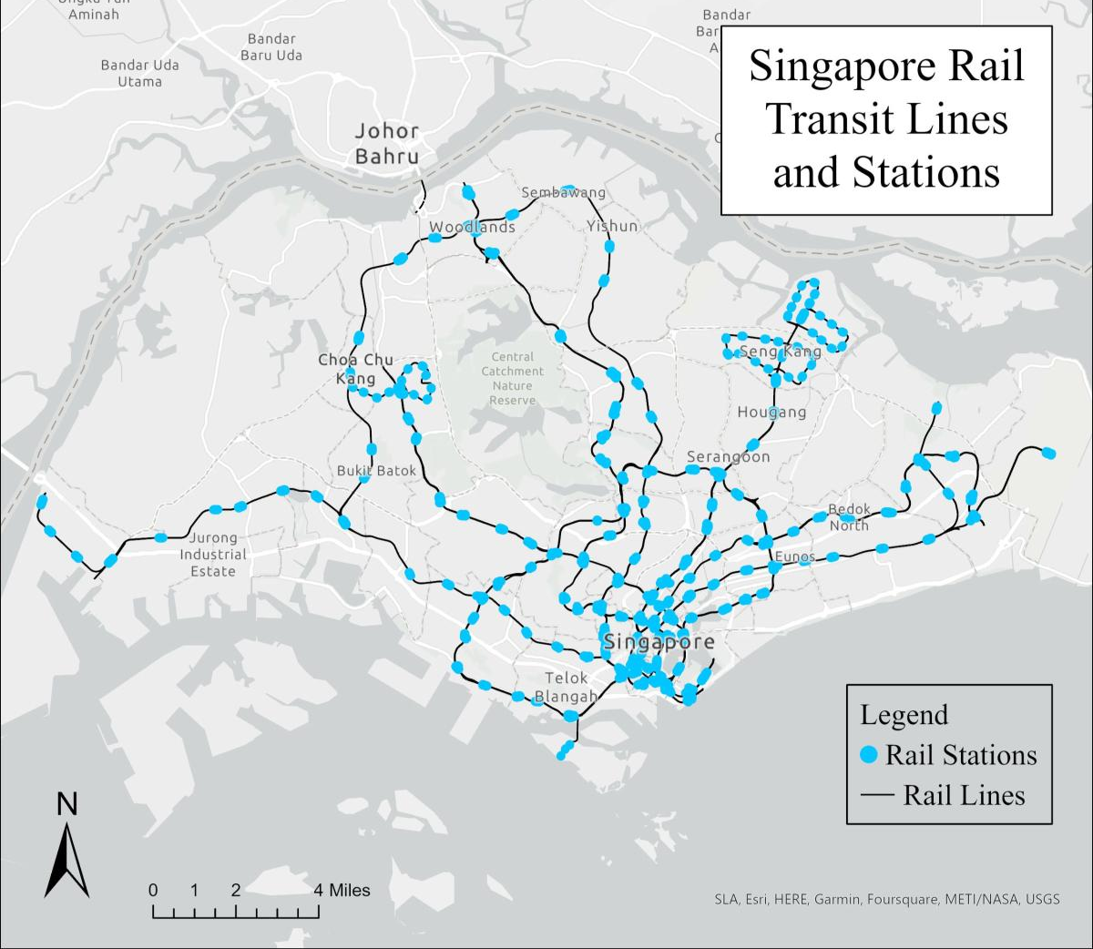
Rail Transit in Singapore
Data Source: ArcGIS Online Learner
Map created in ArcGIS Pro

Slide 11
Analysis
To show access to transport we create a 0.5 mile buffer
  Buffer represents a 10 minute walk from the station by the average person
To assess centrality we count the number of nodes and edges
  Can also determine closeness and betweenness centrality
To assess accessibility we use a significant location
  Pharmacies
  Count the number of pharmacies within 0.5 miles from the station

Slide 12
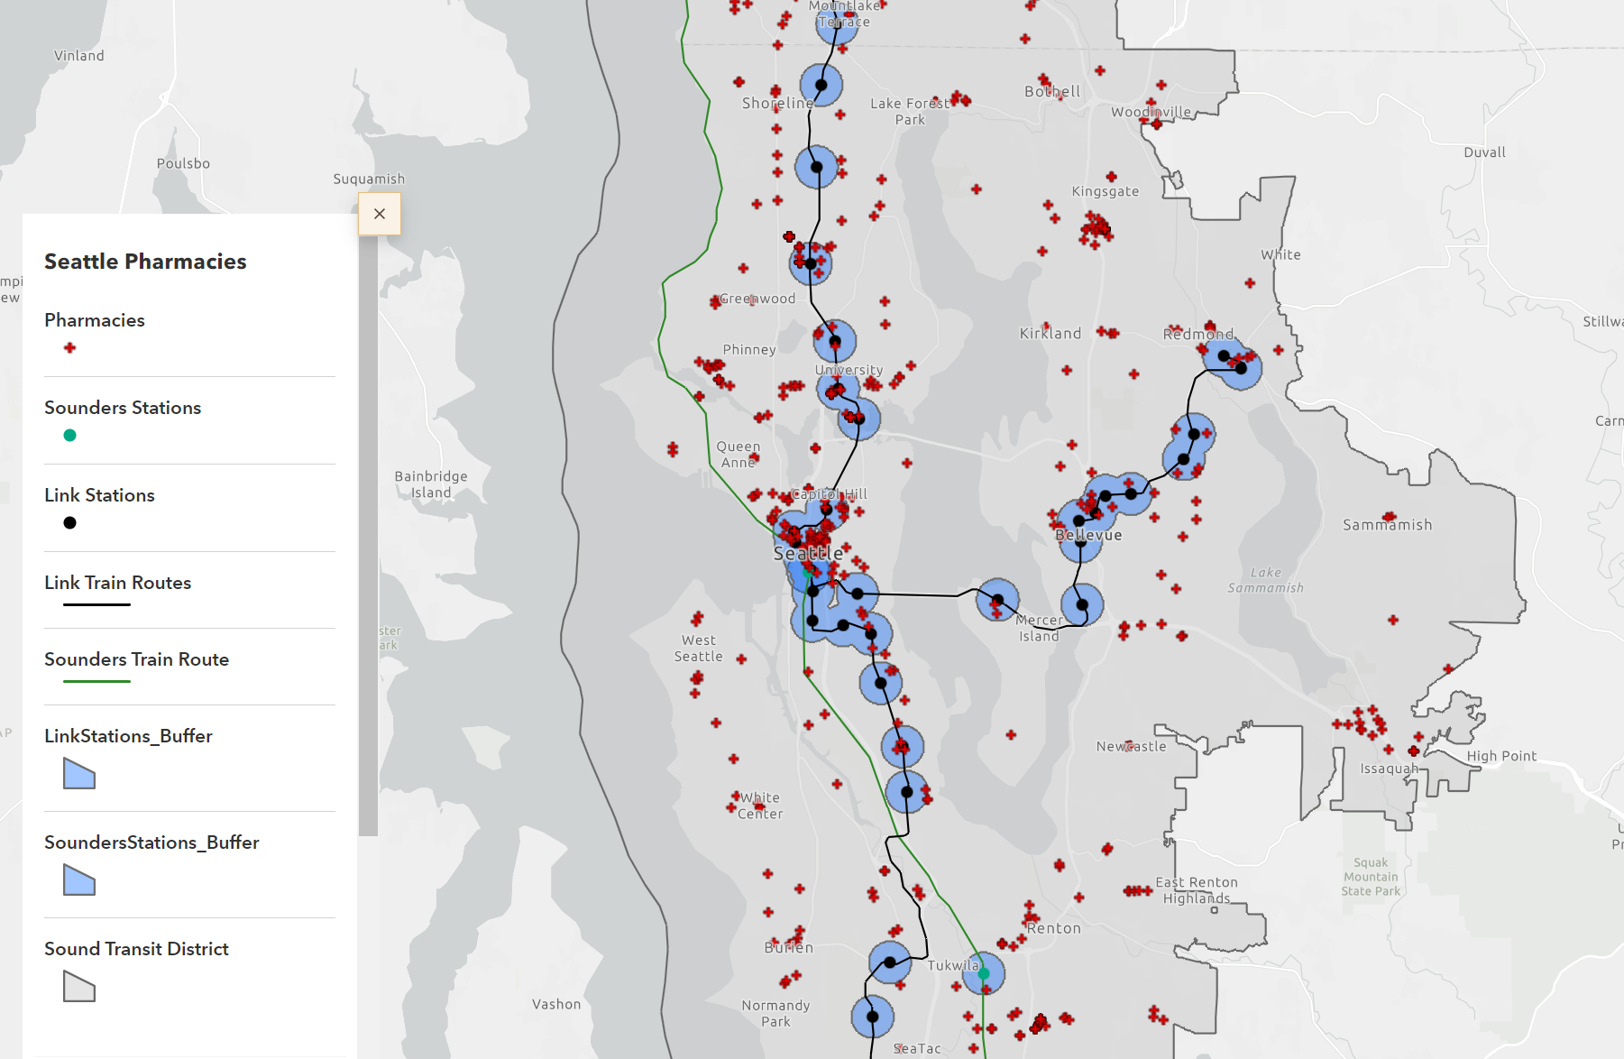
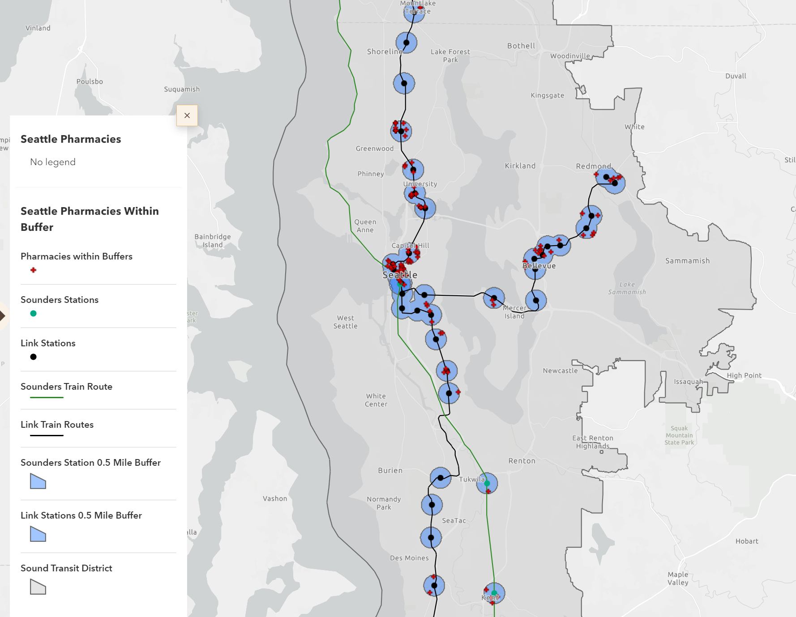
Seattle and Pharmacies
Left: All Pharmacies within the Sound Transit District
Right: Pharmacies within 0.5 miles of a station

Slide 13
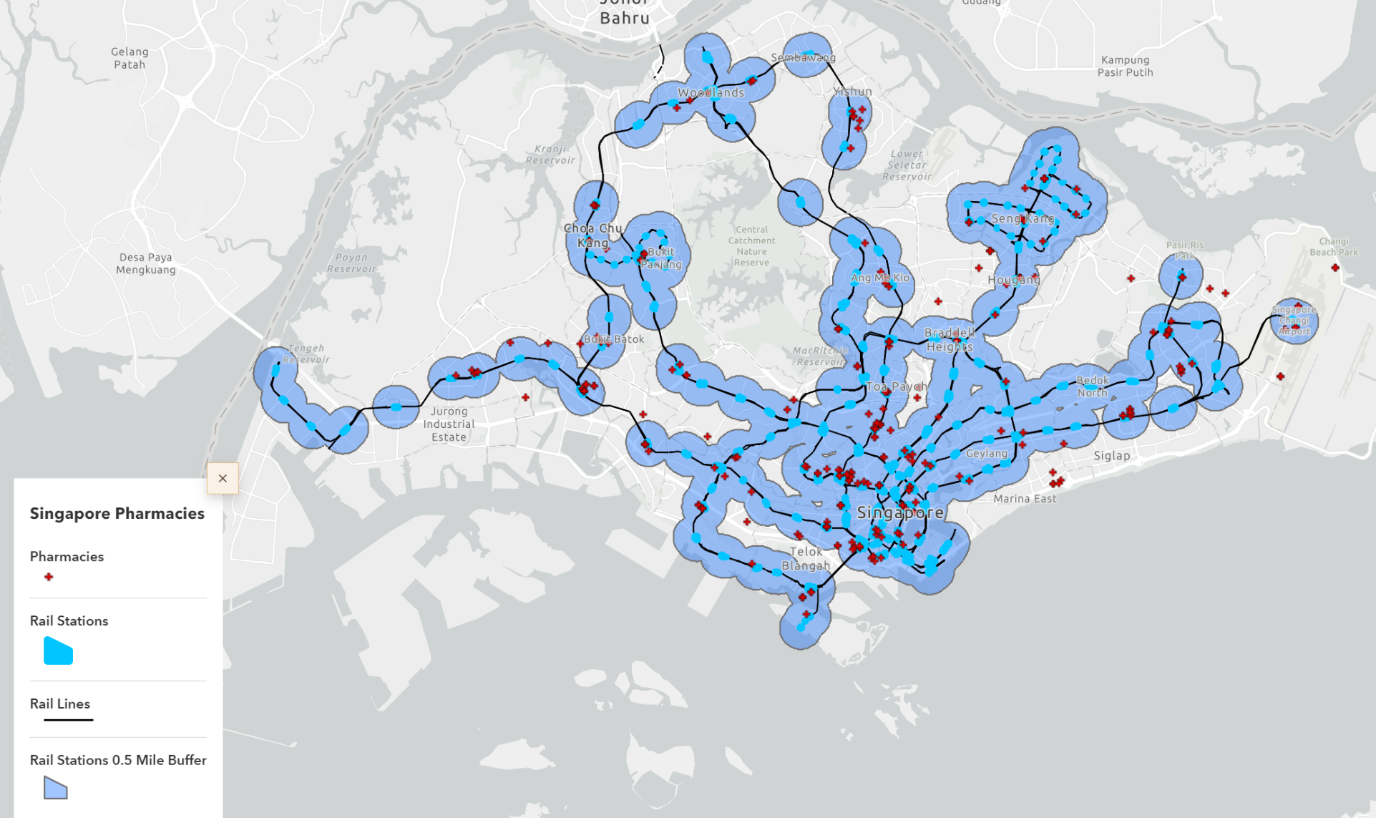
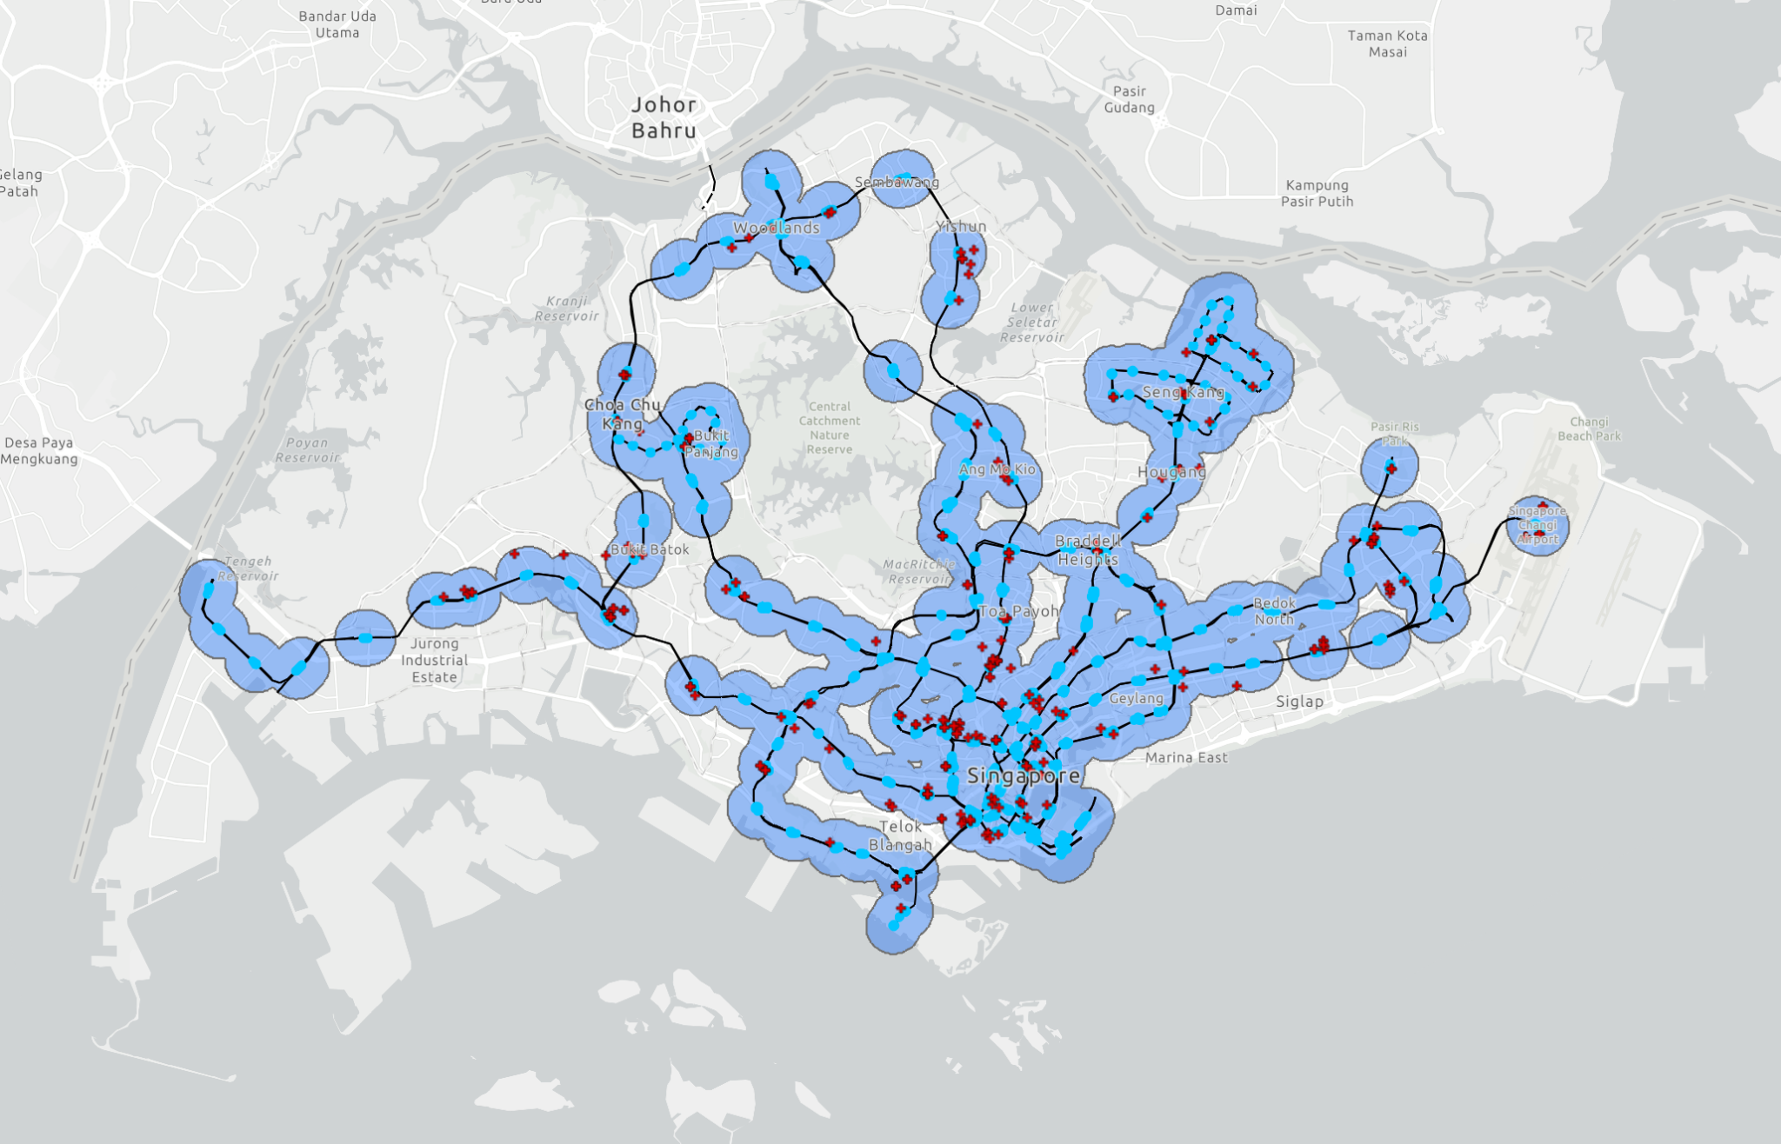
Singapore and Pharmacies
Left: All pharmacies in Singapore
Right: Pharmacies within 0.5 miles of a station

Slide 14
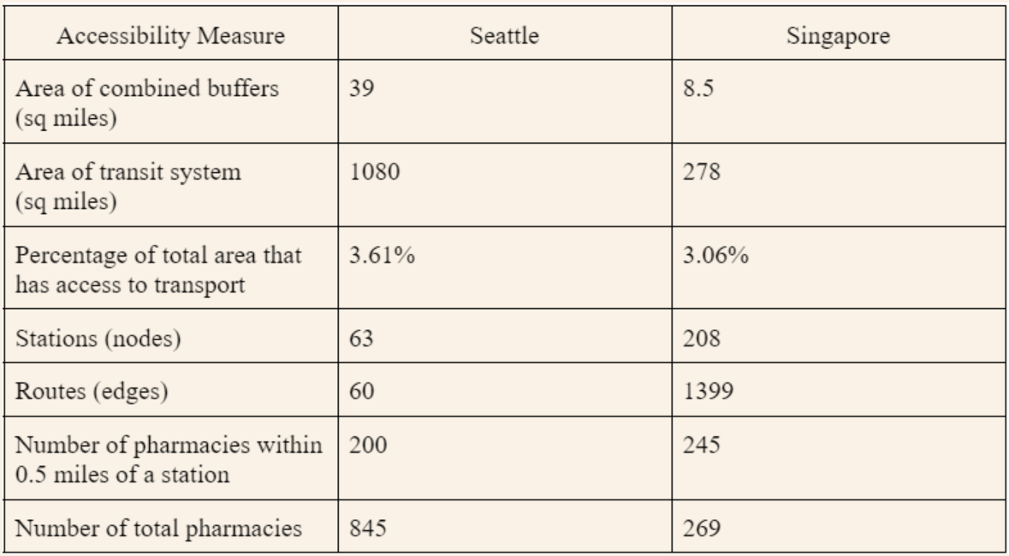
Results

Slide 15
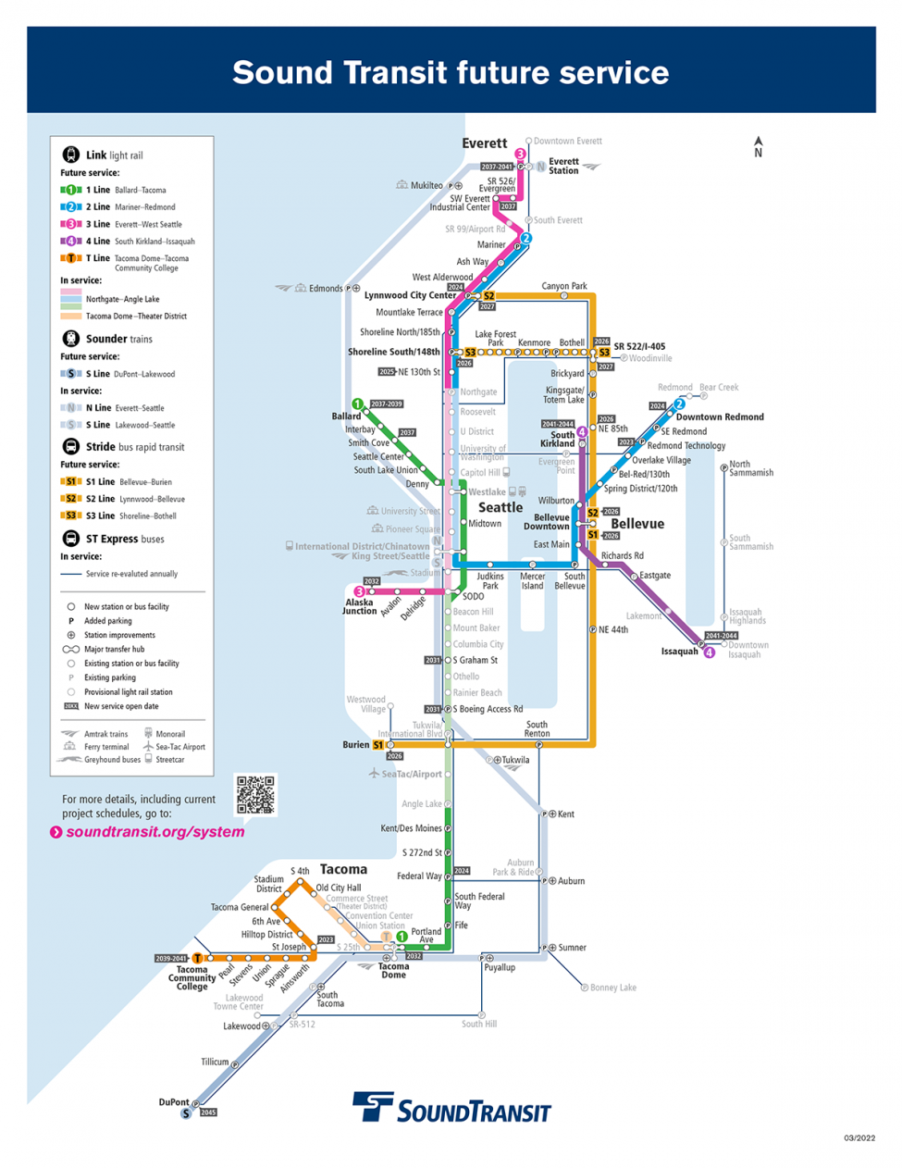
New Transit Plans
This project was made in AU 2022
Data did not include the new additions made recently
Number of stations and routes increase significantly
  Reaches more neighboring cities
More connectivity in stations
  Many lines overlap
Current design requires many transfers
  Still follows linear designs
Source: soundtransit.org

Slide 16
Conclusion
As Seattle expands link, it is important to account for accessibility along with interconnectedness
Seattle’s population is increasing
  Increased public transit decreases reliance on personal vehicles
Comparing to Singapore we can gain insights on improving our rail transit
  Extend beyond Link’s linear routes
  More connectivity among routes
Main goal: connecting residents to the city

Slide 17
References
Chanel, T. and Moynihan, Q. (2021). 15 cities that are home to some of the world’s best transport solutions. Business Insider France. https://www.businessinsider.com/15-cities-worlds-best-transport-solutions-2019-12
Currie, G. (2010). Quantifying spatial gaps in public transport supply based on social needs. Journal of Transport Geography. 18(1), 31-41. https://doi.org/10.1016/j.jtrangeo.2008.12.002
Hawas, Y. E., Hussan, M. N., and Abulibdeh, A. (2016). A multi-criteria approach of assessing public transport accessibility at a strategic level. Journal of Transport Geography, 57, 19-34. Doi: https://doi.org/10.1016/j.jtrangeo.2016.09.011
Miller, E. J. (2018). Accessibility: measurement and application in transportation planning. Transport Reviews. 38(5), 551-555. https://doi.org/10.1080/01441647.2018.1492778
Puspas, J. (2020). Measuring Quality of Urban Public Transport. Medium. https://medium.com/vesputi/measuring-quality-of-urban-public-transport-3f2e5fda666a
Westneat, D. (2021). Seattle shrinking? Seattleites moved out in droves in 2020, though most didn’t go far. The Seattle Times. https://www.seattletimes.com/seattle-news/seattle-shrinking-seattleites-moved-out-in-droves-in-2020-though-they-didnt-go-far/

Slide 18
Data Sources
Seattle Data Sources
Pharmacies: https://doh.wa.gov/data-statistical-reports/data-systems/geographic-information-system/downloadable-data-sets
Transit data: https://www.soundtransit.org/help-contacts/business-information/open-transit-data-otd/otd-downloads
Vehicle counts: https://data.census.gov/table?tid=ACSDP5Y2021.DP04&g=0400000US53_1600000US5363000&hidePreview=true
Singapore Data Sources
Vehicle counts: https://data.gov.sg/dataset/annual-motor-vehicle-population-by-vehicle-type
Pharmacies: https://www.onemap.gov.sg/home/
Transit stations and routes: https://www.arcgis.com/home/item.html?id=b6c521bf02fc46b8887c7af0d071b483

Slide 19
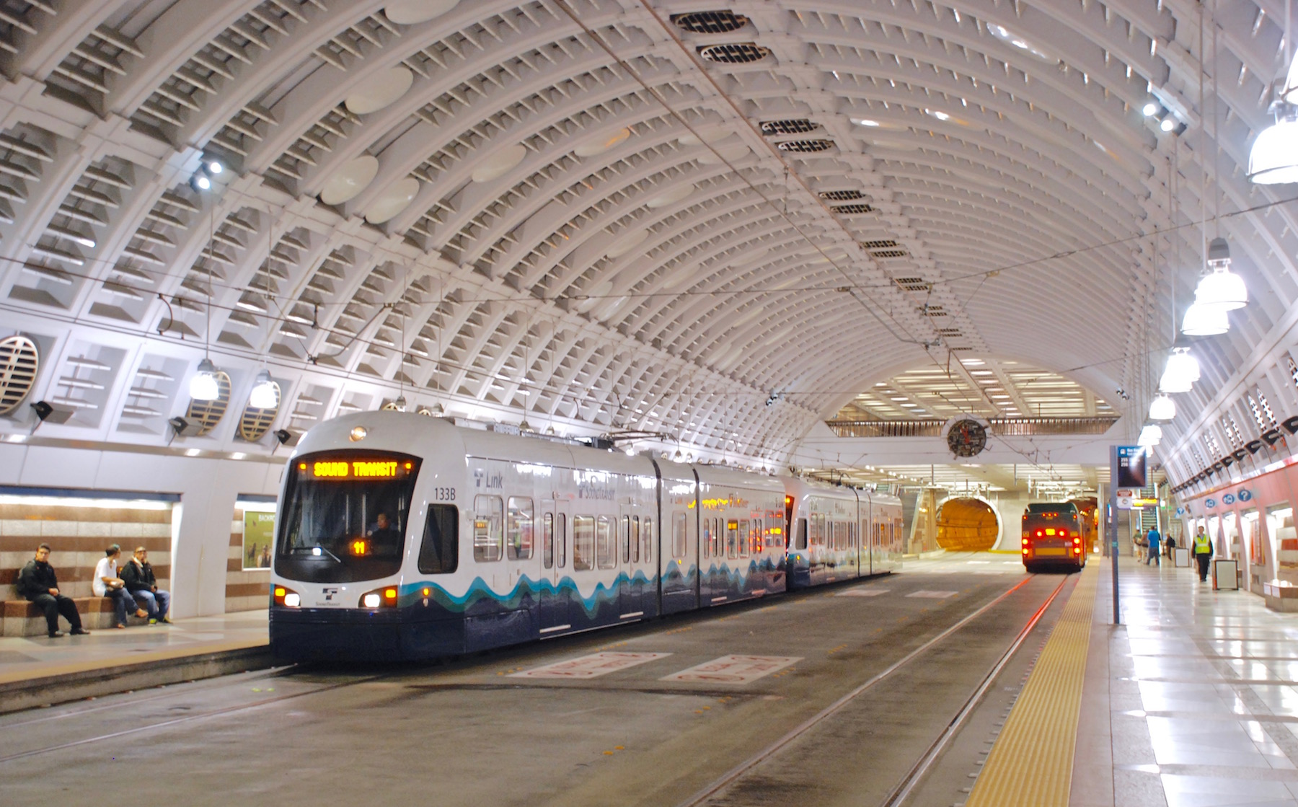
Thank you!

