Slide 1
Using Location Data from Smartphones to Time a
Small Marathon
Nick Walker

Slide 2

OwnTracks
Suite of software
Collect and store live location data from devices, privately
Free & open source (MIT License)
Since 2014

Slide 3



GPS Coordinates
Velocity
Battery %
Cellular/WiFi
Step count (iOS)
MQTTS
HTTPS
WebSocket
Friend map (optional)
Client Device
Server
Browser
OwnTracks Recorder
OwnTracks Frontend
OwnTracks App
iOS or Android

Slide 4
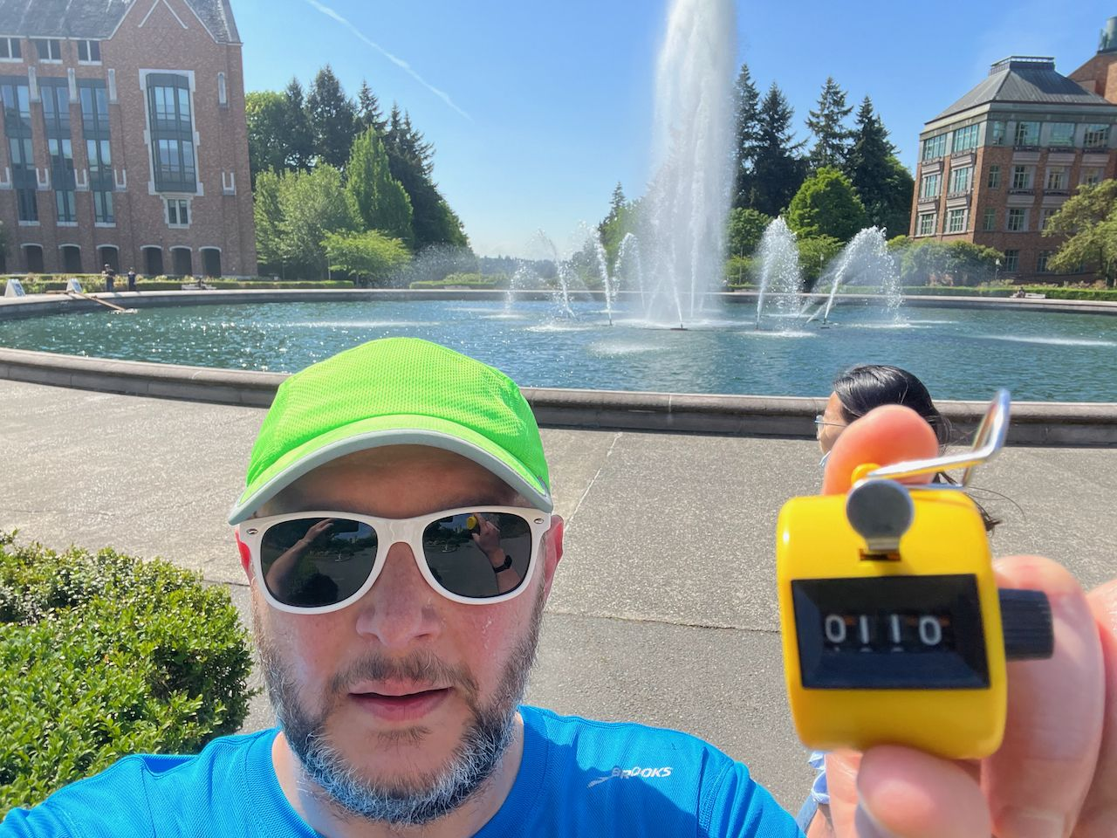
Use Case: Timing the
Drumheller Marathon
110 laps half, 220 full
Counting is hard
Standard solutions too expensive
High Frequency RFID, “chip timing”

Slide 5
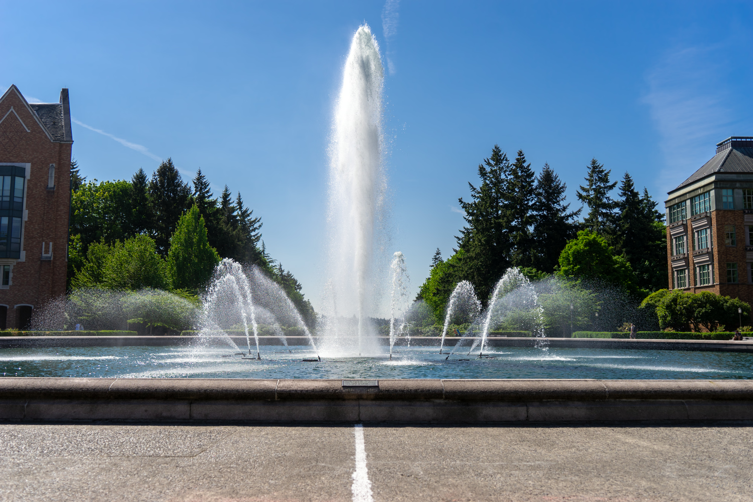
Demo: Drumheller Live Tracking
Off-the-shelf OwnTracks for phones, server
Custom live data visualization for browsers
https://drumhellermarathon.com

