Slide 1
Cool Projects at UW’s Polar Science Center
And a job opportunity!

Slide 2
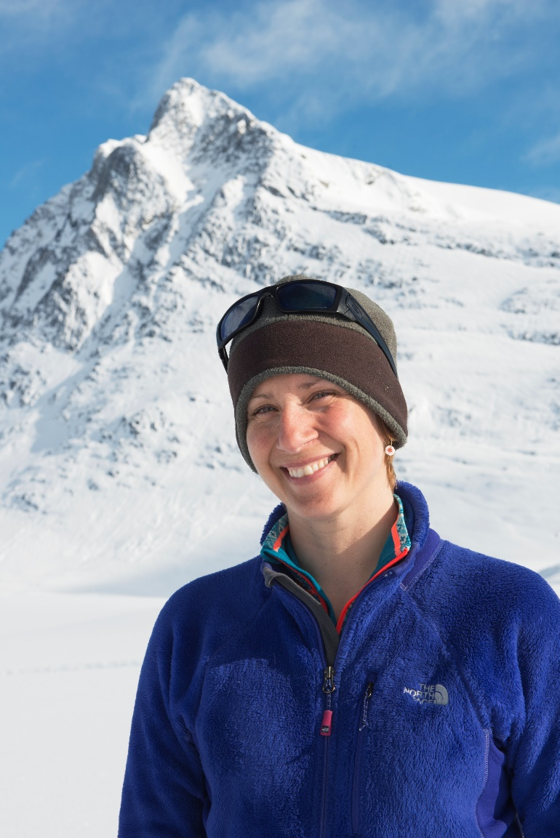
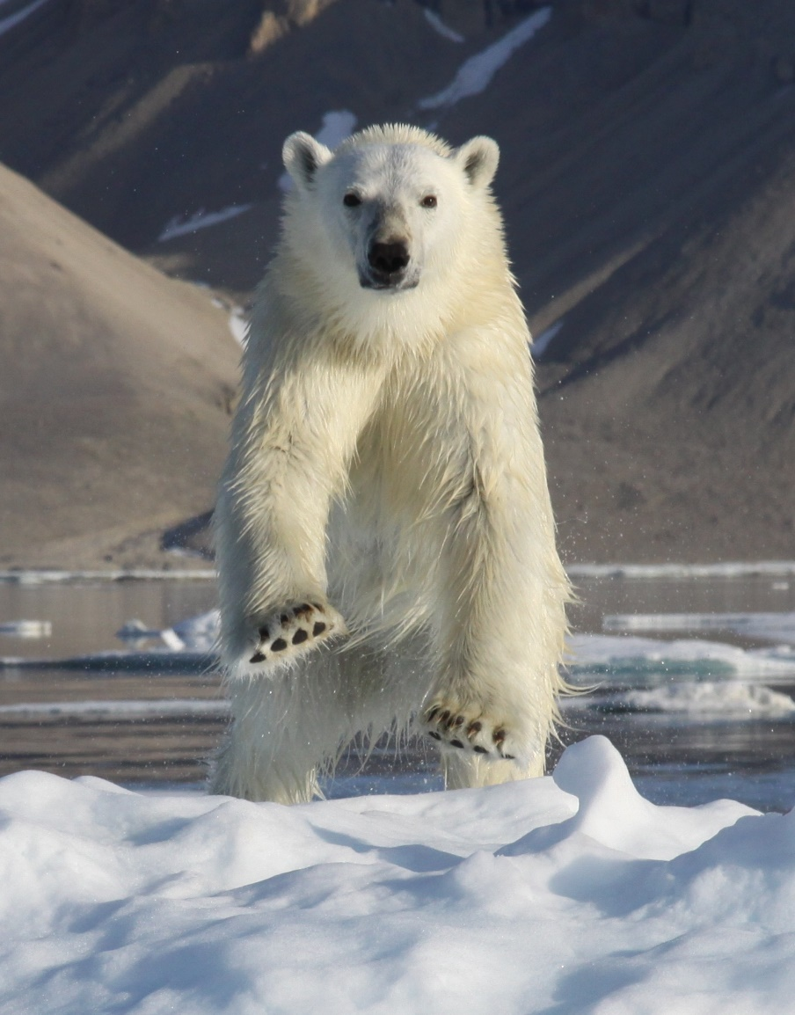
Kristin Laidre

Slide 3
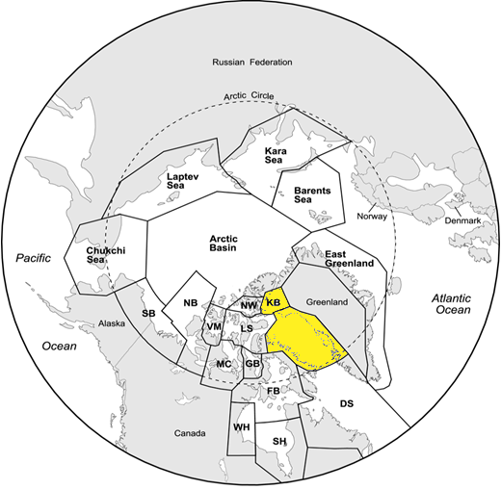

Slide 4
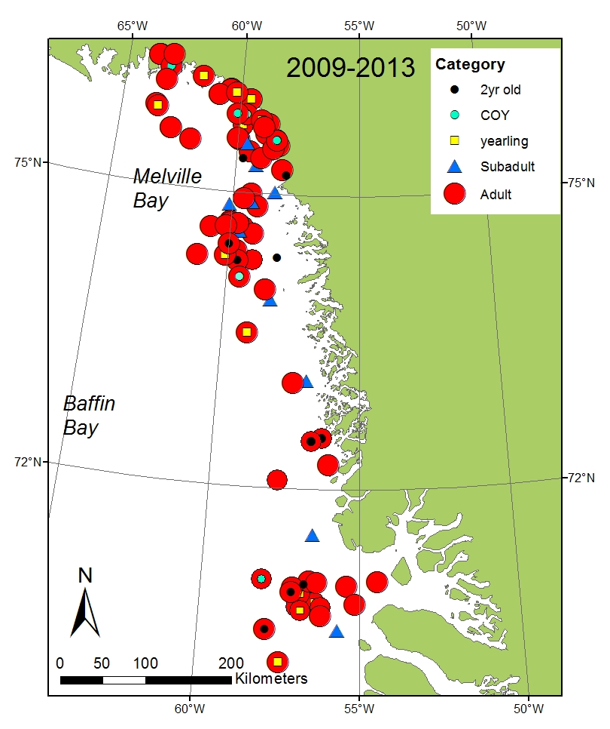
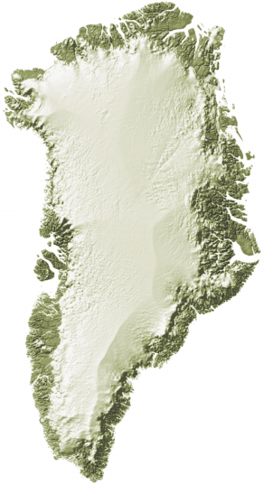
2009-2013
satellite tagging sites
139 bears

Slide 5
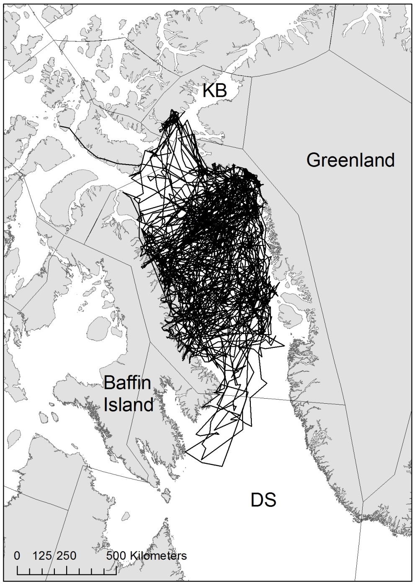
2009-2013
Tracks of 38
adult female bears

Slide 6
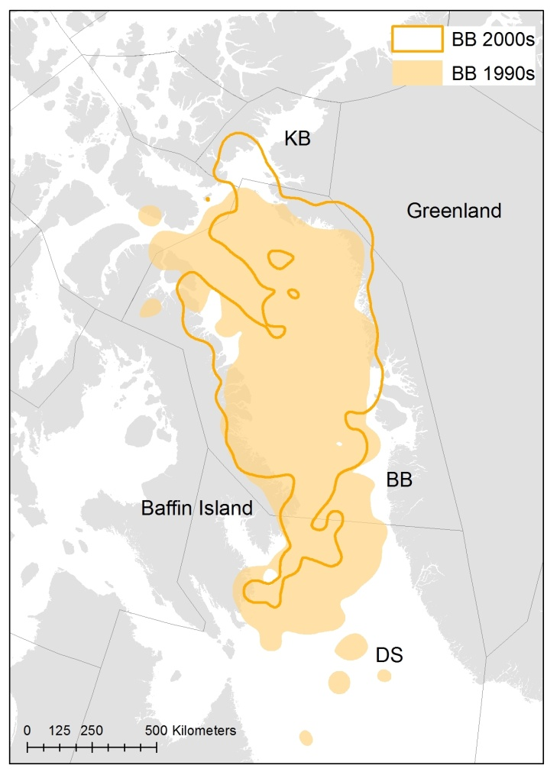
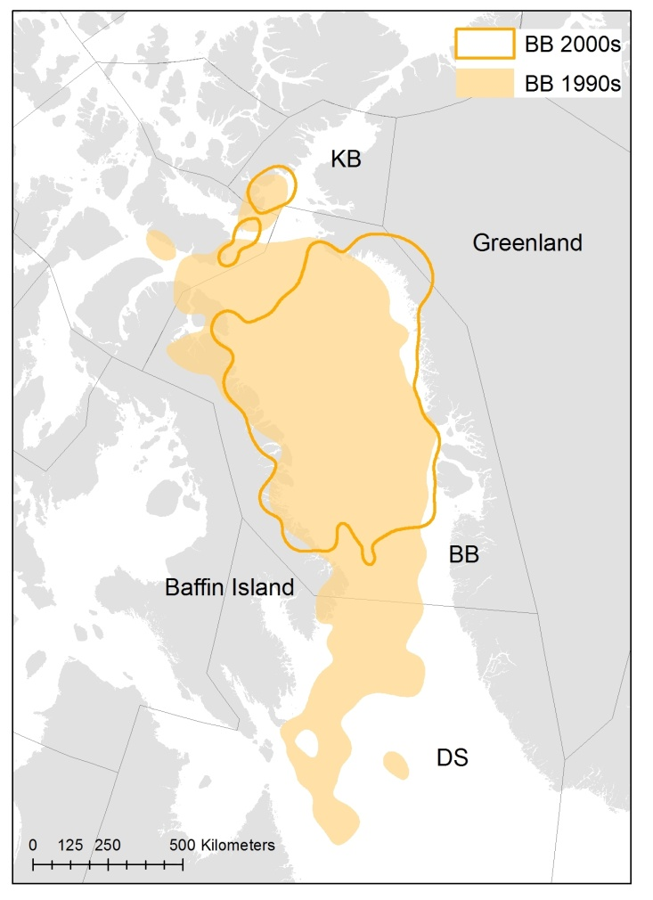
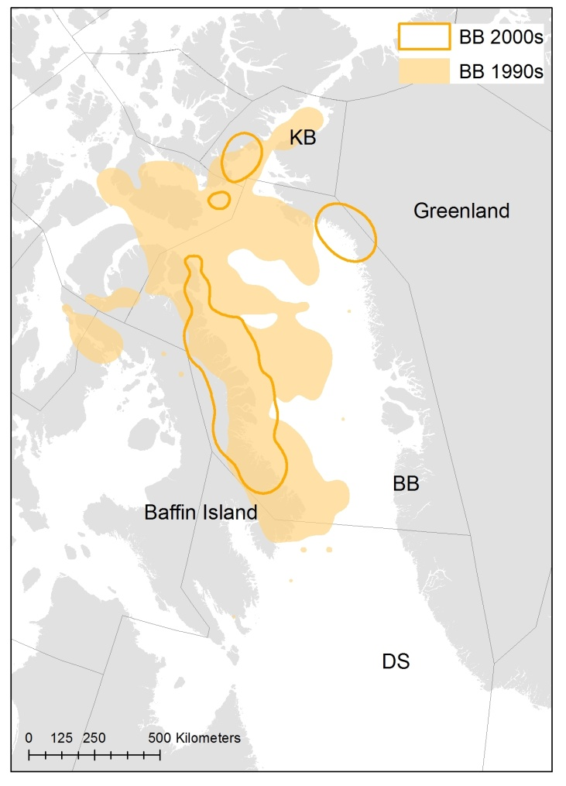
Seasonal Range
Winter (Nov-Feb)
Spring (March-July)
Summer (Aug-Oct)
13% reduction
30% reduction
70% reduction

Slide 7
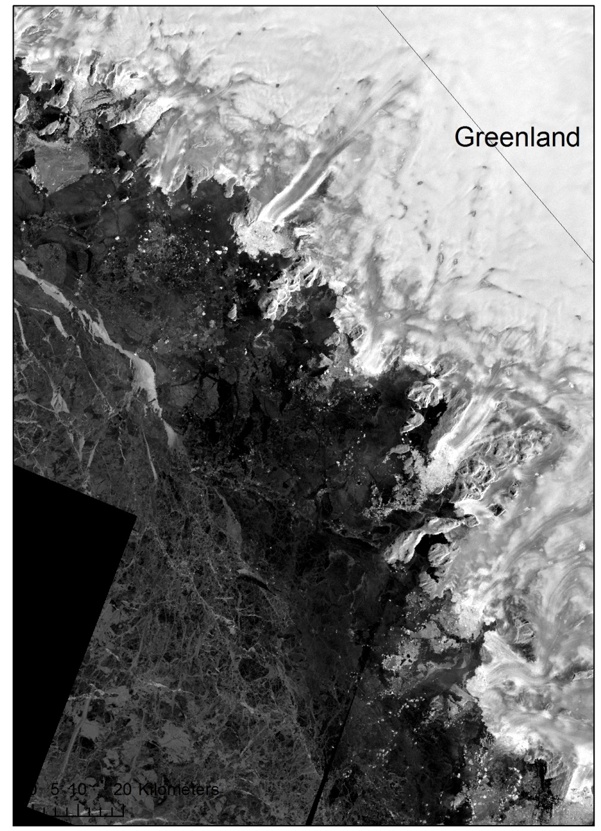
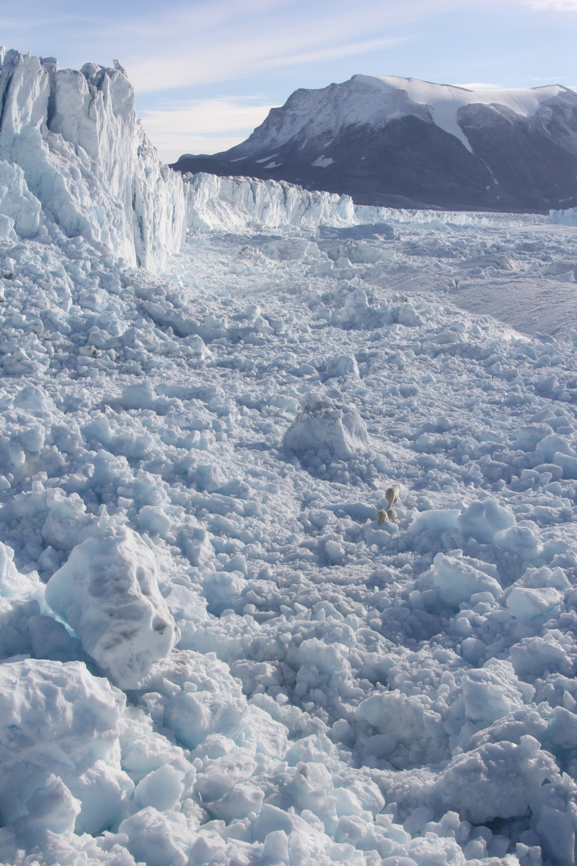
Melville Bay

Slide 8
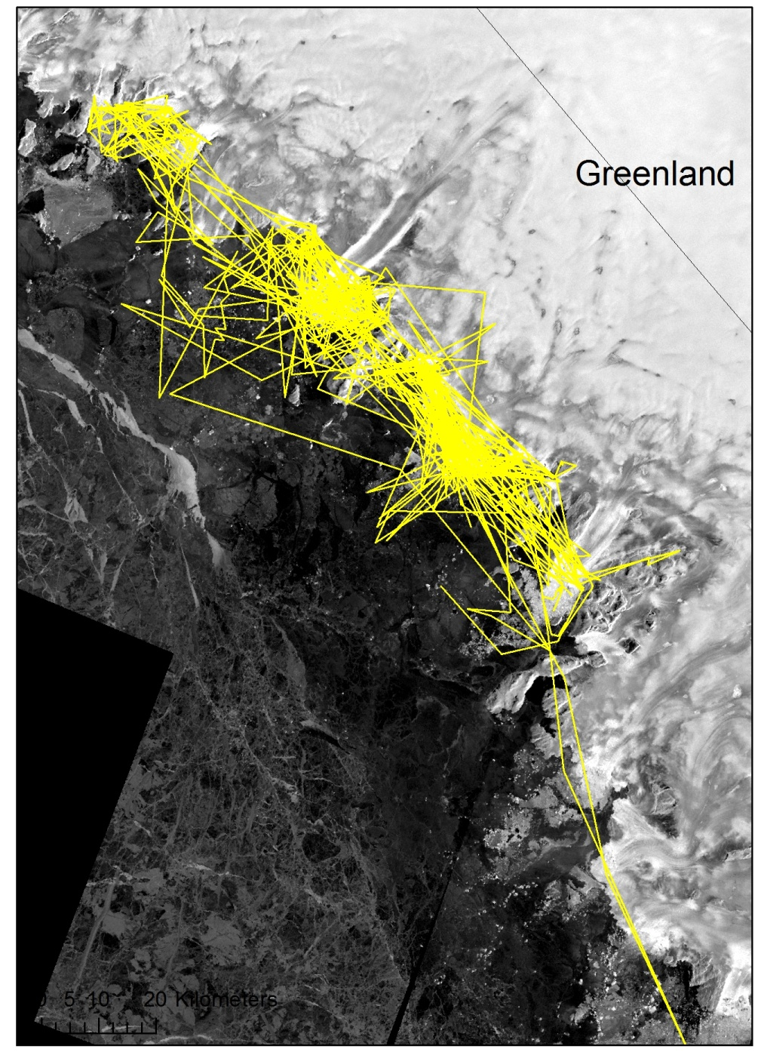
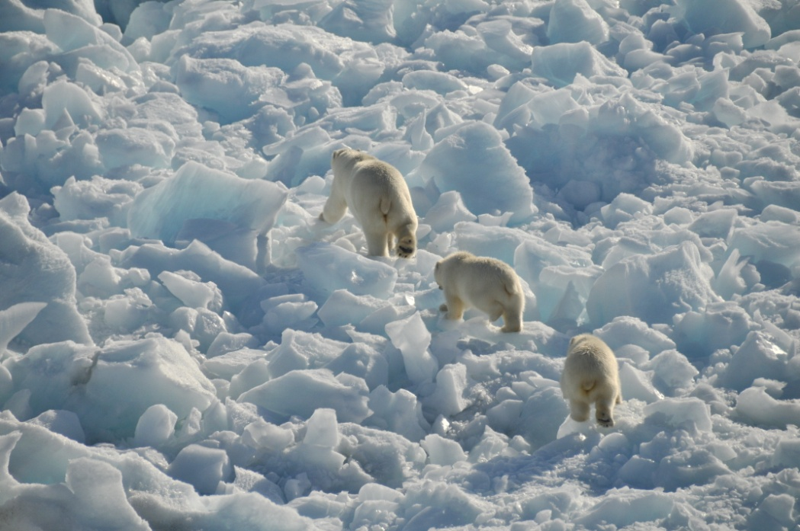
Melville Bay

Slide 9
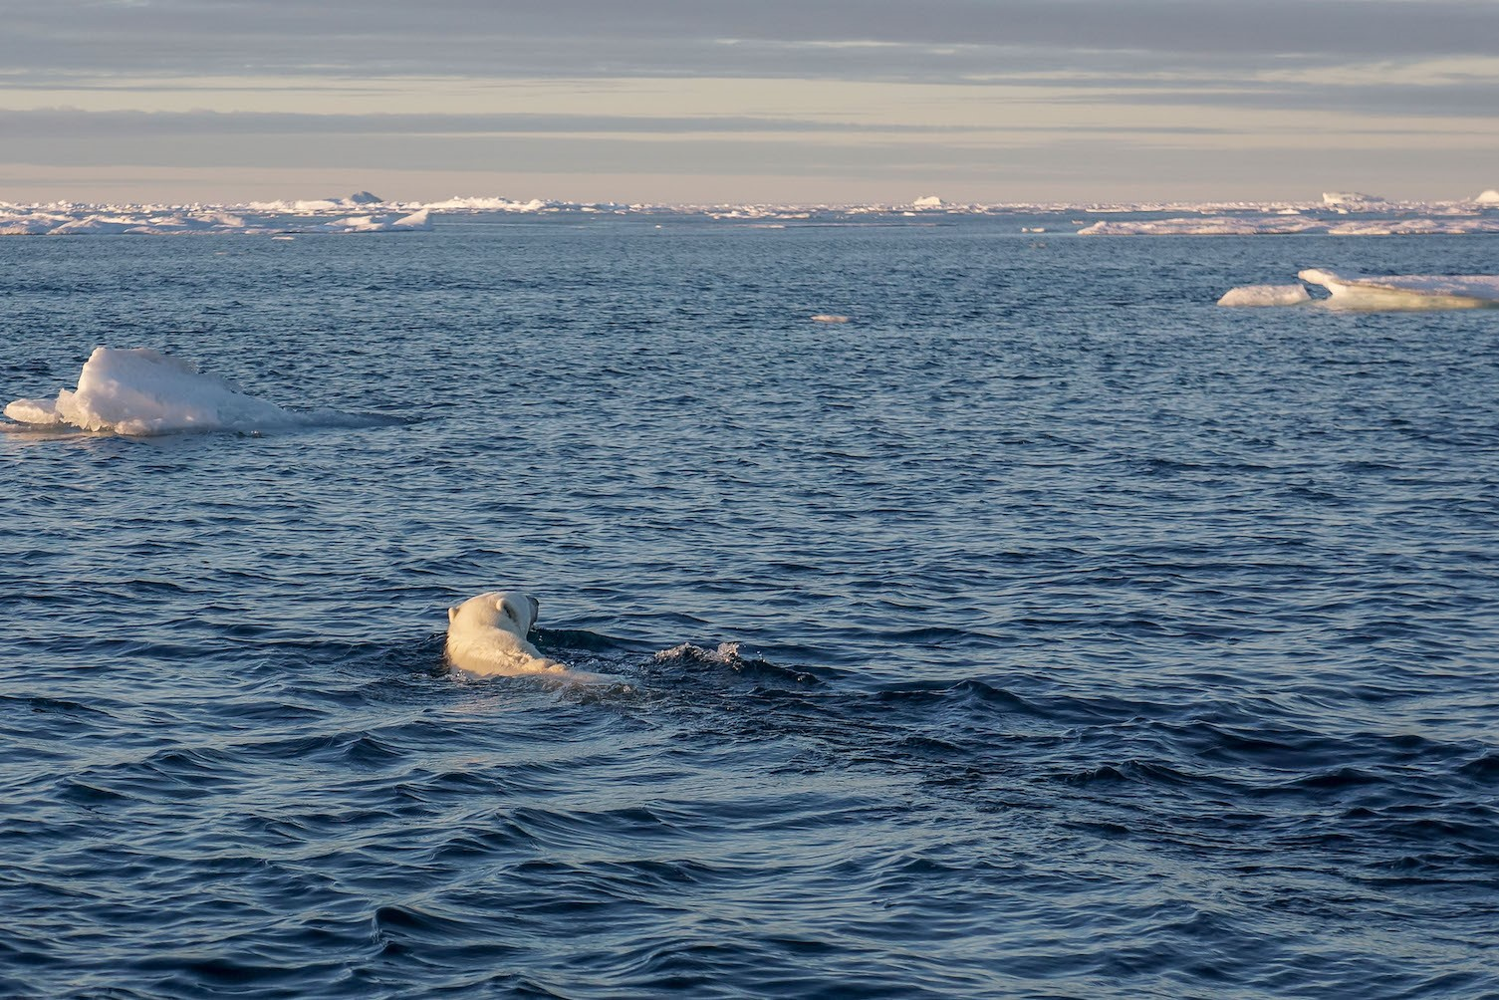

Slide 10
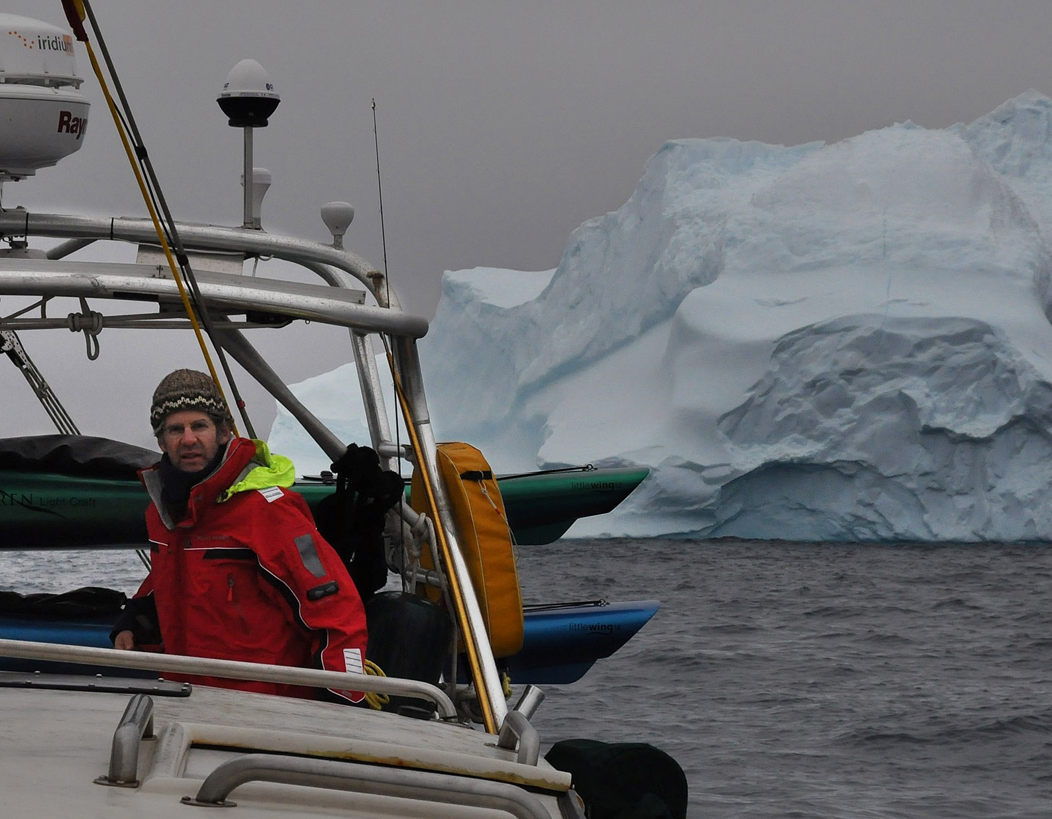
Harry Stern

Slide 11
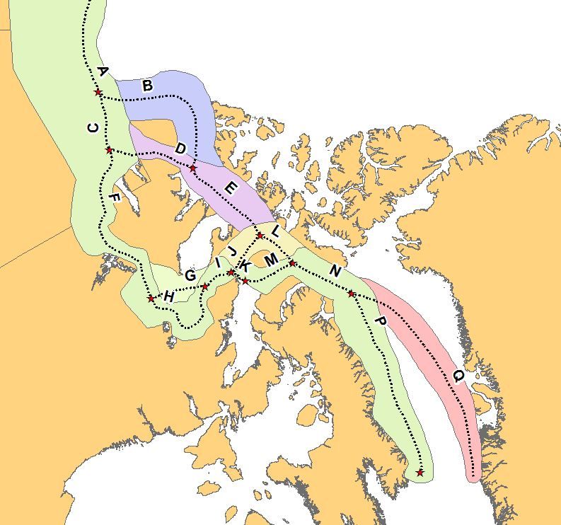
Routes of the Northwest Passage
Greenland
Canada

Slide 12
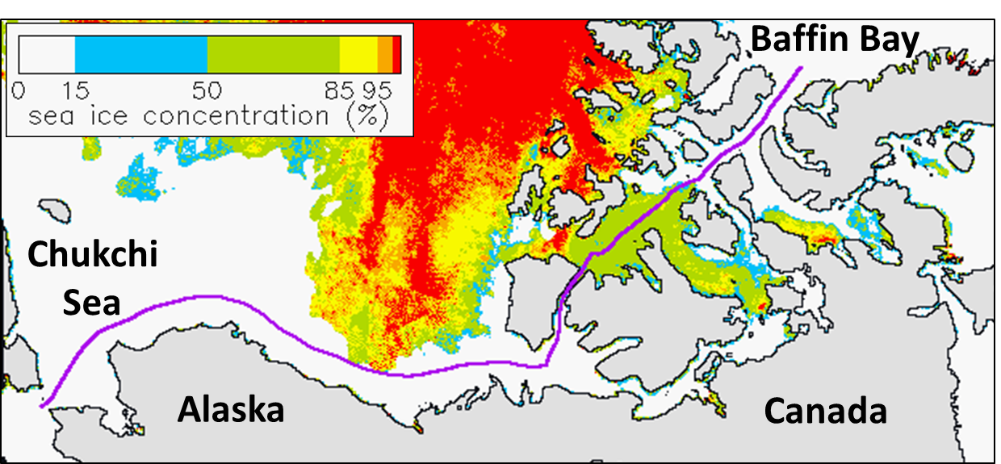

Slide 13
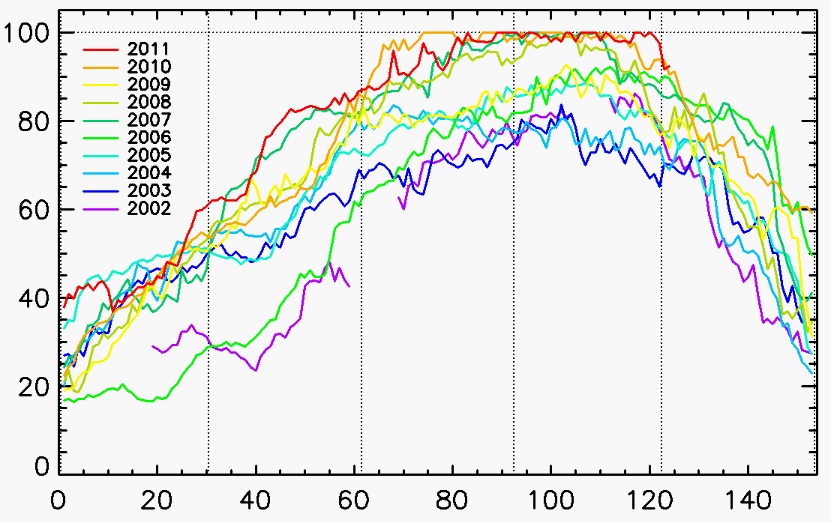
Percent of route open
June
July
Aug
Sept
Oct

Slide 14
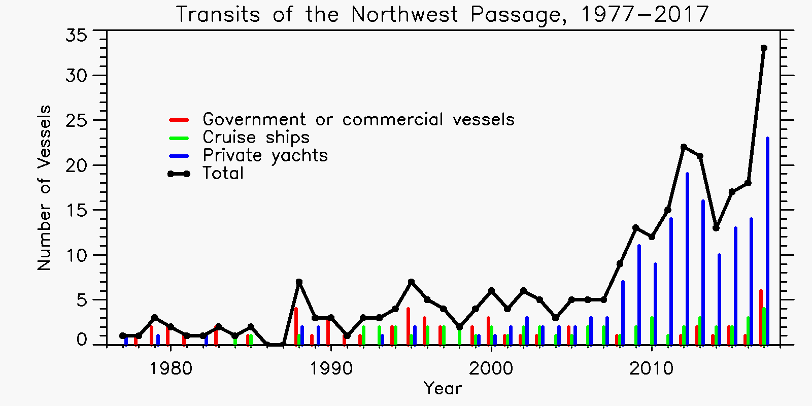

Slide 15
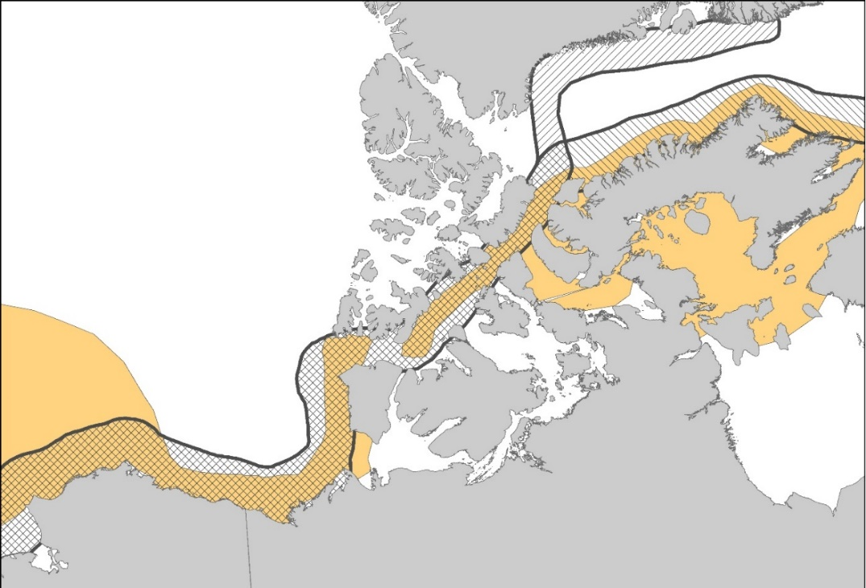
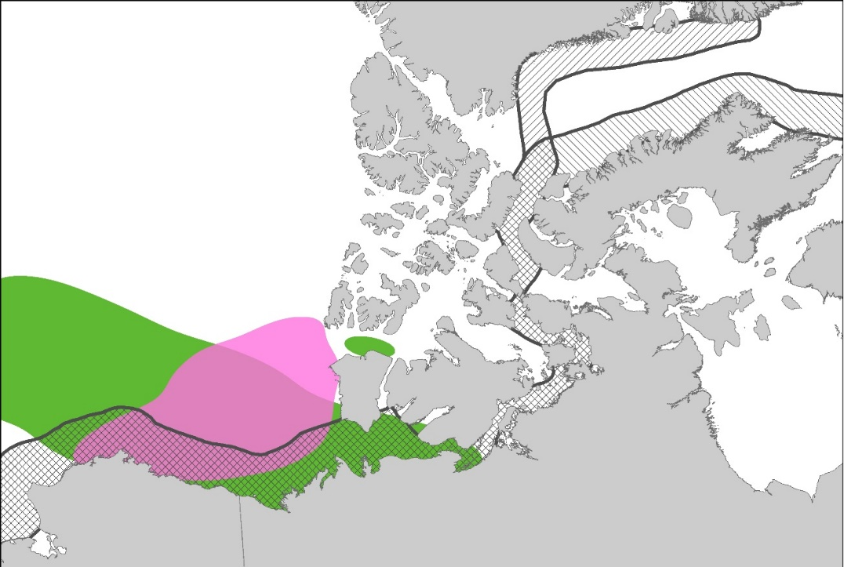
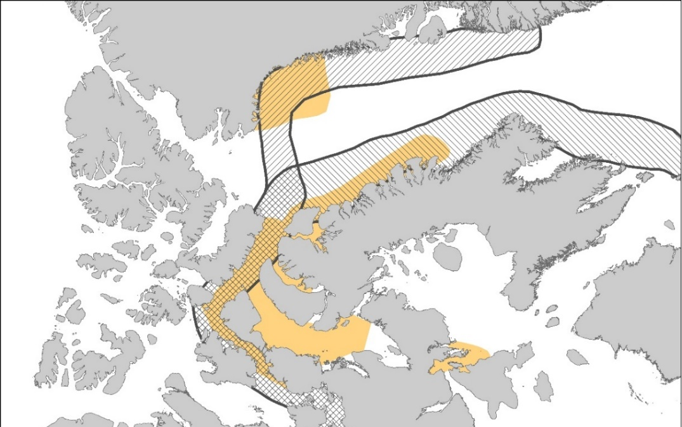
Greenland
Greenland
Bowhead whale
Beluga
Alaska
Canada
Alaska
Canada
Greenland
Narwhal
“Vulnerability of Arctic marine mammals to vessel traffic in the increasingly ice-free Northwest Passage and Northern Sea Route”
submitted to PNAS

Slide 17
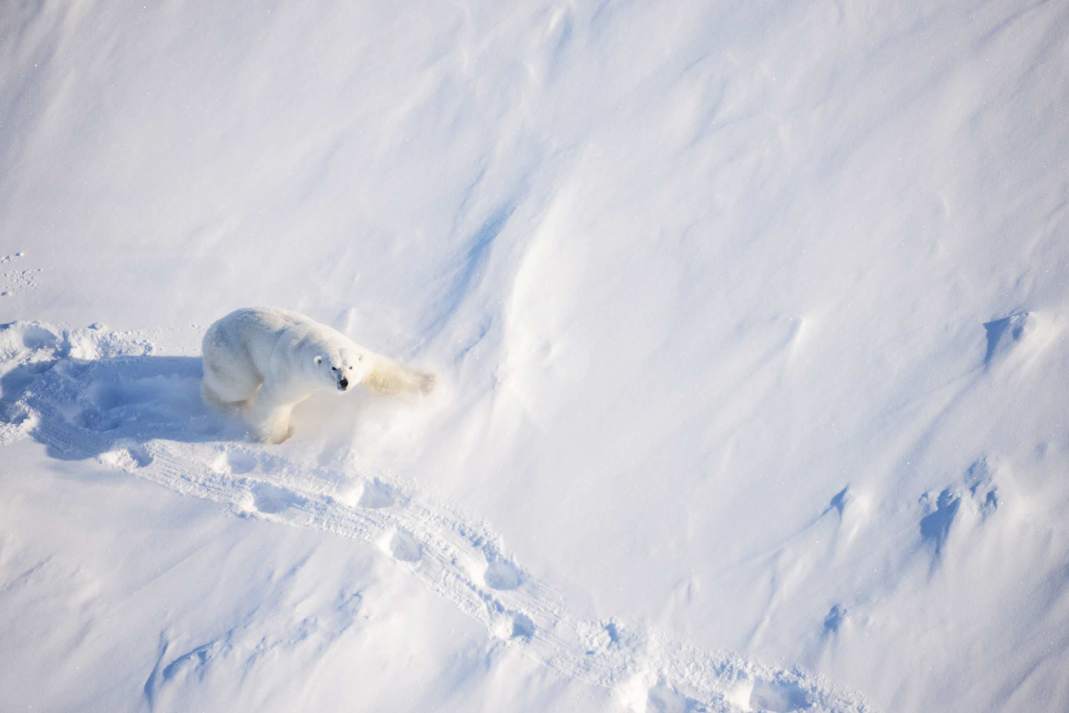
Job Opportunity
Data Analyst
with GIS experience
50% time
with benefits

Slide 18
Bachelor’s degree
ArcGIS
Python, R
Excel, Word, PPT

Slide 19
Flexible work schedule

Slide 20
Great work environment

Slide 21
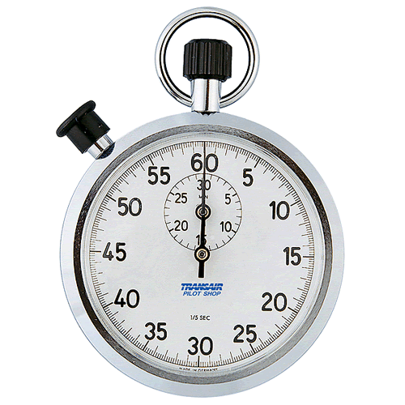
Time’s Up!
About your speaker:
Name: Kristin Laidre
Company: Polar Science Center, UW
Tel: 206-616-9030
Email: klaidre@uw.edu
Social Media: Twitter – @KristinLaidre
Quick bio: Marine biologist https://staff.washington.edu/klaidre/

