Slide 2
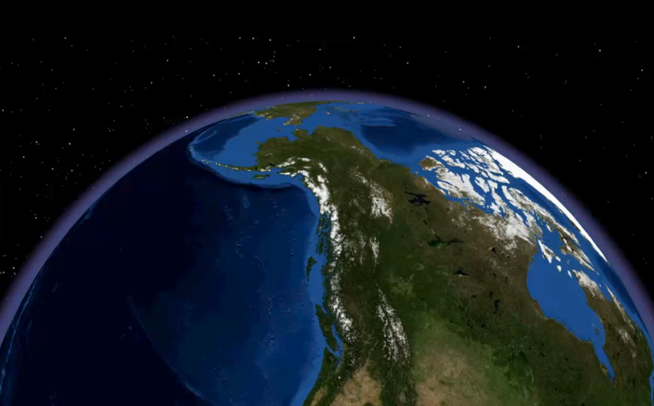
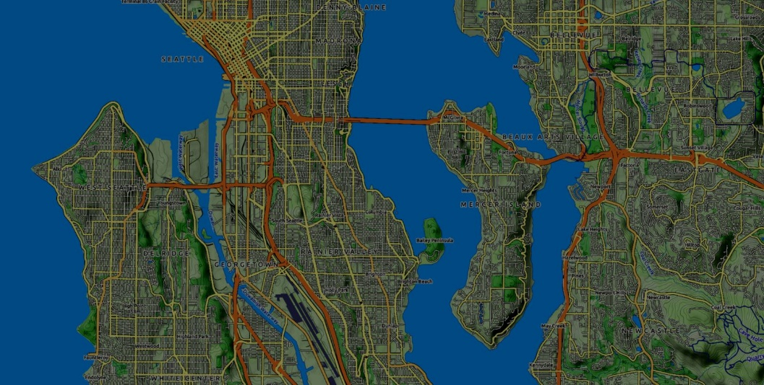
Geospatial datasets

Slide 3
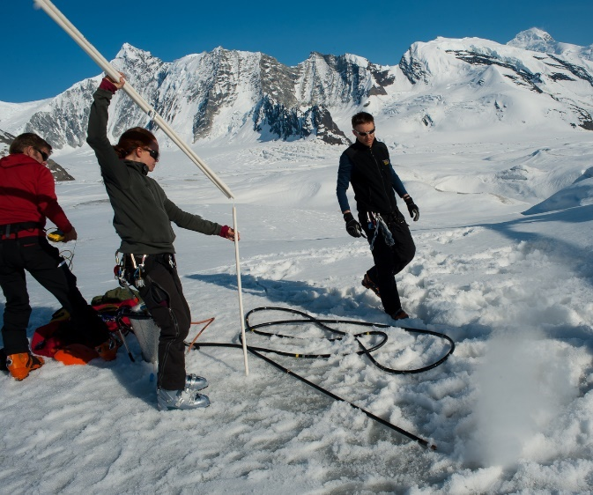
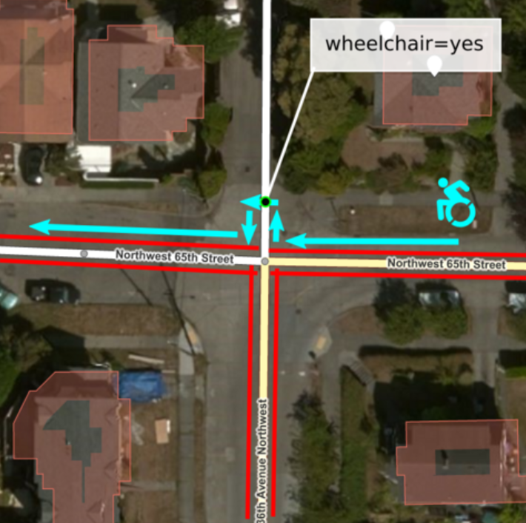
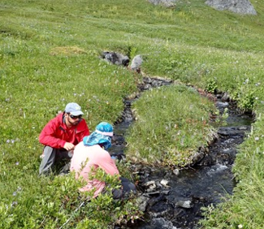
Field Data

Slide 4
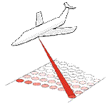
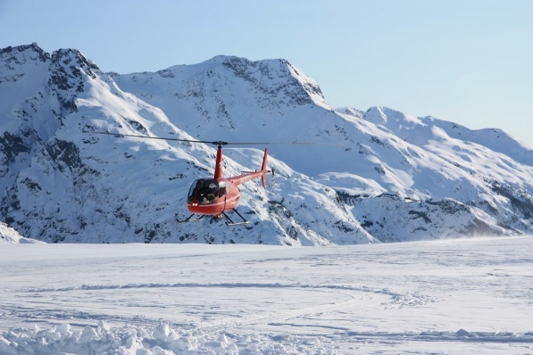
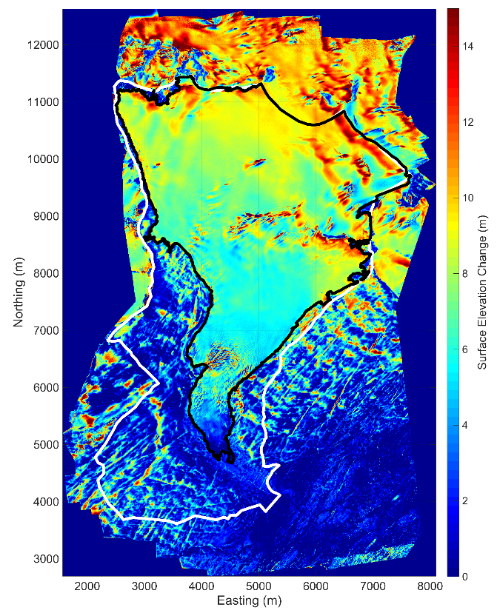
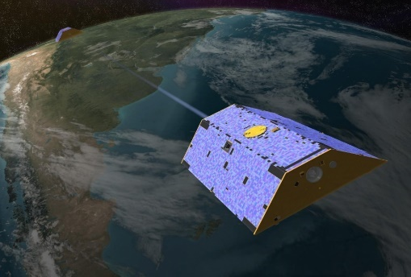
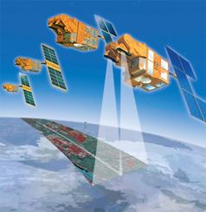
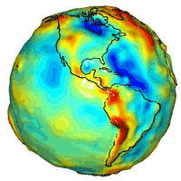
Remote Sensing Data

Slide 5
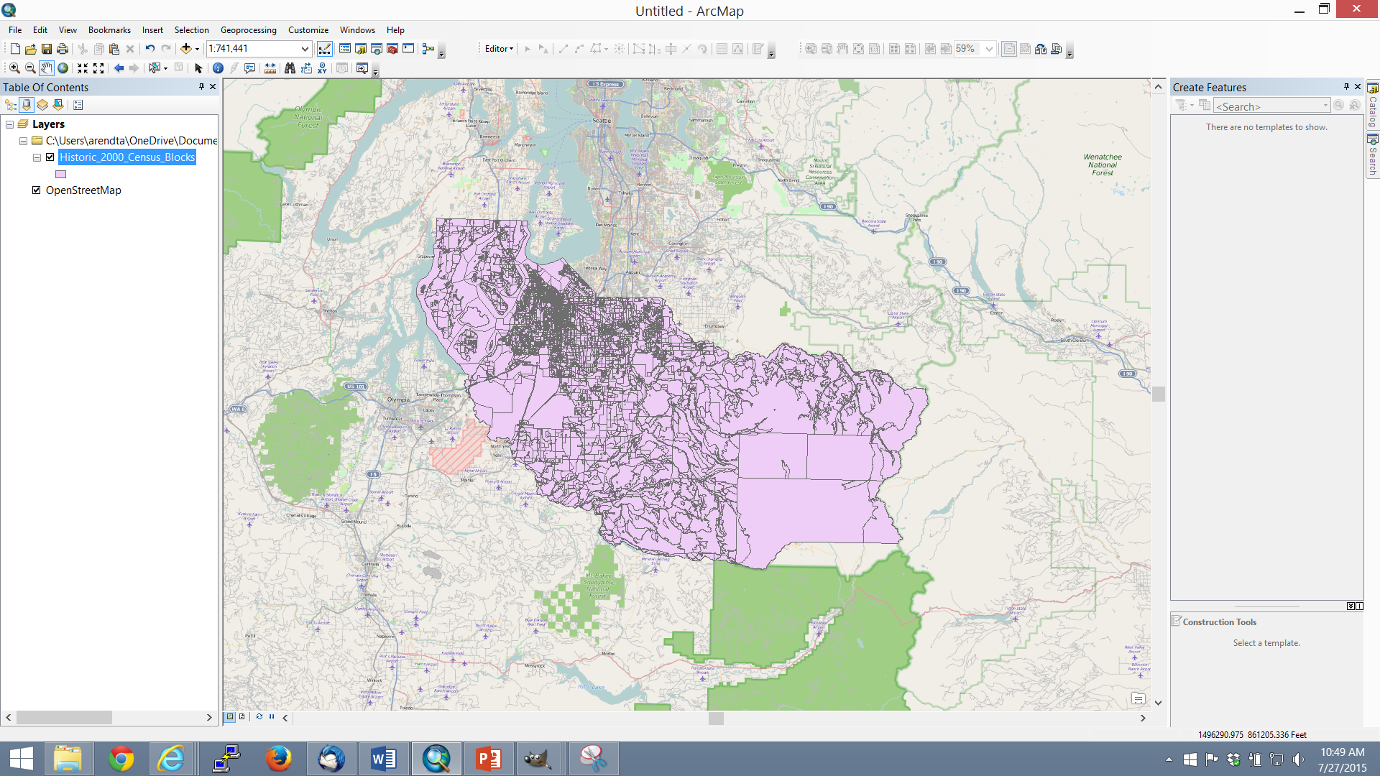
Commercial GIS Tools
difficulty handling large datasets
not optimized for rasters

Slide 6
Geospatial Education
tends to be scattered across multiple departments
subject to discipline bias

Slide 7
Geospatial Education
limited training on open source
difficult to keep up with all the new tools

Slide 8
Hackweeks
time-bounded, collaborative events
hands-on training
community building
software development
networking opportunities

Slide 9
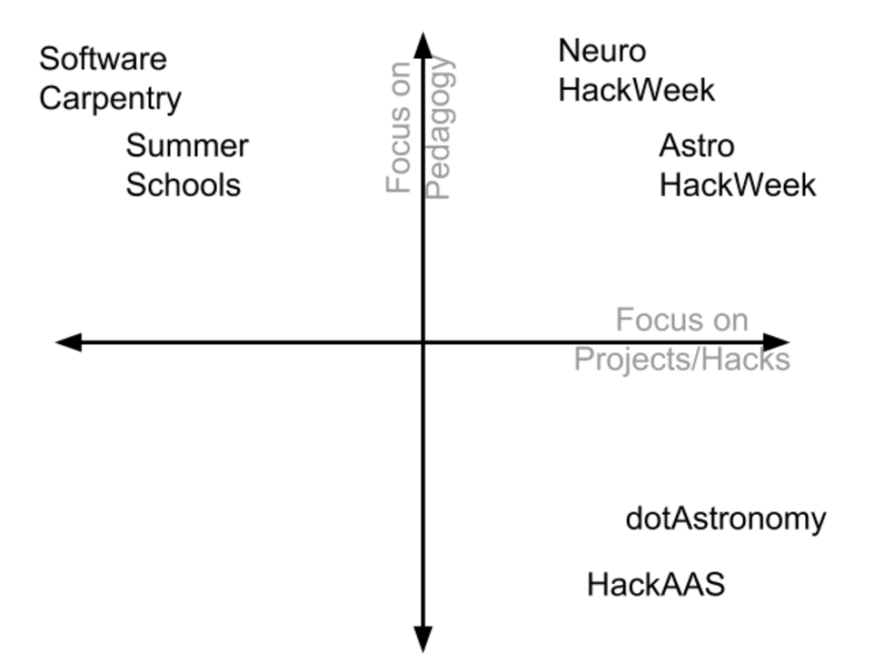
Hackweeks

Slide 10
Geo Hackweek 2016
50 participants
10 instructors
industry/academia/governement

Slide 11
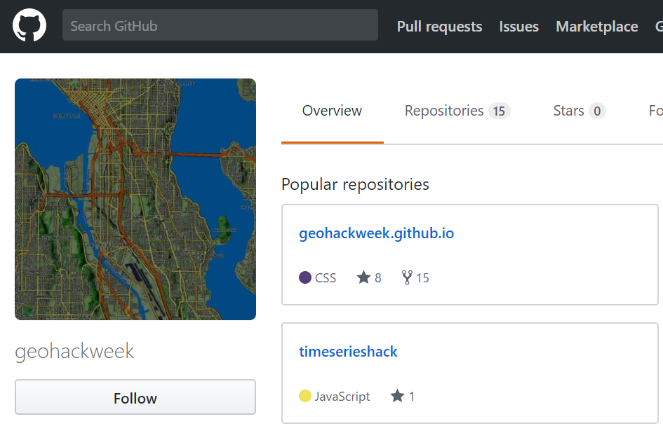
Introductory
Docker
Anaconda
Git and
Github

Slide 12
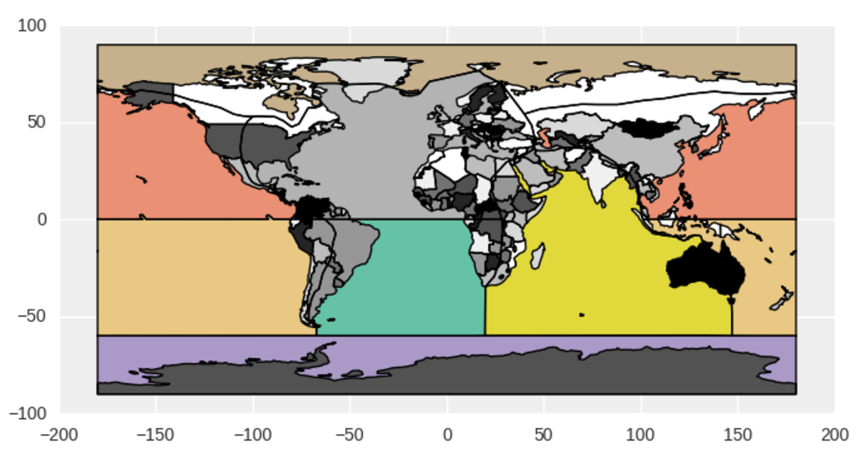
Vector Data
geometry
standards
GeoPandas

Slide 13
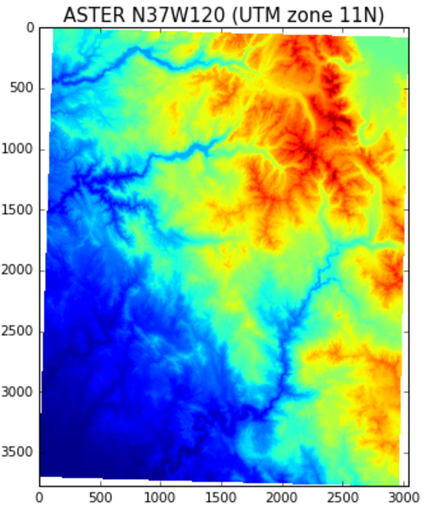
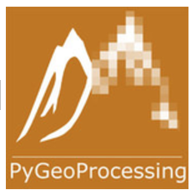
Raster

Slide 14
Multi-dimensional arrays
xarray

Slide 15
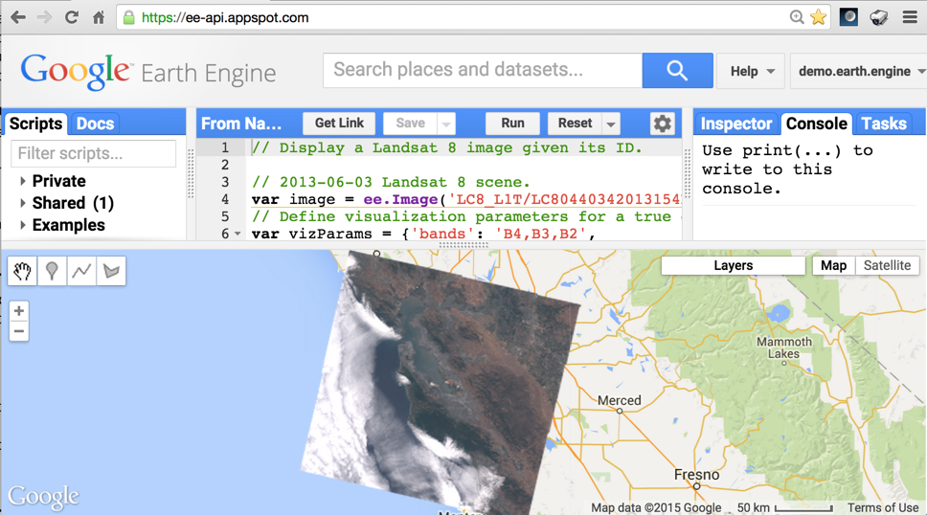
Google Earth Engine

Slide 16
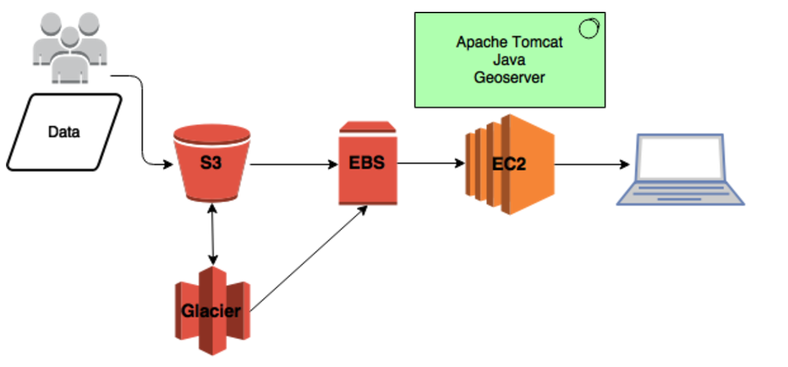
Cloud Computing

Slide 17
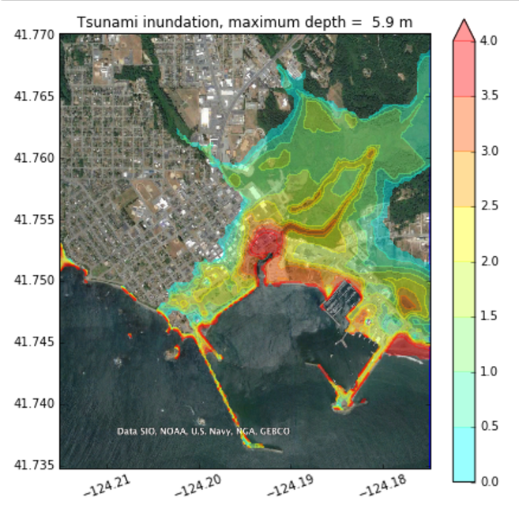
Visualization
matplotlib
cartopy
cesium

Slide 18
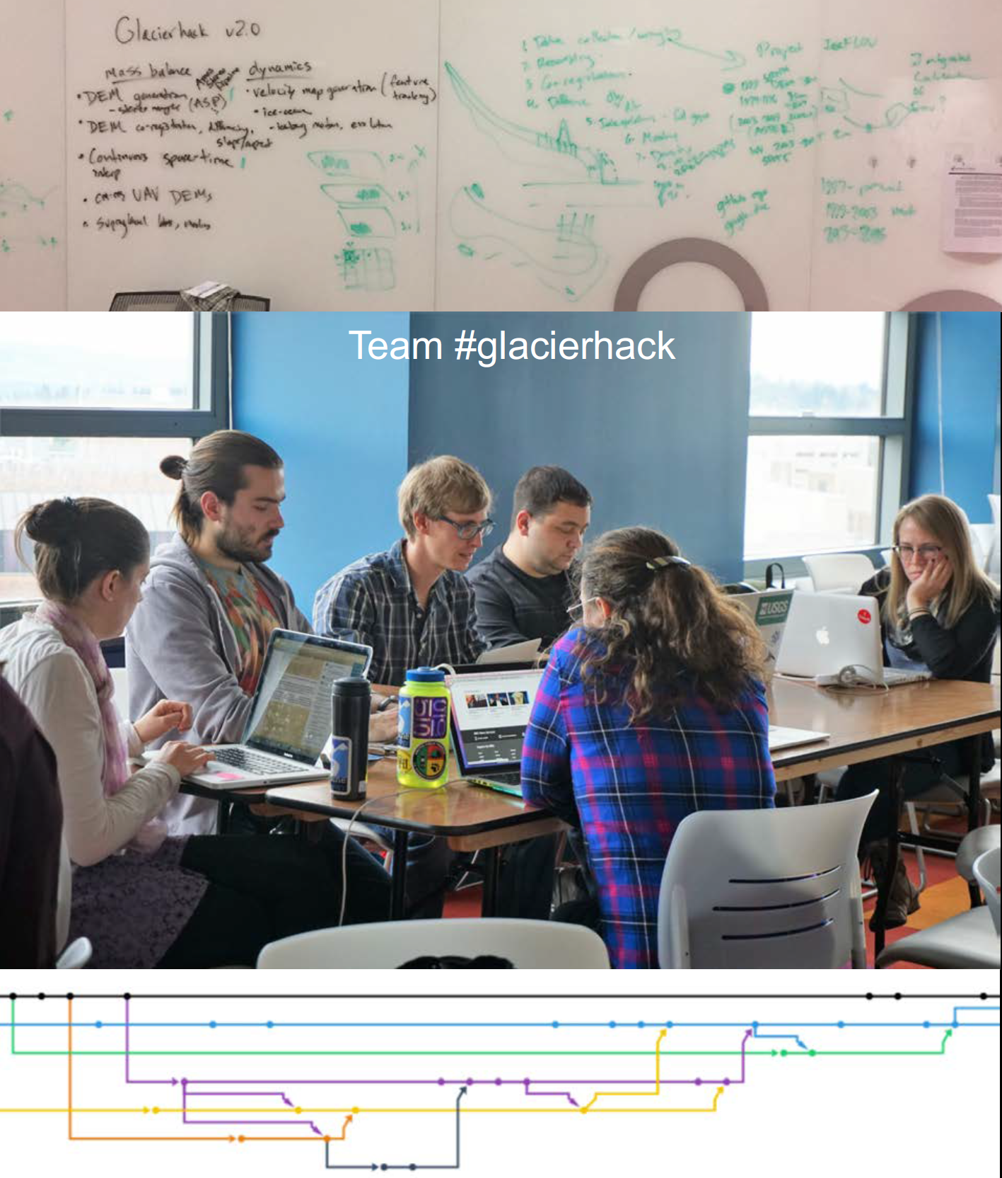
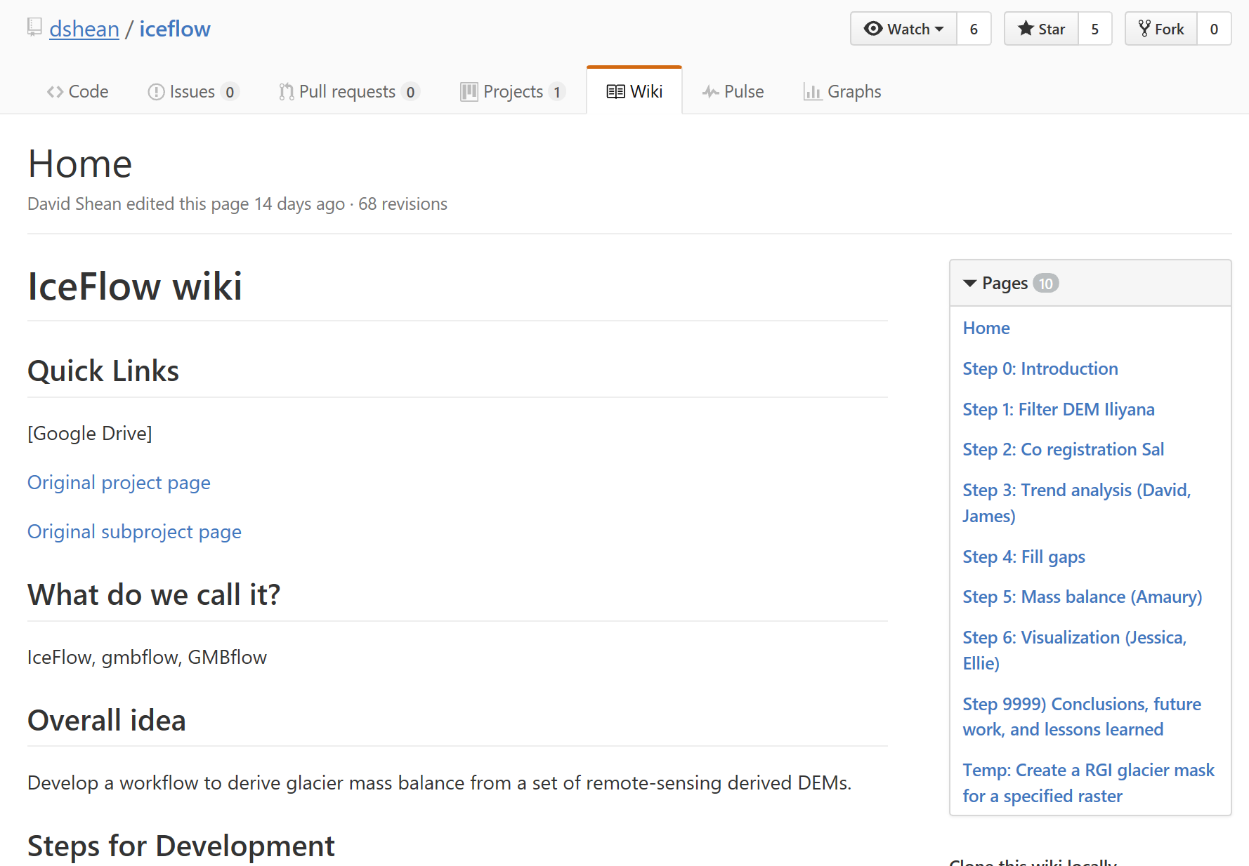
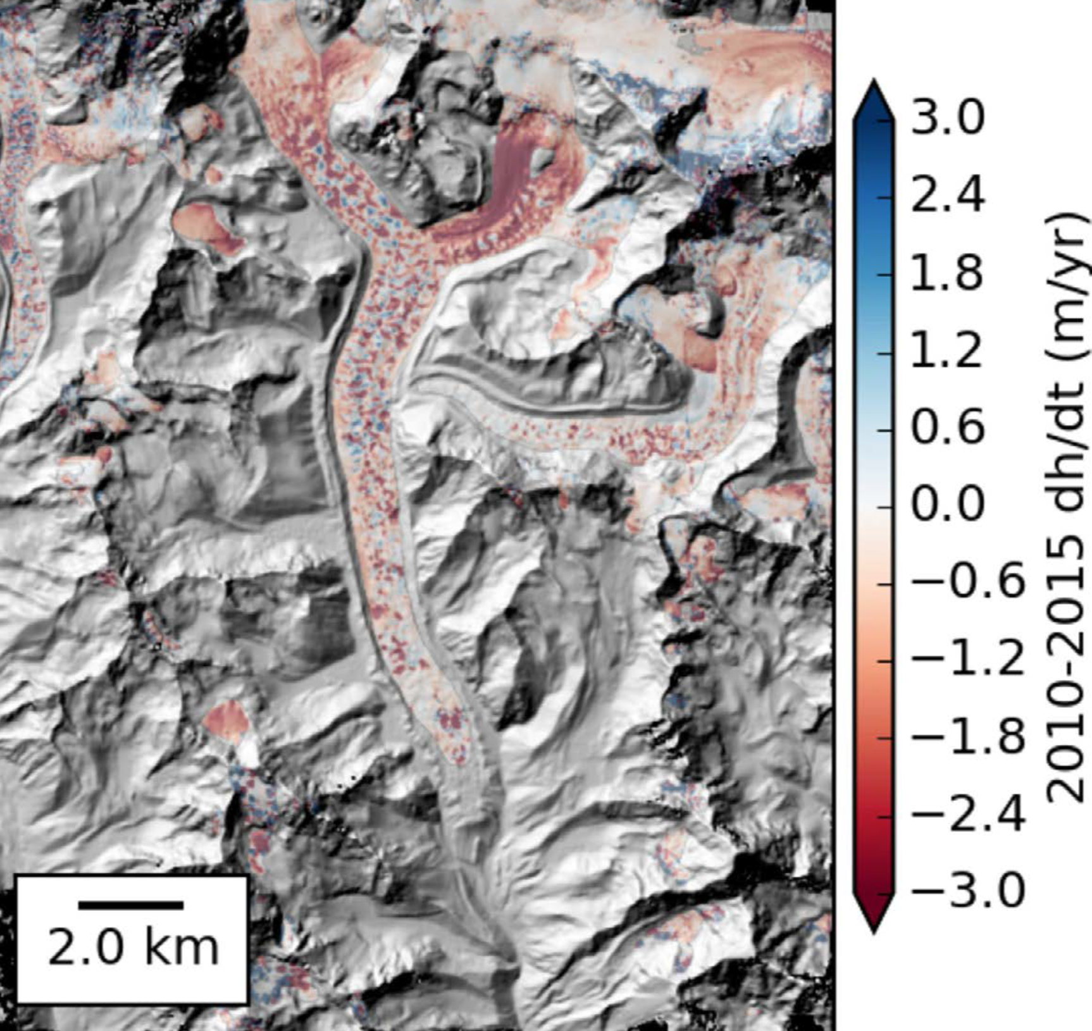
Projects

Slide 19
Projects

Slide 20
https://geohackweek.github.io/ghw2017

Slide 21
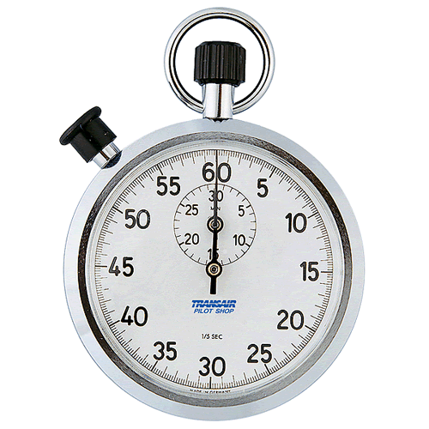
Anthony Arendt, eScience Institute
https://geohackweek.github.io/ghw2017
arendta@uw.edu
@aaarendt
aaarendt

