Slide 1
Farewell Victoria: Quantifying the Value of Foreign Names
Zhaowen Guo Chenyue Cao
Department of Political Science Evans School of Public Policy

Slide 2
Motivation

Slide 3
Motivation
In 2018, the government issued the “Notice from the Ministry of Civil Affairs and Five Other Departments on Disposing of and Rectifying Irregular Place Names”

Slide 4
Motivation
Place names do not only reflect the physical characteristics of a place, but also embody people’s relationship with their culture and their worldview (Cooper and Knotts, 2010)
Cultural patterns are encoded in place names
place names are shaped by nation-building efforts
place names are markers of regional identity and local culture

Slide 5
Motivation
Place names do not only reflect the physical characteristics of a place, but also embody people’s relationship with their culture and their worldview (Cooper and Knotts, 2010)
Cultural patterns are encoded in place names
place names are shaped by nation-building efforts
place names are markers of regional identity and local culture

Slide 6
Research question: what are the values of foreign names in China’s housing market?

Slide 7
Data and measures
Scraped ~900,000 records of residential dwellings constructed since the 1970s in China from a real estate broker’s website
Unit prices, names, locations, ratings, built years, and types of housing units
Scraped other housing units’ attributes and matched with the original data source
Floor area ratio, green space ratio, parking availability, and access to schools in the neighborhood
Constructed two geographic measures
Nighttime light brightness, and transport accessibility

Slide 8
GIS in our work
Measurement
Create buffers
Nighttime light brightness
Number of subway stations nearby
Analysis
Buffer analysis
Geographically weighted regressions

Slide 9
Identify foreign names
Dictionary-based approach
Flagged foreign names in government documents
Manual examination of ~6,000 random sample
Removal of false positives
Machine learning-based approach
Encode names as dense vectors using a pre-trained Chinese language model
Predict the probability of being a foreign name using a trained two-layer Feedforward Neural Network classifier

Slide 10
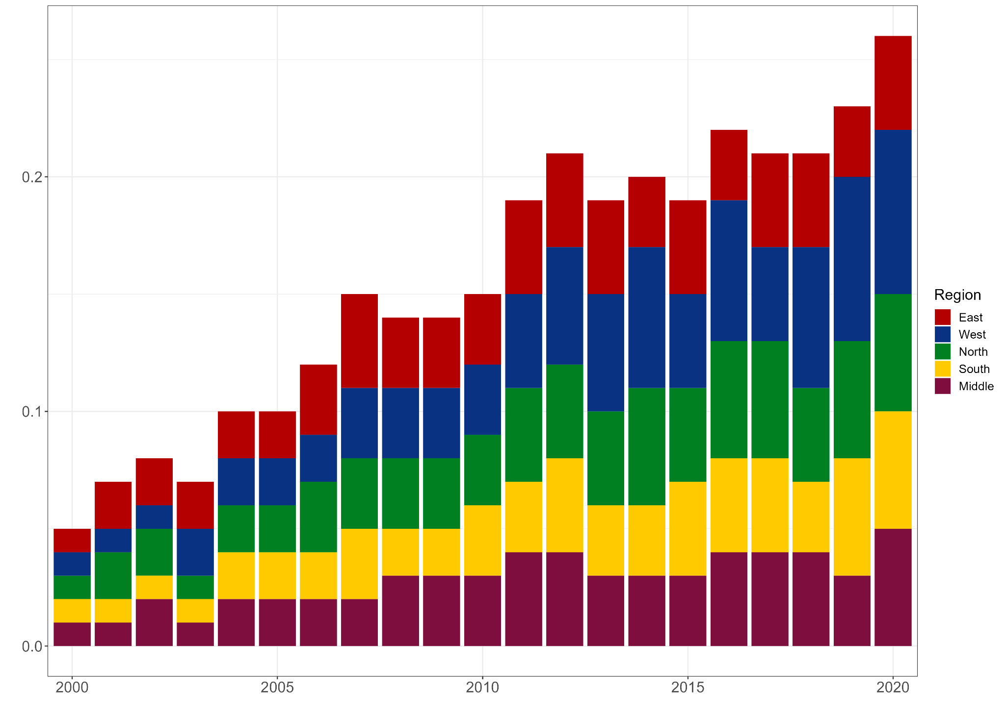
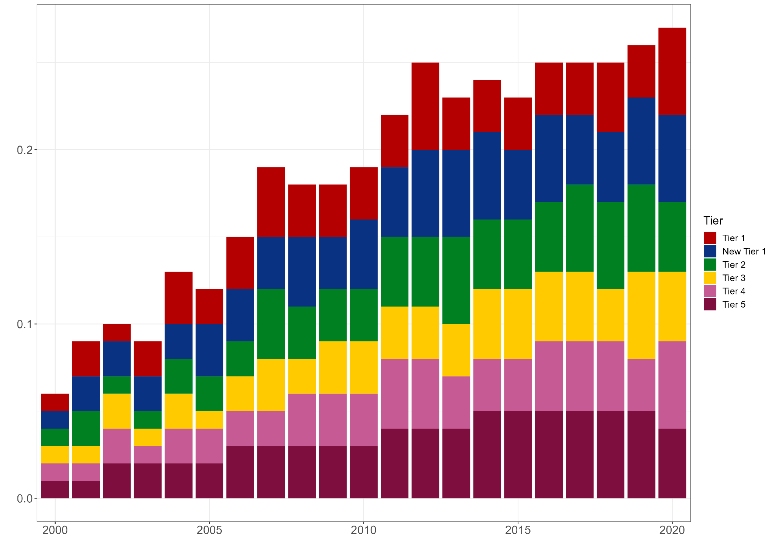
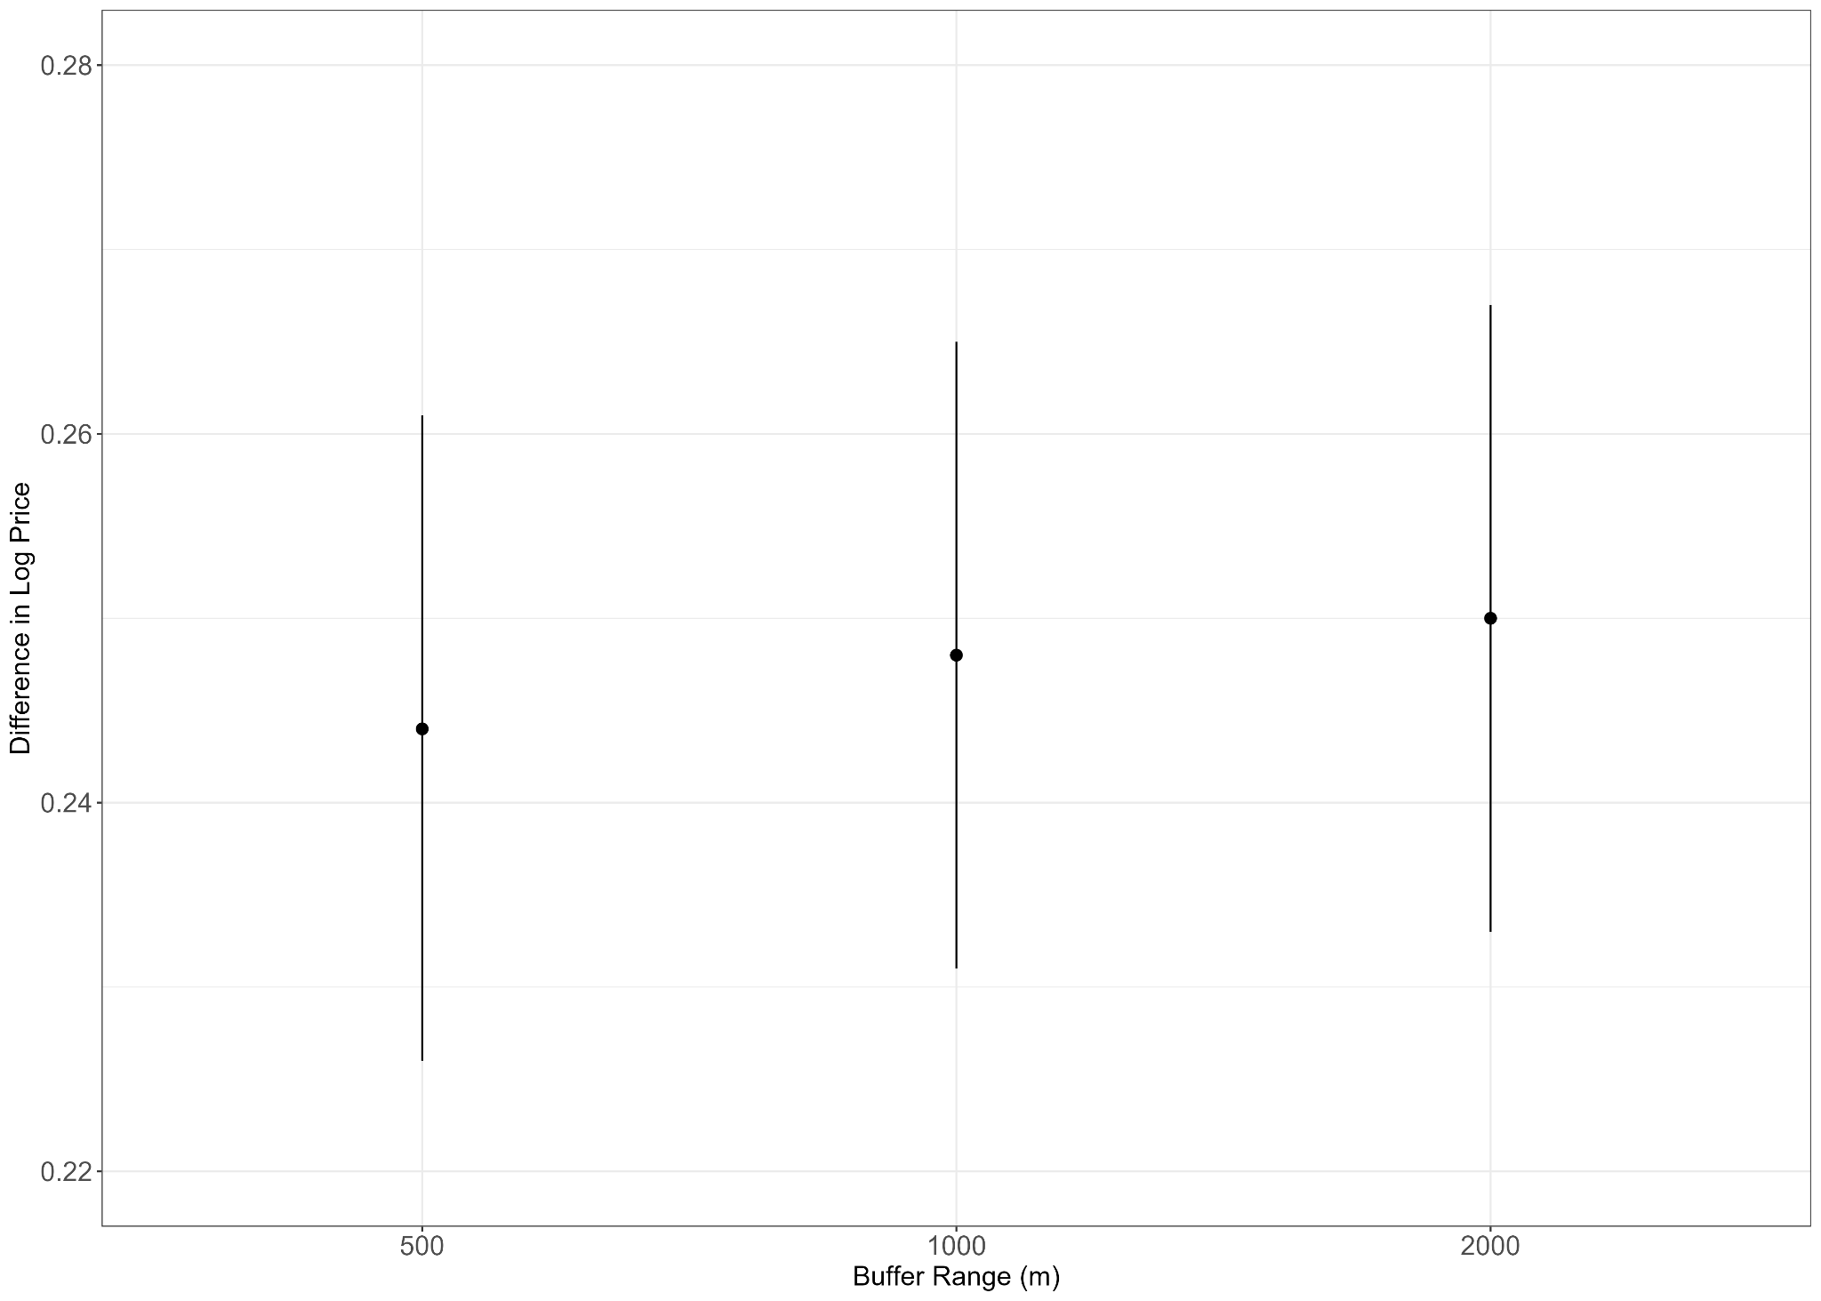
Descriptive patterns
The proportion of foreign-named residential complexes is increasing, especially in Western China and Tier-2 cities
Our buffer analyses indicate that foreign-named residential complexes command a price premium compared to those without within each buffering range

Slide 11
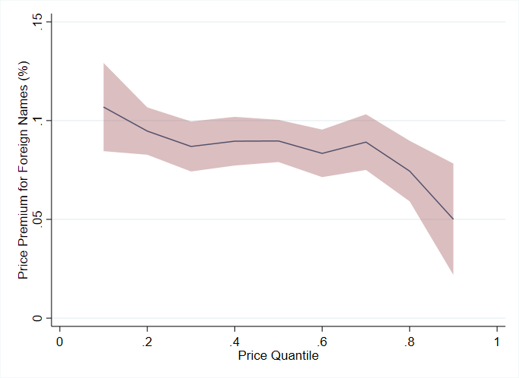
Findings
Foreign-named residential buildings command a 11% price premium compared to those without
The price premium is primarily driven by residential buildings excluding villas (别墅)
The price premium is the most significant in Western China
The price premium is the most significant for houses with lower prices

Slide 12
Conclusions
Gated communities with foreign names command a price premium of up to 11% compared to those without
Contrary to the prevailing notion that conspicuous consumption is mainly practiced by the wealthy (Zahirovic-Herbert and Chatterjee, 2011; Kim, 2019), the price premium associated with foreign names is mainly driven by buyers with lower socioeconomic status and those from underdeveloped areas

Slide 13
Q&A

