Slide 1
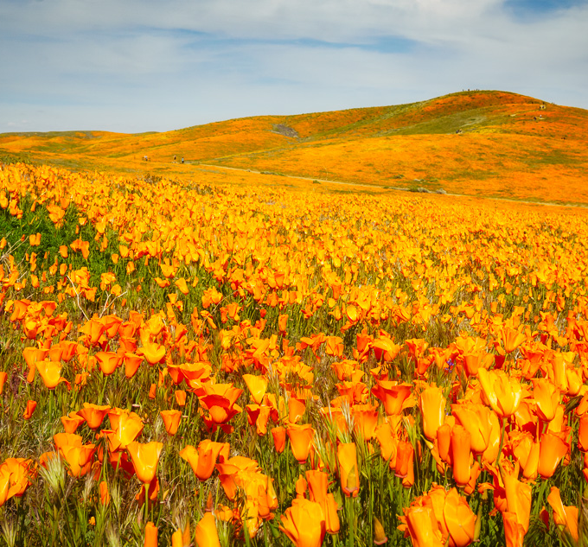
Monitoring EBI/GNDVI in the Antelope Valley California Poppy Reserve
UW GIS Symposium 2025
Jin Yeh
School of Environmental and Forest Sciences (SEFS)
Notes:
My project was on monitoring the Enhanced Bloom Index and the Green Normalized Difference Vegetation Index in California, specifically in the Antelope Valley California Poppy Reserve, which is part of the Mojave Desert region in southern California.

Slide 2
Motivation
Question: how does the phenology of the California poppy shift through time?
  Is there an increase or decrease in bloom intensity too?
Notes:
The question I wanted to investigate was how the phenology of the California poppy shifted in time from recent superbloom years (from 2019 to 2023), and whether there was an increase or decrease in bloom intensities as well.

Slide 3
Motivation
Question: how does the phenology of the California poppy shift through time?
  Is there an increase or decrease in bloom intensity too?
Background / interest:
  Related to MS thesis
  Limited data in wildflower phenology in extreme environments
Notes:
The reason why I’m interested in this is due to its relation to my Master’s project, where I aim to investigate how California poppy phenology might translate to an exoplanetary setting similar to the Mojave Desert.
A large knowledge gap in wildflower phenology is that there is limited data on phenology specifically in extreme environments, but wildflowers ecosystems in these environments are rare and especially sensitive to climate variability, so more data is imperative to understanding wildflower phenology.

Slide 4
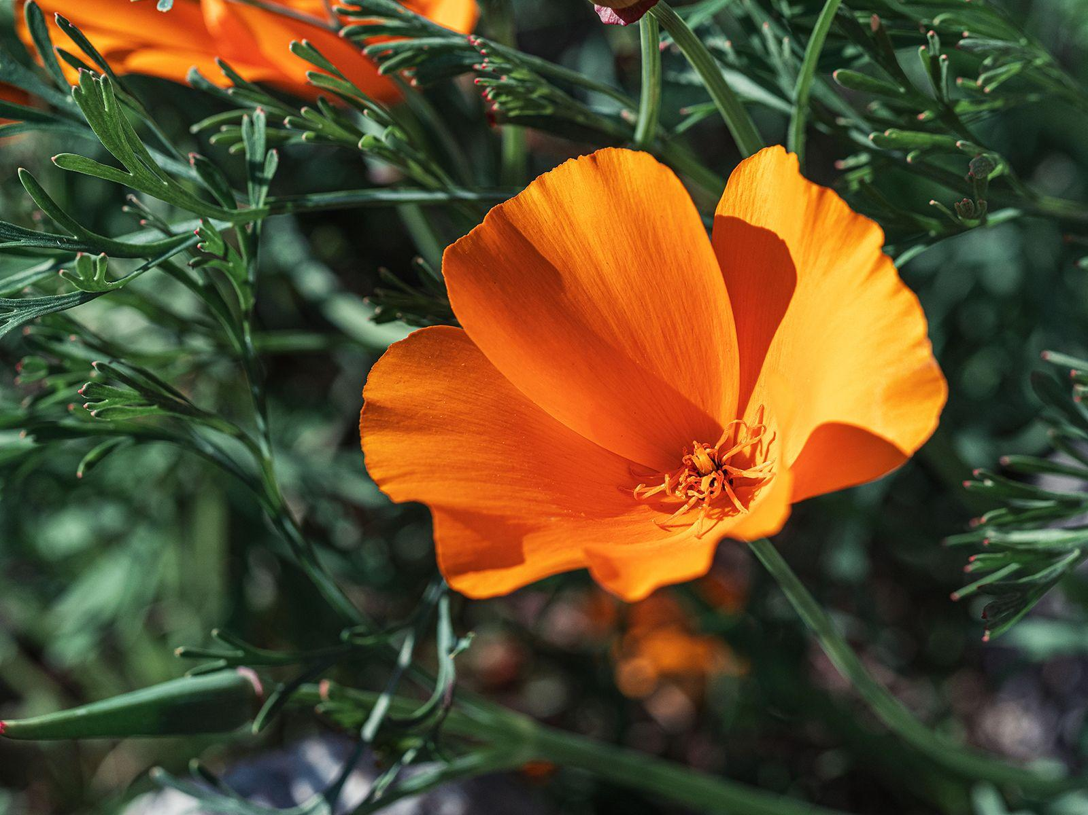
Motivation
California poppy
  Model organism
  Bright petals and dark foliage
  Landscape-scale growth
Notes:
I chose to monitor the California poppy not only because it’s a model organism that acts as a representative plant for broader fundamental plant functions, but that its bright orange petals, dark green foliage, and landscape-scale blooms make detection and observation using space-borne imagery feasible.
It is also a plant with medicinal purposes, which provides an opportunity to explore how small plants with multifunctional roles can be used in space-based agriculture and sustainability.

Slide 5
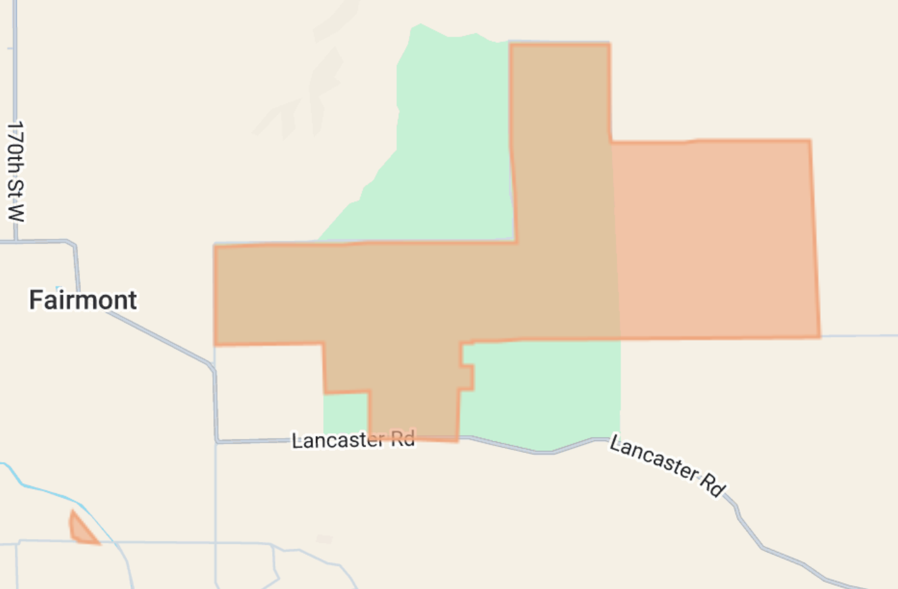
Motivation
California poppy
  Model organism
  Bright petals and dark foliage
  Landscape-scale growth
Antelope Valley California Poppy Reserve
  High desert climate
  Arid conditions and limited water
  Trends towards warming climate
Notes:
The Antelope Valley California Poppy Reserve is the area of interest for a number of reasons. As part of the Mojave Desert, it’s classified as a high desert environment, with extremely arid conditions and limited water availability. This region is also trending towards even warmer climates.
The Mojave Desert is also a well-known analog site for exoplanetary terrestrial processes, which pairs well with the California poppy for my graduate research.

Slide 6
Workflow
Collect data
Data source: PlanetScope
  Planet Explorer: order images
  Planet API: upload directly into GEE image collection
Calculate EBI
Enhanced Bloom Index
Calculate GNDVI
Green Normalized Difference Vegetation Index
Notes:
Since the poppy reserve is around 7.2 square kilometers, I selected data from PlanetScope’s 3-meter resolution surface reflectance product, and filtering those results for standard image quality, 100% area coverage, and less than 5% cloud coverage.
Google Earth Engine was then used to analyze the data, repeating the process for each year.

Slide 7
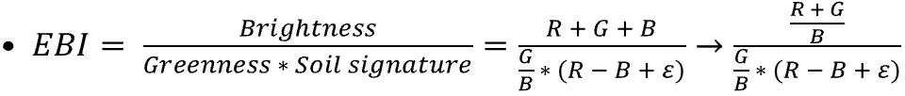
Workflow
Collect data
Data source: PlanetScope
  Planet Explorer: order images
  Planet API: upload directly into GEE image collection
Calculate EBI
Enhanced Bloom Index
Calculate GNDVI
Green Normalized Difference Vegetation Index
Notes:
Next, I calculated the Enhanced Bloom Index, which is a quantitative measurement of bloom intensity. EBI is calculated using the ratio of petal brightness to the product of leaf greenness and soil signature, and is customizable to the color of the petal. In my project, I adjusted this formula to detect orange petals, using the sum of red and green values and dividing them by blue values to minimizing blue signatures.

Slide 8

Workflow
Collect data
Data source: PlanetScope
  Planet Explorer: order images
  Planet API: upload directly into GEE image collection
Calculate EBI
Enhanced Bloom Index
Calculate GNDVI
Green Normalized Difference Vegetation Index
Notes:
And I calculated the Green Normalized Difference Vegetation Index to compare both whether if there was a correlation between bloom and greenness, and whether vegetation indices in general are able to pick out the bloom signatures that are unique only to the petals.

Slide 9
Workflow
Create composite images
Average bloom values
  Compare mean composites for each year
  True color, EBI, GNDVI
Create time series
EBI + GNDVI
  Identify phenological events
  Particularly: peak bloom dates and periods
Detect change
Time-lapse animations
  Create animations of EBI through time
Notes:
I also created mean composite images for each year, for the true color, EBI, and GNDVI images, to see if there was a visual difference in bloom intensities over the five years.

Slide 10
Workflow
Create composite images
Average bloom values
  Compare mean composites for each year
  True color, EBI, GNDVI
Create time series
EBI + GNDVI
  Identify phenological events
  Particularly: peak bloom dates and periods
Detect change
Time-lapse animations
  Create animations of EBI through time
Notes:
Next, I created time-series charts for EBI and GNDVI to identify phenological events. Specifically for this project, I was interested in looking at the shifts in peak bloom dates and bloom periods.

Slide 11
Workflow
Create composite images
Average bloom values
  Compare mean composites for each year
  True color, EBI, GNDVI
Create time series
EBI + GNDVI
  Identify phenological events
  Particularly: peak bloom dates and periods
Detect change
Time-lapse animations
  Create animations of EBI through time
Notes:
And lastly as a bonus, I created some time-lapse animations for each year to see a change in EBI through each image of the collection for each year.

Slide 12
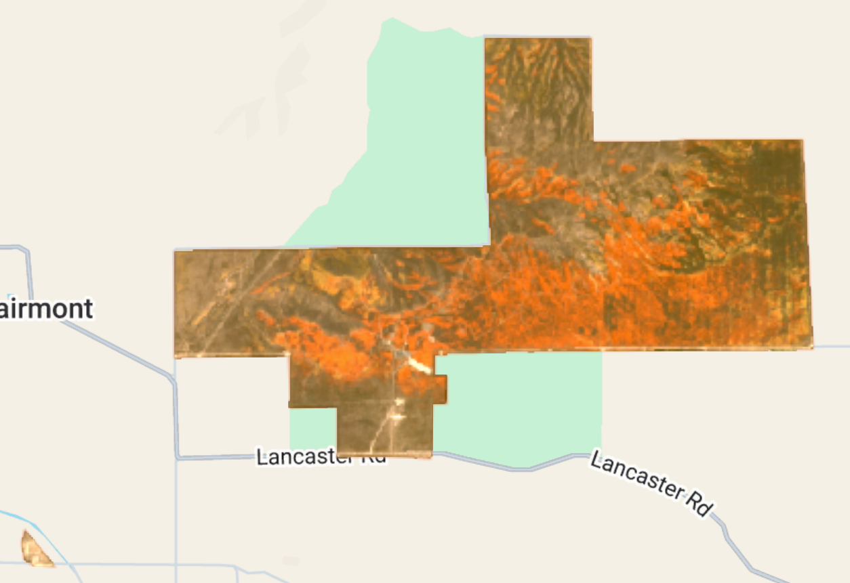
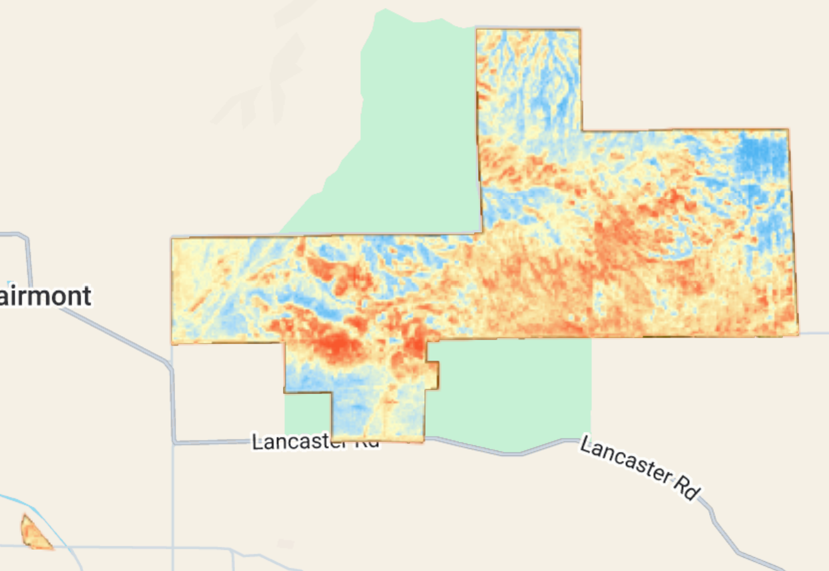
March 31, 2019
Figure 1. true color Planet image of Antelope Valley California Poppy Reserve; Red: B3, Green: B2, Blue: B1.
Figure 2. Calculated EBI image of Antelope Valley California Poppy Reserve; values range 0-1; Red = high bloom intensity, Blue = low bloom intensity.
Notes:
This was one example of the images that I wanted to highlight. From using Planet Explorer, the peak bloom date (visually) for 2019 was March 31, and here you can see the comparison between the true color image on the left of the poppy blooms and the EBI image on the right.
The blues indicate areas with low bloom intensities, and the reds and oranges indicate areas with high bloom intensities. And as you can see, EBI did relatively well in detecting only the areas with poppy blooms, and EBI values ranged from about 0.23 to 0.64.

Slide 13
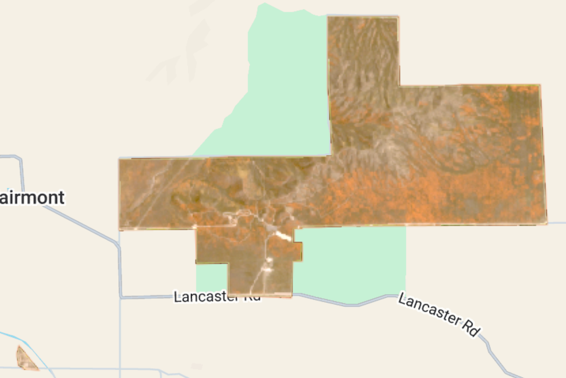
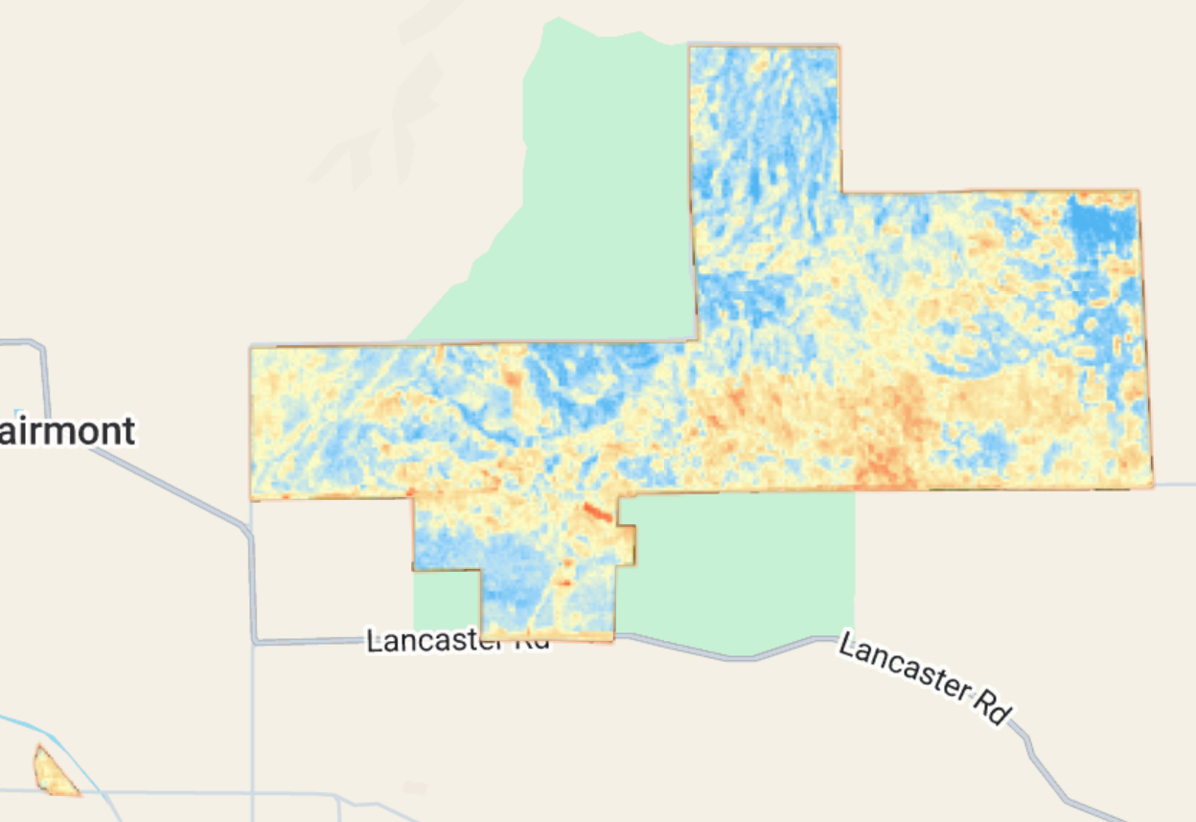
April 15, 2020
Figure 3. true color Planet image of Antelope Valley California Poppy Reserve; Red: B3, Green: B2, Blue: B1.
Figure 4. Calculated EBI image of Antelope Valley California Poppy Reserve; values range 0-1; Red = high bloom intensity, Blue = low bloom intensity.
Notes:
In 2020, the peak bloom date visually using Planet Explorer was April 15. And it appeared that the blooms in 2020 was noticeably less intense than those in 2019, and about two weeks later. The EBI range for 2020 was around 0.25 to 0.58. So while the low value of EBI remained similar to 2019, the high value was relatively lower, quantitatively indicating a lower bloom intensity for 2020.

Slide 14
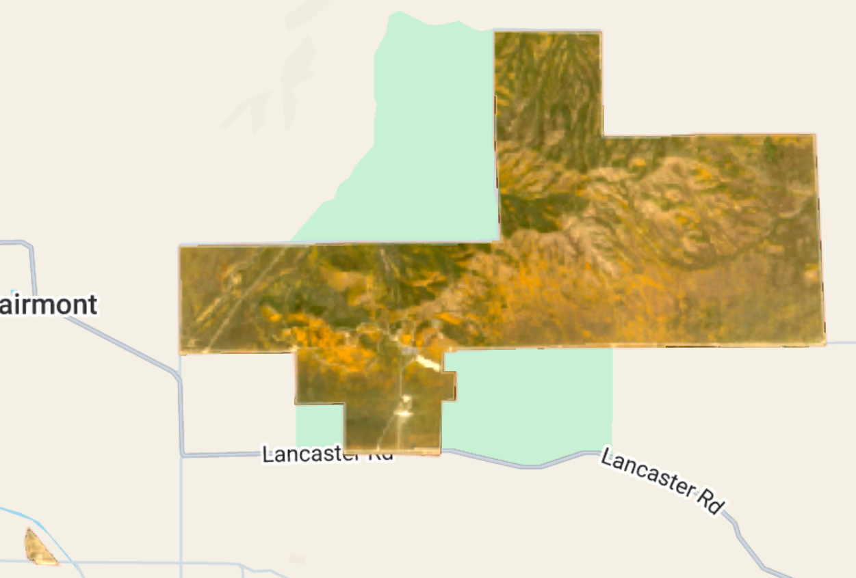
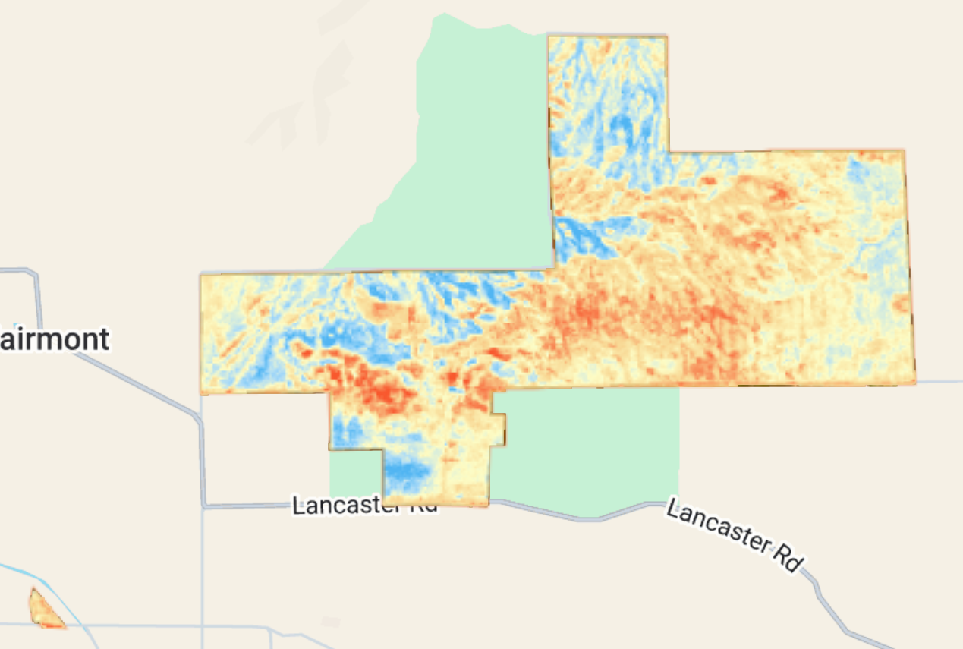
March 23, 2022
Figure 5. true color Planet image of Antelope Valley California Poppy Reserve; Red: B3, Green: B2, Blue: B1.
Figure 6. Calculated EBI image of Antelope Valley California Poppy Reserve; values range 0-1; Red = high bloom intensity, Blue = low bloom intensity.
Notes:
For 2022, the peak bloom date appeared to be March 23, and the intensity visually looked to be similar to that from 2019. EBI values for 2022 ranged from about 0.24 to 0.48, which was surprising to me, because while the blooms looked to be more intense in this year than 2020, the high value of EBI was lower. This might be explained by the hue of the poppy bloom, with the blooms for 2022 being more yellow in color than previous years.

Slide 15
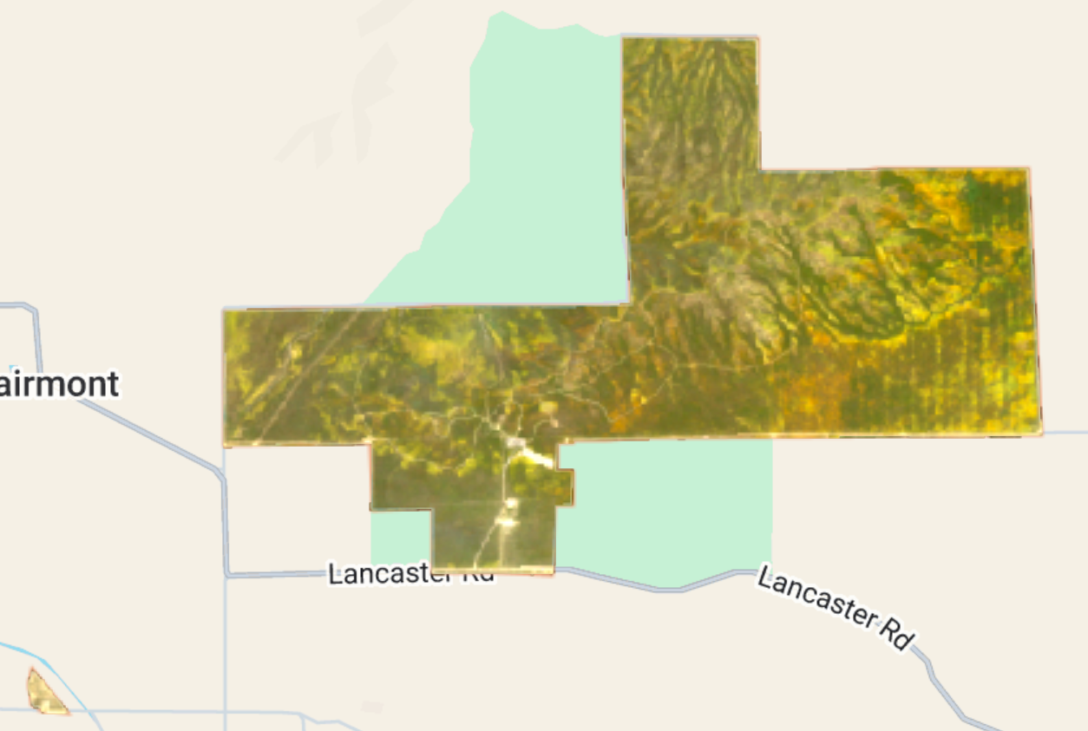
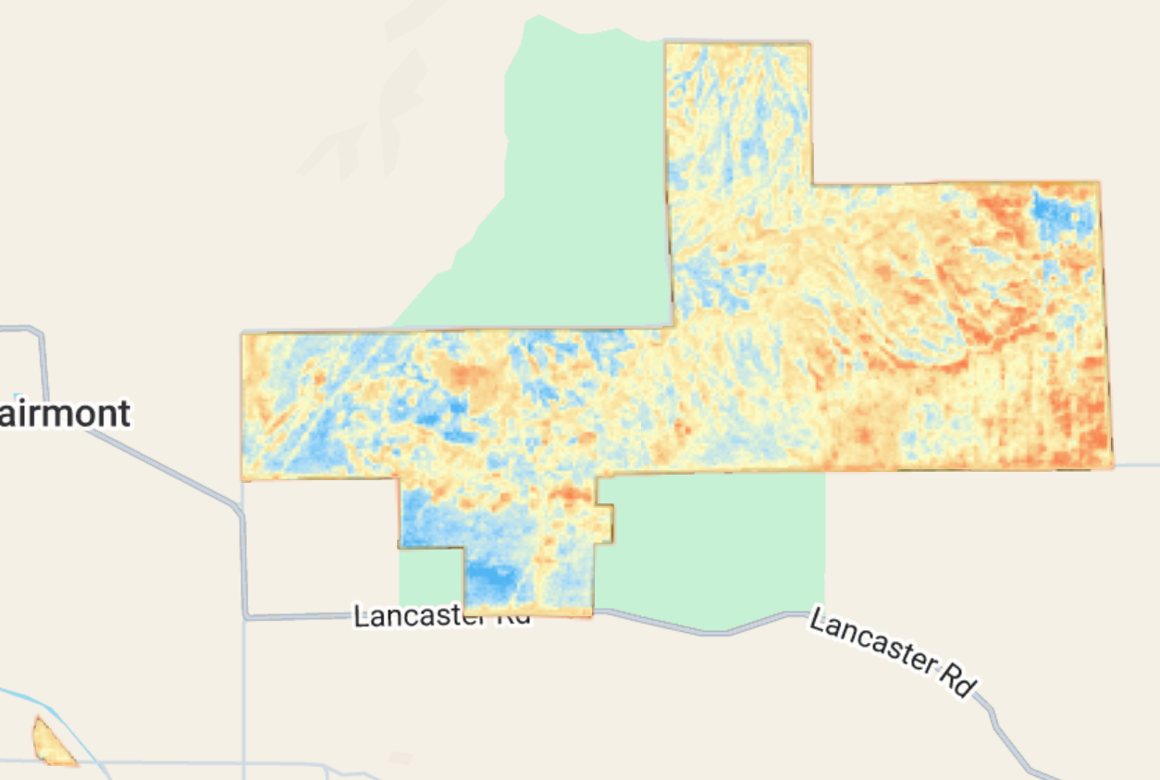
April 10, 2023
Figure 7. true color Planet image of Antelope Valley California Poppy Reserve; Red: B3, Green: B2, Blue: B1.
Figure 8. Calculated EBI image of Antelope Valley California Poppy Reserve; values range 0-1; Red = high bloom intensity, Blue = low bloom intensity.
Notes:
Here you can see another example, from 2023, where EBI can pick out more of the subtle blooms in the midst of all the greenness around the reserve.

Slide 16
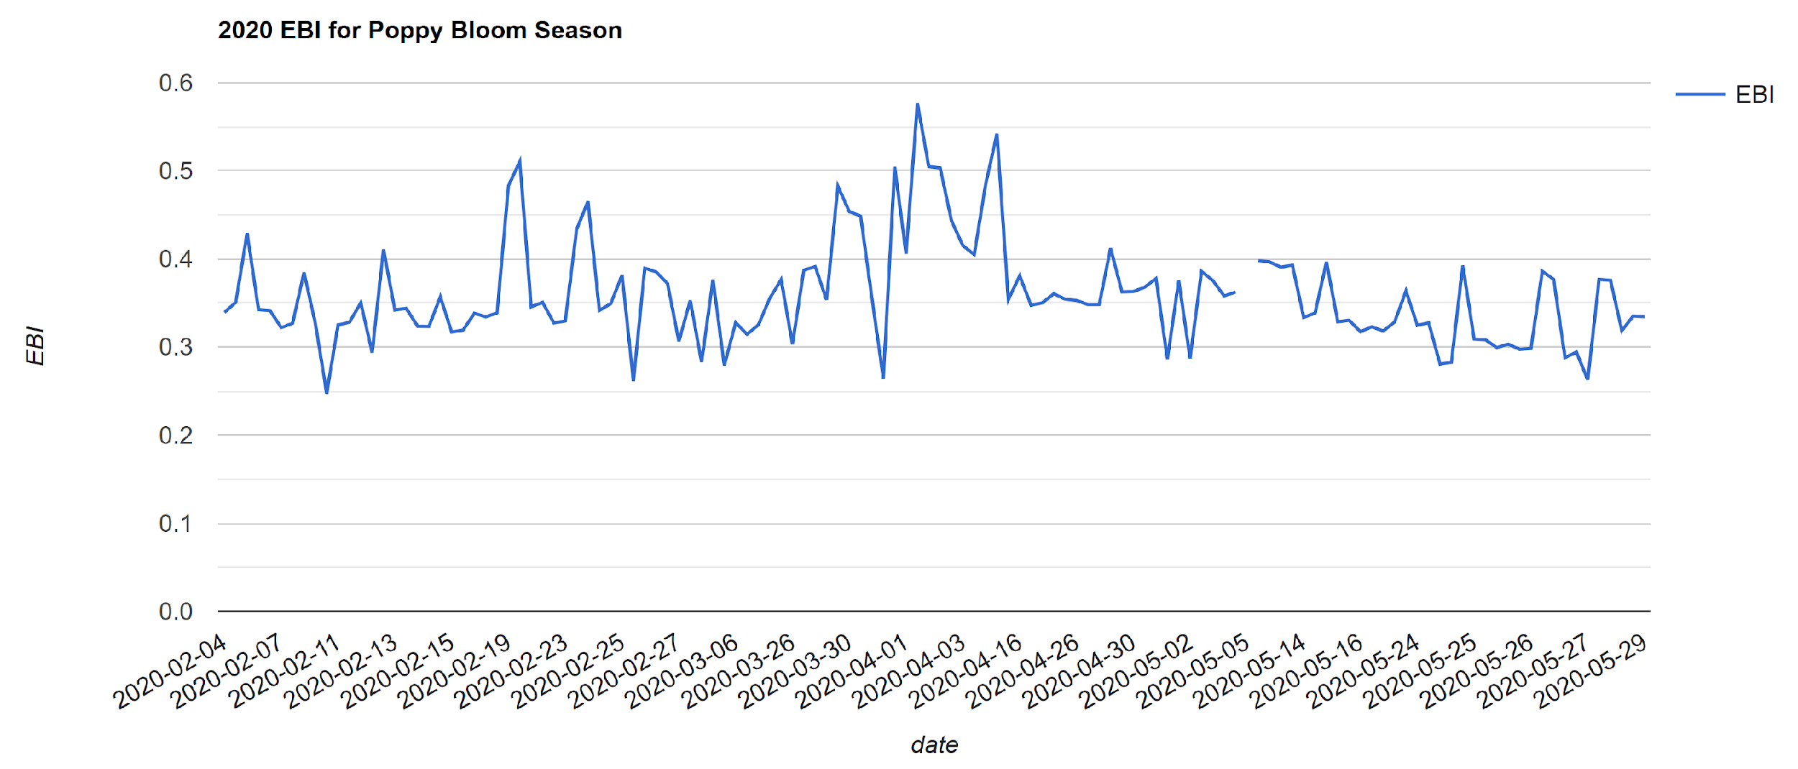
Results - 2020
Figure 9. EBI time series for the 2020 poppy bloom season using Planet imagery. Peak bloom date occurred in early- to mid-April; period of bloom occurred from end of March to end of April.
Notes:
I also wanted to highlight the time series generated for the 2020 bloom season, because it was the season that matched up the closest to what I visually saw using Planet Explorer. And as you can see, the peak bloom date occurred in early- to mid-April, and the period of bloom occurred from the end of March to the end of April. And while EBI was relatively good at picking out the petal signature of the California poppy, it also seemed to pick up general background noise, which is seen by the general baseline of the time series curve remaining at around an EBI value of 0.35.

Slide 17
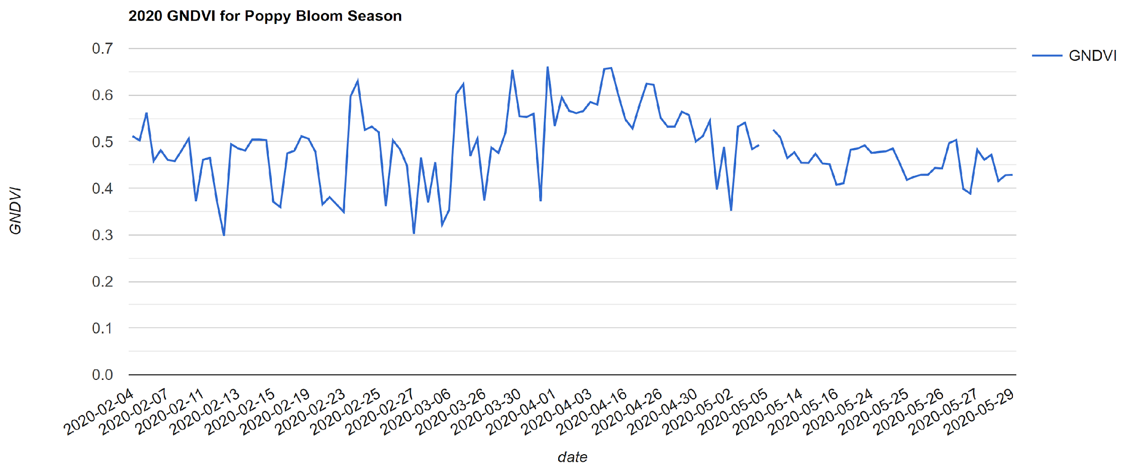
Results - 2020
Figure 10. GNDVI time series for the 2020 poppy bloom season using Planet imagery. Peak greenness date occurred in early- to mid-April; period of greenness occurred from start of March to start of May.
Notes:
The GNDVI time series for 2020 was slightly different. While the peak greenness date coincided with the peak bloom date, the period of greenness lasted longer than the period of blooming. This was also generally the case with what I saw of the other years, that the peak greenness date was similar to the peak bloom date, but that the period of greenness lasted longer than the period of flowering.

Slide 18
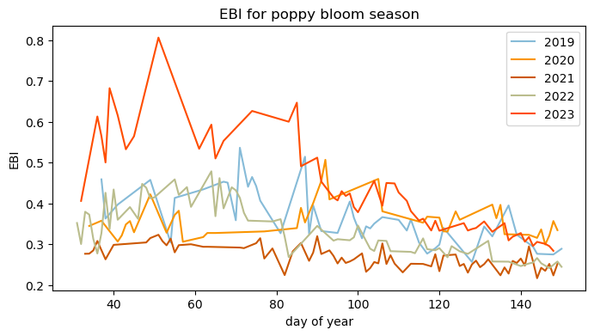
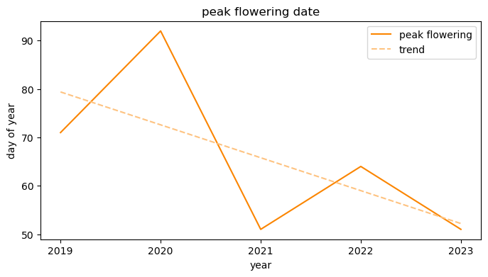
Discussion
Results:
  General early shift in peak bloom date
  No trend in intensity increase or decrease
Figures 3, 4. (Top) EBI time series for 2019-2023 poppy bloom seasons using Planet imagery. (Bottom) Peak bloom dates displayed an overall trend of earlier peak bloom dates.
Notes:
To summarize, based on the time series charts, while there was no general trend in bloom intensity through the years (seen on the top right), there seemed to be a shift of peak bloom date to earlier in the flowering season (seen on the bottom right).

Slide 19
Discussion
Results:
  General early shift in peak bloom date
  No trend in intensity increase or decrease
What worked / what did not work:
  EBI captured specific floral bloom than GNDVI
  Peak bloom date and period was able to be determined
    Within an error of ~2 weeks
  Additional noise captured
Figures 3, 4. (Top) EBI time series for 2019-2023 poppy bloom seasons using Planet imagery. (Bottom) Peak bloom dates displayed an overall trend of earlier peak bloom dates.
Notes:
I noticed that EBI captured the floral bloom in areas where GNDVI did not, and that while their peak dates coincided, GNDVI was relatively less accurate in determining flowering periods.
Besides 2020, the other years of interest were around 2 weeks varied between the peak bloom date detected in the time series and the peak bloom date visually picked out using Planet Explorer. But a 2-week error is also around the general average for most phenology models as well.
This might be due to additional noise that was captured, such as the red desert hue that was present in some (but not all) images.

Slide 20
Next Steps
Further noise reduction
Input more data
Ground-truth imagery
Notes:
In the future, I would want to reduce the background noise that EBI might also detect, which could coincide with picking out the orange poppy blooms and skew the detection of peak bloom dates. This would also mean further exploring the customizations for the Enhanced Bloom Index.
I would also like to add more data to the pipeline, to see whether the trend I found holds true for further years in the past, and to ground truth the data with maybe some herbarium and phenology network datasets as well.

Slide 21
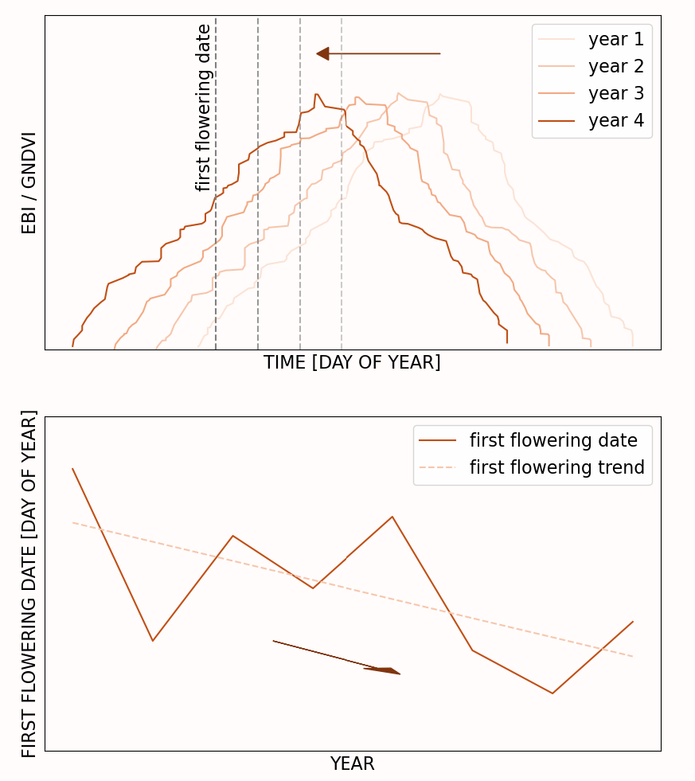
Next Steps
Further noise reduction
Input more data
Ground-truth imagery
Collect data on environmental conditions
Generate a phenological model for bloom events
Forecast future bloom dates (+ climate projections)
  Climate variability on Earth
  Analog site for exoplanets
Figure 5. Conceptualized phenology model using EBI/GNDVI (top) and predicting first flowering dates (bottom). Climate and planetary climate projections will be used as parameter inputs.
Notes:
Next steps for this project would be collecting environmental data, as I am interested in seeing how climate stressors affect the phenology of the California poppy, and creating a phenology model that can predict phenological events.
And lastly, to take it even further, I am interested in forecasting future bloom dates using climate projections. Since I am interested in the astrobiological implications of plant phenology, I am considering both climate projections in the Mojave Desert and that of exoplanets.
Thank you for listening.

