Slide 1
Powering the Last Mile:
Distributed, Solar-based & Equitable Charging for
Electric Three Wheelers in West Bengal, India
Ahana Mukherjee
May 20, 2025
UW GIS Symposium
UNIVERSITY OF WASHINGTON
Department of Electrical & Computer Engineering
‹#›
Notes:
I’d like to spend some time today discussing the use of geospatial analysis to identify priority locations for siting charging infrastructure for E3Ws as the means to enhance their first and last mile services in West Bengal, India.

Slide 2
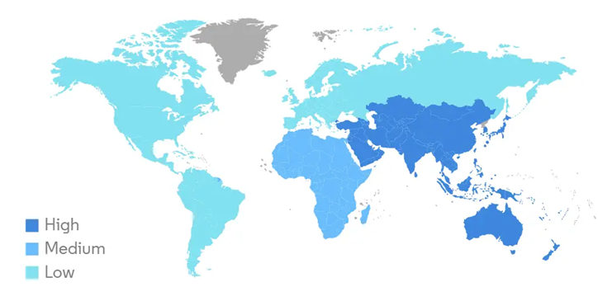
Three-Wheeler Market Proliferation
Electric Three Wheelers serve as the low hanging fruit in EV adoption
Electric Three-Wheeler Market Growth Rate (2020—2025)
157 2/3Ws per 1000 people
in India
Source: IEA Global EV Outlook 2024
580,000 E3W
sales in 2023 in India
Source: IEA Global EV Outlook 2024
70% E3W penetration
in West Bengal 2024
Source: Mordor Intelligence
Source: Center for Energy Finance
UNIVERSITY OF WASHINGTON
Department of Electrical & Computer Engineering
INTRODUCTION & BACKGROUND
Notes:
Electric three wheelers serve as a crucial bridge between private and public mobility modes. These vehicles are demand responsive and cost-competitive modes of transport that provide first- and last-mile connectivity to various socioeconomic groups. Three wheelers exist globally yet their prominence is concentrated in Southeast Asia. Moreover, the electric three wheeler market represents one of the most electrified transport sectors globally with India leading the global market with 580,000 E3W vehicle sales in 2023. Due to their low power requirements and cost effective nature, E3Ws serve as the low hanging fruit in electric vehicle adoption specifically in India.
These vehicles are experiencing rapid adoption in the state of West Bengal in India due to policy support and fiscal incentives aimed at spurring the transition to electric vehicles. Current charging practices for these vehicles are dependent on grid-tied electricity which not only poses a financial burden on low-income vehicle operators due to high electricity tariffs but has the potential to have future impacts on the grid due to creating peak demand challenges as the fleet size increases. Moreover, charging infrastructure for electric three wheelers remains limited in scope, reach, and accessibility and inhibits these fleets from increasing their spatial coverage and serving a broader range of customers. This study evaluates the techno-economic feasibility of implementing a distributed network of photovoltaic-based, grid-independent charging stations to facilitate battery swapping for electric three wheelers as the means to reduce operational costs while proposing priority locations for charging infrastructure deployment as the means to enhance mobility coverage to ensure a sustainable and inclusive transition to electrified transportation.

Slide 3
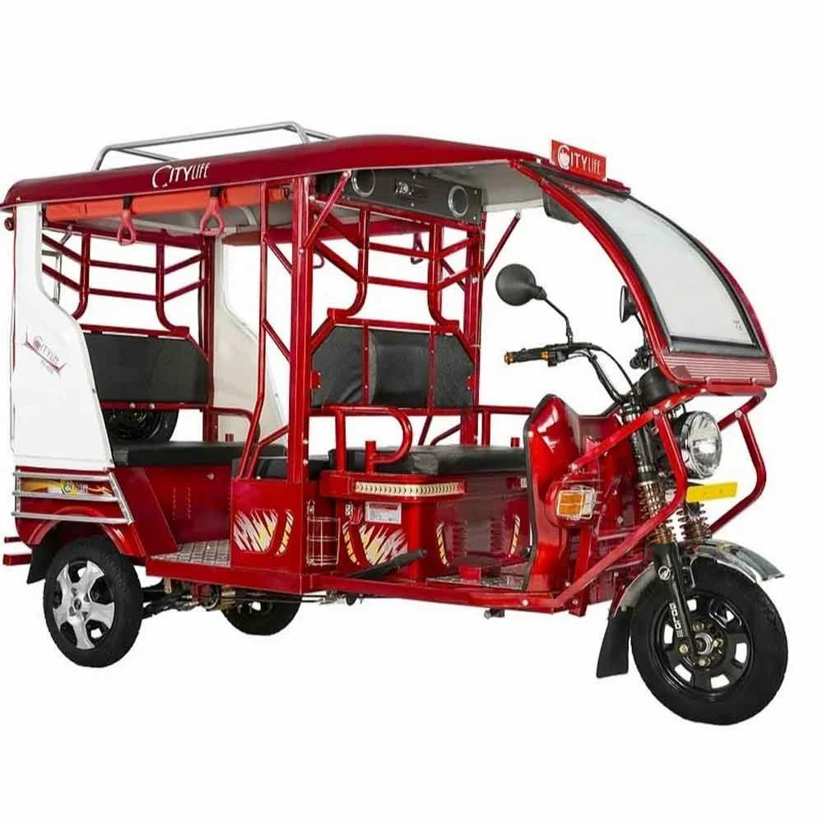
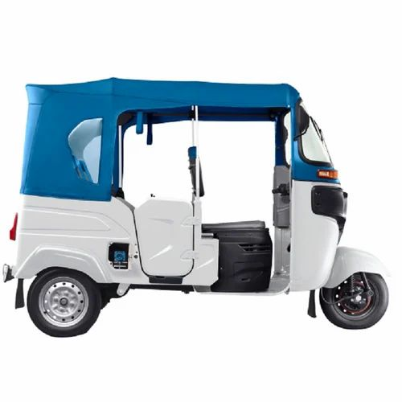
Three-Wheeler Vehicle Fleets
E-Rickshaw
  (4) Lead-acid battery
  Flexible routes, typically not on major arterial roads
  Short distance travel, enforced vehicular speed limit
  Informal operations
Autorickshaw (E-Auto)
  (1) Lithium-ion battery
  Fixed routes with passengers embarking/disembarking along the route
  Medium distance travel, no enforced speed limit
  Formal operations
UNIVERSITY OF WASHINGTON
Department of Electrical & Computer Engineering
INTRODUCTION & BACKGROUND
Notes:
There are two types of vehicles that exist amongst the three wheeler fleet: the e-rickshaw which is a lower tier vehicle typically operating on lead-acid batteries and primarily on flexible routes with feeder services while the electric autorickshaw operates on lithium-ion batteries with fixed routes set by the local transportation authorities.

Slide 4
Research Objectives
Determine the techno-economic feasibility of implementing a network of photovoltaic-based, grid-independent battery charging stations for electric three wheelers
Identify priority locations for the charging infrastructure to provide affordable mobility solutions that enhance connectivity and bridge service gaps in underserved regions.
UNIVERSITY OF WASHINGTON
Department of Electrical & Computer Engineering
INTRODUCTION & BACKGROUND
Notes:
The second research objective will be discussed in this talk.

Slide 5
Model & Analysis
Input
Model / Algorithm
Intermediate Output
Output
Solar Resource
PV System Size
Battery Specifications
Battery SoC
Charging Module
Number of 3Ws Served
Priority Sites
Number of Charging Stations
Siting Module
CAPEX
OPEX
Investment Subsidy
Economics Module
Max Number of Charging Stations
Net Present Value
Internal Rate of Return
Levelized Cost of Energy
Operator Net Profit
Relative Wealth Index
Distance to Train
Long Distance Walking
E3W Vehicle Registrations
Policy Investment Size
UNIVERSITY OF WASHINGTON
Department of Electrical & Computer Engineering
METHODS

Slide 6
Model & Analysis
Input
Model / Algorithm
Intermediate Output
Output
Solar Resource
PV System Size
Battery Specifications
Battery SoC
Charging Module
Number of 3Ws Served
Priority Sites
Number of Charging Stations
Siting Module
CAPEX
OPEX
Investment Subsidy
Economics Module
Max Number of Charging Stations
Net Present Value
Internal Rate of Return
Levelized Cost of Energy
Operator Net Profit
Relative Wealth Index
Distance to Train
Long Distance Walking
E3W Vehicle Registrations
Policy Investment Size
UNIVERSITY OF WASHINGTON
Department of Electrical & Computer Engineering
METHODS

Slide 7
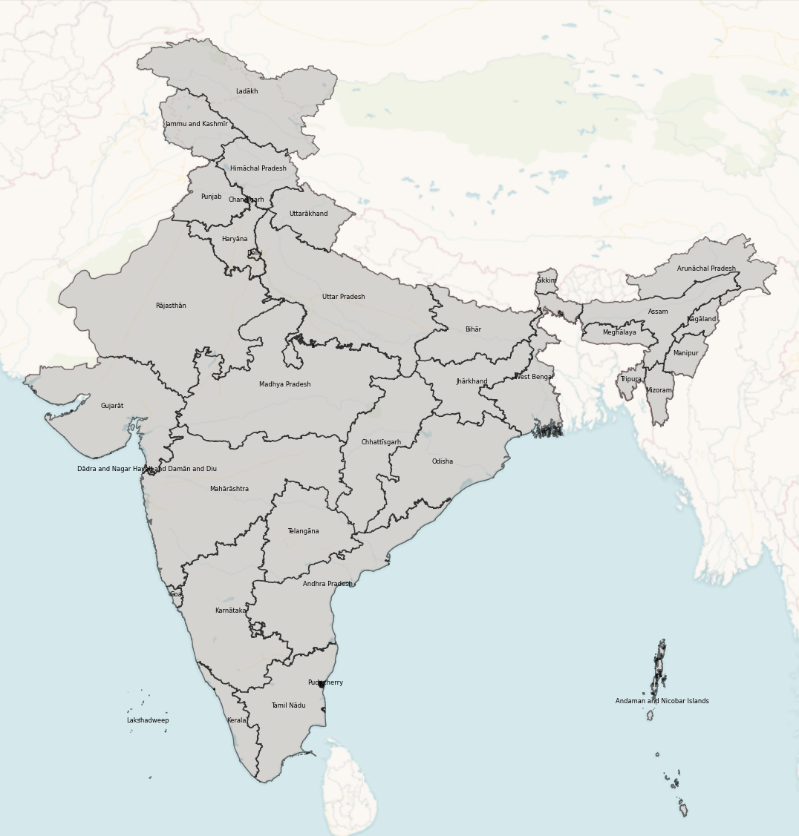
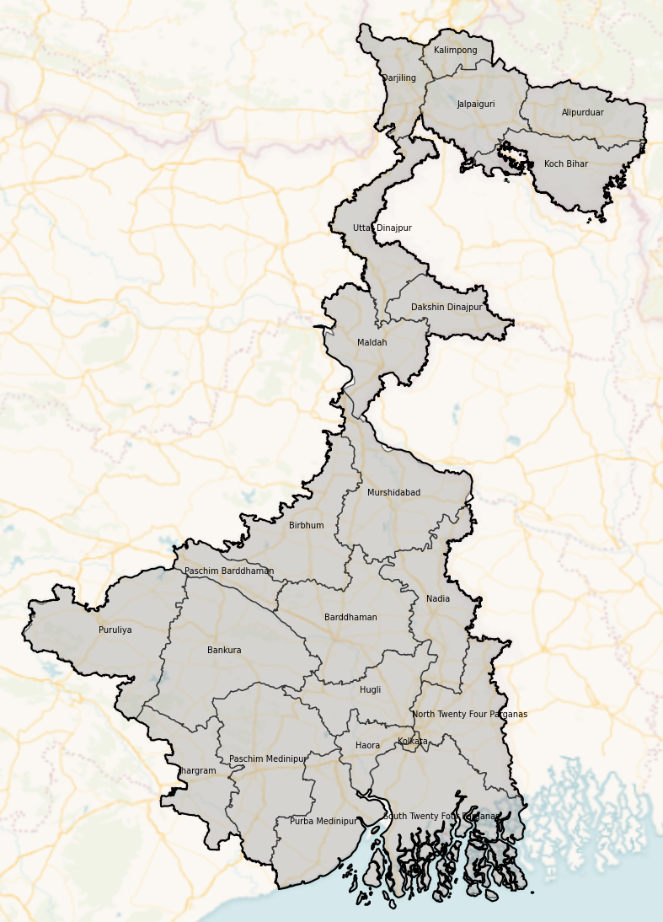
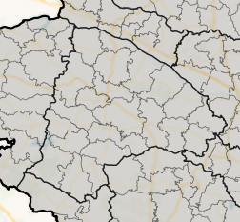
Spatial Unit of Analysis
Block level administrative boundary
UNIVERSITY OF WASHINGTON
Department of Electrical & Computer Engineering
METHODS
Notes:
As India’s 13th largest state by area and with an average population density of 1,028 people per square kilometer, there is a need for effective transportation modes to satisfy the mobility needs of individuals throughout the state. West Bengal also has a unique history in terms of transportation electrification. Kolkata, the capital city of West Bengal, was the first city in India to introduce a public transportation system (i.e. electric trams) running on electricity in 1902. Moreover, the Calcutta Electricity Supply Corporation (CESC) was the first electric utility in the country which continues to serve a large customer base throughout the metropolitan region of greater Kolkata

Slide 8
Equitable Mobility Priorities
How do we locate charging stations in an equitable manner?
Priority
Metric
1
Enhance connectivity
Distance to Transit Node
2
Affordable mobility
Relative Wealth
3
Fill service gap
Mode Share (Walking)
UNIVERSITY OF WASHINGTON
Department of Electrical & Computer Engineering
METHODS

Slide 9



Spatial Data
Distance to Transit Node
Relative Wealth
Mode Share (Walking)
Coordinate data processed to GeoJSON files
Spatial index at 2.4 km resolution
World Population
2011 India Census
Number of Walkers
Train Station
Distance from block centroid
Average index for each block
Avg RWI
Share of Walkers per Block
=
Walkers in Distance Segment
Block Population
Travel data normalized with respect to population
UNIVERSITY OF WASHINGTON
Department of Electrical & Computer Engineering
METHODS

Slide 10
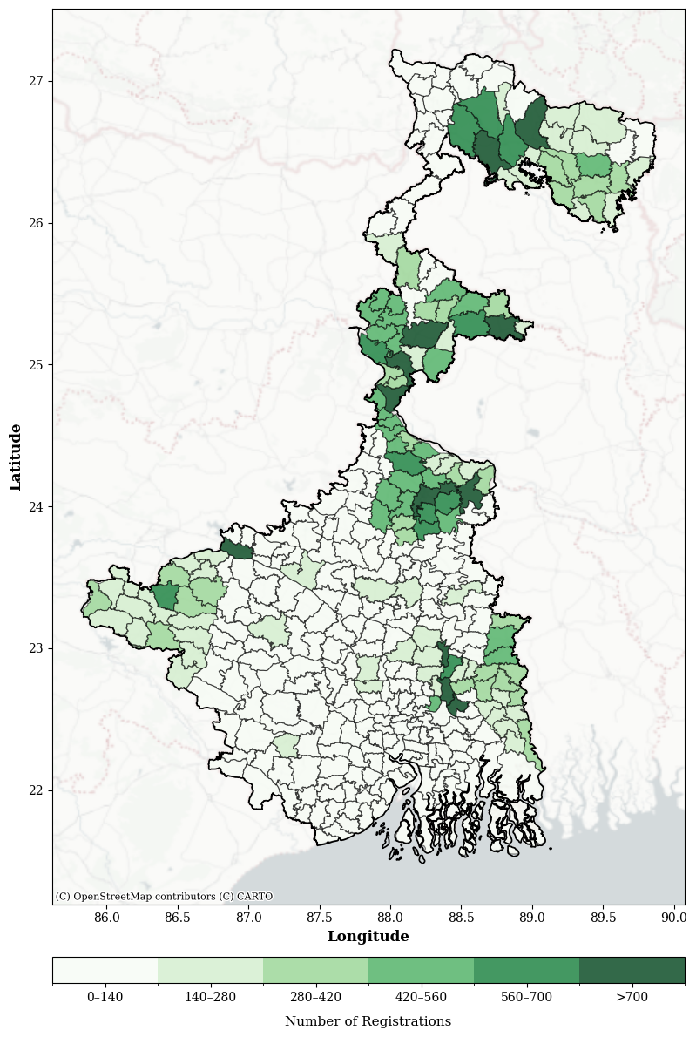
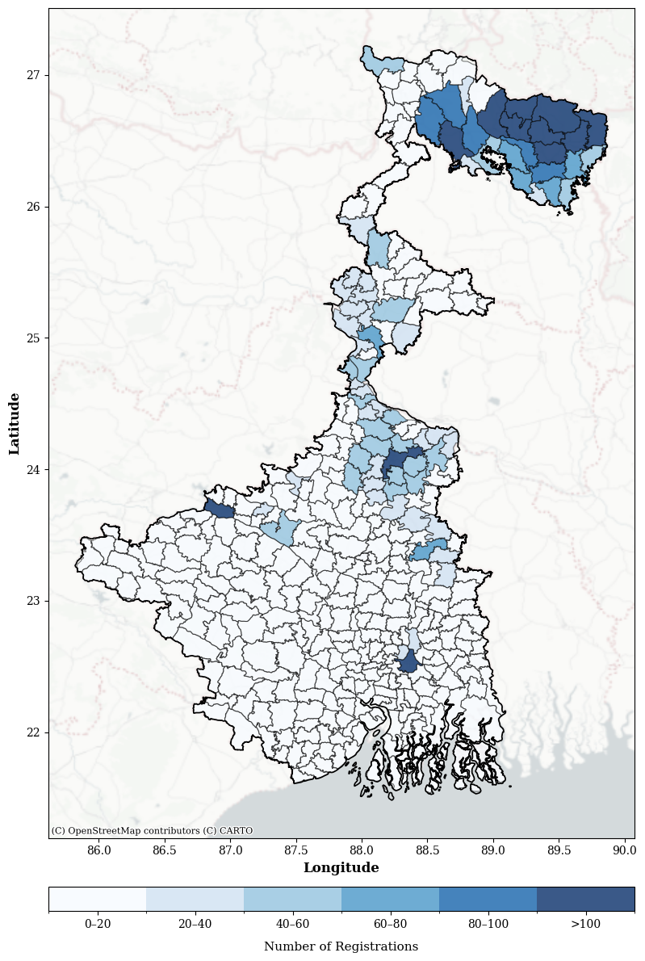
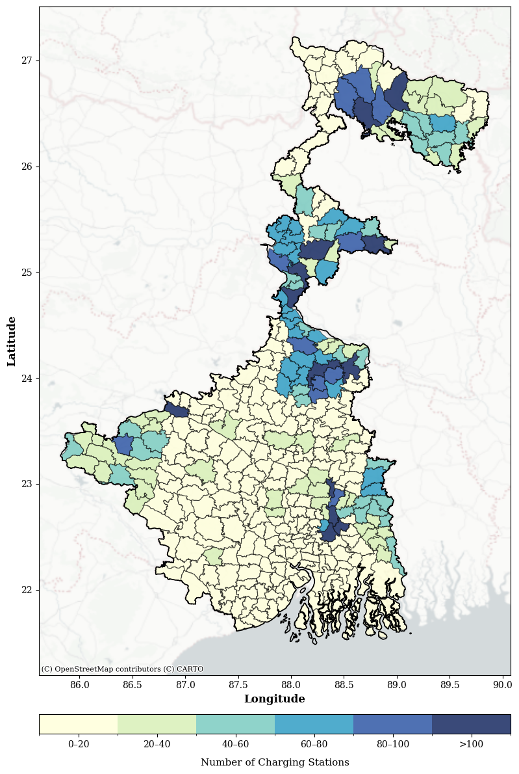
Number of Charging Stations based on Registrations
Number of Registered E-rickshaws per Block
Number of Registered E-autos per Block
30 kW Charging Stations per Block
UNIVERSITY OF WASHINGTON
Department of Electrical & Computer Engineering
RESULTS

Slide 11
Infrastructure Siting
30 kW Charging Stations per Block
EV Ecosystem Policy (2022)
Capital Investment Size
INR 5,000 Lakh – INR 20,000 Lakh
eligible to receive 35% subsidy
CAPEX 30 kW PV
INR 27 Lakh
185 Charging Stations
741 Charging Stations
UNIVERSITY OF WASHINGTON
Department of Electrical & Computer Engineering
METHODS

Slide 12
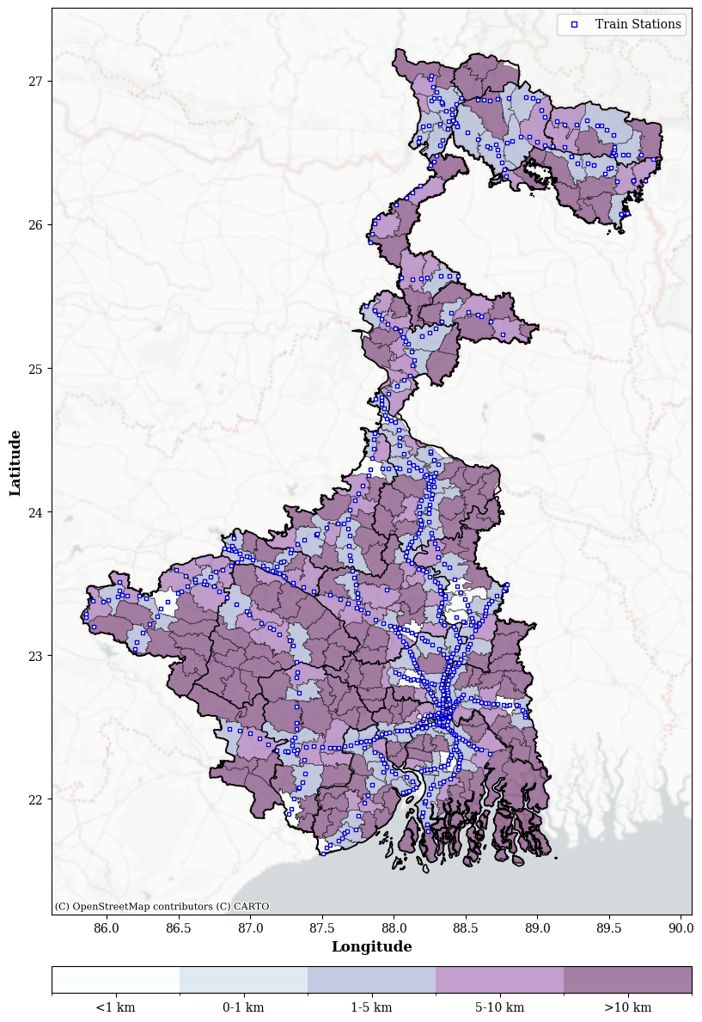
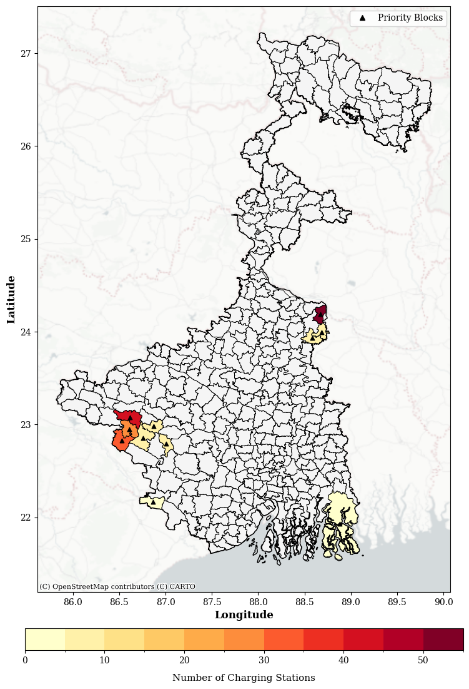
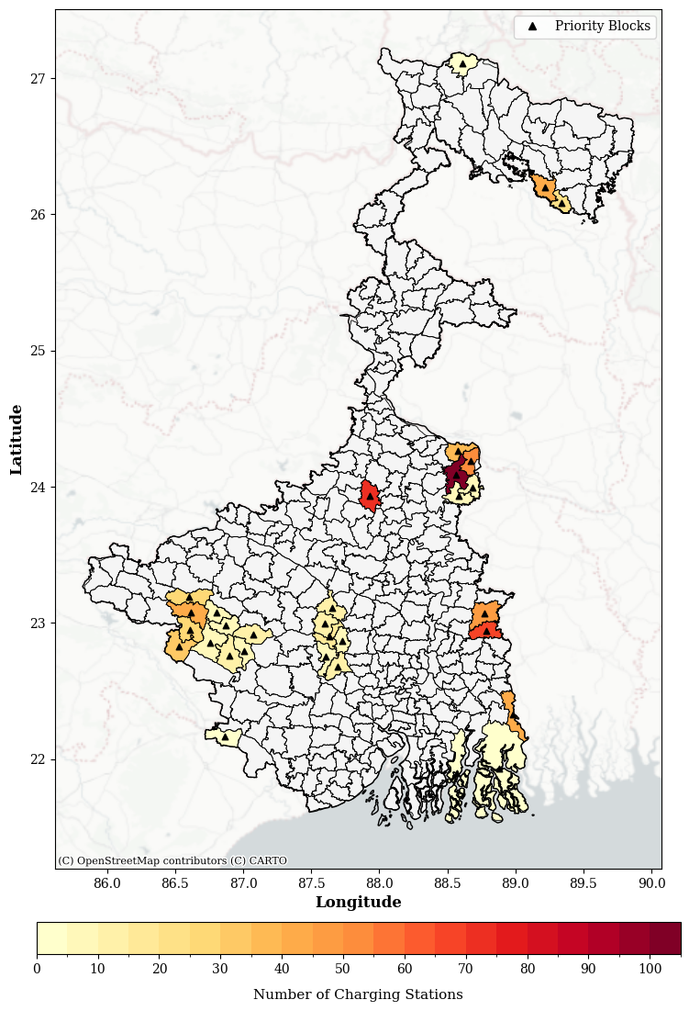
Blocks Prioritized to Enhance Connectivity
Distance to Nearest Train Station
185 Stations Charging Stations Distribution
741 Charging Stations Spatial Distribution
UNIVERSITY OF WASHINGTON
Department of Electrical & Computer Engineering
RESULTS

Slide 13
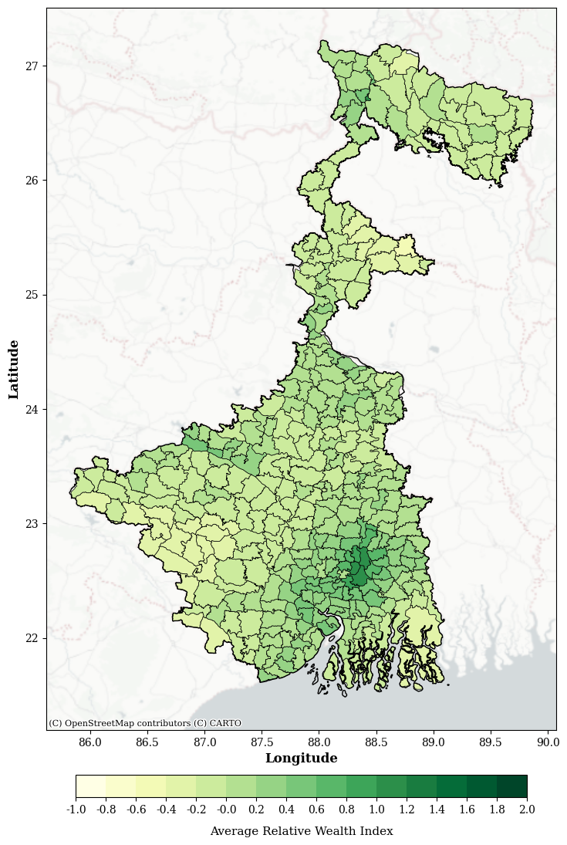
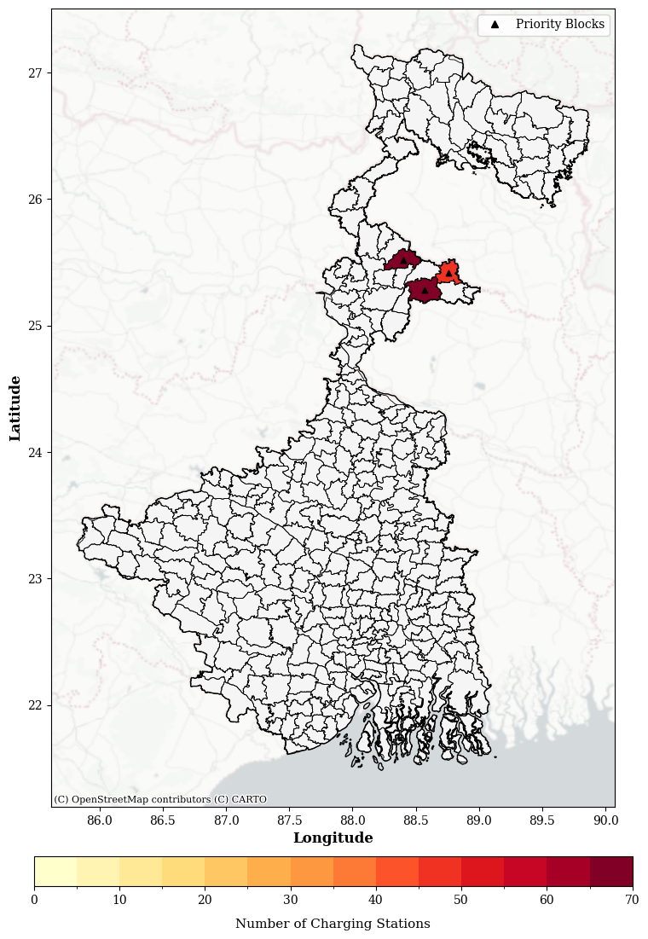
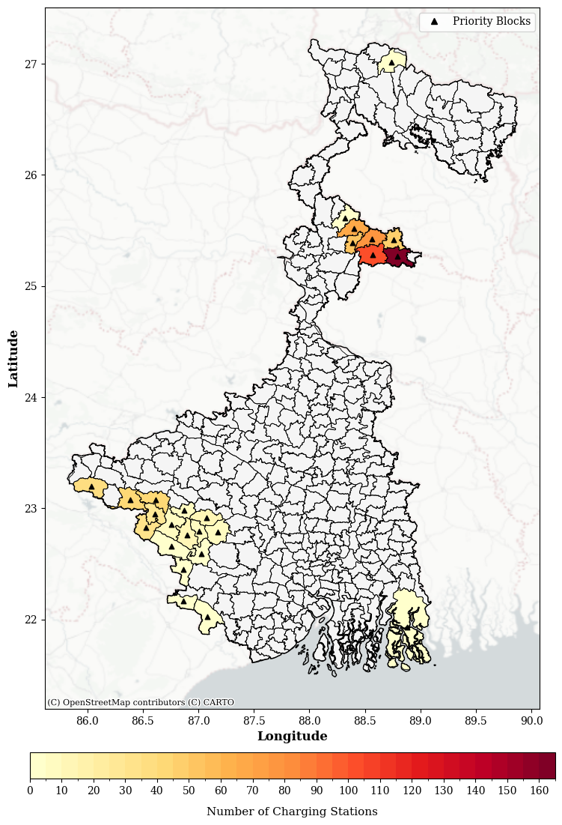
Blocks Prioritized for Affordable Mobility
Average Wealth Index
185 Stations Charging Stations Distribution
741 Charging Stations Spatial Distribution
UNIVERSITY OF WASHINGTON
Department of Electrical & Computer Engineering
RESULTS

Slide 14
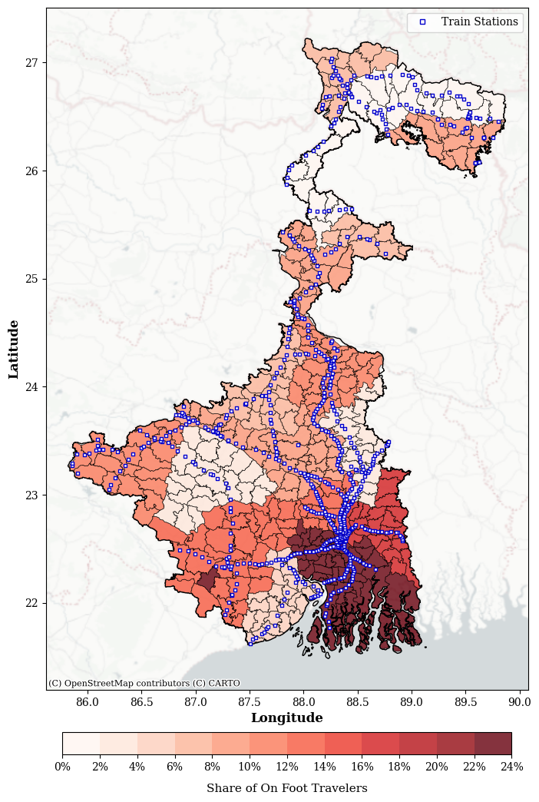
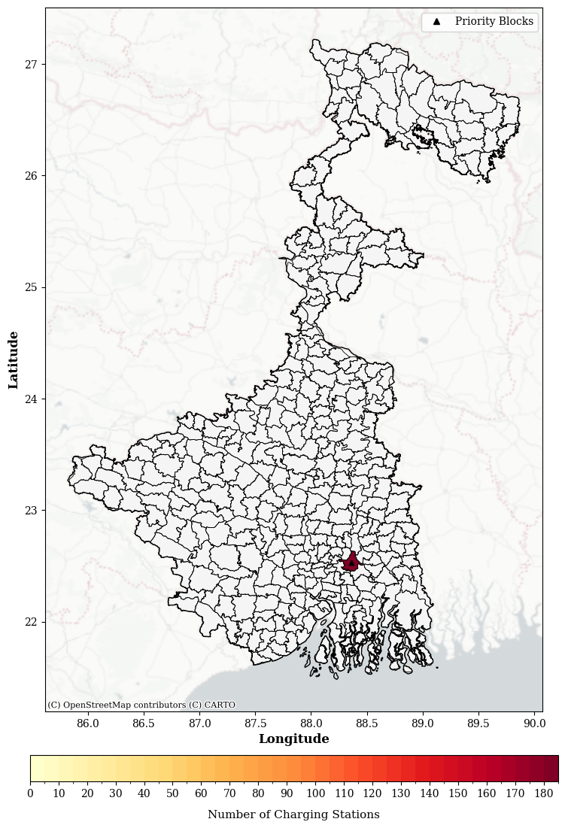
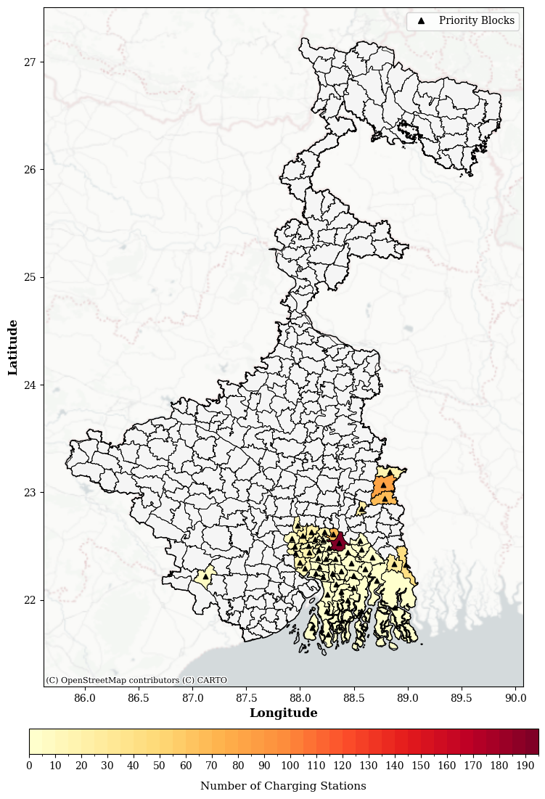
Blocks Prioritized for Filling Service Gap
Share of Walkers Traveling 6-10 km
185 Stations Charging Stations Distribution
741 Charging Stations Spatial Distribution
UNIVERSITY OF WASHINGTON
Department of Electrical & Computer Engineering
RESULTS

Slide 15
Priorities Yield Different Siting Locations
Enhance Connectivity
Affordable Mobility
Fill Service Gap
Number of Blocks Selected for Infrastructure Siting
 | 185 Charging Stations | 741 Charging Stations
Enhance Connectivity | 11 | 31
Affordable Mobility | 3 | 25
Fill Service Gap | 1 | 51
UNIVERSITY OF WASHINGTON
Department of Electrical & Computer Engineering
DISCUSSION
Notes:
Mobility priorities yield different results for siting infrastructure
Does not follow where vehicular demand (i.e. registrations) is concentrated which is a more conventional approach to siting infrastructure
These results can be used to inform policies depending on which components legislators may want to prioritize for infrastructure siting
Can lead to different opportunities in investing in charging infrastructure projects

Slide 16
Broader Impact
Average Daily Vehicles Served by PV-Based Charging System
Over
75,000 registered E3Ws
in West Bengal
 | 185 Charging Stations | 741 Charging Stations
E-rickshaw | 1,295 | 5,187
E-auto | 1,110 | 4,446
West Bengal EV Policy Target
25,000 E3Ws
for demand side fiscal support
1.8 million e-rickshaws
or
1.6 million e-autos
served over 1 year
UNIVERSITY OF WASHINGTON
Department of Electrical & Computer Engineering
DISCUSSION
Notes:
Comparative slide, summarize the different priorities and highlight that it different results
This is how people are currently thinking and but it can lead to different opportunities investing
Ex. If the current way of thinking is infra placement where EVs are currently densely populated 🡪 highlight the registrations map again and say with equitable priorities, infra siting is actually different because the goal is to not leave people behind

Slide 17
Thank You!
Ahana Mukherjee
ahanam@uw.edu
UNIVERSITY OF WASHINGTON
Department of Electrical & Computer Engineering
‹#›

