Slide 1
















Supporting Mental Health on
BOTH SIDES OF THE DESK

Slide 2
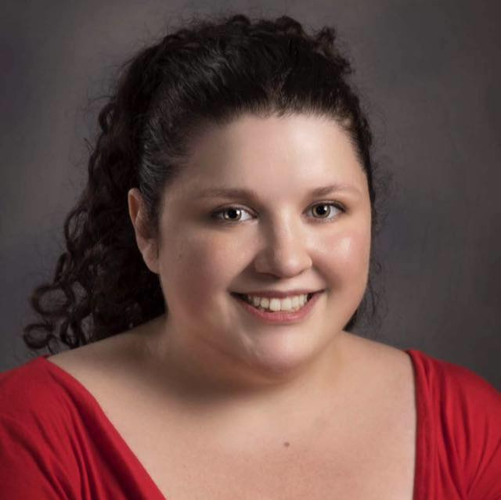
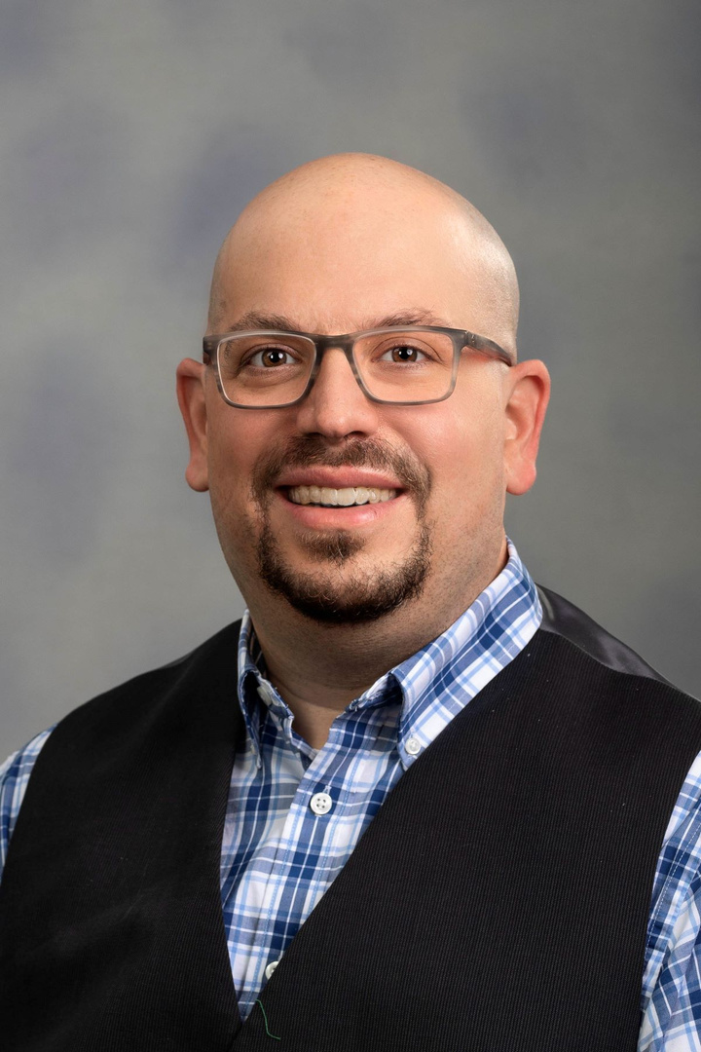
PRESENTERS
Tessie Holliday (she/her/hers)
John Siegel (he/him/his)
Stack Maintenance Specialist/
Student Employment Coordinator
Associate Librarian-Coordinator of Library Instructional Services

Slide 3
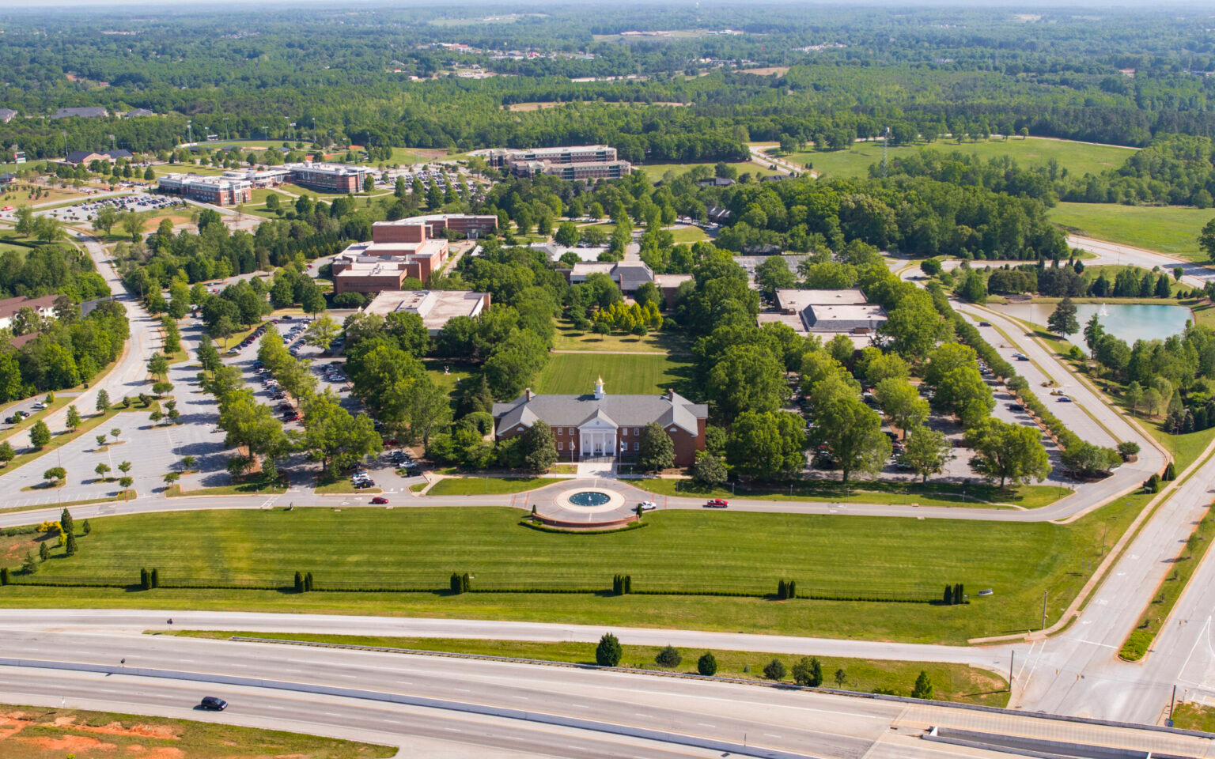
ABOUT
USC UPSTATE
  Regional Comprehensive University in Spartanburg, SC
founded in 1967
  50+ undergraduate/graduate majors
  ~5,000 students, ~800 faculty/staff
  1/3 student body transferred from other schools
  Large number of first-generation students, growing number of graduate and international students
Notes:
John's slide

Slide 4
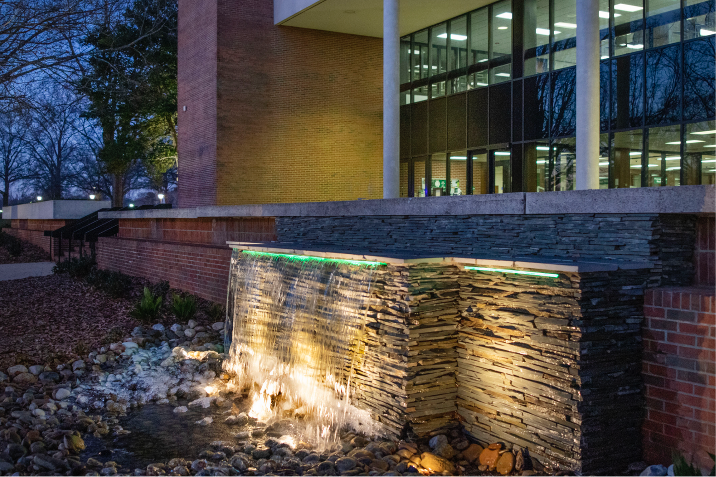
ABOUT
UPSTATE LIBRARY
  ~60,000 square feet across two stories
  25 FT/PT employees
  150,000+ volumes, 350+ databases
  Open 7 days a week during the semester, with extended hours leading up to exams
Notes:
Tessie's slide

Slide 5




ABOUT
OUR STUDENTS
  10 undergraduate student assistants
  staff the information desk, circulation duties, stacks maintenance, technology assistance
  students keep the library open until midnight each night, work weekends
Notes:
Tessie's slide

Slide 6

... snapshot of US college students
nearly 3 in four students experienced insecurity in mental health care, childcare, transportation or internet and technology access
“more than 60% of college students meet the criteria for a least one mental health problem”
nearly three in
five students experienced either food or housing insecurity in the past year

Slide 7

Student Success
Mental health and belonging are tied to both academic performance and workplace performance and satisfaction.
Notes:
John's slide

Slide 8

TRAUMA-INFORMED PRINCIPLES
Safety
Trustworthiness and Transparency
Cultural/Historical/Gender issues
physical and psychological safety
building and maintaining trust with student employees
cultural humility in practice, confronting bias, evaluating policies/procedures
Peer Support
Collaboration and Mutuality
Empowerment/ Voice/ Choice
culturally supportive environment, access to peer support through counseling services
Develop trust and cultivate a level playing field
student employees are empowered to act in confidence and autonomy, and make choices

Slide 9
TRAUMA-INFORMED PRINCIPLES
Safety
Peer Support
  physical safety:
    involved students in creating policies and procedures that impact their safety
  psychological safety
    day-one support for open expression, making mistakes, being authentic
  culturally supportive environment
    encouraging relationship-building
  access to peer support through counseling services
    TogetherAll and peer counselors

Slide 10
TRAUMA-INFORMED PRINCIPLES
Trustworthiness and Transparency
Collaboration and Mutuality
  consistent feedback
  encouraging open communication
  practicing vulnerability as a leader
  involving student employees in wellness and belonging efforts
  mutuality in transparency and vulnerability

Slide 11
TRAUMA-INFORMED PRINCIPLES
Empowerment/ Voice/ Choice
Cultural/Historical/Gender issues
  cultural humility in practice
  confronting personal bias
  evaluating policies/procedures
  student employees are empowered to act in confidence and autonomy, and make choices when you take their concerns and ideas seriously

Slide 12


NEUROINCLUSION MATTERS!
Neurodivergent employees face heightened stress and dissatisfaction in the workplace.
don’t make assumptions about how people feel or think
you don’t have to be an expert - just listen to what your students need
provide flexible work environments and job duties

Slide 13


